Slide 1
Decision-making in Management
Using the Diversity of Truth-seeking and Sense-making to Advantage in Organizational Contexts
Wayne Smith, Ph.D.
Department of Management
CSU Northridge

Slide 2
Management Decision-making (links to MGT 360 Principles)
Which side is (i.e., questions managers must ask)…
More Systematic or More Intuitive?
Does the problem require a Rational/Analytical Approach or does it require a Flexible/Spontaneous Approach?
More Structured or More Unstructured?
Is the information required familiar/straight-forward/clear or new/unusual/ambiguous/deficient?
More Operationally-oriented or More Crisis-oriented?
Is the problem ongoing/long-term/managed/expected or one-time/short-term/extraordinary/unique?
More Classical Model or More Behavioral Model?
Can we act rationally (optimize within constraints) or do we act with cognitive limitations (satisficing—choose the first good solution).
More Analysis needed or more Creativity needed?
Will the existing paradigm work (broader and deeper analysis) or will we need a new paradigm (think completely differently)?

Slide 3
Management Decision-making (from a Quantitative perspective)
Statistics
Computing
“Big Data”
“Data Science”
“Analytics”
But our task is to “sandwich” these technological activities with thinking before the assumptions (which precede the analysis) and after the interpretations (which are derived from the analysis).

Slide 4
Two kids playing hide and seek for >30 minutes

Slide 5
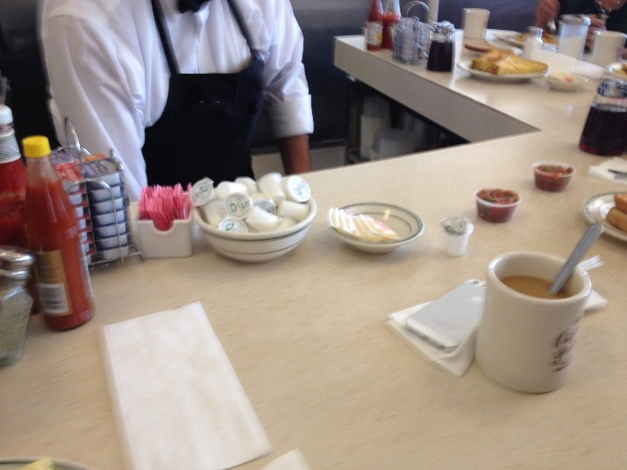
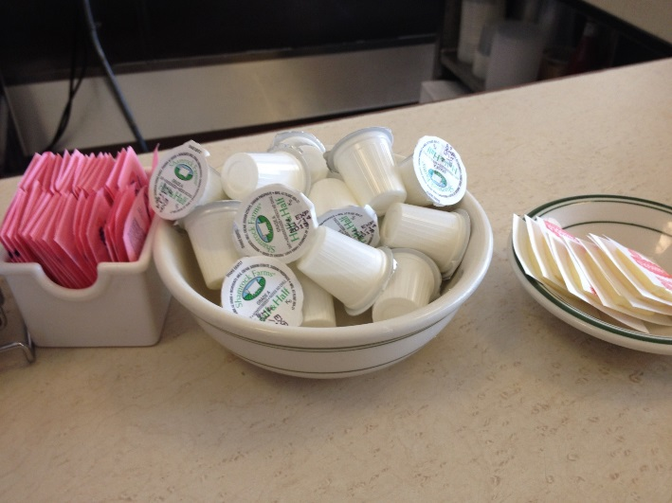
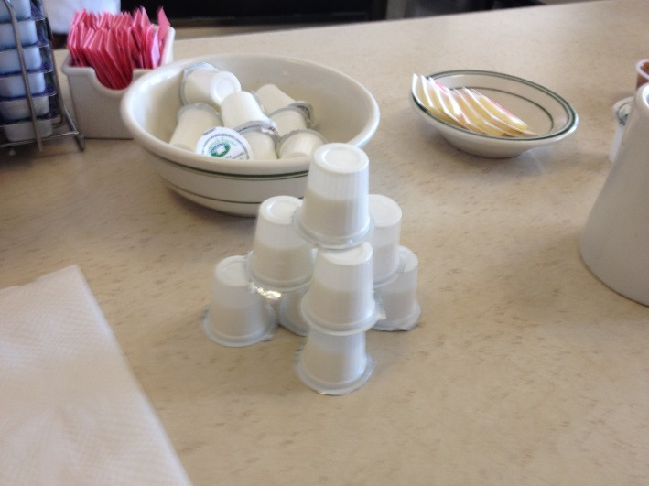
A kid making something new

Slide 6
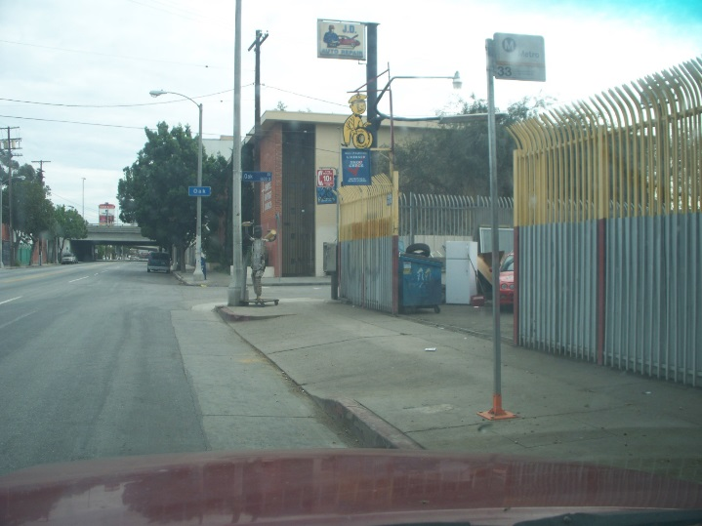
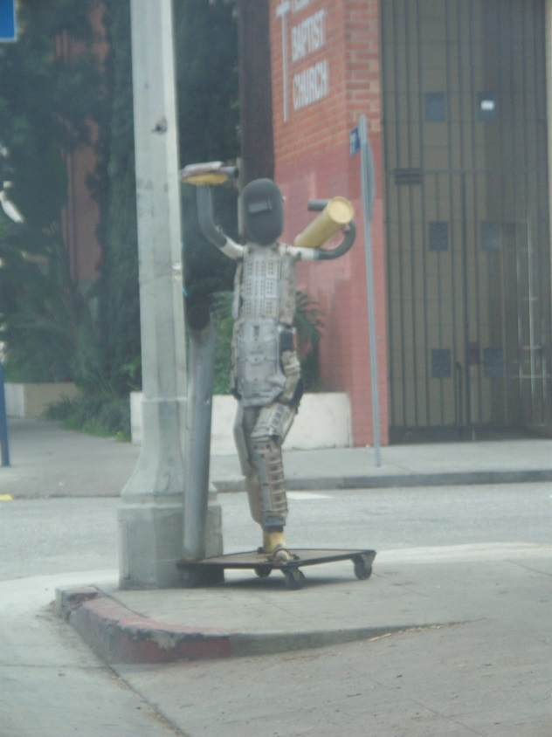
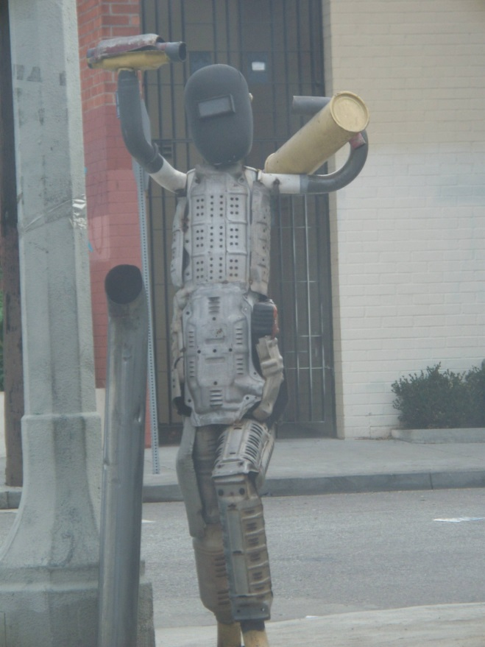
Body Shop - wide
An adult making something new

Slide 7
What…really…is Creativity?
There is a Philosophy of Creativity
Existence: Imagination, Idealization, Consummation, The Aesthetic
Modes: Physical Separation, Divine Inspiration, Nature of the Creative Process, Aesthetic Creativity (in the Art), Creative Practice
You can Test and Audit for Creativity
Support for ideas, Challenge, Time for ideas, Freedom, Trust and openness, Dynamism/liveliness, Risk-taking, Playfulness and humor, Debates, Conflicts and impediments
E.g., http://www.ststesting.com/ngifted.html
You can Engineer Creativity
Substitute, Combine, Adapt, Magnify, Put to other uses, Eliminate, Rearrange
E.g., http://litemind.com/scamper/
You can Manage Creativity (by first structuring it correctly)
Imagination (be new), Investment (be first), Incubation (be sustainable), or Improvement (be better)
You can Nurture Creativity (by removing blocking obstacles)
Constancy (defining problems in only one way/language), Commitment (presents problems are only variations on past problems), Compression (defining the boundaries of the problem too narrowly), Complacency (not asking questions and an unconscious bias towards “non-thinking”)

Slide 8
Information Dynamics
Wisdom
Extraordinary Insight (Explanation) or Foresight (Prediction)
Restaurant: How should our menu change in the future to best optimize nightly sales?
Knowledge
Combination of Explicit Information and Tacit Information
Restaurant: What action led to the change in last night’s sales?
Information
Meaningful Data
Restaurant: How does last night’s sales compare to that night the previous year? How does last night’s sales compare to our goals?
Data
Raw, atomic, basic
Restaurant: What were the total sales for last night?

Slide 9
Analytics for Management Decision-making
Prescriptive Analytics
What should we do?
HR Department: What should we (the HR Department) do to meet or exceed the organization’s hiring and retention goals for next year? What data/information/knowledge/wisdom should we provide to our hiring and technical managers to help? What are we missing?
Predictive Analytics
What is likely to happen?
HR Department: How many new employees will our organization need next year? How will the mix change? What is our competition likely to do?
Diagnostic Analytics
Why did it happen?
HR Department: Did our emphasis on recruiting from campus A (over campus B, etc.) matter? What do the managers of these entry-level employees think?
Descriptive Analytics
What happened?
HR Department: How many entry-level professionals did we hire last year? How many of them are still with us now?

