Slide 1
An Introduction to Sociograms:
Using the Big Bang Theory clips as an example of a Gratitude network
Wayne Smith, Ph.D.
Department of Management
CSU Northridge

Slide 2
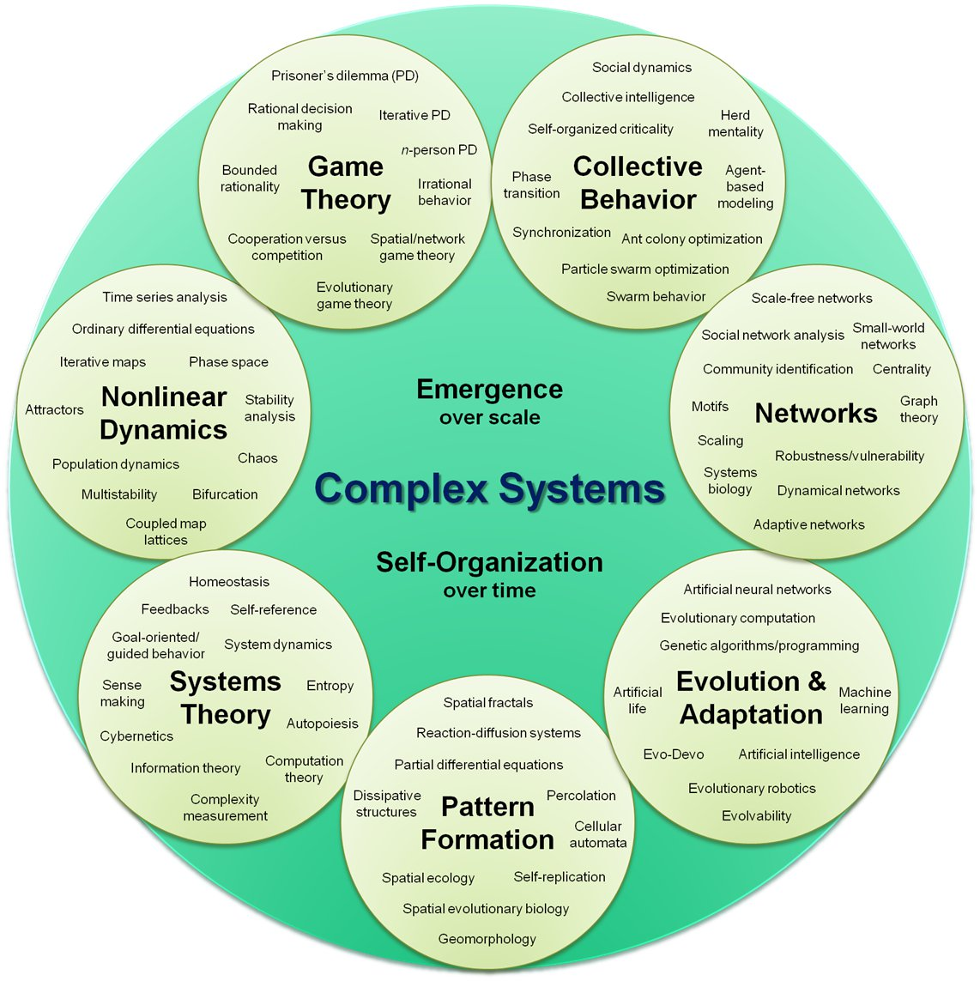

Slide 3
Network Sociograms
Title
Here…it’s Gratitude but it could be anything:
Authority, power, informal communication, respect, learning dynamics, trust, etc.
Entities (usually persons, but can be other things)
drawn with boxes, circles, triangles, etc.
Can have attributes too:
Sex/Gender, education level, experience, salary, rank, status, etc.
Relationships (the thing being transferred)
drawn with lines—sometimes different kinds of lines
Can have attributes too:
Direction, distance, strength, origin, value, etc.
Legend
Document entities and/or relationships if any aren’t clear
Can also group various entities together for clarity

Slide 4
Gratitude Network
Work
together
Exes
Raj
Leonard
Live
together
Science kit
Motorcycle
lessons
Howard
Mall and
Purchases
Penny
1
2
3
Sheldon
Relationship Legend:
missing gratitude
faux gratitude
measurable gratitude
Immeasurable gratitude
Sheldon’s Gratitude Growth:
1 -> dislikes gift reciprocity
2 -> misunderstands gift value
3 -> demonstrates true gift

Slide 5
Final Thoughts
Don’t try to cram everything on a single network
you’ll run out of room and it’s too hard to read
Just focus on the most applicable network with the most important entities and the most important relationships
It’s OK to leave out non-important entities & relationships
Can draw more than one network…for example:
“pre” (as-is, or existing network)
…(management skill or human resources intervention)
“post” (to-be, or new network)
In a very real sense, every organization is an integrated set of networks
Each network illuminates one part of the organization
Each network changes (or doesn’t change) over time
The organization, then, is really a network of networks

