Slide 1
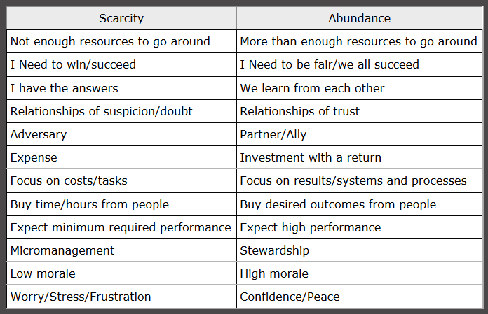
“Scarcity” Mindset vs. “Abundance” Mindset

Slide 2
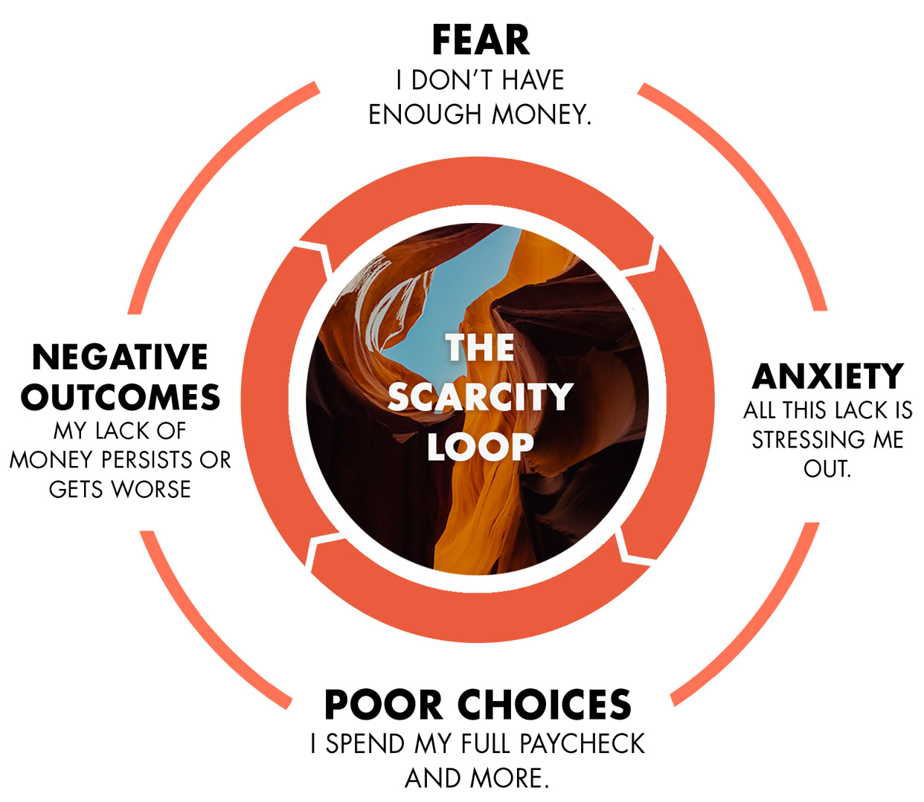
“Scarcity” Mindset vs. “Abundance” Mindset (Negative Loop)

Slide 3
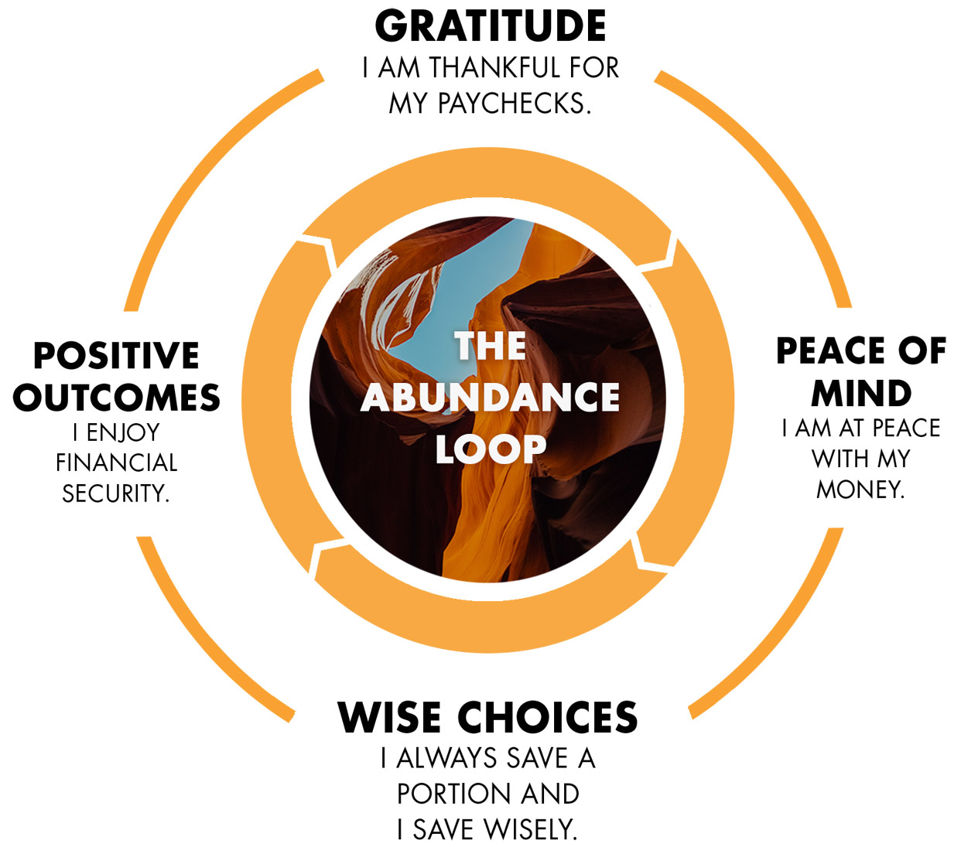
“Scarcity” Mindset vs. “Abundance” Mindset (Positive Loop)

