Slide 1
Strategy:
Contemporary Business Examples Benefitting from “PESTEL” Analysis
Wayne Smith, Ph.D.
wayne.smith@csun.edu
Department of Management

Slide 2
“PESTEL” Analysis
In general, “PESTEL” helps with understanding the external competitive landscape.
Chief Assumption: Adapting to the changing context of the marketplace drives success.
Political
Economic
Sociological
Technological
Environmental
Legal
Always…recall and apply ideas from your General Education classes in your strategic thinking…

Slide 3
Political

Slide 4
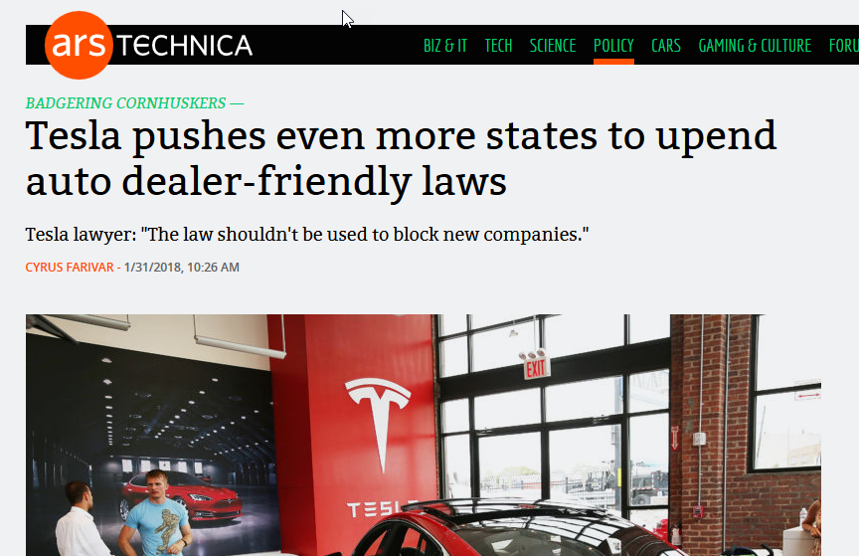

Slide 5
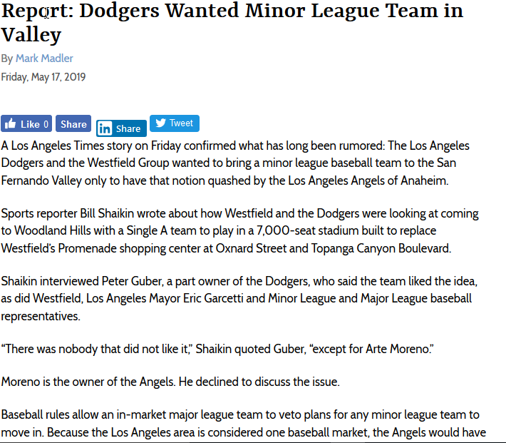

Slide 6
Economic

Slide 7
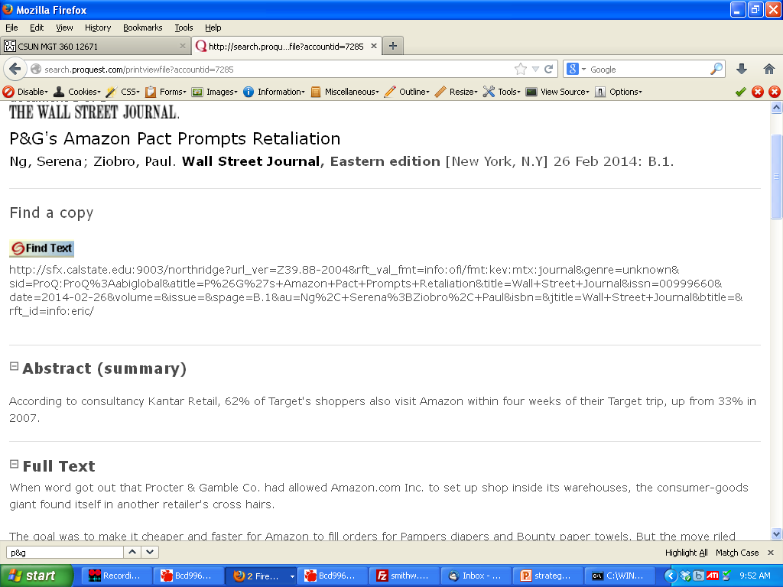

Slide 8
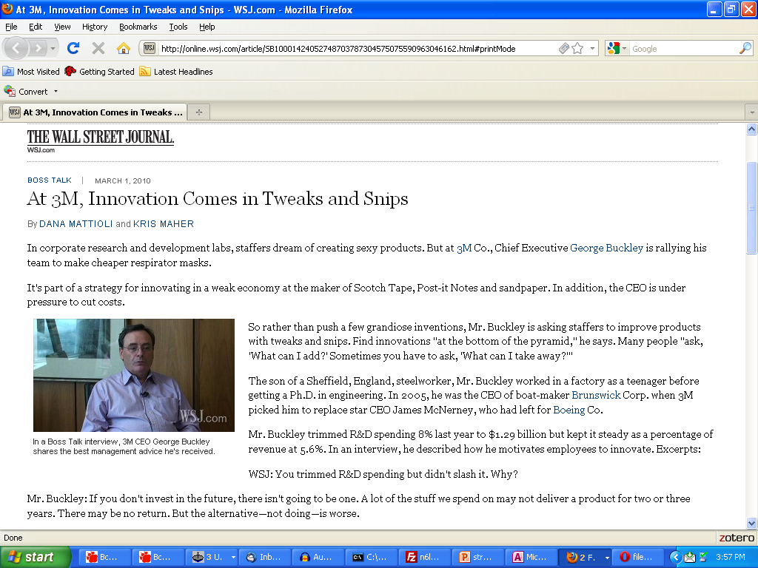

Slide 9
Sociological

Slide 11
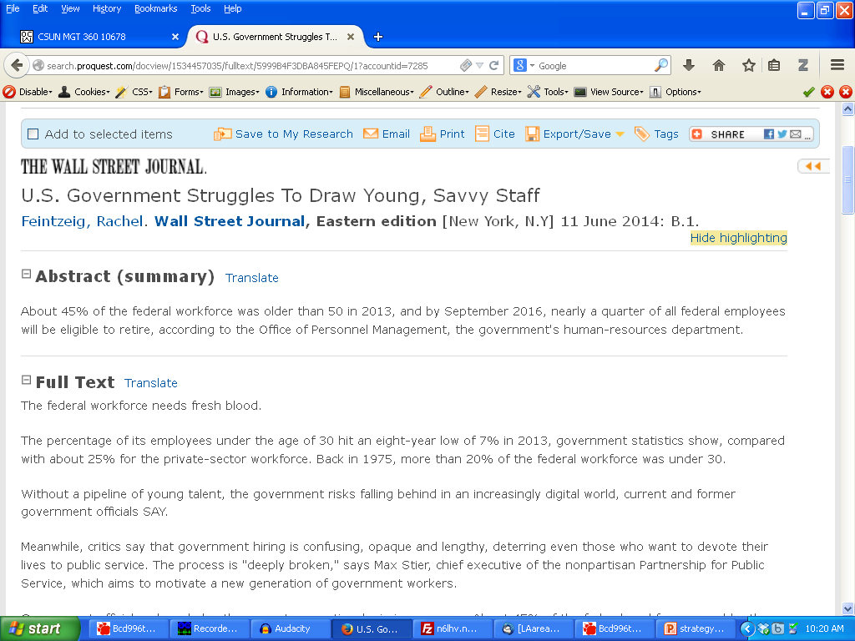
People -> buses

Slide 12
Technological

Slide 13
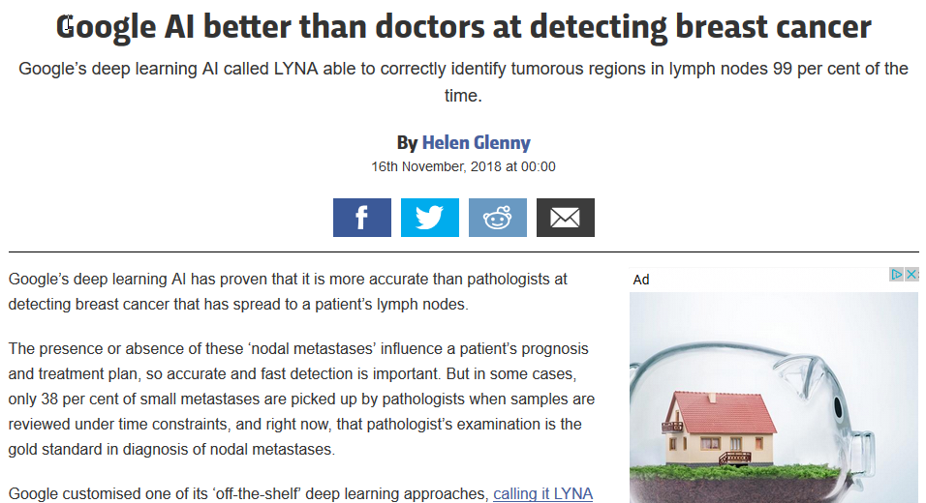
People -> buses

Slide 14
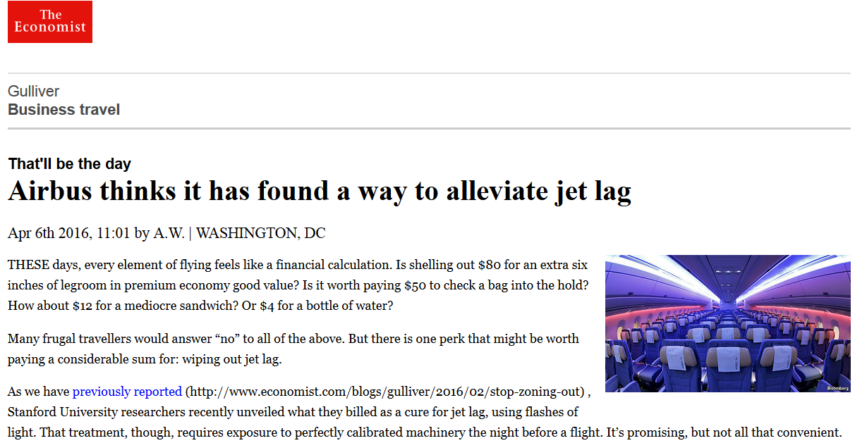

Slide 15
Environmental

Slide 16
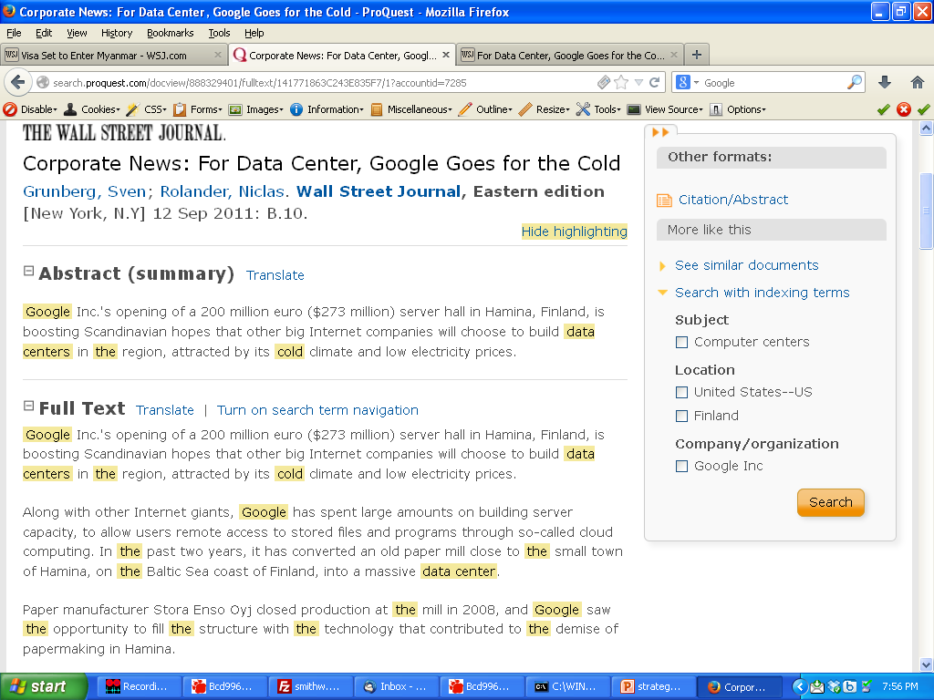

Slide 18
Legal

Slide 19
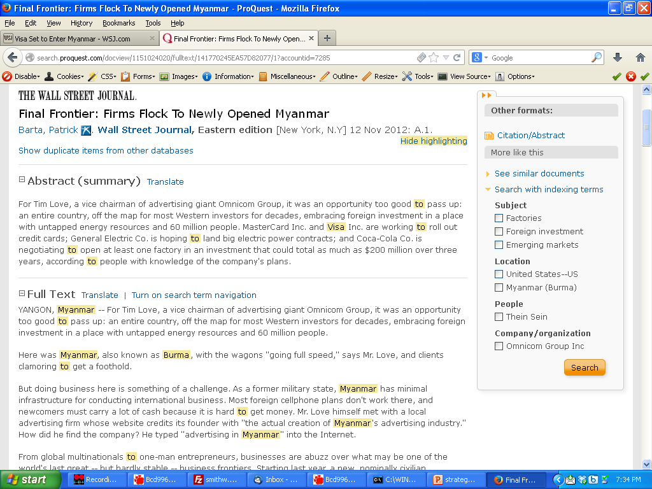
984468834

Slide 20
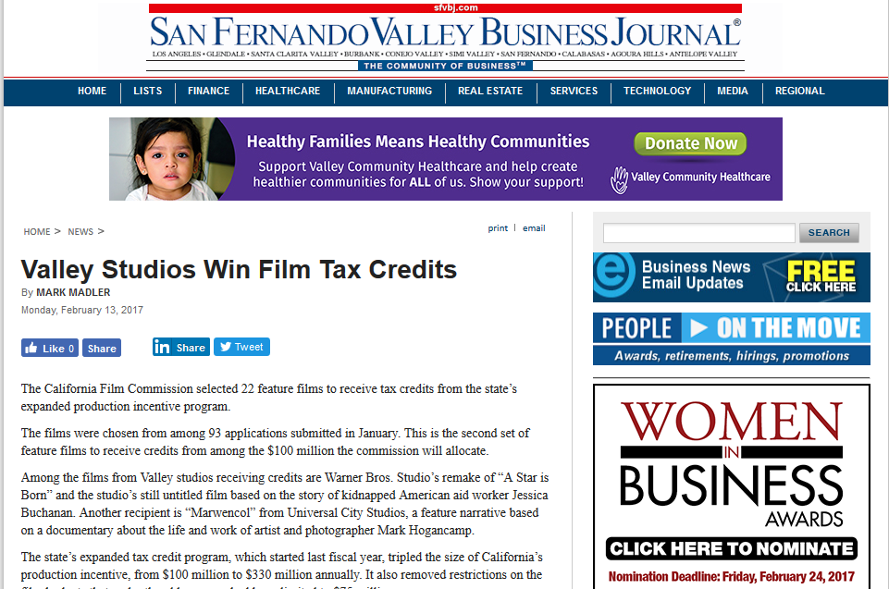
People -> buses

Slide 21
All and Interdependent

Slide 22
People -> buses

Slide 23
Other Examples
“Should Westfield include a hotel in its new Woodland Hills development?”
“Should Walt Disney support the Boy Scouts?”
“Should oil ‘fracking’ be allowed within Los Angeles City limits?”
“Should I move my football team to Los Angeles?”

