Slide 1
Continuous Improvement for Writing — Semantics:
Using Signage and Culture in Los Angeles to Help Improve Business Prose and Rhetoric
Wayne Smith, Ph.D.
Department of Management
CSU Northridge
ws@csun.edu

Slide 2
The “English of Business”
Sentence Economics
Do I know what counts as value and impact for the reader?
Sentence Accounting
Has message waste and message noise been minimized?
Sentence Law
What are the rules and patterns governing sentence structure?
Sentence Statistics
Has systematic uncertainty (and therefore ambiguity) been controlled for in the sentence?

Slide 3
(We assume that the latest, greatest writing technology will “catch” errors in composition, prose, and rhetoric—we couldn’t be more wrong.)

Slide 4
Some Errors Beyond the Reach of Current Technology
Hacker, D., and Sommers, N. (2017), “A Writer’s Reference 9th ed.”, Bedford/St. Martin’s
“[Current word processors have difficulty with]…writing context and culture, appropriate style of discourse, degree of ‘assertiveness,’ faulty parallelism, misplaced and dangling modifiers, homonyms, missing words and omitted verbs, shifts in verb tense or mood, coordination and subordination, sentence variety and fragments, run-on sentences, common redundancies, unnecessary wordiness, jargon and abbreviations, clichés, sexist language, irregular verbs, pronoun agreements and references, missing or misused commas, semi-colons, apostrophes, hyphens, quotation marks, capitalization, and problems with emphasis.”

Slide 5
No computer word processor can make appropriate headings—you have to specify it manually

Slide 6
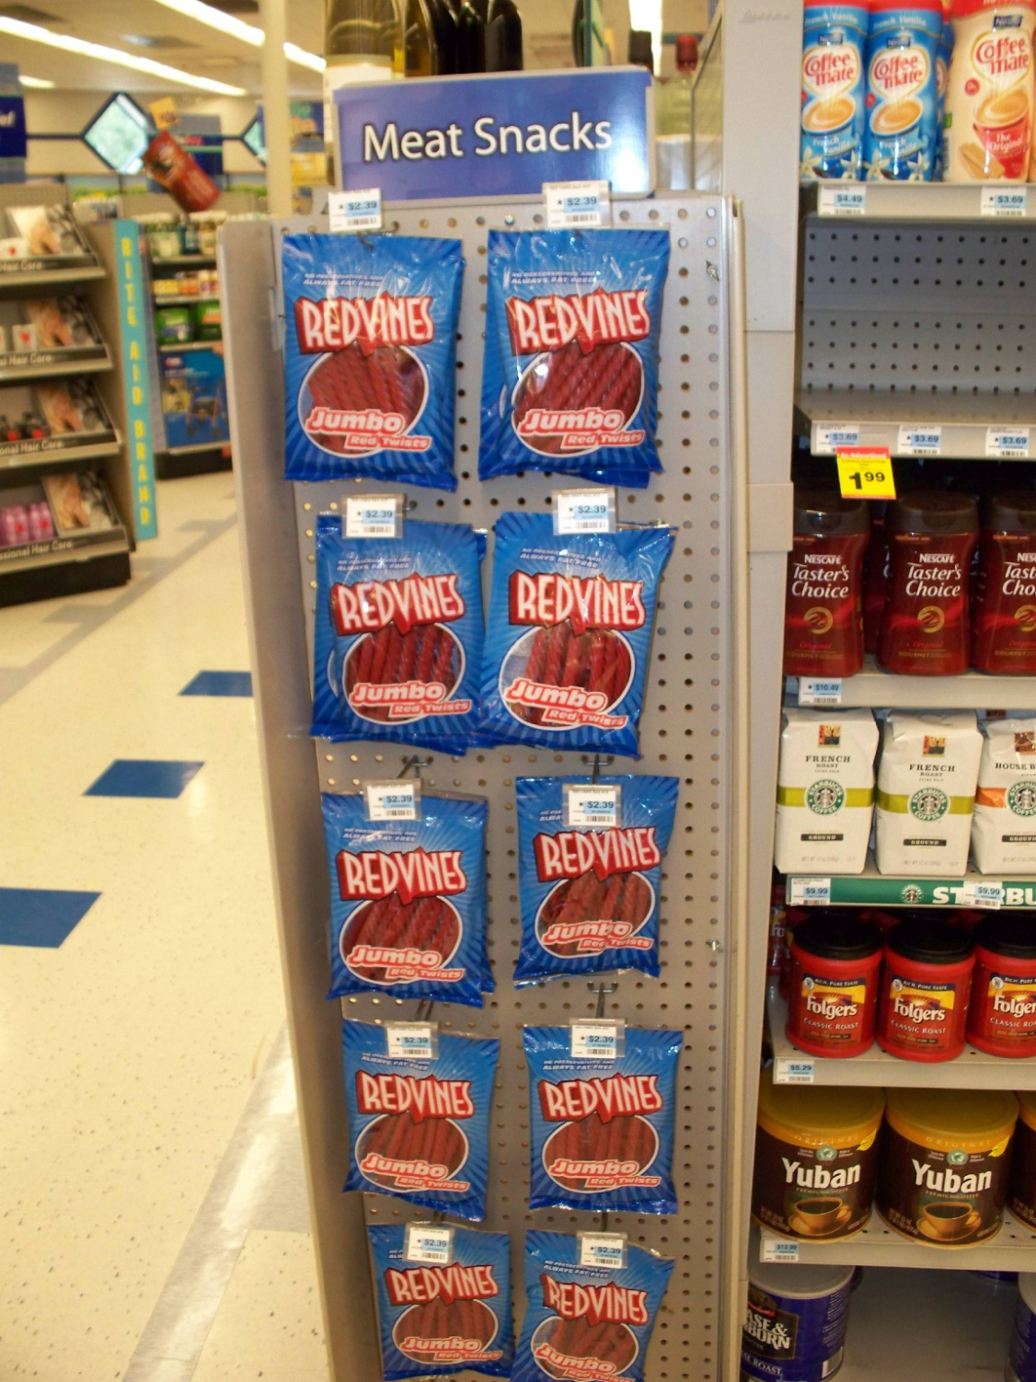
Headings - “Meat” Snacks

Slide 7
Some semantic mistakes have dire consequences

Slide 8
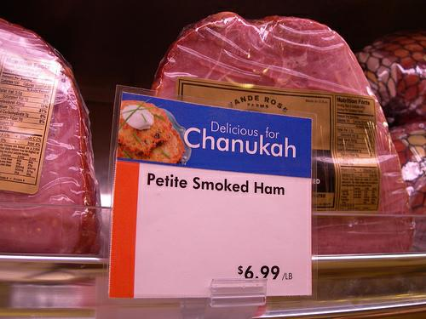
Headings - “Meat” Snacks

Slide 9
Computers aren’t good at detecting (automatically) how a reader will interpret a writer’s belief or intention

Slide 10
Semantics-unintended En.

Slide 11
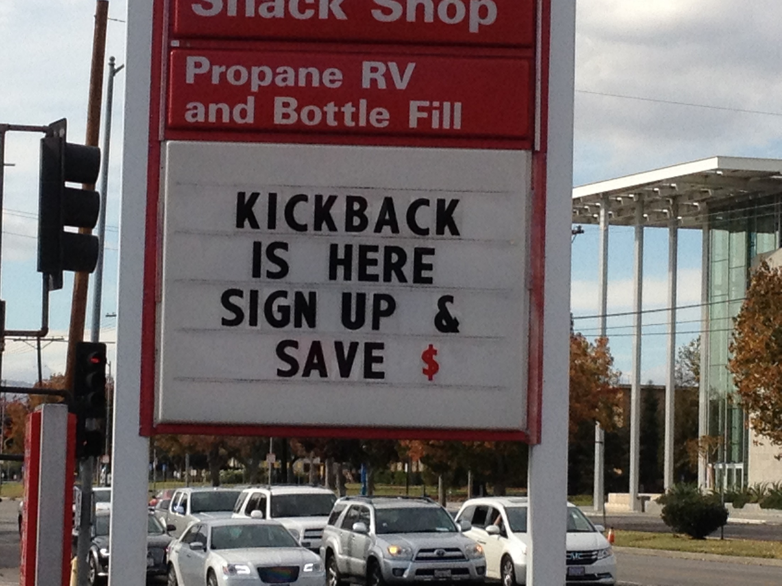
Semantics-unintended En.

Slide 12
Computers aren’t good at detecting sarcasm, irony, allegory, motifs and other semantic (“meaning”) issues

Slide 13
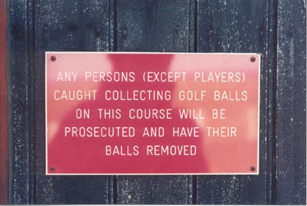
Semantics-unintended En.

Slide 14
In addition to word order, sentence order matters too, but word processors don’t help at all

Slide 15
Semantics – Hair cuts

Slide 16
Technology can’t understand the concept of “validity”

Slide 17
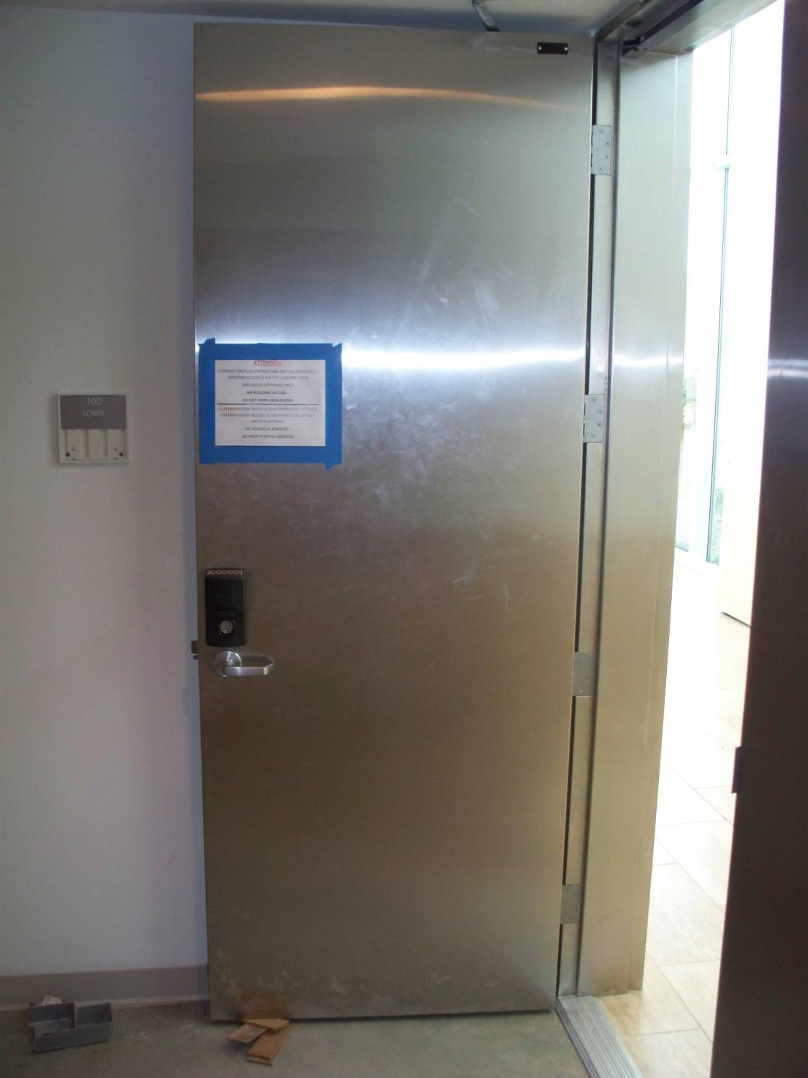
safety/spanish-prop door 1

Slide 18
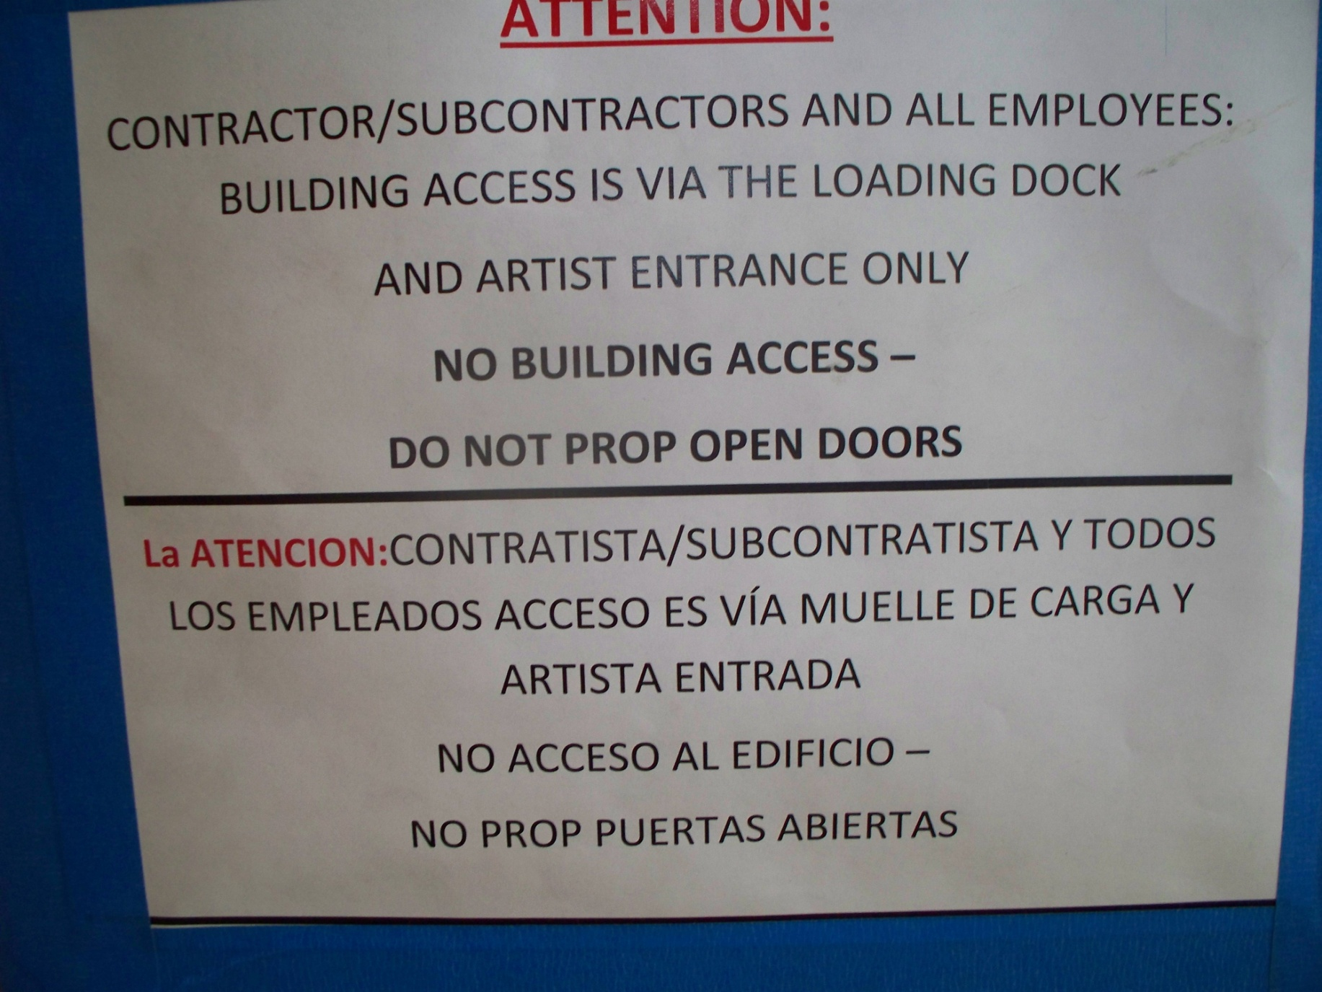
Safety/spanish-prop door 2

Slide 19
(One needs to read and write “artful” sentences, and skill with both requires extensive practice.)

Slide 20
Elementary Tips for Improving your Prose
Practice use of “although” and “despite”
These help with understanding “contrasts”
Practice use of “because”
This helps with understanding “cause”
Practice use of “for”, “and”, “not”, “but”, “or”, “yet”, and “so” (aka “FANBOYS”)
This helps with understanding “relationships”
Source: Tyre, P. (2012) “The Writing Revolution”, Atlantic, Oct. Retrieved from http://www.theatlantic.com/magazine/archive/2012/10/the-writing-revolution/309090/

Slide 21
Intermediate Tips for Improving your Prose
Think of prose as “your [or your organization’s] brand”. Seriously consider reading:
http://ocw.smithw.org/bus302/developing-revising-prose.pdf
Everyone (including well-educated, well-experienced, well-meaning individuals) benefit from routine practice to continuously improve prose
Read your text aloud to yourself
Practice with multiple variations of subordinate clauses to augment multiple variations of main clauses

Slide 22
Simile

Slide 23
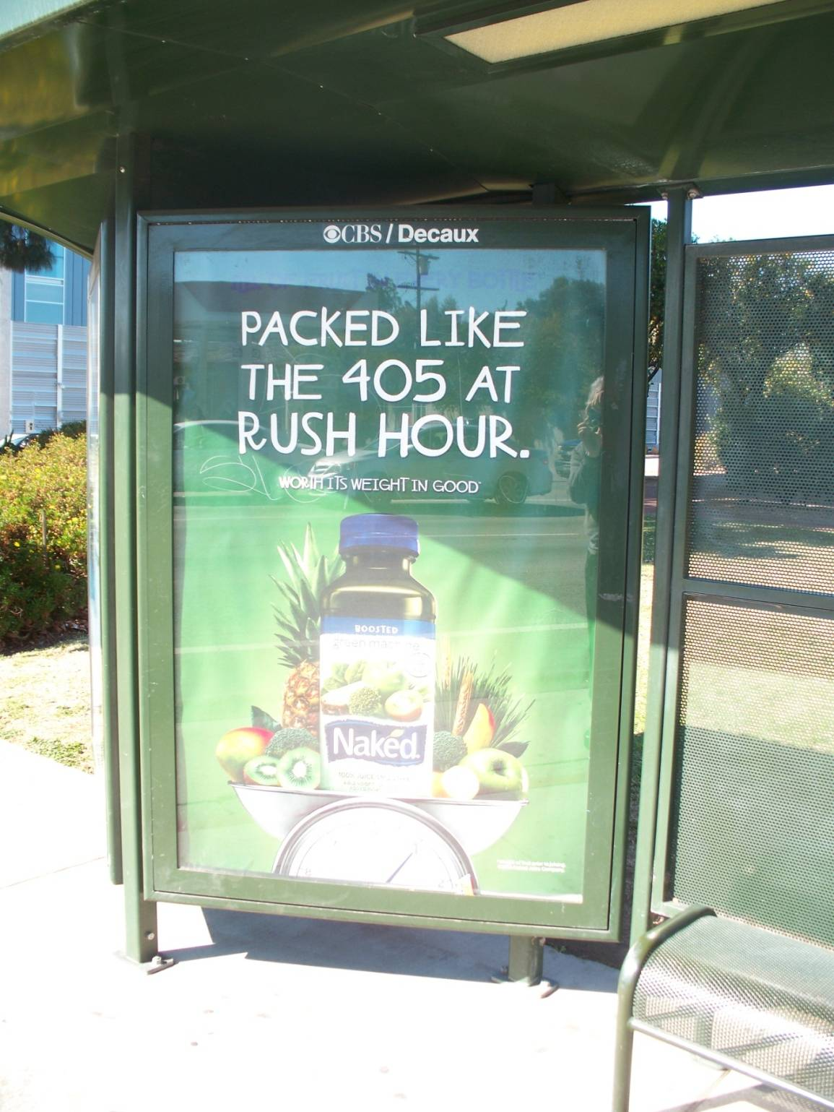
In-service training

Slide 24
Transitions (between sentences)
Relationship Between Ideas | Transitional Words and Phrases
Similarity between the previous point and the next one | Similarly, Also, In addition, Further, Furthermore, Moreover
Difference between the previous point and the next one | However, Nevertheless, Nonetheless, Although, On the other hand
Enumeration of points | First, second, third, etc.
Causal relationship | Consequently, Therefore, Thus, Because
Temporal relationship | Subsequently, Previously, Later, In the meantime, Then, Recently

Slide 25
(The subjects of rhetoric, philosophy, and logic, for example, are much more aligned with success, especially life-long success, than we give them credit for.)

Slide 26
What is the difference between the sense of a word the representation of the word?)

Slide 28
What’s not written can matter just as much as what is written

Slide 29
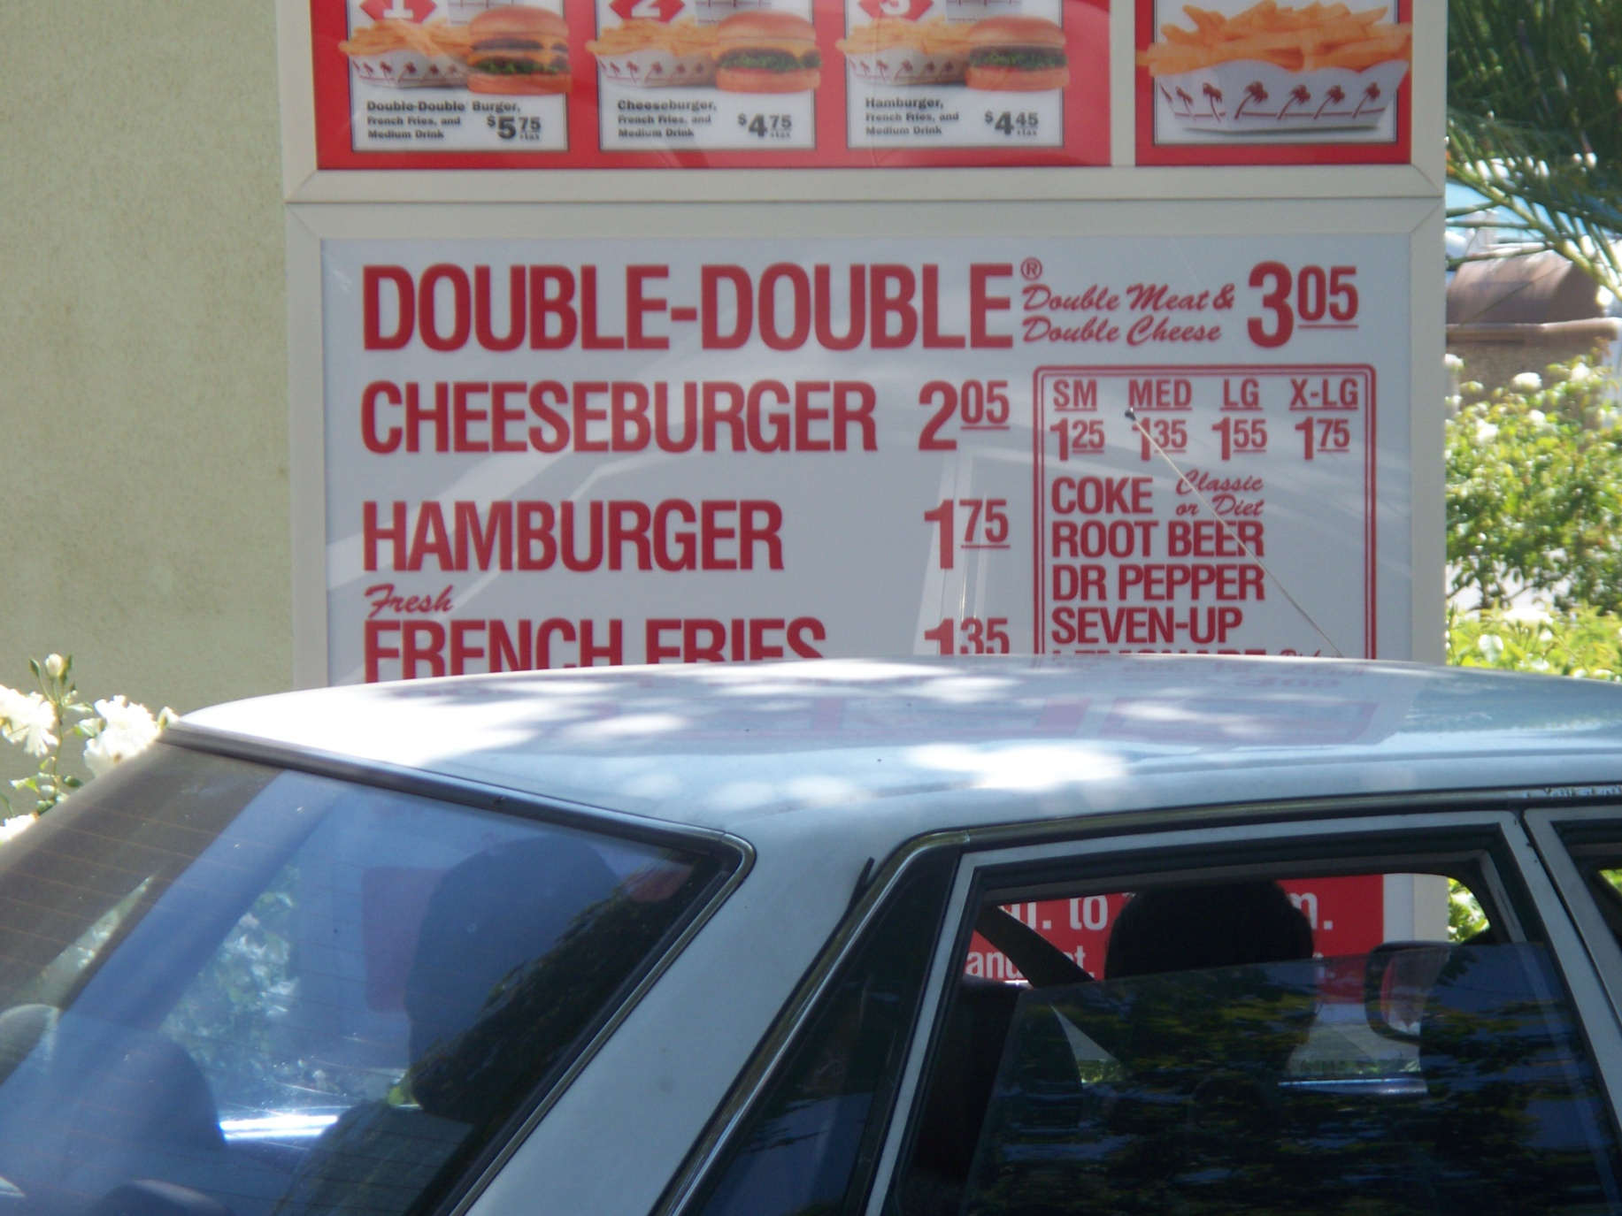
In N Out burger –up close

Slide 30
There is even a “Philosophy of Language” too

Slide 31
“Philosophy of Language”
Consciousness
Consciousness
Belief
(statement-assertion)
Representation-level
Desire
(affirmation-statement)
Prior-intention
(decision)
Conditions of Satisfaction-level
Intention-in-action
(decision)
Intentionality
(conscious or subconscious)
Proposition-level
Understanding
(explanation or prediction)
Meaning
(constitutive or causal)
Speaker (S)
Hearer (H)
Reality

Slide 32
Bottom-line: write everything assuming your writing will outlive you

Slide 33
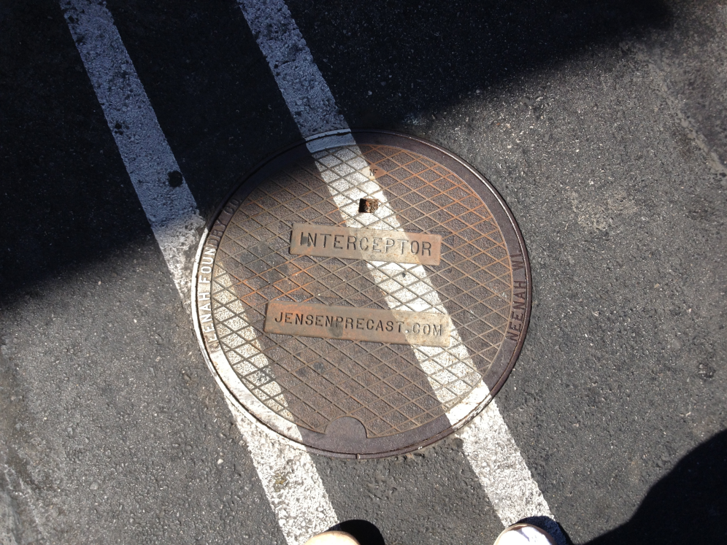
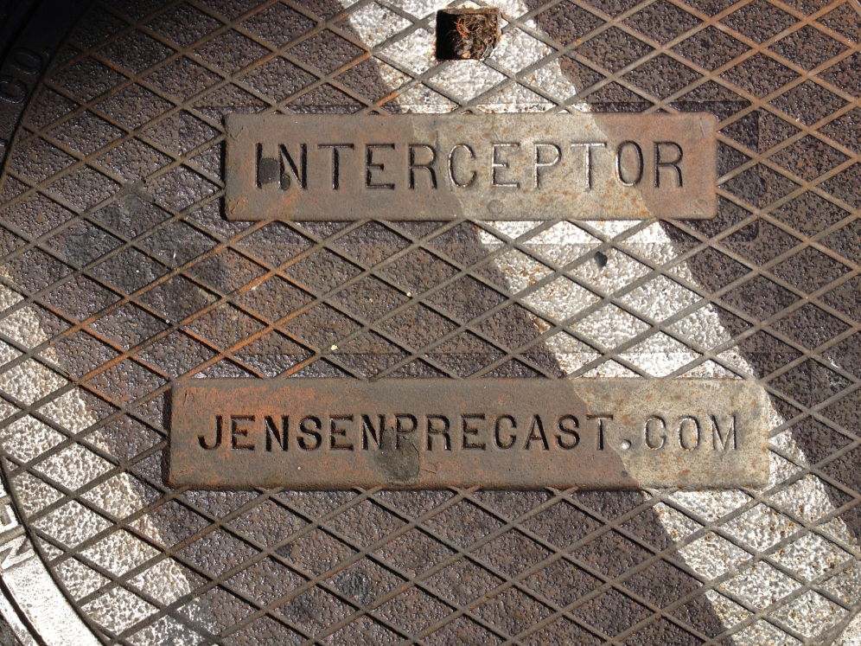
In-service training

Slide 34
“Back Pocket” (Extra) Slides

Slide 35
Some words are important, but not common

Slide 36
Semantics – “Paradigm”

Slide 37
Some words are important, but have multiple lexical meanings and connotations

Slide 38
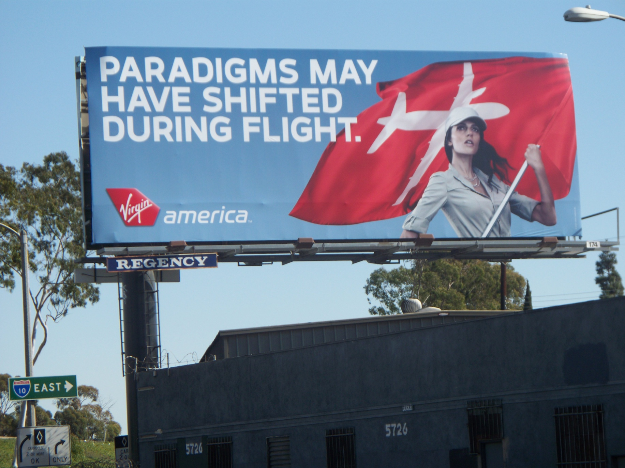
Semantics – “Paradigm”

Slide 39
Over the last decade, my MGT 360 students have identified the word “paradigm” as the most commonly used but most misunderstood word they have encountered in their MGT 360 coursework and library readings

Slide 40
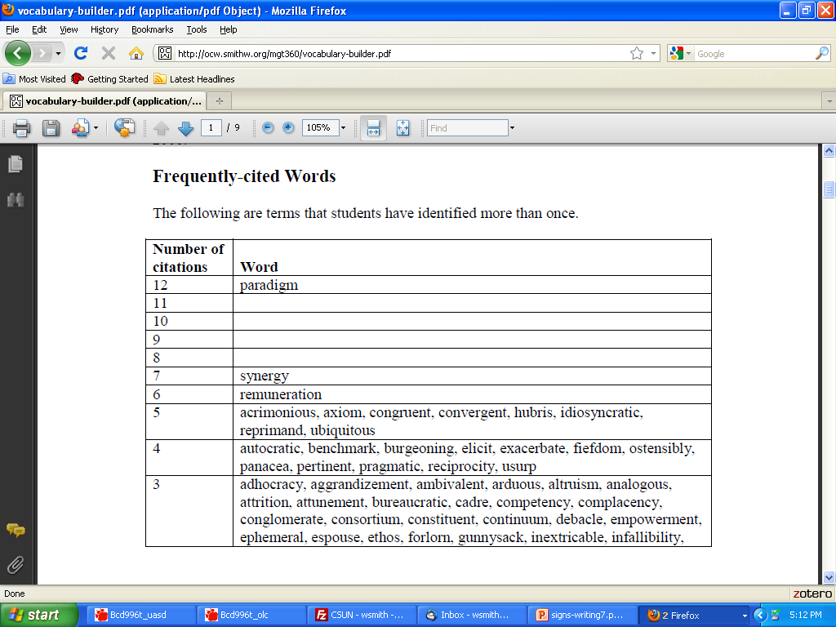
Semantics – “Paradigm”

Slide 41
Literature or Folklore

