Slide 1
Contemporary Human Resources:
Strategic Issues
Wayne Smith, Ph.D.
Department of Management
CSU Northridge
ws@csun.edu

Slide 2
“Professional and Personal Development” (Examples from CSUN)

Slide 3
New Employee Welcome Orientation
Cyber Safety
Workplace Violence/Surviving and Active Shooter Incident
For Managers and Supervisors: Payroll Basics
Navigating the Audit Trail
Smoking Cessation
Incorporating Healthier Behaviors into your Lifestyle
Working Moms: Brown Bag Lunch
Benefiting from our Differences/Engaging in Creative Conflict
Performance Feedback/Providing Useful Feedback/360 Evaluation
Transitioning from Peer to Supervisor
Team Building
Leadership Development
Maximizing CSUN Identity and Positioning
Go Green and Save Green

Slide 4
“Lifestyle Counseling” (Again, Examples from CSUN)

Slide 5
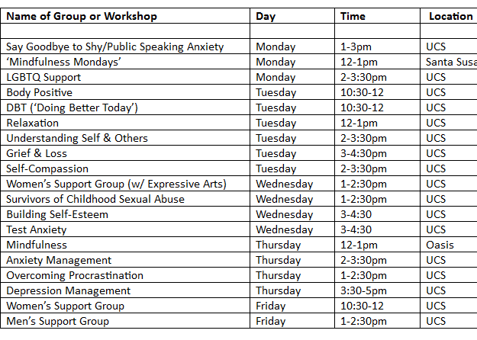

Slide 6
Managing Stress and Well-being

Slide 7
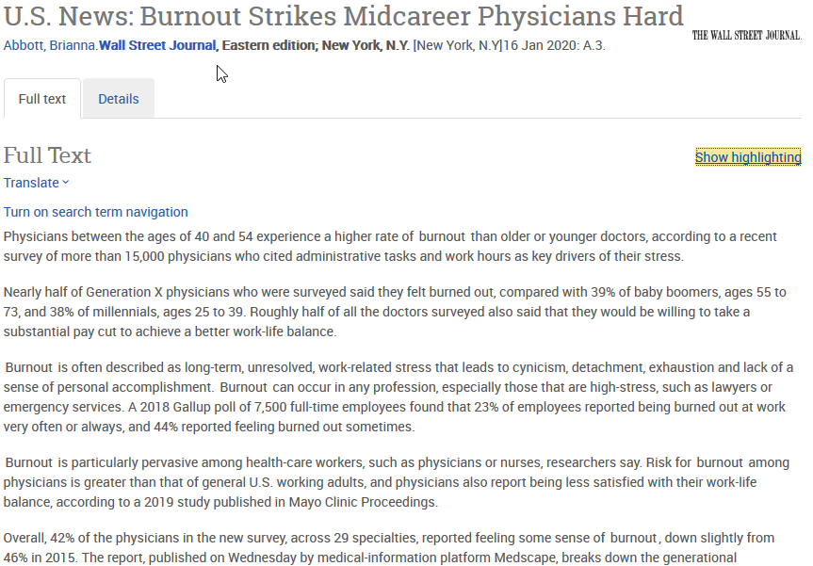

Slide 8
“What’s missing?” (E.g., Multi-generational workforce)

Slide 9
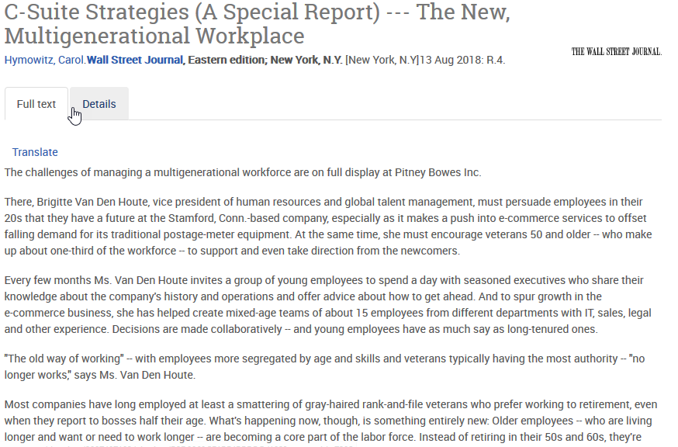

Slide 11
What is “People Analytics”?

Slide 12
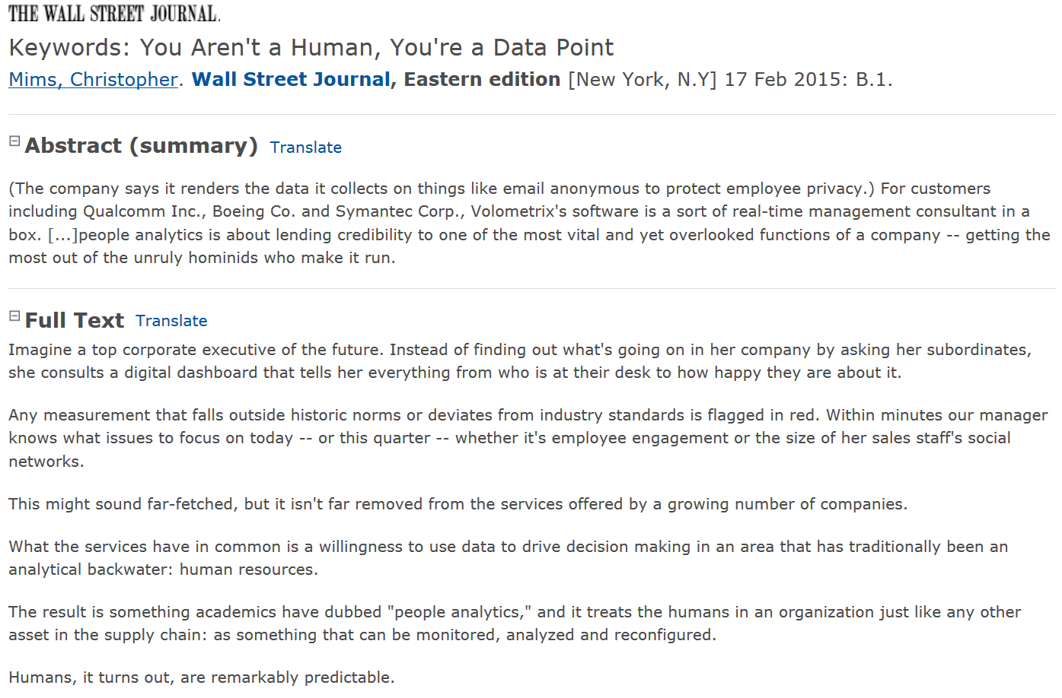

Slide 13
How do we increase the number of females in Technology and Finance firms?

Slide 14
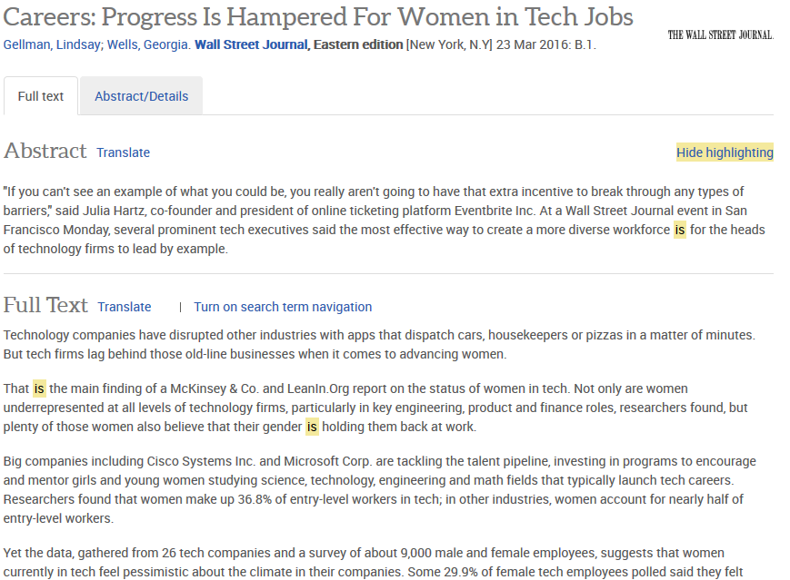

Slide 15
What is the appropriate level of education?

Slide 16
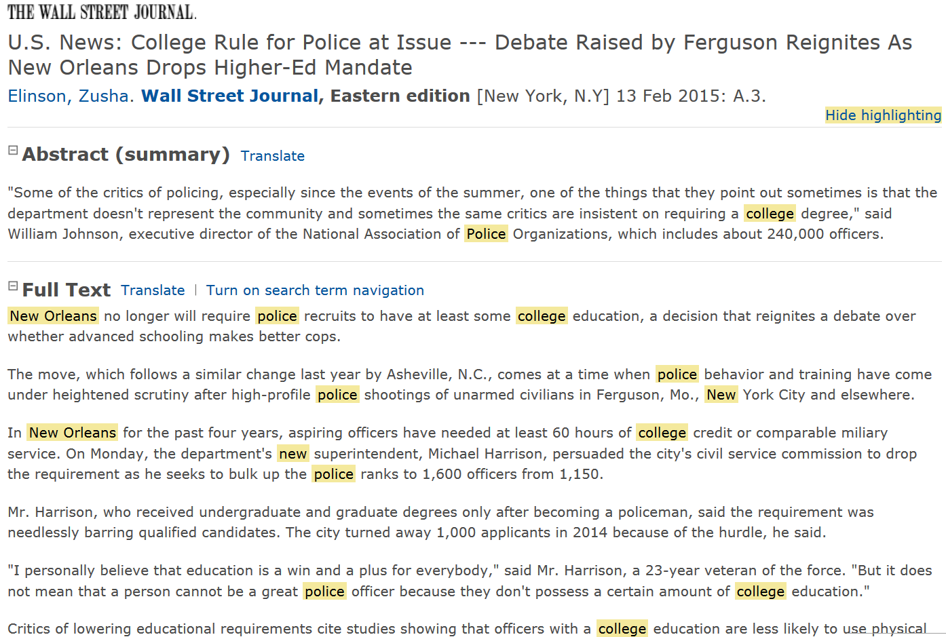

Slide 17
What is the appropriate level of executive compensation?

Slide 18
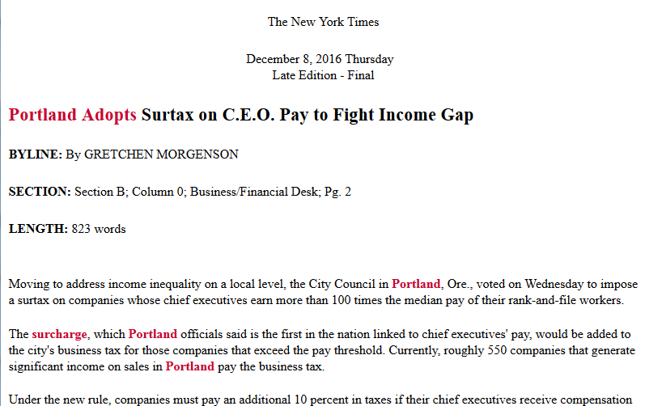

Slide 19
What should be the policies surrounding Consensual Relationships?

Slide 20
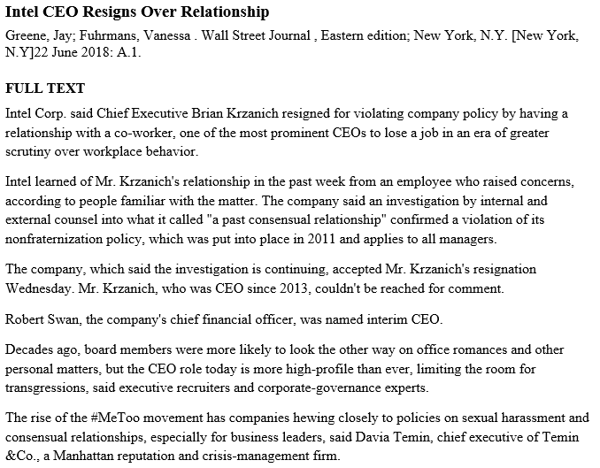

Slide 21
How can firms improve Succession Planning?

Slide 22
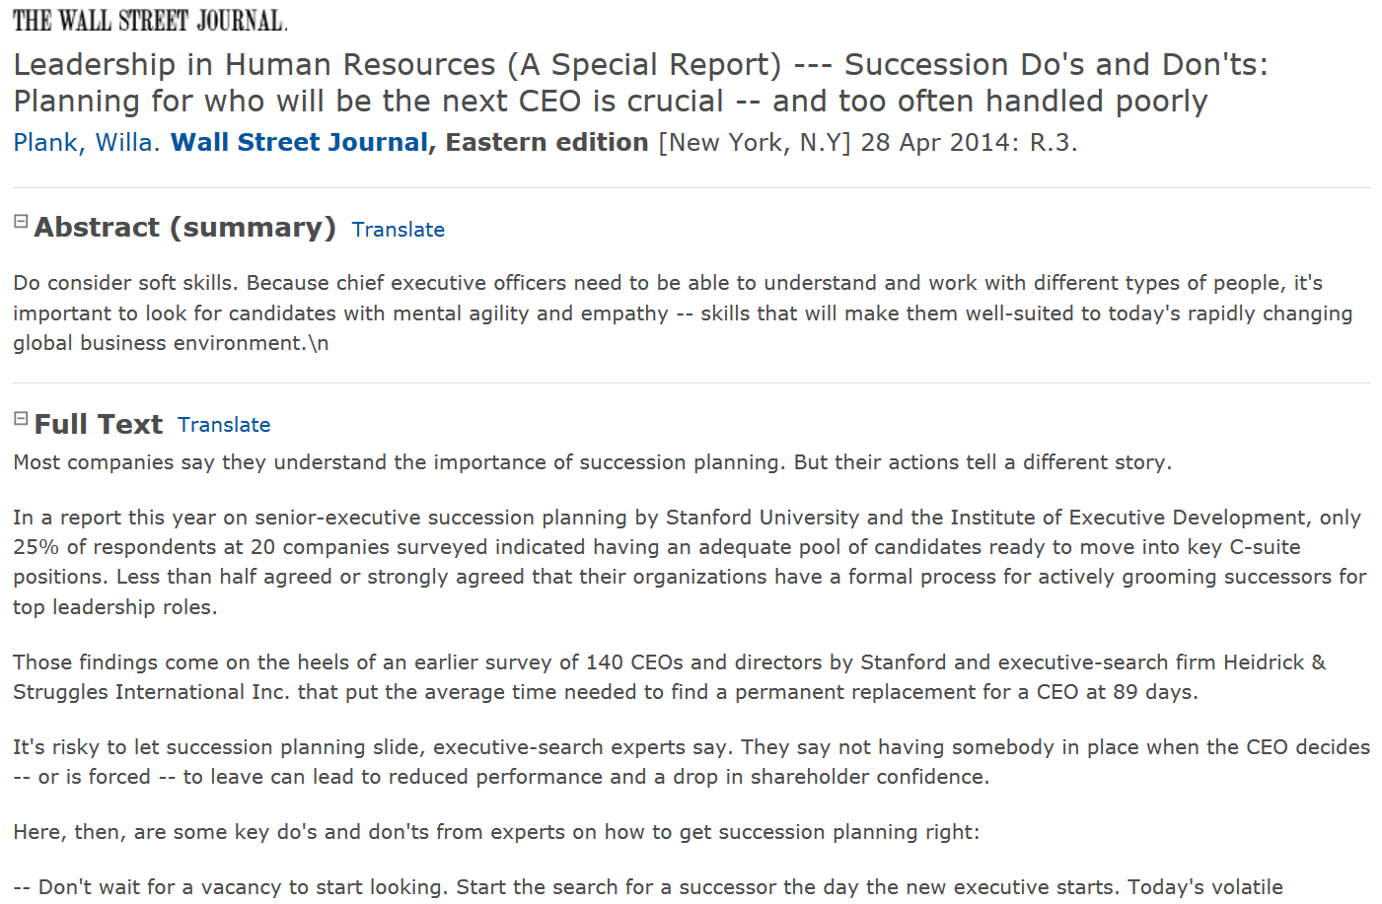

Slide 23
“Employees” or “Contractors” or ?

Slide 24
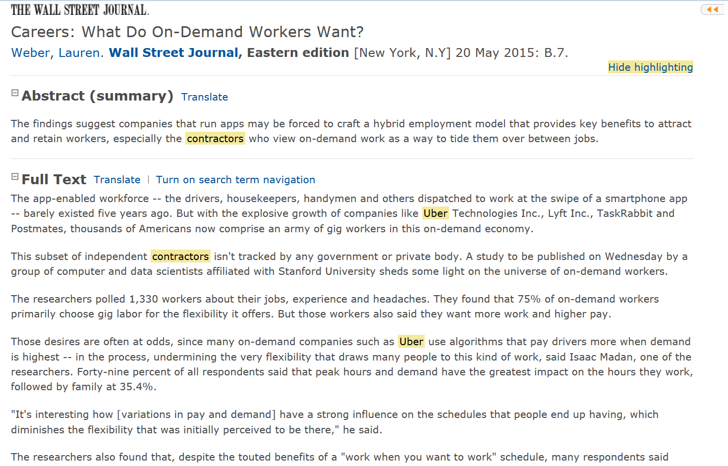

Slide 25
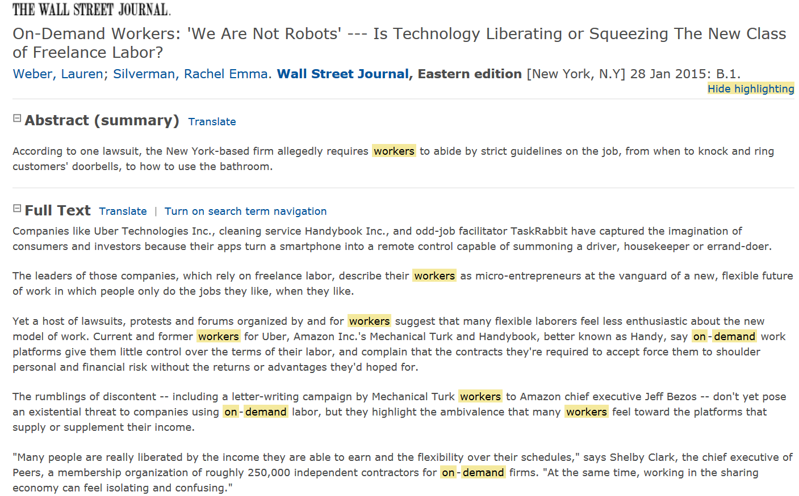

Slide 26
Has technology matured enough to enable a Four-Day Work Week?

Slide 27
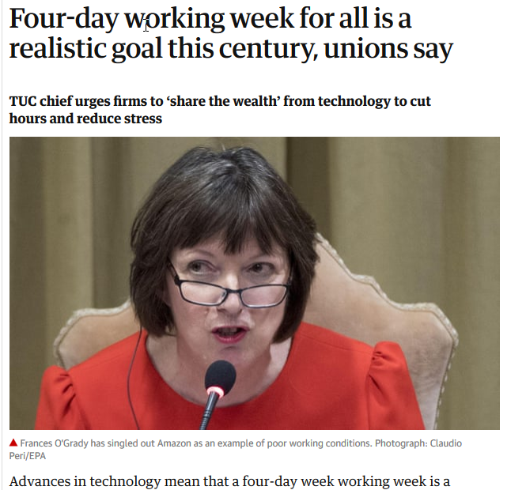

Slide 28
Ethics, Ethics, Ethics

Slide 30
And now…a myriad of post-pandemic issues

Slide 31
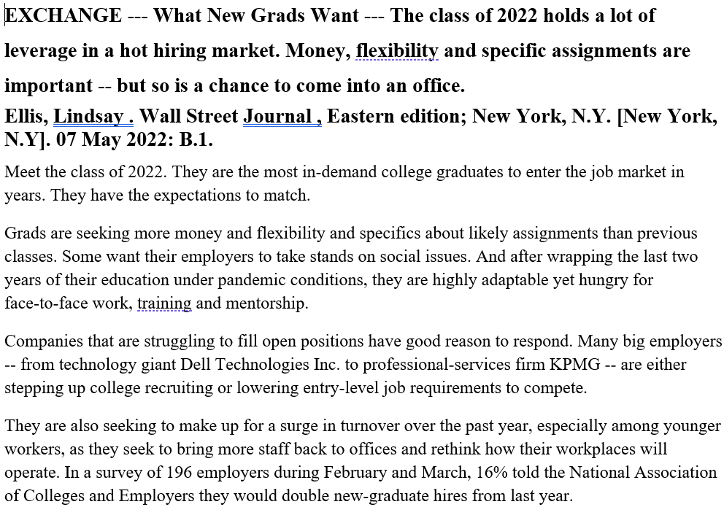

Slide 32
Post-pandemic—new values, new priorities, a different work-ethic?

Slide 33
