Slide 1
Contemporary Human Resources:
Compliance Issues
Wayne Smith, Ph.D.
Department of Management
CSU Northridge
ws@csun.edu

Slide 2
Anti-Discrimination Statutes
U.S. Civil Rights Act of 1964 (Title VII--Employment) (aka “protected classes”)
Race
Color [of Skin]
Religion
Sex
National Origin
Extensions from Case Law
Gender Identity, Gender Expression, and Sexual Orientation
Marital Status
Other Acts/Policies
Age
Disability (ADA and Rehabilitation—Section 504)
Veteran Status
Genetic Disposition
Prevention from retribution or reprisal from prior acts of Civil Rights activities
Pregnancy
Except: Bona-fide Occupational Qualifications (“BFOQs”)
A legal reason to discriminate based upon a organization’s specific need

Slide 3
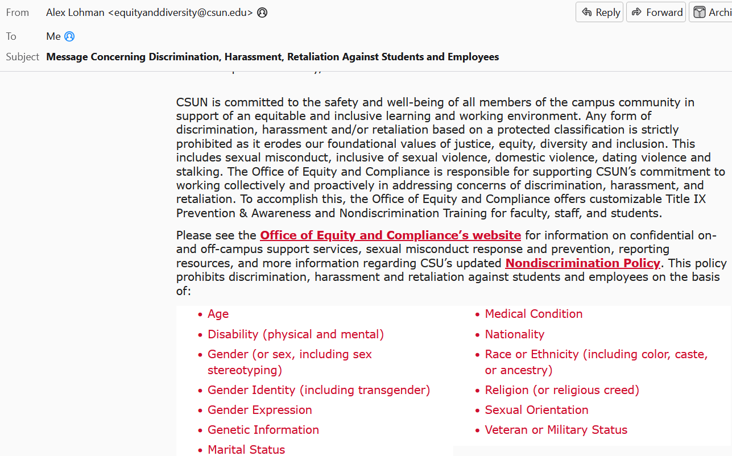

Slide 4
Race Bias (Denny’s)

Slide 5
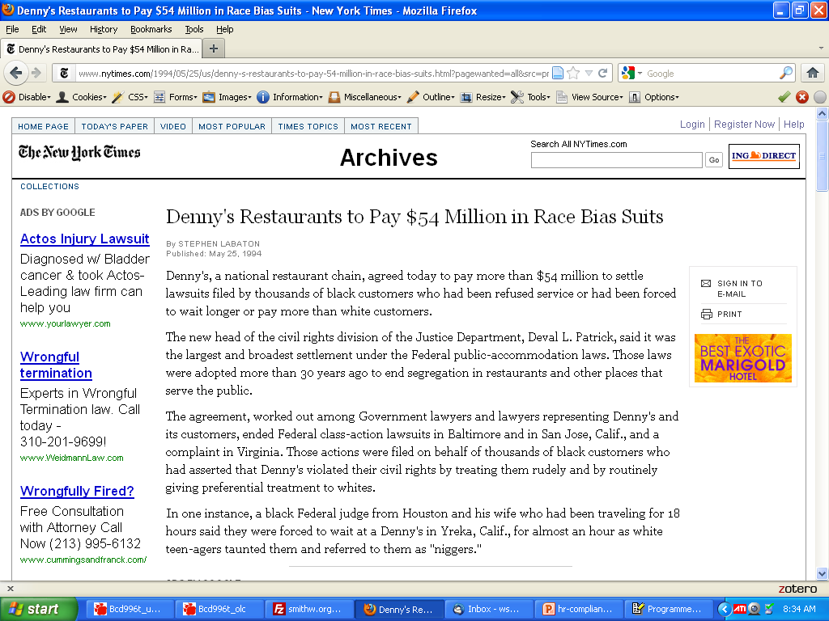

Slide 6
Sex Bias

Slide 7
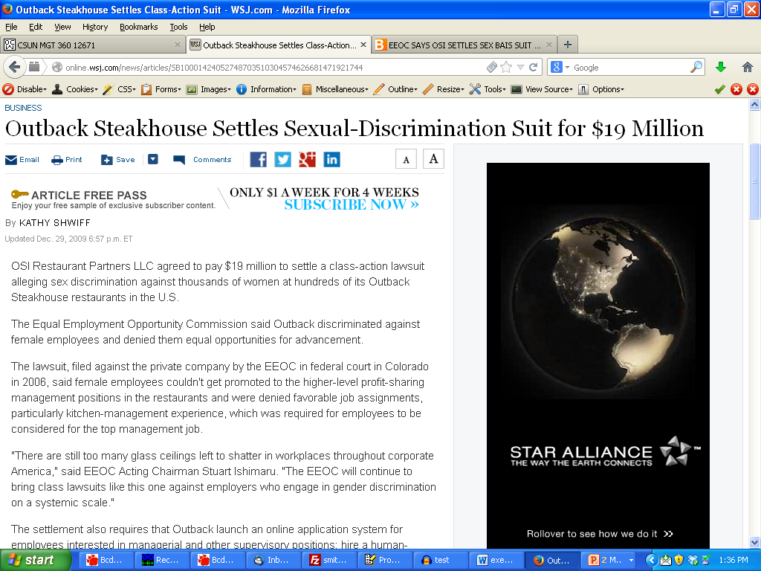

Slide 8
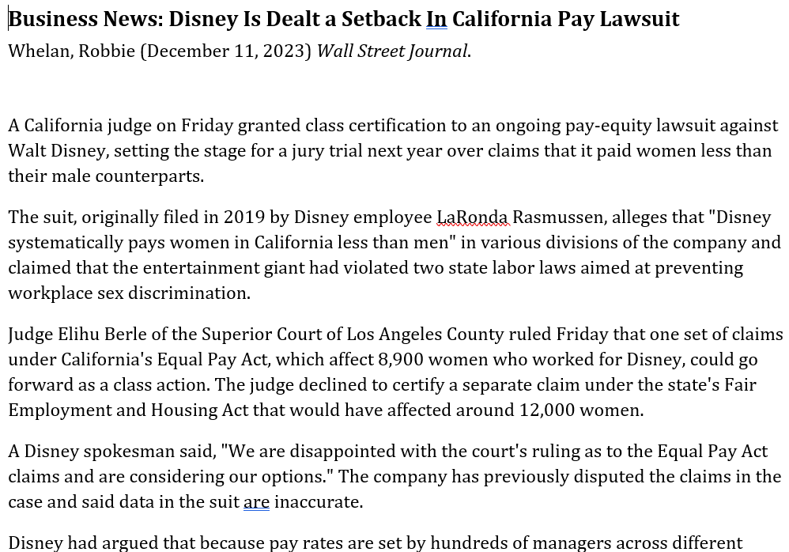

Slide 9
Age Bias

Slide 10
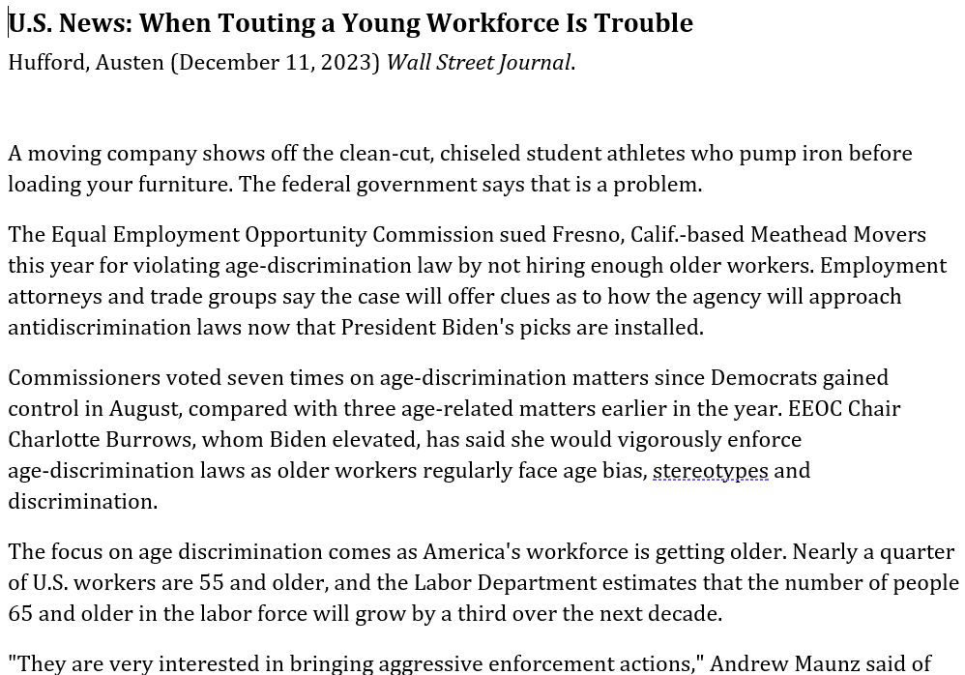

Slide 11
Disability

Slide 12
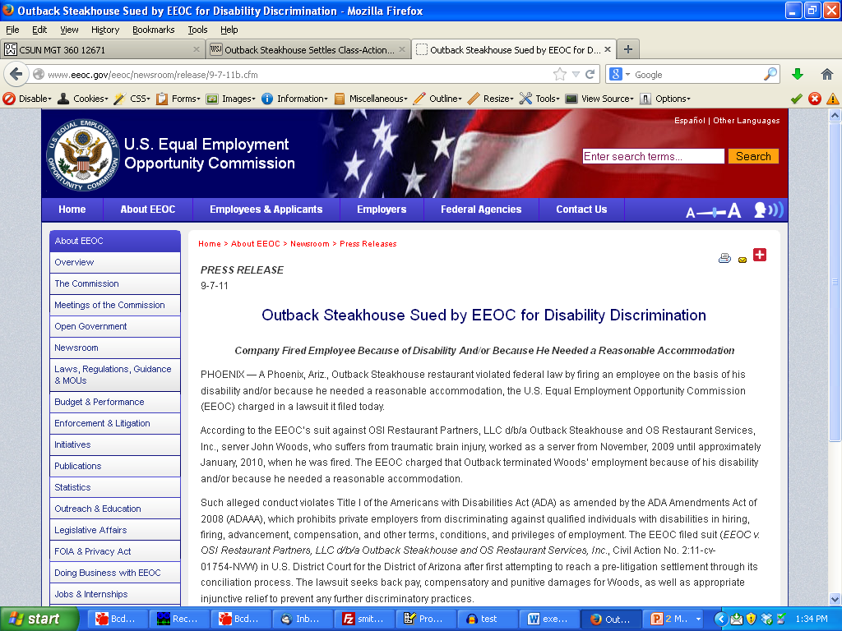

Slide 13
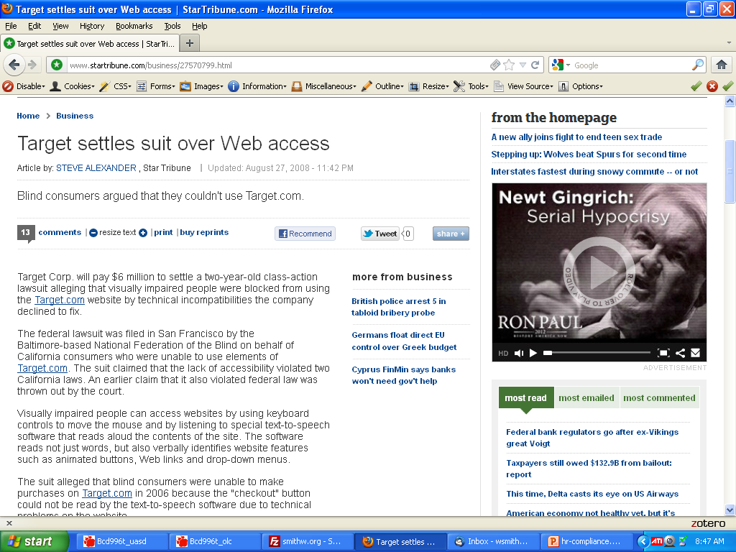

Slide 14
Every State has Additional Requirements too

Slide 15
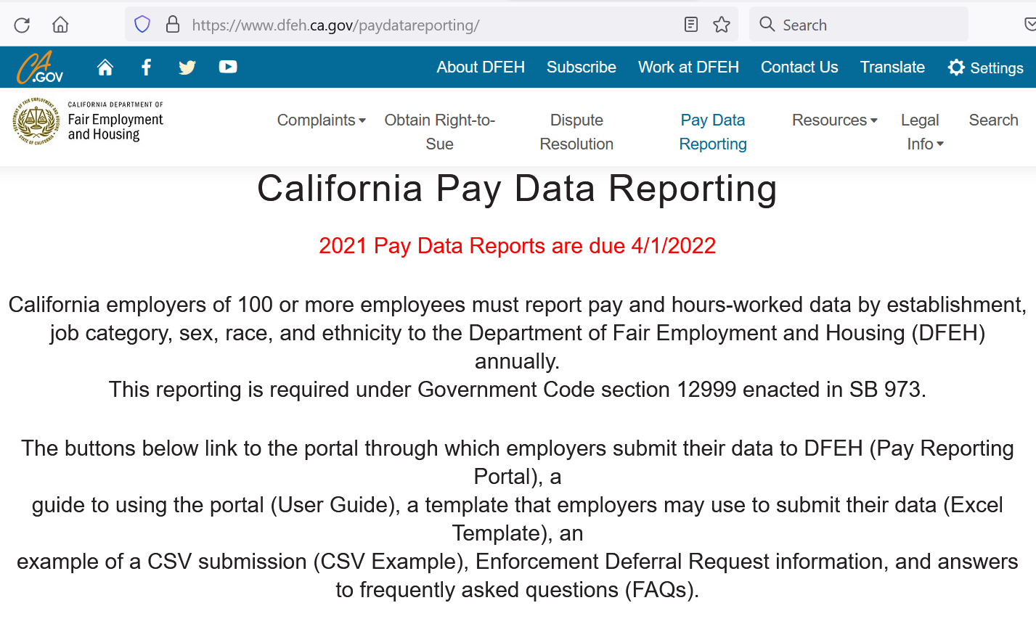

Slide 16
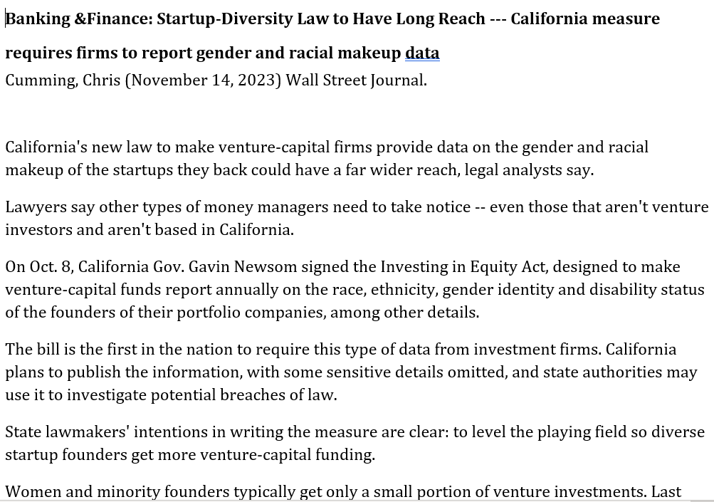

Slide 17
Every City has Additional Requirements (e.g., Prior Arrests/Convictions Records)

Slide 18
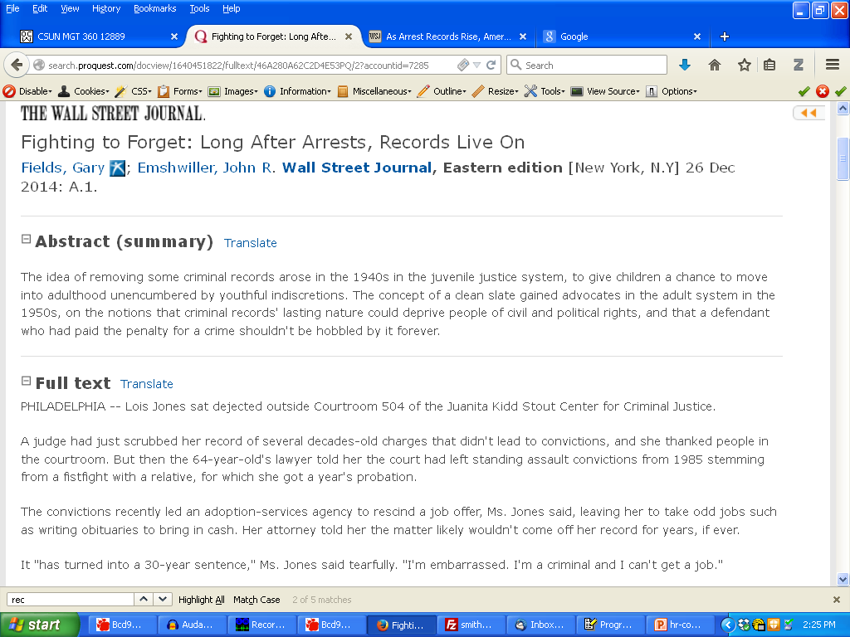

Slide 20
Increasing Drug Use

Slide 21
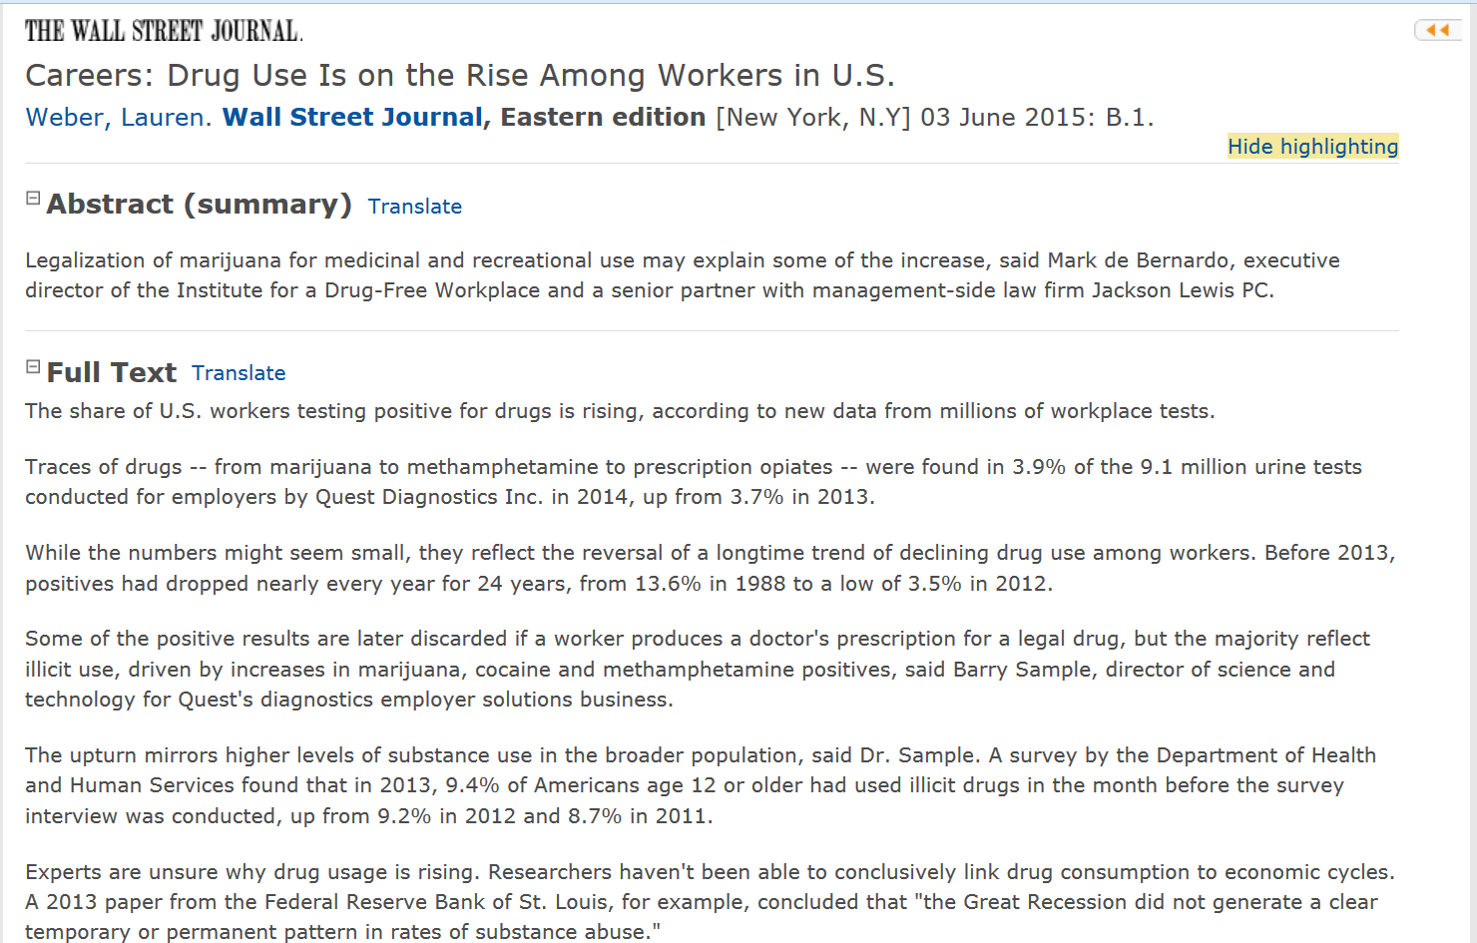

Slide 22
Undocumented Workers (Chipotle)

Slide 23
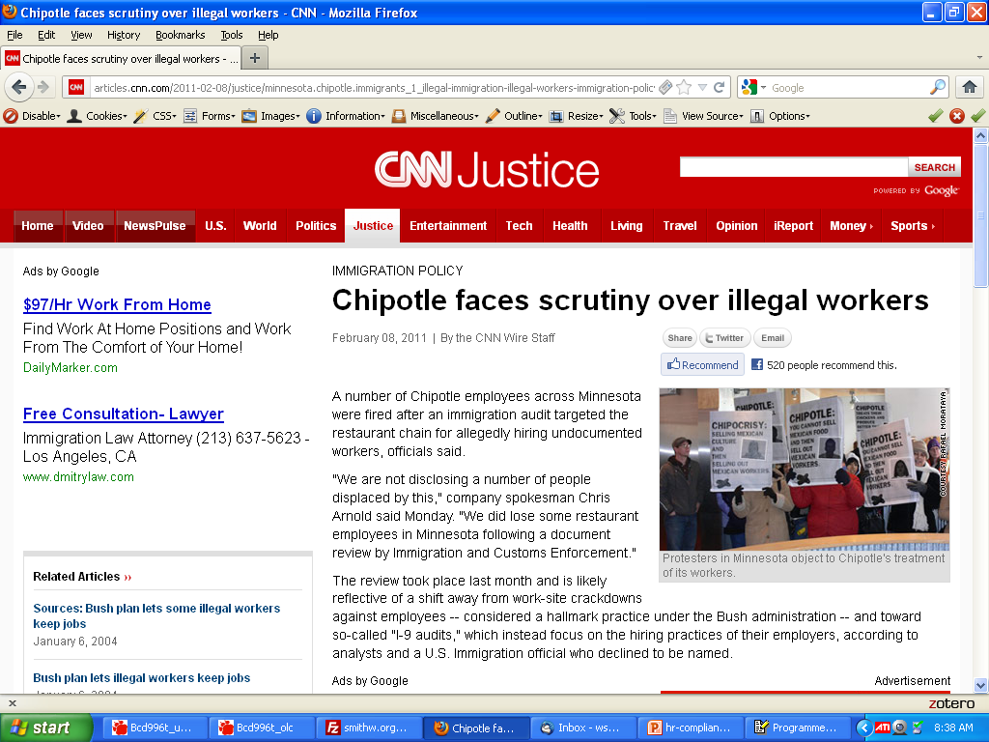

Slide 24
“Non-compete/Non-disclosure” Nike/Adidas

Slide 25
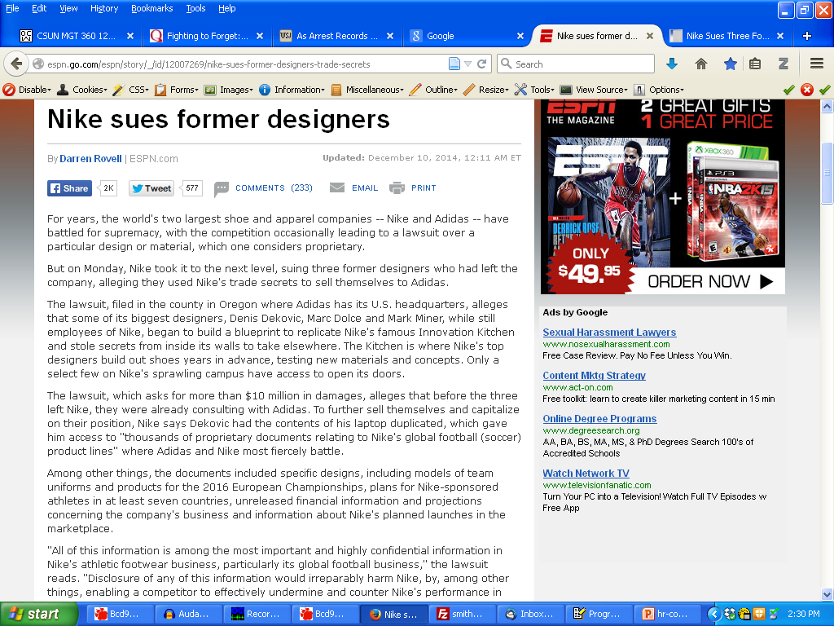

Slide 26
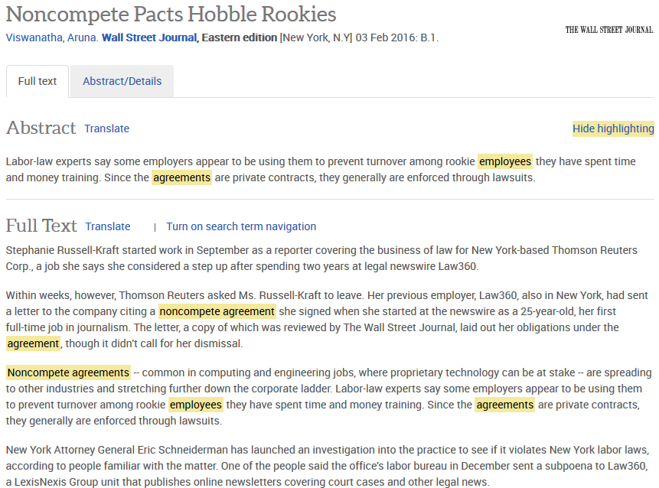

Slide 27
“Specialized Compliance” (e.g., Security Clearances)

Slide 28
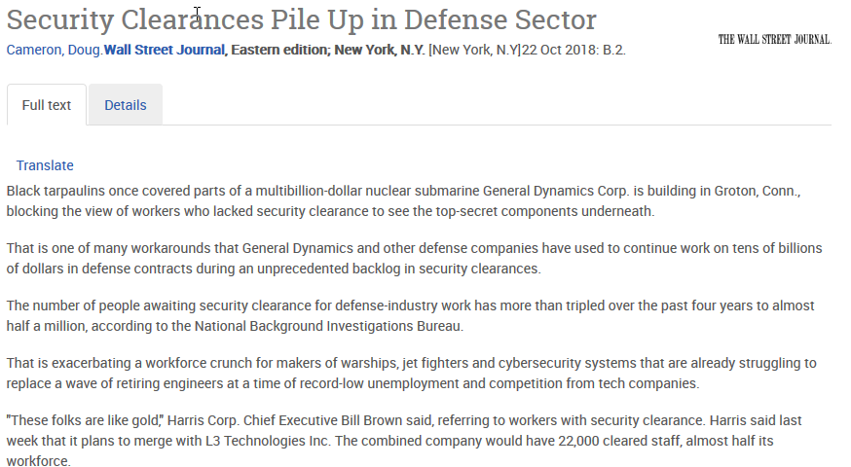

Slide 29
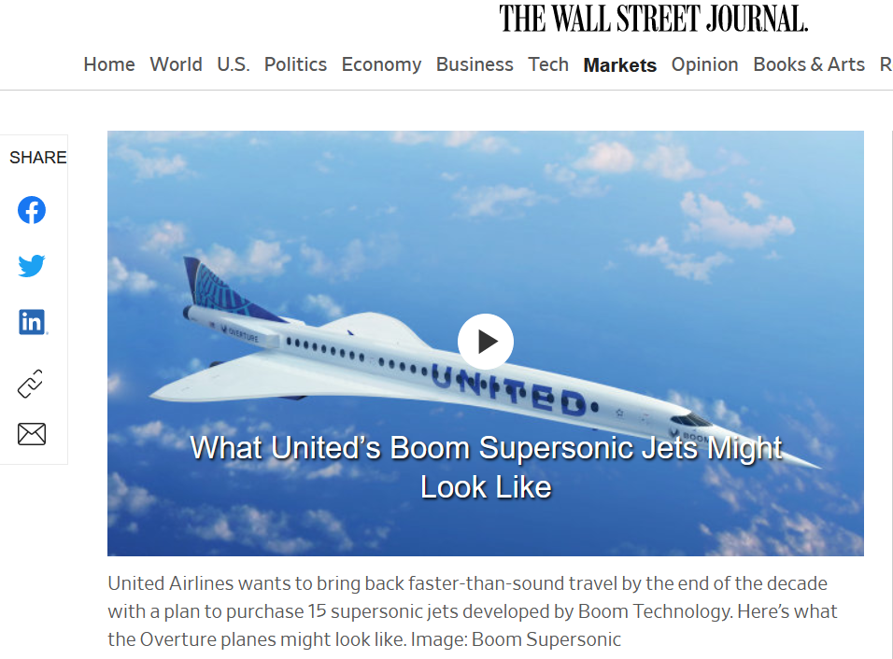

Slide 30
“Trade Secrets”

Slide 31
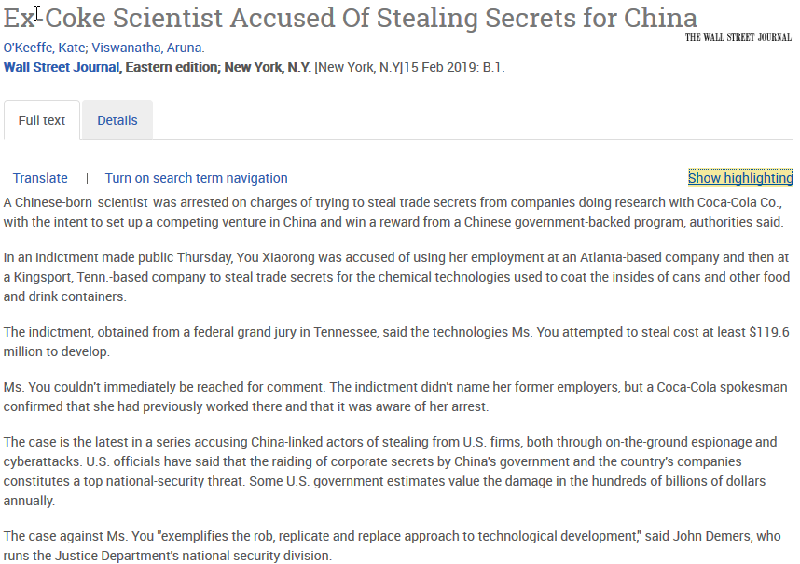

Slide 32
“Whistleblowers”

Slide 33
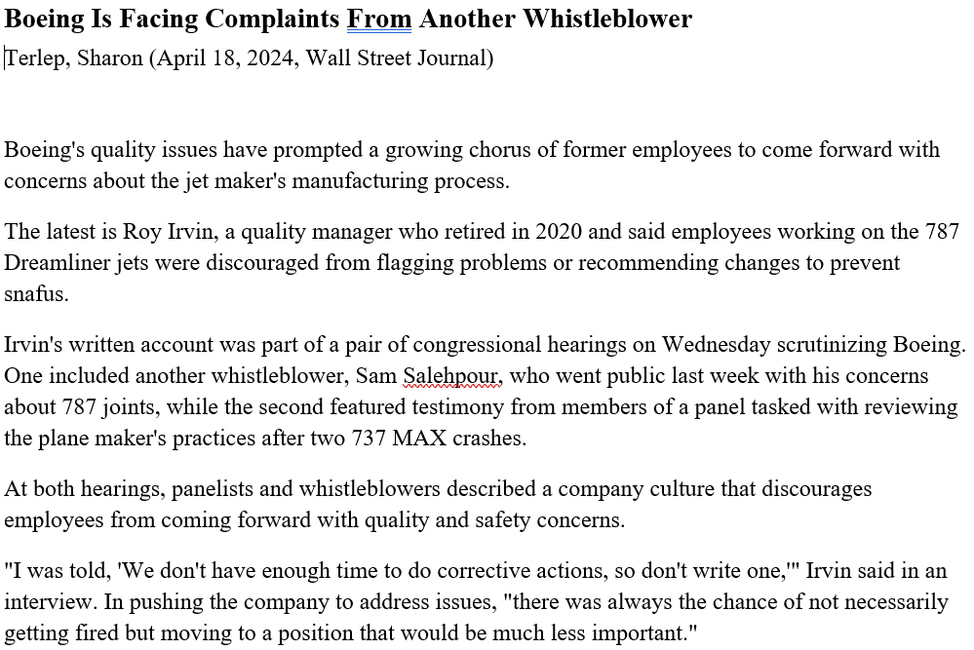

Slide 34
Workers on “H1-B Visas” replacing American workers)

Slide 35
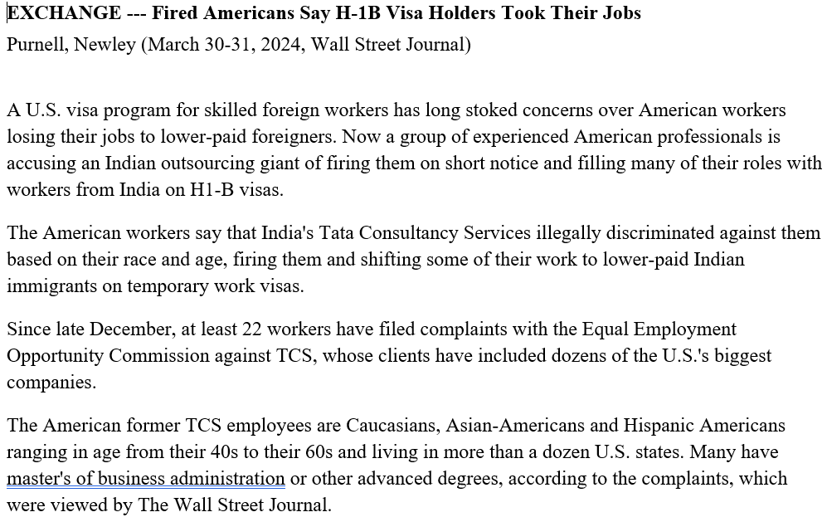

Slide 36
“Non-disparaging” contracts (and Workers on “H1-B Visas”)

Slide 38
“No-Poaching Collusion”

Slide 39
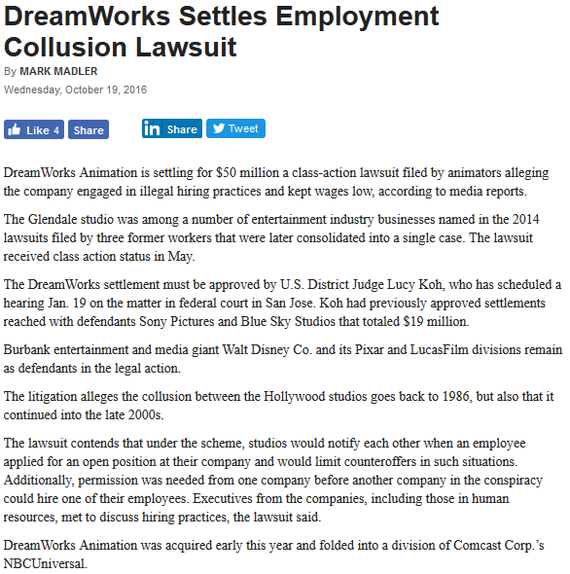

Slide 40
“Contract Workers and Franchisees”

Slide 41
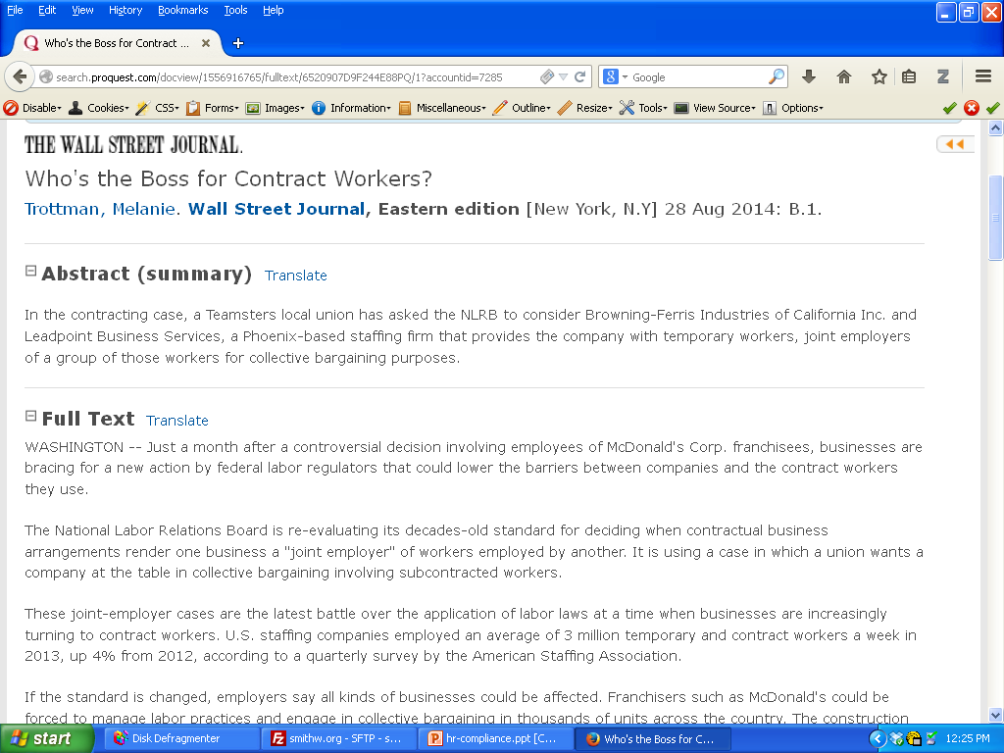

Slide 42
“Collective Bargaining (Unions)”

Slide 43
