Slide 1
Decision-making in Management
Using the Diversity of Truth-seeking and Sense-making to Advantage in Organizational Contexts
Wayne Smith, Ph.D.
Department of Management
CSU Northridge

Slide 2
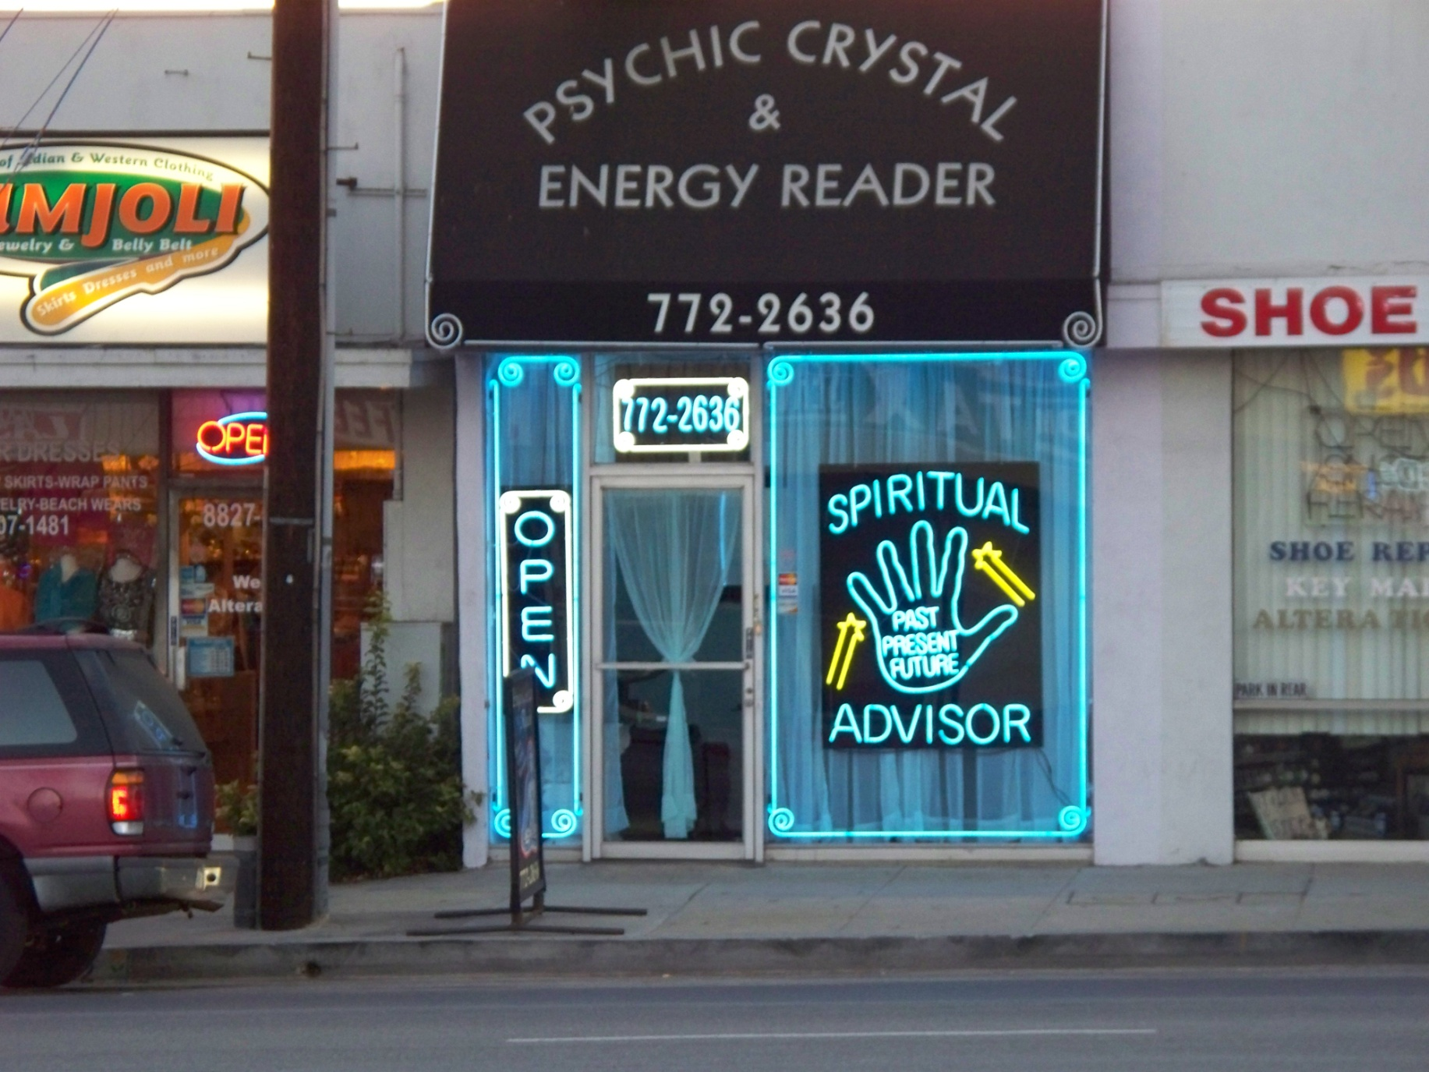
Spiritual Advisor - wide

Slide 3
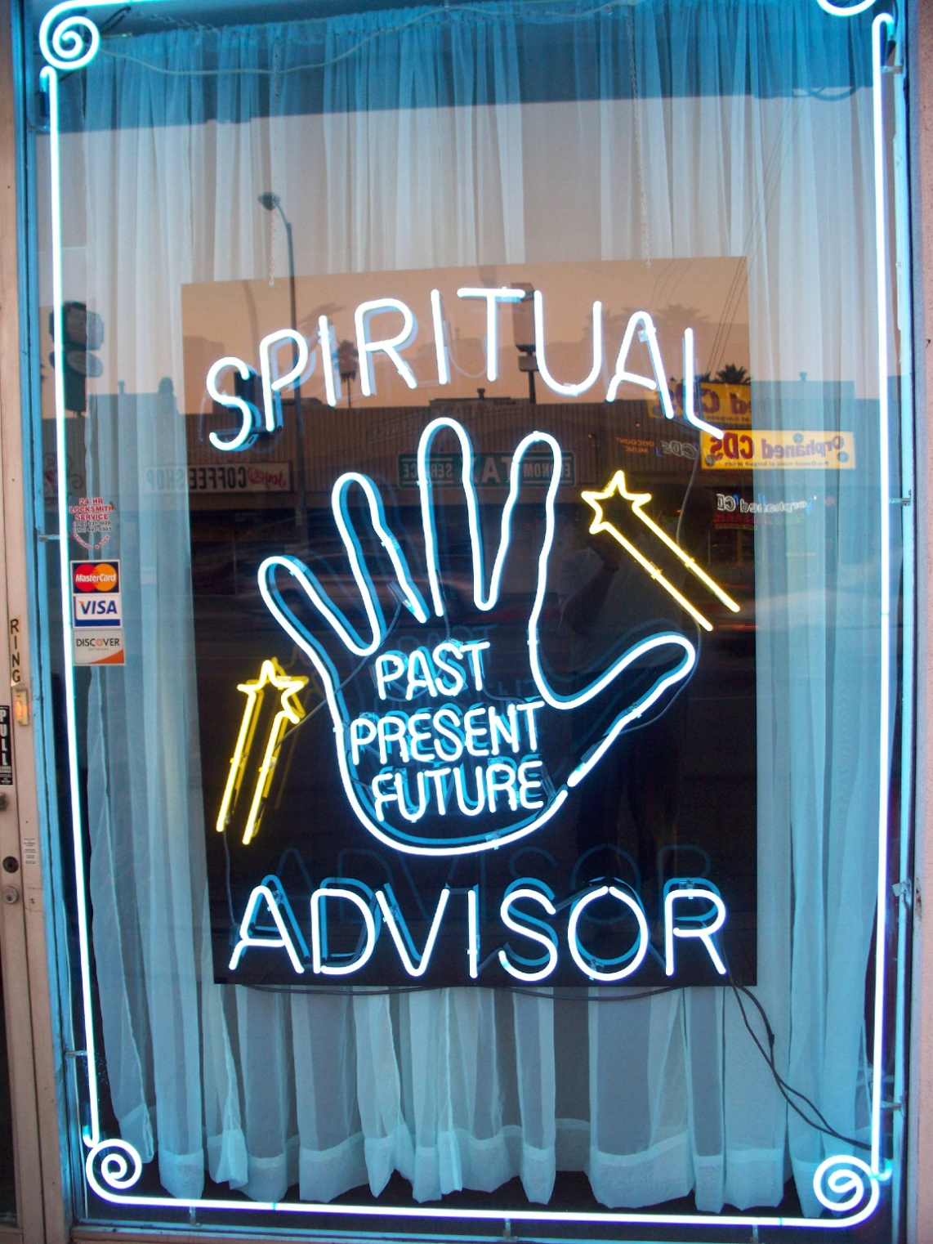
Spiritual Advisor – up close

Slide 4
What is Decision-making?
What is Decision-making?
Formal Definition
“The process of identifying problems and opportunities for the Organization”
Requires 1), design a choice, 2), form expectations, 3), evaluate the consequences
Informal Definition of a Decision
Deliberate, Conscious (e.g., material choice)
Automated, Saccadic (e.g., eye movement)
Short sequences (e.g., driving a car)
Long sequences (e.g., life-time investment)

Slide 5
Management Decision-making
Desire
Prediction
Desire
Explanation
Modeling
Judgment
Model-based
(reject H₀ hypothesis)
Motivational
Biases
Quant-
ified
Risk
(with
some
data)
Qualified
Risk
(without
much
data)
Chance
KE/SL/RO
BJ
CR
PO
Objective
(programmed decisions)
Subjective
(non-programmed decisions)
Model-free
(optimization/machine learning)
Task
Complexities
Maximize
Rationality,
Minimize
Uncertainty
Change
Leverage
Serendipity,
Control
Complexity

Slide 6
Management Decision-making (links to the Chapter reading)
Which side is (i.e., questions managers must ask)…
More Systematic or More Intuitive?
Does the problem require a Rational/Analytical Approach or does it require a Flexible/Spontaneous Approach?
More Structured or More Unstructured?
Is the information required familiar/straight-forward/clear or new/unusual/ambiguous/deficient?
More Operationally-oriented or More Crisis-oriented?
Is the problem ongoing/long-term/managed/expected or one-time/short-term/extraordinary/unique?
More Classical Model or More Behavioral Model?
Can we act rationally (optimize within constraints) or do we act with cognitive limitations (satisficing—choose the first good solution).
More Analysis needed or more Creativity needed?
Will the existing paradigm work (broader and deeper analysis) or will we need a new paradigm (think completely differently)?

Slide 7
Information Dynamics
Wisdom
Extraordinary Insight (Explanation) for Foresight (Prediction)
Restaurant: How should our menu change in the future to best optimize nightly sales?
Knowledge
Combination of Explicit Information and Tacit Information
Restaurant: What action led to the change in last night’s sales?
Information
Meaningful Data
Restaurant: How does last night’s sales compare to that night the previous year? How does last night’s sales compare to our goals?
Data
Raw, atomic, basic
Restaurant: What were the total sales for last night?

Slide 8
Analytics for Management Decision-making
Prescriptive Analytics
What should we do?
HR Department: What should we (the HR Department) do to meet or exceed the organization’s hiring and retention goals for next year? What data/information/knowledge/wisdom should we provide to our hiring and technical managers to help? What are we missing?
Predictive Analytics
What is likely to happen?
HR Department: How many new employees will our organization need next year? How will the mix change? What is our competition likely to do?
Diagnostic Analytics
Why did it happen?
HR Department: Did our emphasis on recruiting from campus A (over campus B, etc.) matter? What do the managers of these entry-level employees think?
Descriptive Analytics
What happened?
HR Department: How many entry-level professionals did we hire last year? How many of them are still with us now?

Slide 9
How do most managers make most decisions most of the time?
(adapted from Joseph Badaracco, HBR, 2016)
What are the net consequences of all my options?
What are my core obligations?
What will work in the world as it is?
Who are we?
What can I live with?

Slide 10
Two kids playing hide and seek for >30 minutes

Slide 11
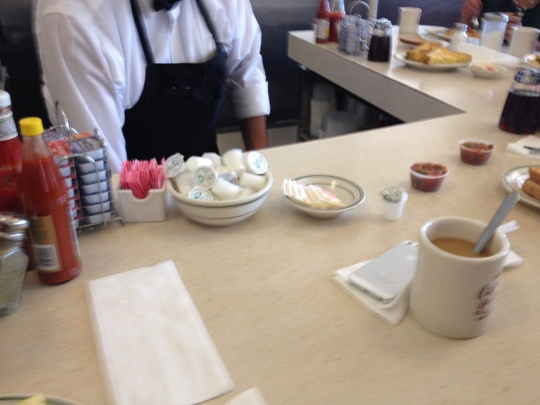
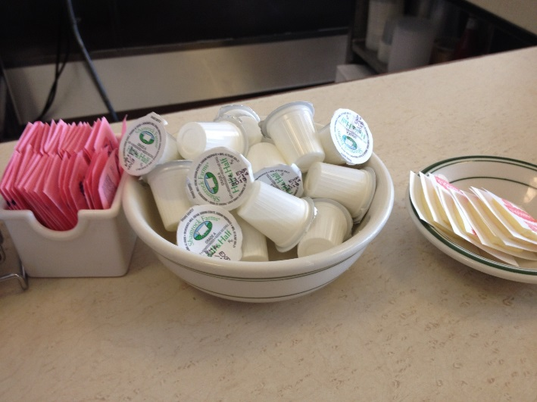
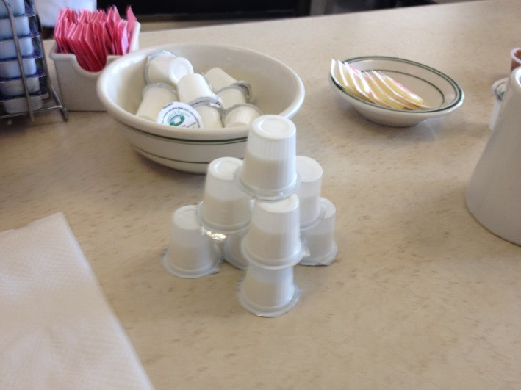
A kid making something new

Slide 12
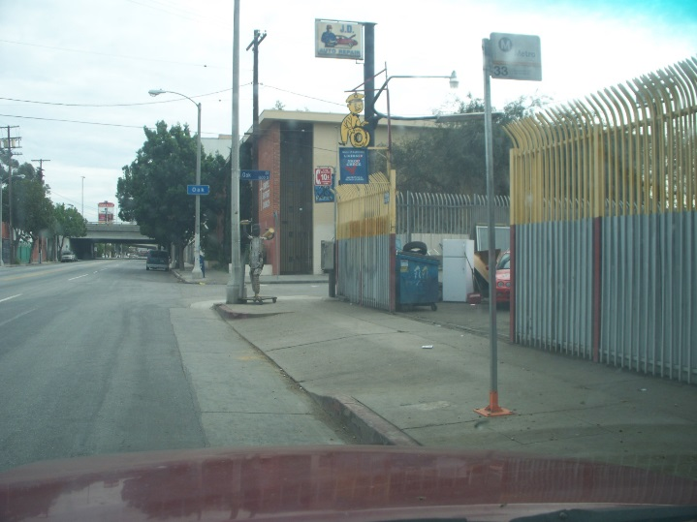
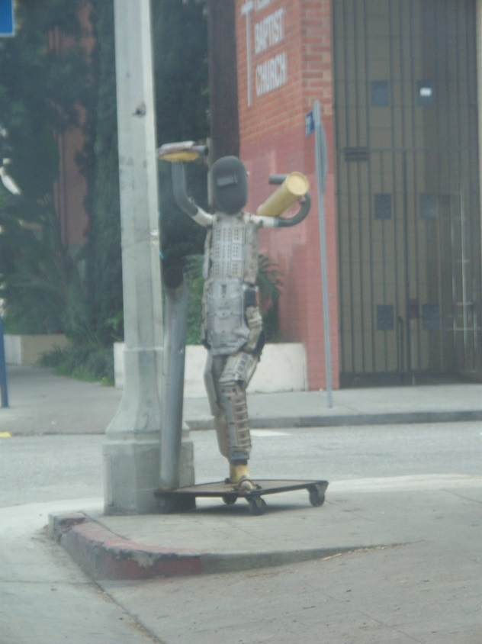
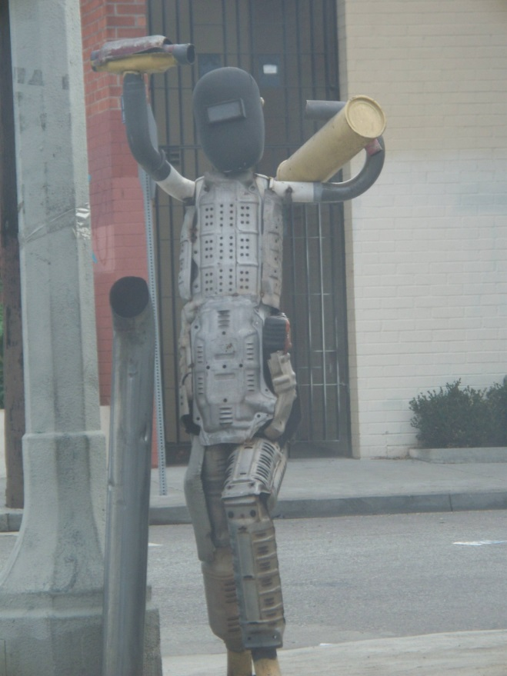
Body Shop - wide
An adult making something new

Slide 13
What…really…is Creativity? (The “Idea” Camp)
There is a Philosophy of Creativity
Existence: Imagination, Idealization, Consummation, The Aesthetic
Modes: Physical Separation, Divine Inspiration, Nature of the Creative Process, Aesthetic Creativity (in the Art), Creative Practice
You can Test and Audit for Creativity
Support for ideas, Challenge, Time for ideas, Freedom, Trust and openness, Dynamism/liveliness, Risk-taking, Playfulness and humor, Debates, Conflicts and impediments
E.g., http://www.ststesting.com/ngifted.html
The Engineers’ view of Creativity (“S.C.A.M.P.E.R.”)
Substitute, Combine, Adapt, Magnify, Put to other uses, Eliminate, Rearrange
E.g., http://litemind.com/scamper/
The Artists’ view of Creativity (“B.B.B.”)
Bend (Frank Gehry’s buildings), Blend (music “mash-ups”), Break (Picasso)
E.g., https://www.theverge.com/2017/11/5/16597660/david-eagleman-anthony-brandt-runaway-species-creativity-neuroscience-psychology-design-interview

Slide 14
What…really…is Creativity? The “Execution” Camp
You can Manage Creativity (by first structuring it correctly)
Imagination (be new), Investment (be first), Incubation (be sustainable), or Improvement (be better)
You can Nurture Creativity (by removing blocking obstacles)
Constancy (defining problems in only one way/language), Commitment (presents problems are only variations on past problems), Compression (defining the boundaries of the problem too narrowly), Complacency (not asking questions and an unconscious bias towards “non-thinking”)
Develop Innovation and Entrepreneurship (adapted from Peter Drucker)
Make it Purposeful (i.e., link it to Strategy Vision and Mission)
Systematize it (i.e., make it a regular, on-going part of the firm)
Look for Sources of Innovative Opportunity:
The Unexpected, Incongruities, Process Need, Industry and Market Structures, Demographics, Changes in Perception, New Knowledge

