Slide 1
A Primer on Organizational Culture
Rites and their practical and expressive consequences
Wayne Smith, Ph.D.
Department of Management
CSU Northridge

Slide 2
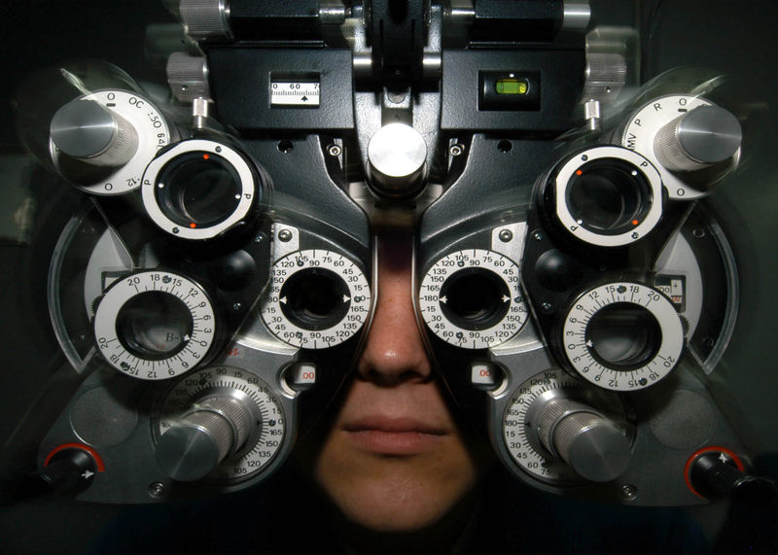
SFVSC T-shirt

Slide 3
Student Success: Culture—Surface Attributes (“Observable Culture”)
Physical Setting
Those things that physically surround people and provide them with immediate sensory stimuli as they carry out culturally expressive activities
Artifacts
Material objects manufactured by people to facilitate culturally expressive activities
Language
A particular manner in which members of a group use vocal sounds and written signs to convey meanings to each other
Gesture
Movements of parts of the body used to express meanings
Symbol
Any object, act, event, quality, or relation that serves as a vehicle for conveying meaning, usually representing another thing
Story
A narrative based on true events—often a combination of truth and fiction

Slide 4
Student Success: Culture—Sub-Surface Attributes (“Core Culture”)
Legend
A handed-down narrative of some wonderful event that has a historical basis but has been embellished with fictional details
Folk-tale
A completely fictional narrative
Myth
A dramatic narrative of imagined events, usually used to explain origins or transformations of something. Also, an unquestioned belief about the practical benefits of certain techniques and behaviors that is not supported by demonstrated facts
Ritual
A standardized, detailed set of techniques and behaviors that manages anxieties but seldom produces intended, practical consequences of any importance
Rite
A relatively elaborate, dramatic, planned set of activities that combines various forms of cultural expression and that often has both practical and expressive consequences

Slide 5
Physical Setting Those things that physically surround people and provide them with immediate sensory stimuli as they carry out culturally expressive activities

Slide 6
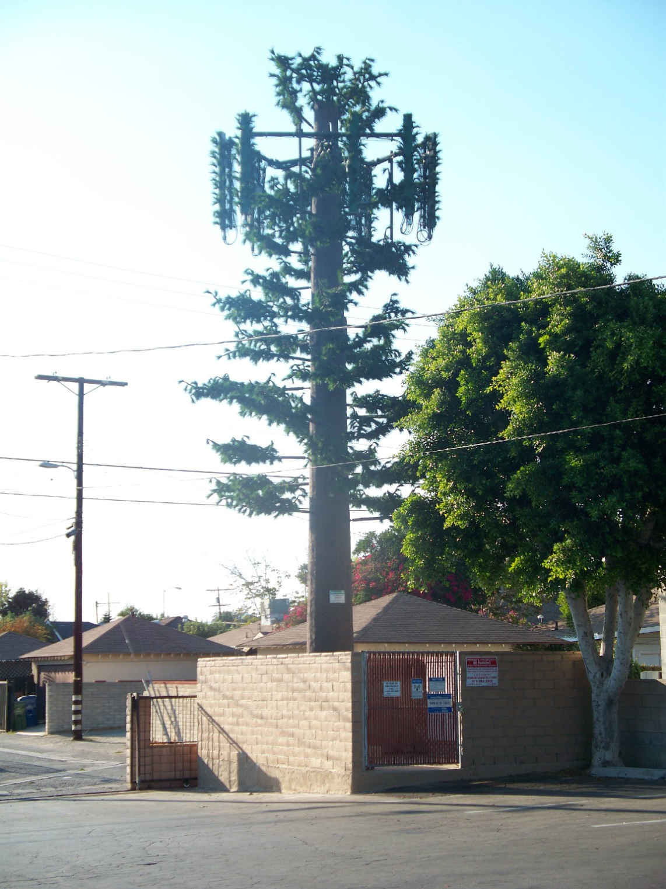
Cell Tower – “hidden” infra.

Slide 7
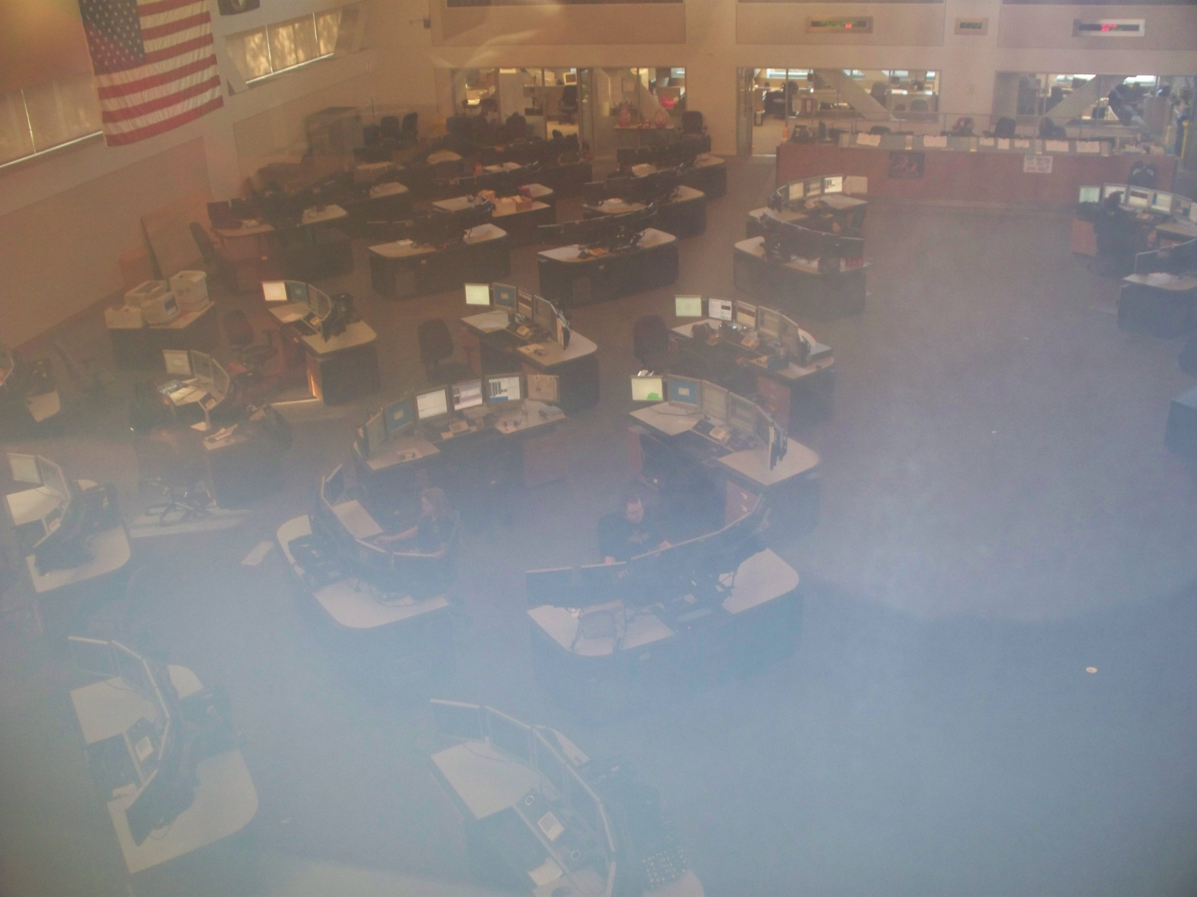
LAPD Disp. - wide

Slide 8
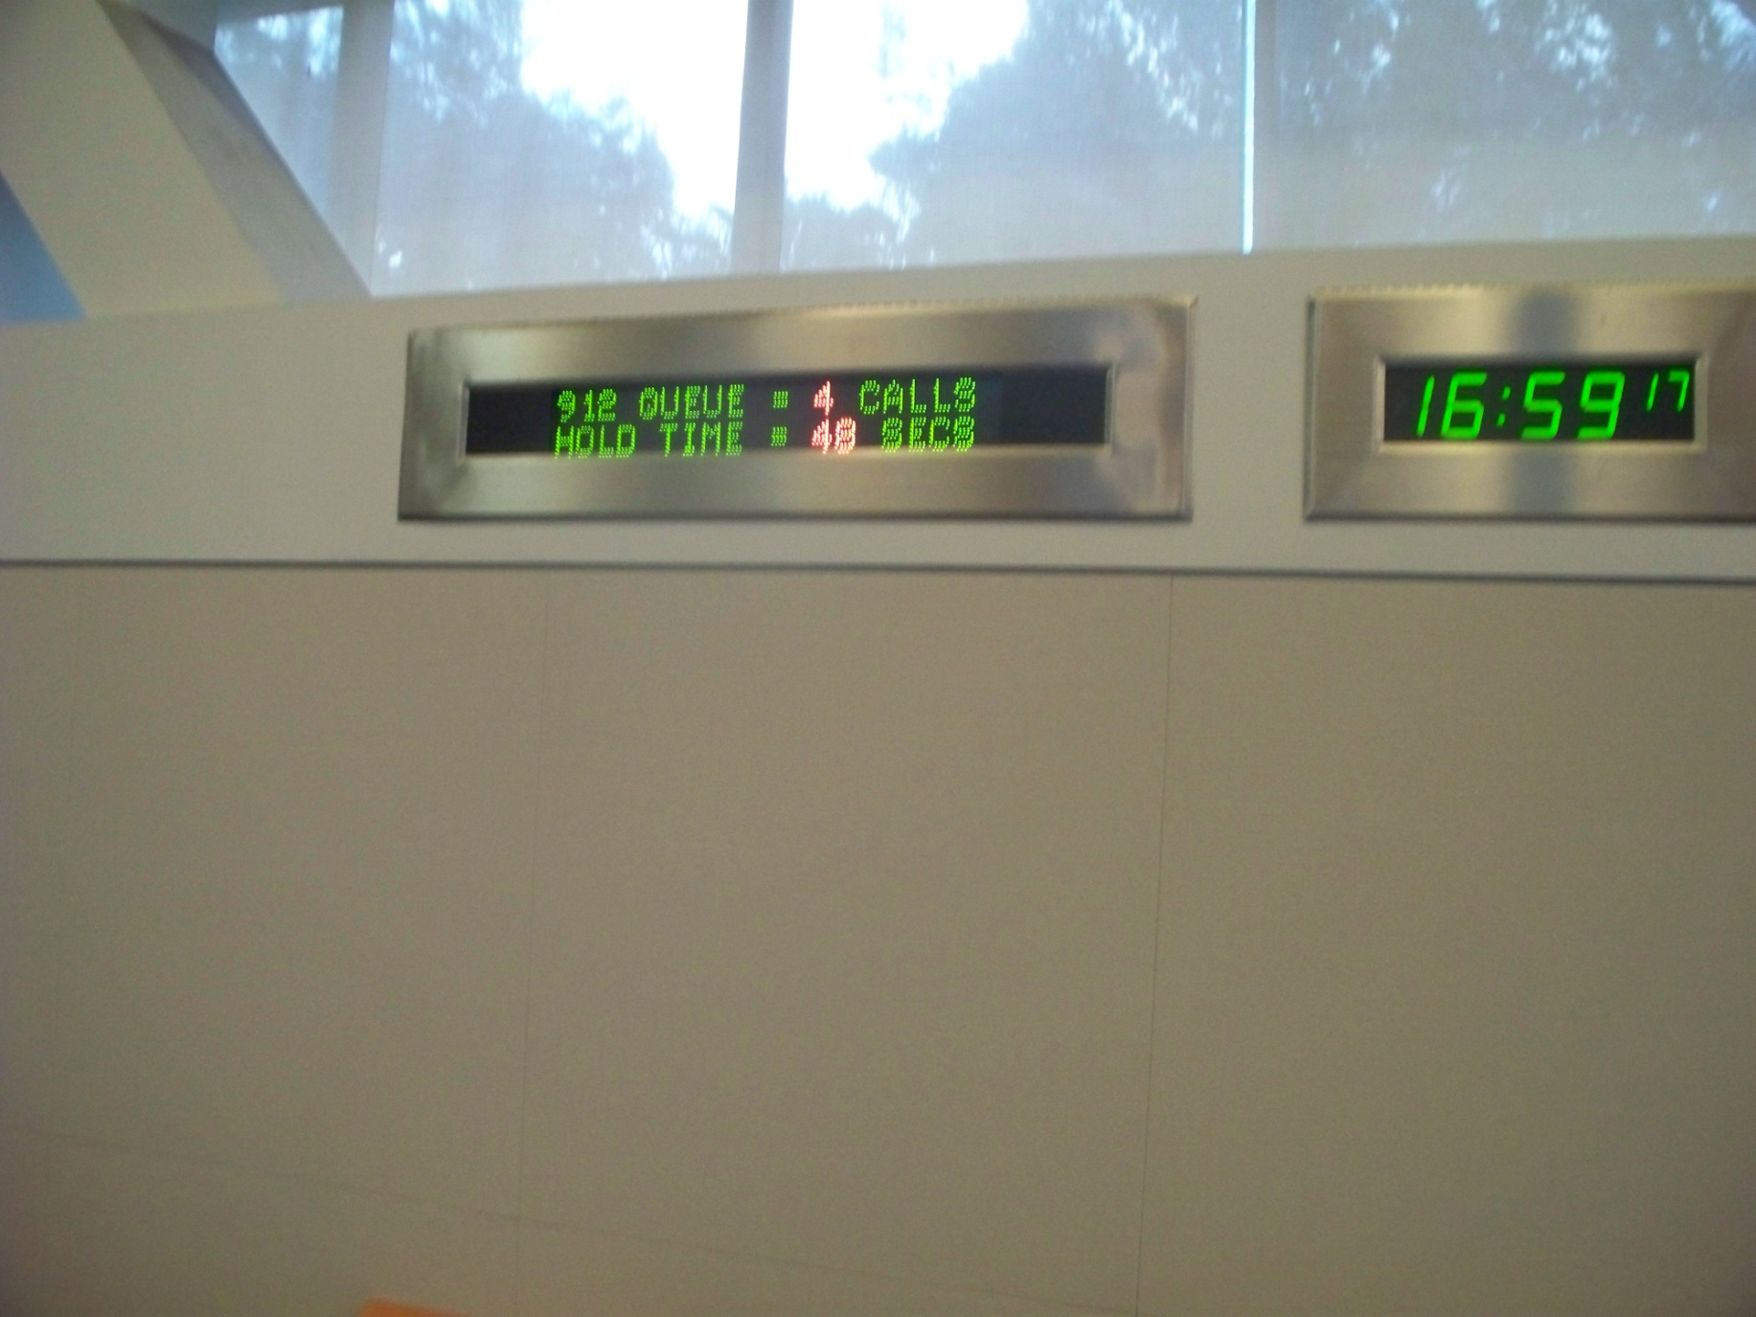
LAPD Disp. - scores

Slide 9
Artifacts Material objects manufactured by people to facilitate culturally expressive activities

Slide 10
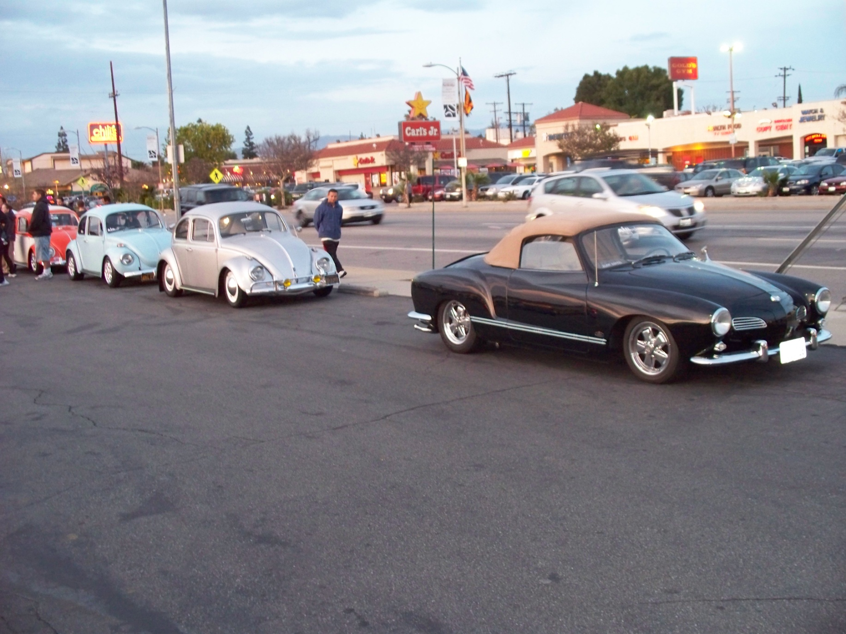
VW car club

Slide 11
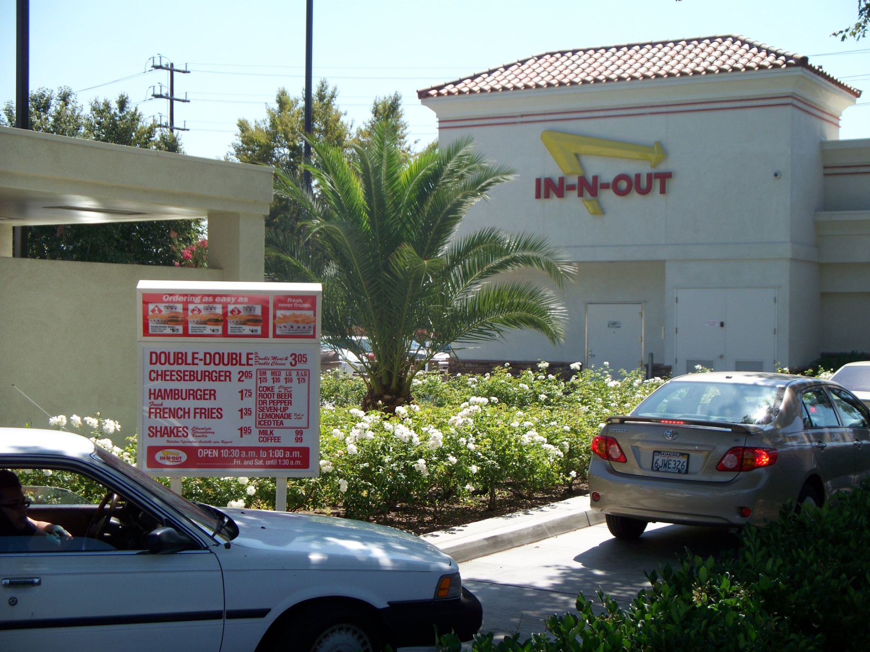
In N Out burger -wide

Slide 12
Language A particular manner in which members of a group use vocal sounds and written signs to convey meanings to each other

Slide 13
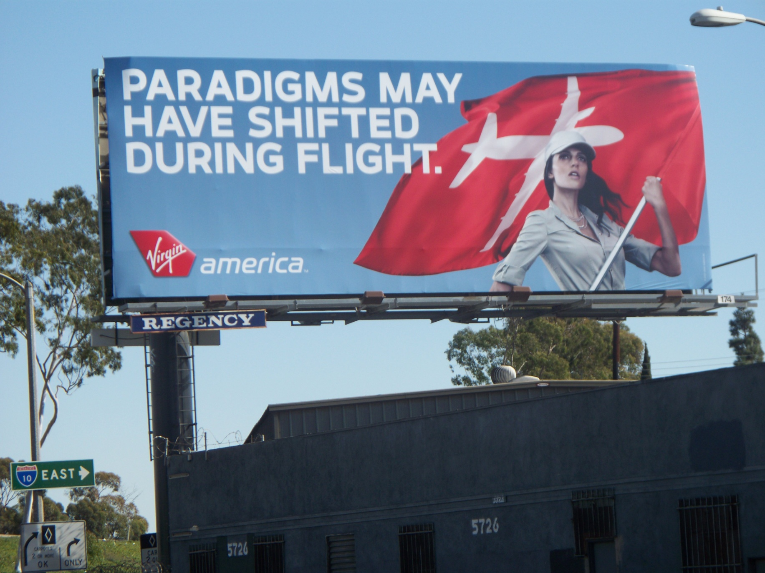
Semantics – “Paradigm”

Slide 14
Semantics – FAA “customers”

Slide 15
Gesture Movements of parts of the body used to express meanings

Slide 16
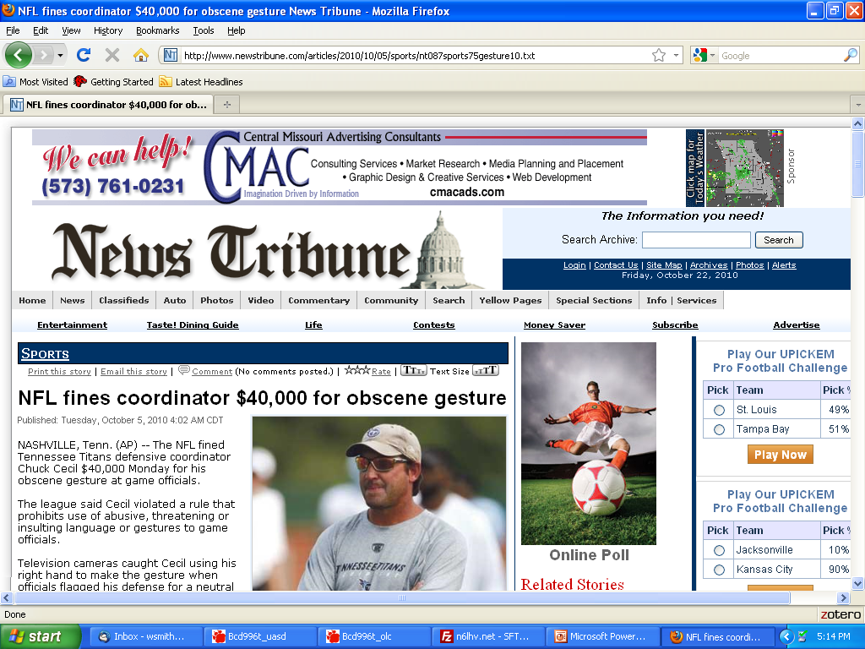

Slide 17
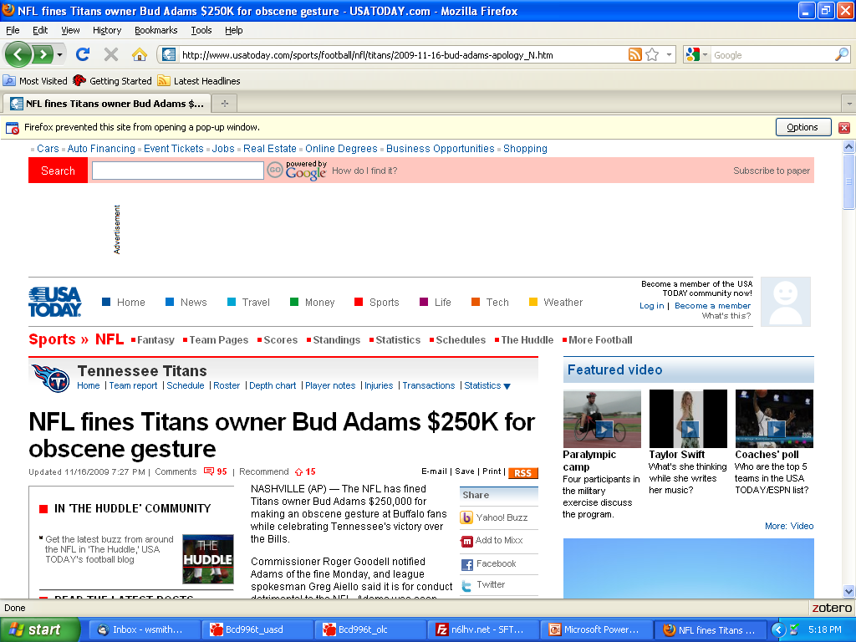

Slide 18
Symbol Any object, act, event, quality, or relation that serves as a vehicle for conveying meaning, usually representing another thing

Slide 19
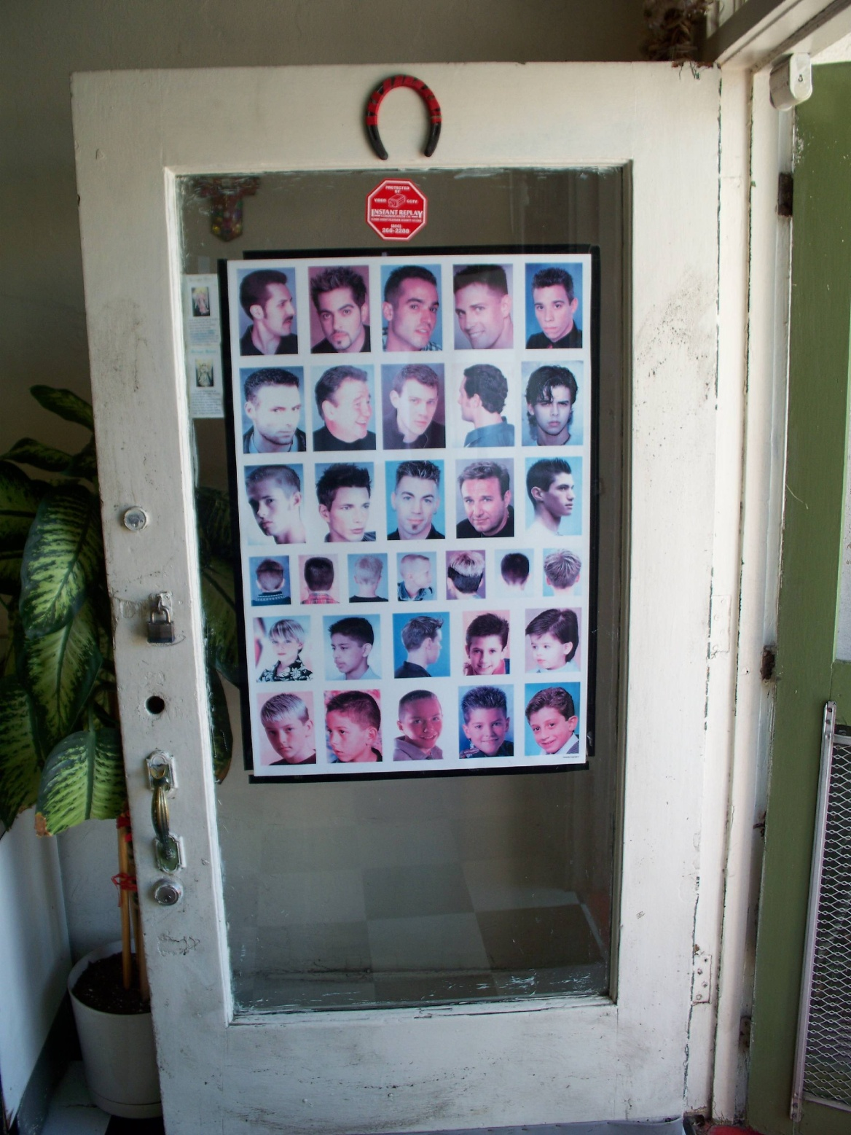
Upside-down horseshoe

Slide 20
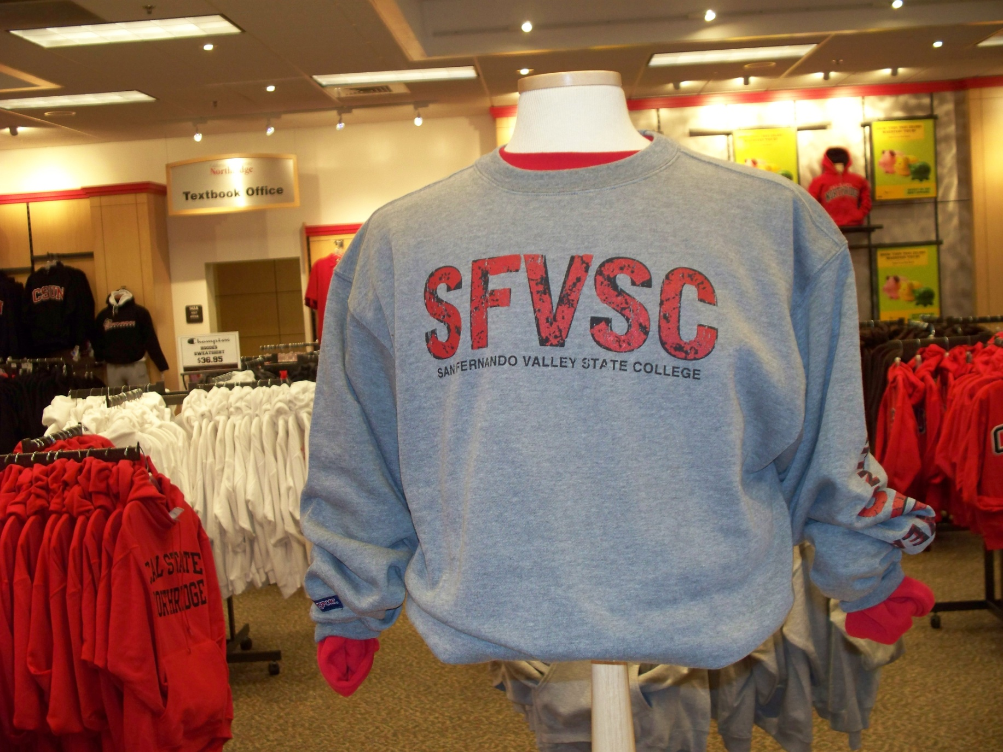
SFVSC T-shirt

Slide 21
Story A narrative based on true events—often a combination of truth and fiction

Slide 22
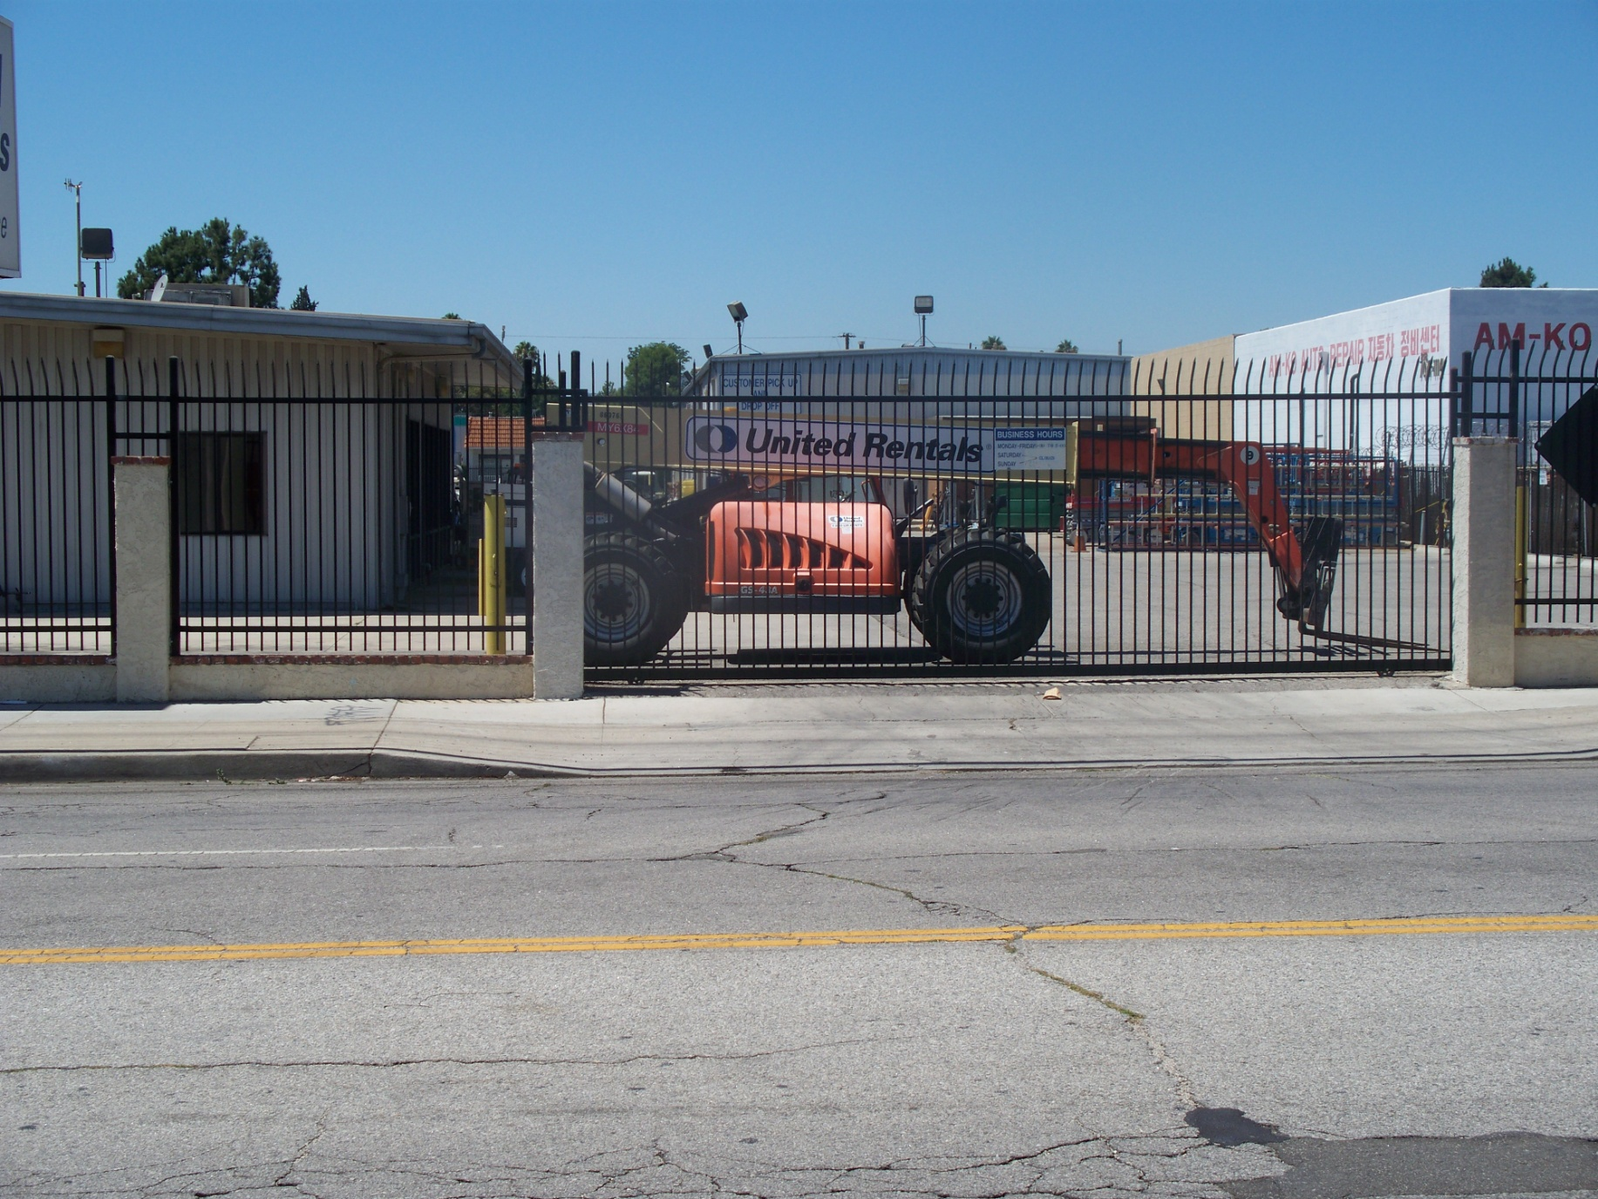
Culture – United Rentals - 2

Slide 23
Legend A handed-down narrative of some wonderful event that has a historical basis but has been embellished with fictional details

Slide 24
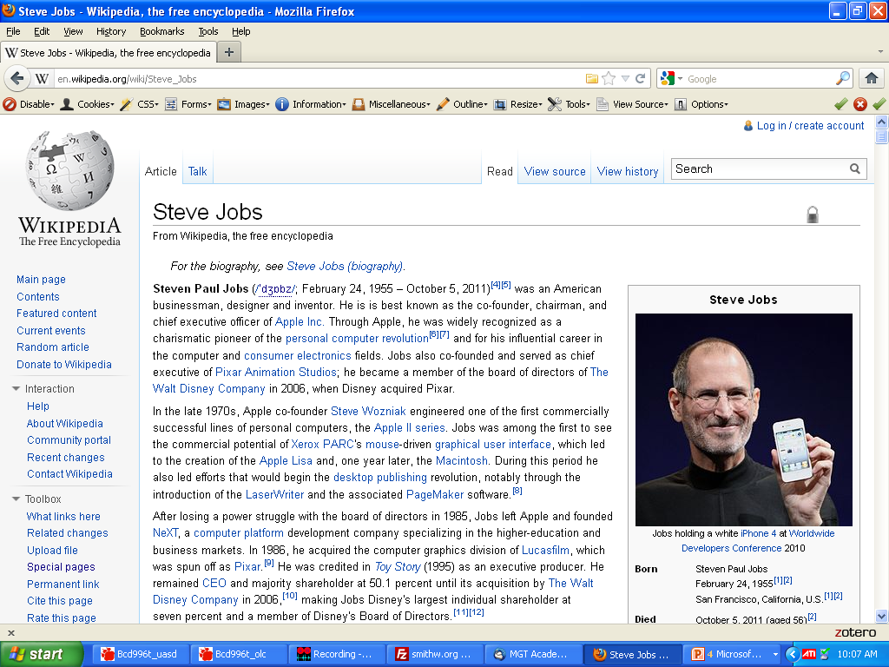
Culture – United Rentals - 2

Slide 25
Folk-tale A completely fictional narrative

Slide 26
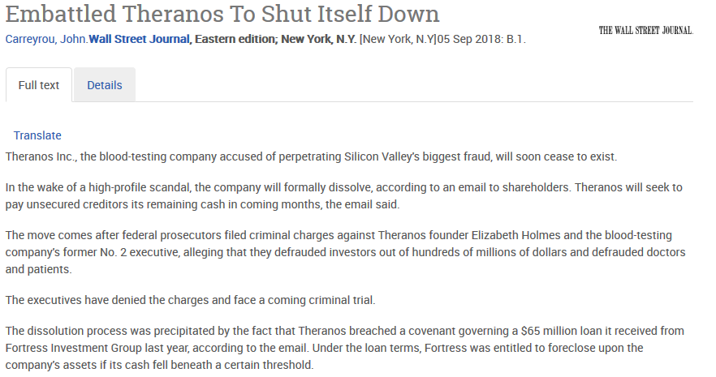
Culture – United Rentals - 2

Slide 27
Myth A dramatic narrative of imagined events, usually used to explain origins or transformations of something. Also, an unquestioned belief about the practical benefits of certain techniques and behaviors that is not supported by demonstrated facts

Slide 28
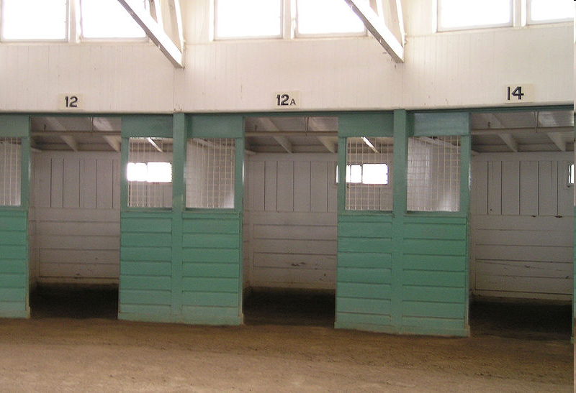
Santa Anita – missing #13

Slide 29
Ritual A standardized, detailed set of techniques and behaviors that manages anxieties but seldom produces intended, practical consequences of any importance

Slide 30
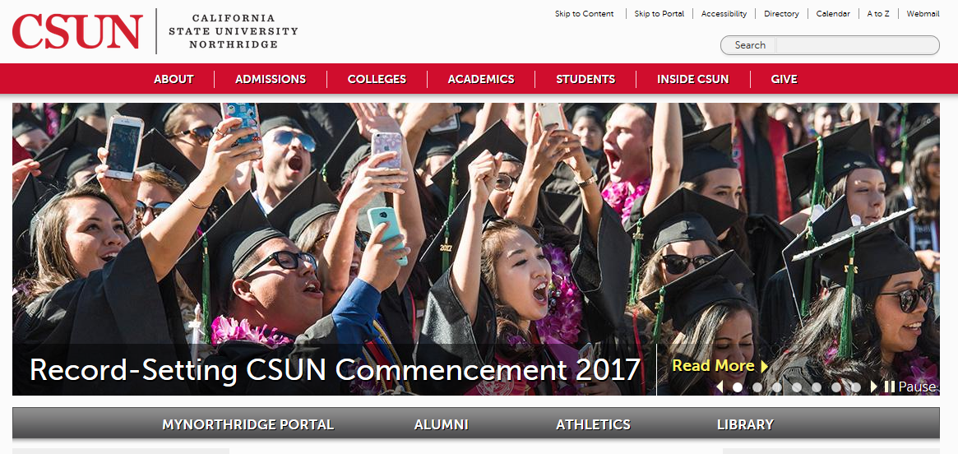
Santa Anita – missing #13

Slide 31
Rite A relatively elaborate, dramatic, planned set of activities that combines various forms of cultural expression and that often has both practical and expressive consequences

Slide 32
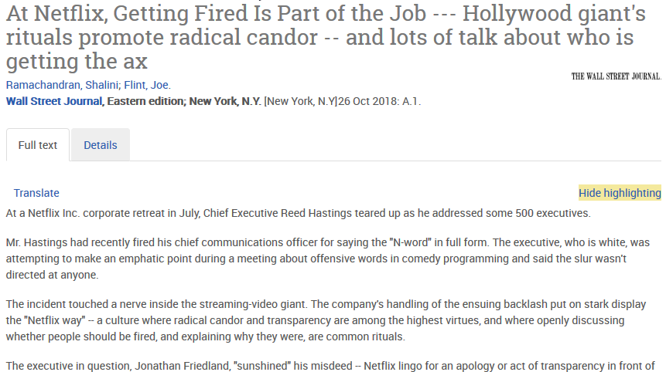
Santa Anita – missing #13

Slide 33
Sources
This presentation is adapted from the following article:
Beyer, J., and Trice, H. (1987), “How an Organization’s Rites Reveal Its Culture”, Organizational Dynamics

