Slide 1
Additional (more subtle) aspects of Organizational Culture
Organizational culture is the cumulative sum of individual culture
Wayne Smith, Ph.D.
Department of Management
CSU Northridge

Slide 2
Remember: Organizational culture is the cumulative sum of individual culture

Slide 3
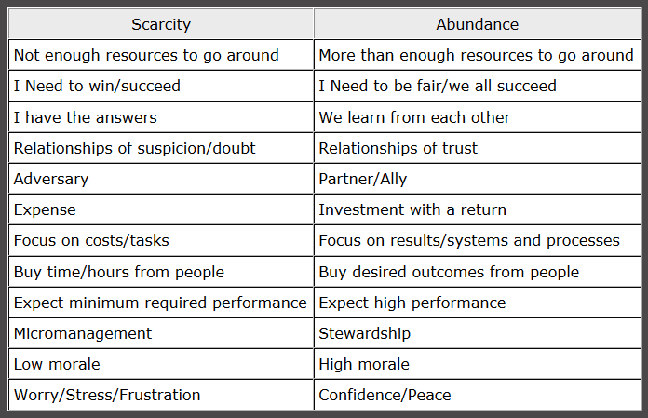
“Scarcity” Mindset vs. “Abundance” Mindset

Slide 4
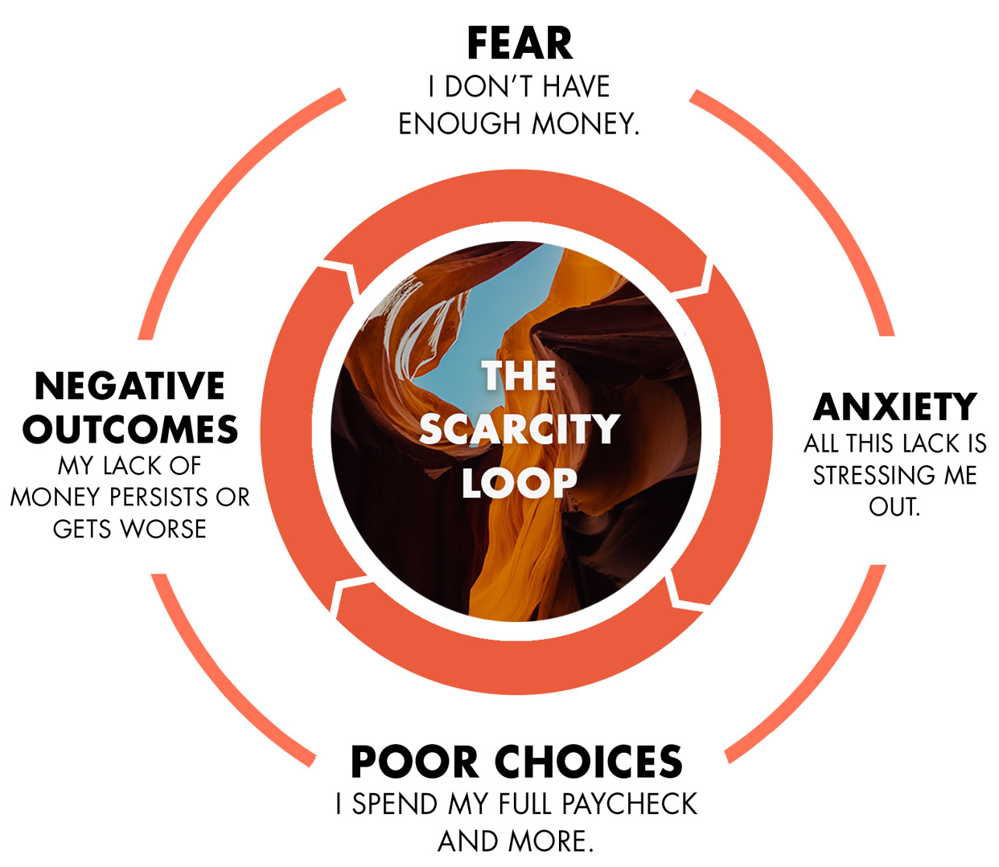
“Scarcity” Mindset vs. “Abundance” Mindset (Negative Loop)

Slide 5
“Scarcity” Mindset vs. “Abundance” Mindset (Positive Loop)

