Slide 1
A Prelude to Behaviorism
(or, “American Economic History in one lecture”)
Wayne Smith, Ph.D.
Department of Management
CSU Northridge

Slide 2


Slide 3
The Fall of the Roman Empire
“Management” Dimension | Example Characteristic
Planning | Increasing urbanization operates very differently than agriculture Formal processes doesn’t always guarantee cultural integration
Leading | Emperors learned the hard way about keeping friends close and keeping enemies closer
Organizing | Learned the hard way about the limits of centralized rule Outsourcing military engagement to mercenaries is not sustainable
Controlling | Couldn’t manage inflation of increasingly non-silver coins Couldn’t manage increasingly far-flung borders

Slide 4
Etymology of “Management”
The “Agrarian revolution” preceded the “Industrial” Revolution
The earliest organizations were farms (zoo)
The most important animal on the farm (organization) is the horse (professional). A human (manager) is in charge
The English word “manage” is derived from the Italian word (maneggiare) for handling a horse which in turn is derived from the Latin word (manus) for “hand”, or in the context of management and leadership, “to lead…by hand.”
  Source: Oxford English Dictionary
How did we get to where we are now?...and how will you get to where you’ll be in the future (i.e., your professional life)?

Slide 5
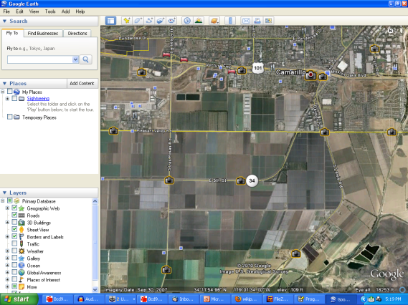
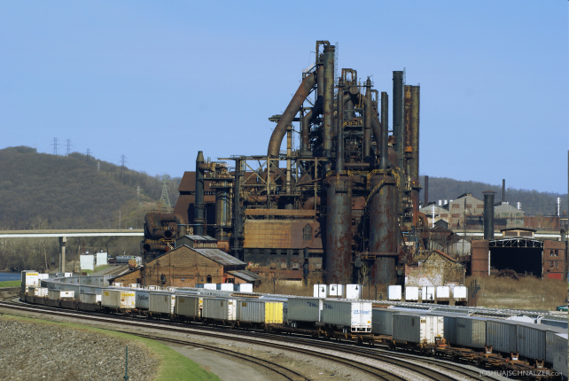
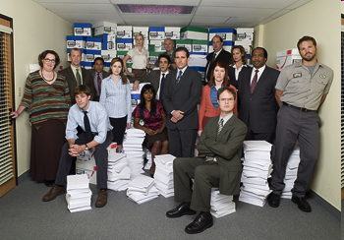
Transitions since ~1875
Agricultural
Economy
Manufacturing
Economy
Service
Economy

Slide 6
Management Transitions
 | Agriculture | Manufacturing | Service
Planning | weather | adapt to markets and economies | predict change in labor and capital
Leading | by land size | extrinsic needs | intrinsic needs
Organizing | cooperatives/ guilds/family/ children | mostly hierarchies (one-to-many) | mostly networks (many-to-many)
Controlling | physical distance/ no other choices | wage/piecework/choice between factory work and school | salary/bonus/ feedback/ continuous learning

Slide 7
1875
1900
1925
1950
1975
2000
2025
2050
Transition
  Agricultural → Manufacturing
Key Trends in (Social) Labor
  Immigration (especially from Europe)
  Urbanization (in large cities)
  Public Education (K-12)
Key Trends in (Economic) Capital
  Division of Labor
    Optimize for efficiency by concentrating resources in a firm within a sector
    Specialization → Coordination
  Industrial Machines
    Large-scale plant and equipment for mass production
    Standardization → Training/Education
    Productivity → Motivation/Incentives
  Financial Markets
    The sale price for a crop is set before it is sowed; Stocks sold to investors
    Forecasting → Decision-making, Strategy
Impact on Management (Classical Approaches)
  How do we do the thing right (efficiency)?
  Scientific Management, Administrative Principles, Bureaucratic Org.’s

Slide 8
1875
1900
1925
1950
1975
2000
2025
2050
Transition
  Manufacturing → Service
Key Trends in (Social) Labor
  Gender (females in the workforce)
  Public Education (college and diversity)
  Professional Careers (including certifications)
Key Trends in (Economic) Capital
  Scope of Goods and Services
    Global Markets (employees, customers, and suppliers)
    Diversity → Culture
  Scale of Firms
    Optimize for stability in large organizations
    Size → Leadership
    Complexity → Control Systems
  Careers
    “Specialist Professionals” professionals and “Generalist Managers”
    Workplace livelihood → Human Resources/Organizational Design
Impact on Management (Behavioral Approaches)
  How do we do the right thing (effectiveness)?
  Communities/Human Needs, Personality/Adult Learning, Theory X/Y

Slide 9
1875
1900
1925
1950
1975
2000
2025
2050
Transition
  Service → ?
Key Trends in (Social) Labor
  “Surrogate” family
  Even more Diversity
Key Trends in (Economic) Capital
  Knowledge Complexity
    Cooperation → Teams
    Negotiation → Conflict Resolution
  Environment, Sustainability, and Governance
    Accountability → Ethics, Corporate Social Responsibility
  Rapid Change
    Continuous Innovation → Communication
Management Science (Operations Research) Approach
  Can we model (first we analyze, and then we automate) all inputs, processes, and outputs (i.e., optimize one or more processes)?
Contingency Approach
  We focus on the behavioral approach…but the “dirty little secret” is…
  Successful managers apply all of these management approaches as needed to best effect an organizational outcome

Slide 10
The New “Industrial” Revolution
(hint: these positions all need management)
15 California Community Colleges plan to offer Bachelor’s Degrees beginning in Fall, 2017.
Airframe manufacturing technology, Antelope Valley College
Industrial automation, Bakersfield College
Emergency services and allied health systems, Crafton Hills College
Mortuary science, Cypress College
Equine industry, Feather River College
Dental hygiene, Foothill College and West Los Angeles College
Bio-manufacturing, Mira Costa College
Respiratory care, Modesto Junior College and Skyline College
Automotive technology, Rio Hondo College
Health information management, Mesa College
Occupational studies, Santa Ana College
Interaction design, Santa Monica College
Health information management, Shasta College

Slide 11
Personal Competencies for Professional Success
Lominger Standard — 67 competencies
Action Oriented; Dealing with Ambiguity; Approachability; Boss Relationships; Business Acumen; Career Ambition; Caring About Direct Reports; Comfort Around Higher Management; Command Skills; Compassion; Composure; Conflict Management; Confronting Direct Reports; Creativity; Customer Focus; Timely Decision Making; Decision Quality; Delegation; Developing Direct Reports and Others; Directing Others; Managing Diversity; Ethics and Values; Fairness to Direct Reports; Functional/Technical Skills; Hiring and Staffing; Humor; Informing; Innovation Management; Integrity and Trust; Intellectual Horsepower; Interpersonal Savvy; Learning on the Fly; Listening; Managerial Courage; Managing and Measuring Work; Negotiating; Organizational Agility; Organizing; Dealing With Paradox; Patience; Peer Relationships; Perseverance; Personal Disclosure; Personal Learning; Perspective; Planning; Political Savvy; Presentation Skills; Priority Setting; Problem Solving; Process Management; Drive for Results; Self-Development; Self-Knowledge; Sizing Up People; Standing Alone; Strategic Agility; Managing Through Systems; Building Effective Teams; Technical Learning; Time Management; Total Work Systems; Understanding Others; Managing Vision and Purpose; Work/Life Balance; Written Communication

Slide 12
Personal Competencies for Managerial Success
All competencies are important, but a few competencies characterize the key differences between professionals and managers. These are relatively indifferent to country, economy, industry, firm, salary, rank, seniority, etc.
Ethics and Values; Integrity and Trust; Compassion; Managing Diversity;
  Successful managers know that trust is the true organizational currency.
Action Oriented; Command Skills; Managerial Courage; Standing Alone;
  Successful managers shrewdly demonstrate a bias towards action.
Interpersonal Savvy; Organizational Agility; Political Savvy; Creativity;
  Successful managers have behavioral flexibility to adapt to reach any goal.
Developing Relationships with Bosses, Direct Reports, and Peers;
  Successful managers are constantly cultivating and nurturing relationships.
Managing Through Systems; Personal Learning;
  Successful managers are the best at self-initiated learning, and the best at visualizing invisible structures in entire organizational ecosystems.
Tolerance for Ambiguity; Dealing With Paradox; Conflict Management;
  Successful managers thrive in environments of uncertainty.
  e.g, Non-routine decision-making; unclear goals, tasks, and outcomes; role conflict

Slide 13
A Story
I have a friend…

Slide 14
Figure 1.5 Four functions of management

Slide 15
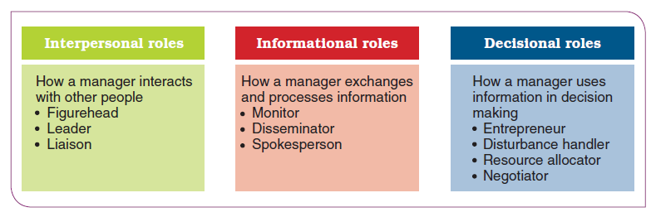
Mintzberg’s 10 Managerial Roles

Slide 16
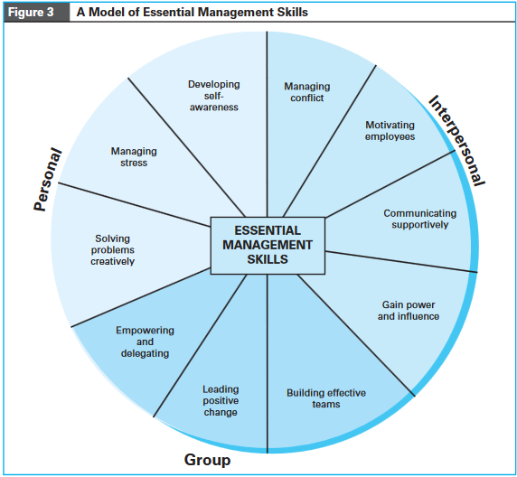
Tolerance for Ambiguity
(How do we deal with it?)

Slide 17
References
The “Professional Competencies” were adapted and excerpted from the “Lominger Standards” (now owned by Korn-Ferry International) :
  https://www.udemy.com/blog/lominger-competencies/
The “Mintzberg’s 10 Managerial Roles” and “Organizations” slides were excerpted from:
  Schermerhorn, J., and Bachrach, D. (2015) Management Skills 13th ed., Wiley.
The “Tolerance for Ambiguity” slides were excerpted from:
  Whetton, D., and Cameron, K. (2011) Developing Management Skills 8th ed., Pearson.

