Slide 1
Management of Emerging Technology and Your Career
How do you earn a place at the Technology and Strategy decision-making table?
Wayne Smith, Ph.D.
Department of Management
CSU Northridge

Slide 2
Our Course
Management of
Planning, Leading, Organizing, Controlling
Emerging
Novel, State-of-the-art, Long-term, Organic
Technologies
“Technology is the application of knowledge for achieving practical goals in a reproducible way.” (Wikipedia)

Slide 3
Big wins

Slide 4
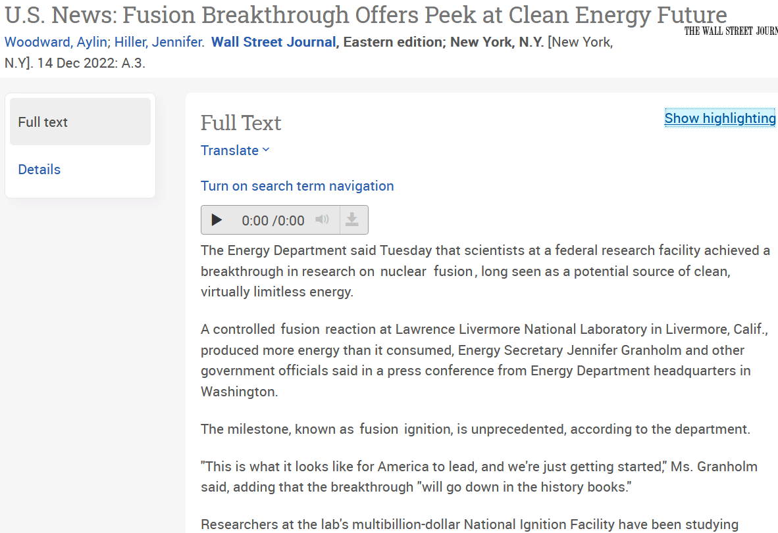

Slide 5
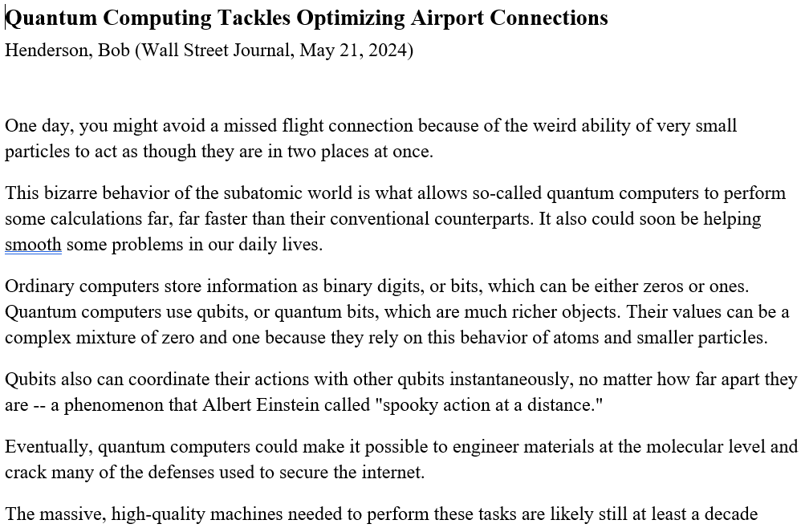

Slide 6
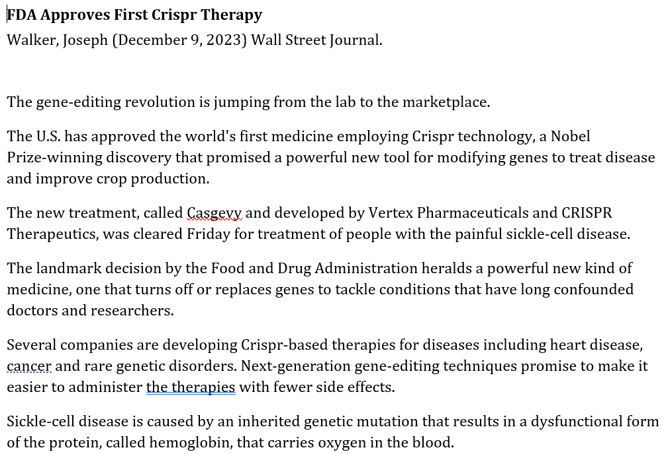

Slide 7
Small Wins are just fine too

Slide 8
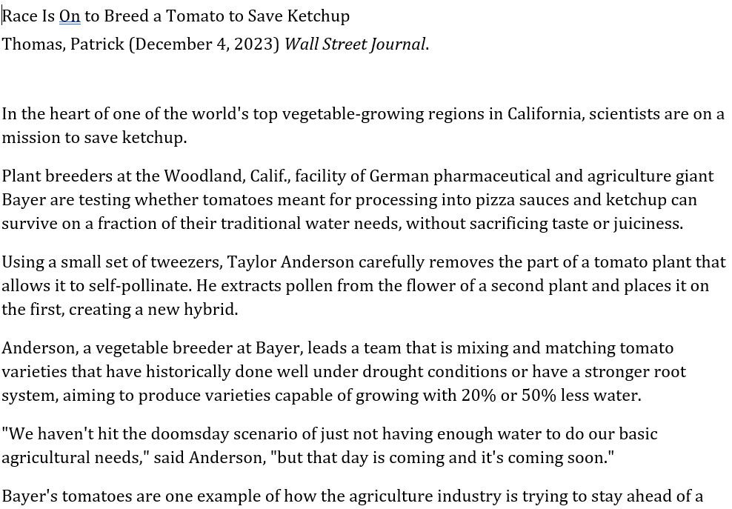

Slide 9
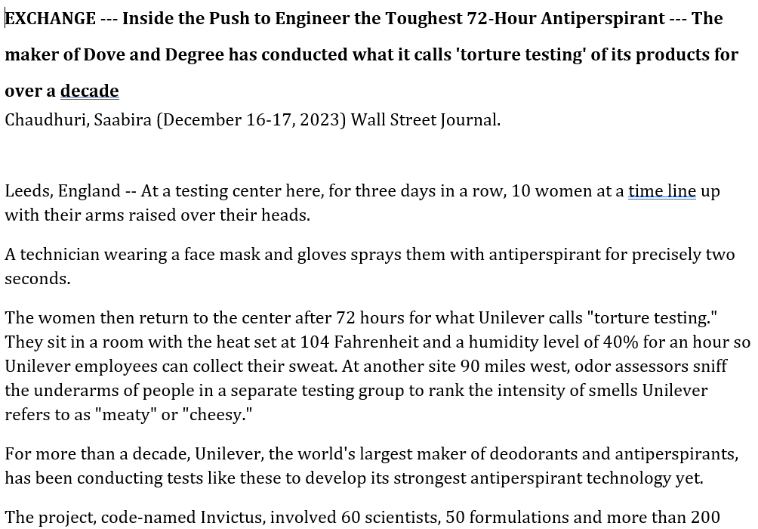

Slide 10
Innovation

Slide 11
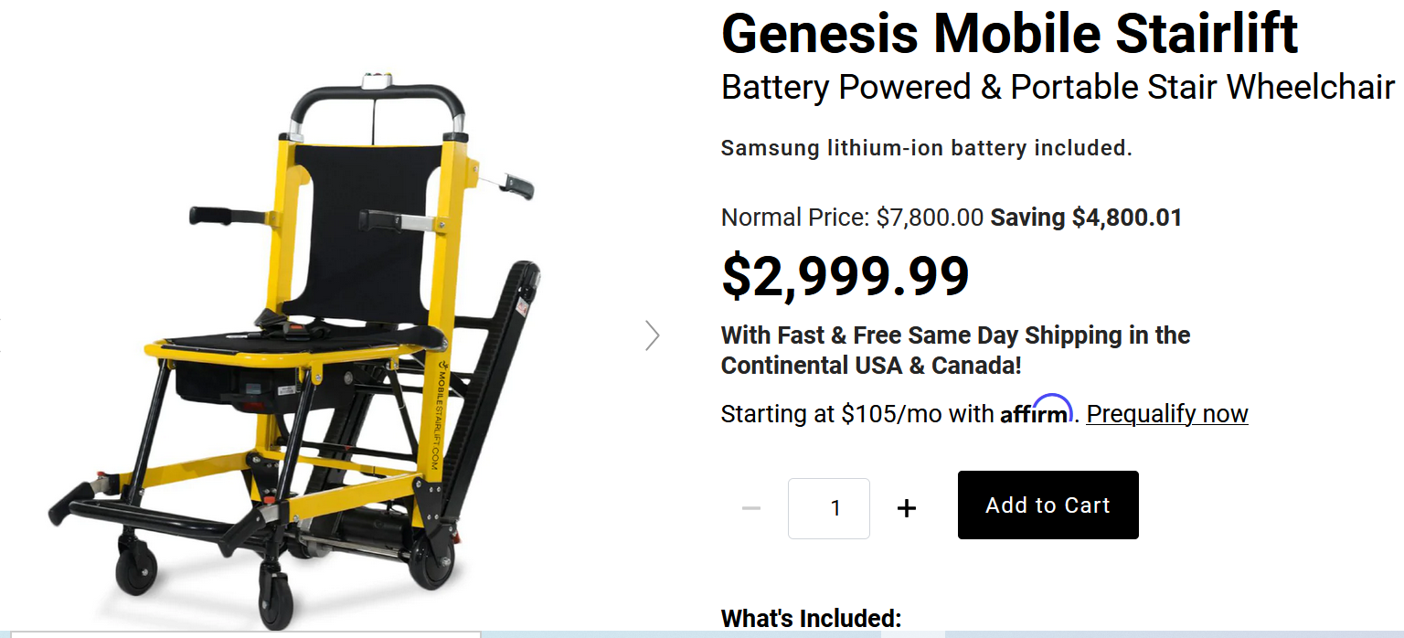

Slide 12
Nothing is off limits in this course

Slide 13
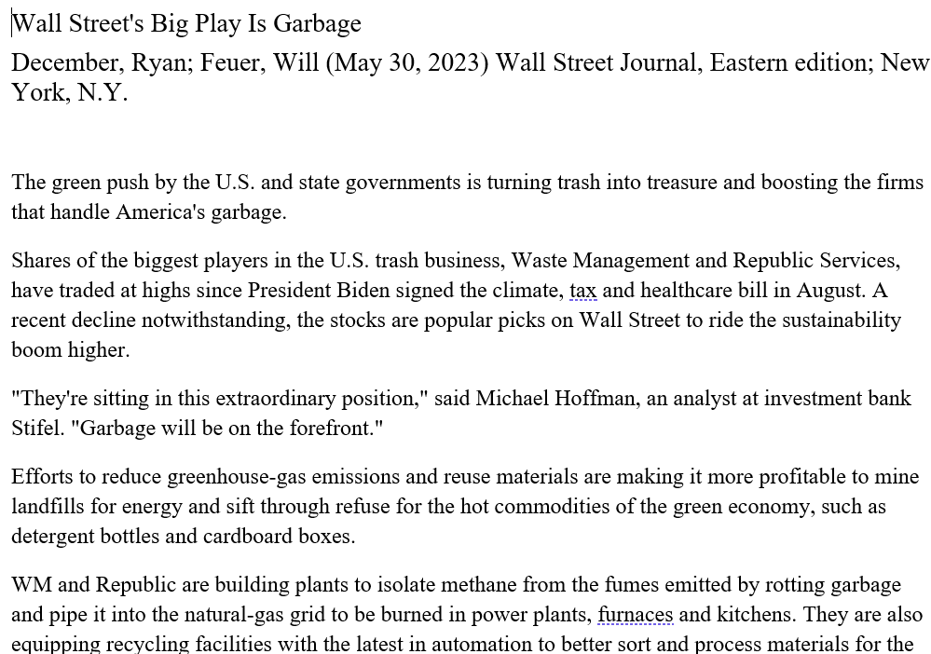

Slide 14
Scale

Slide 15
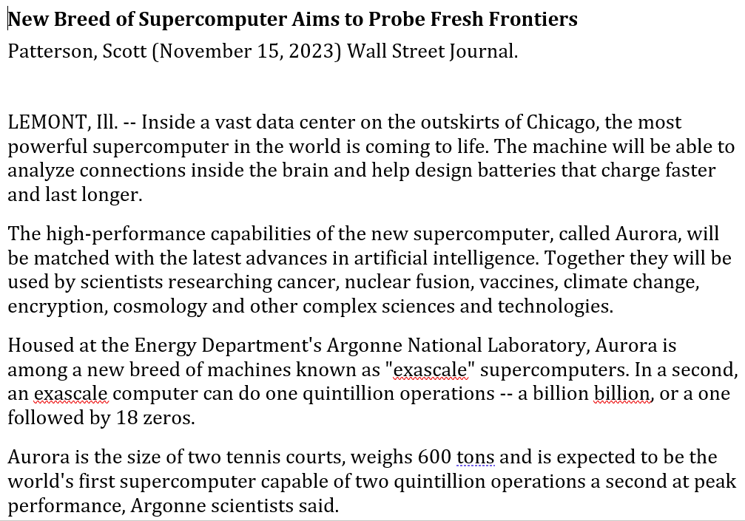

Slide 16
Marketing

Slide 17
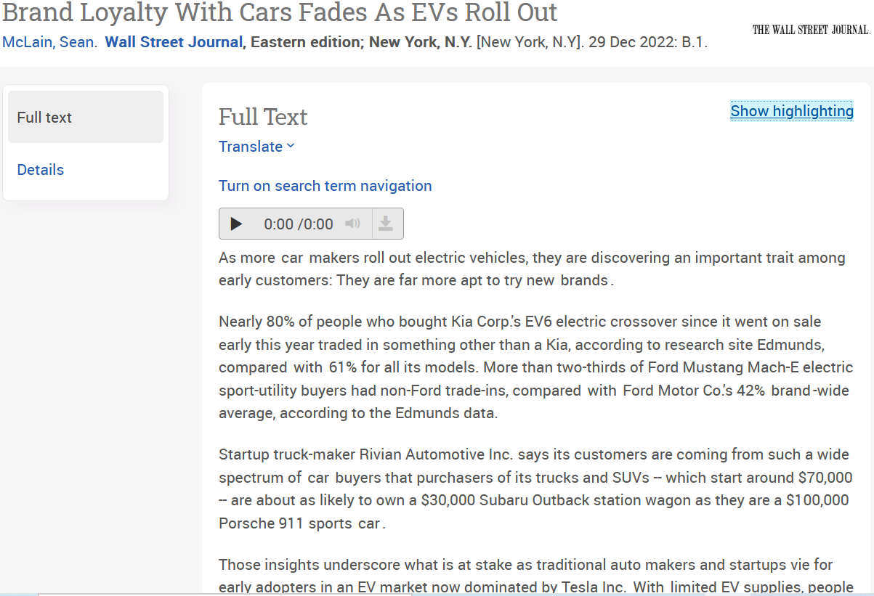

Slide 18
Medical

Slide 19
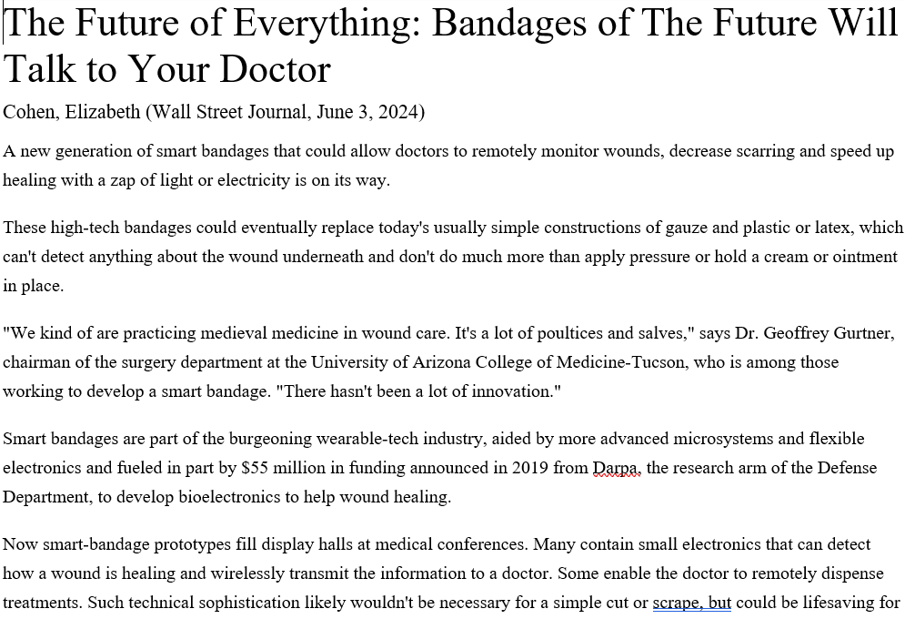

Slide 20
Supply- and Distribution-Chains

Slide 21
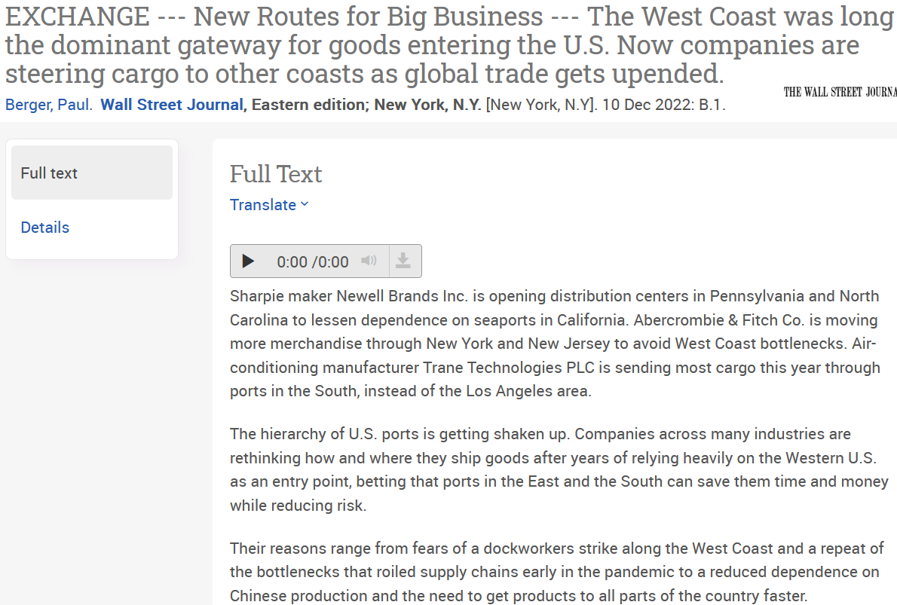

Slide 22
Scientific Learning

Slide 23
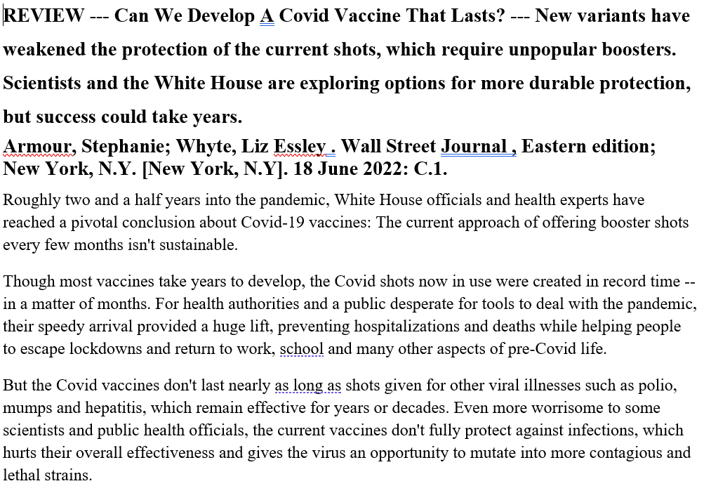

Slide 24
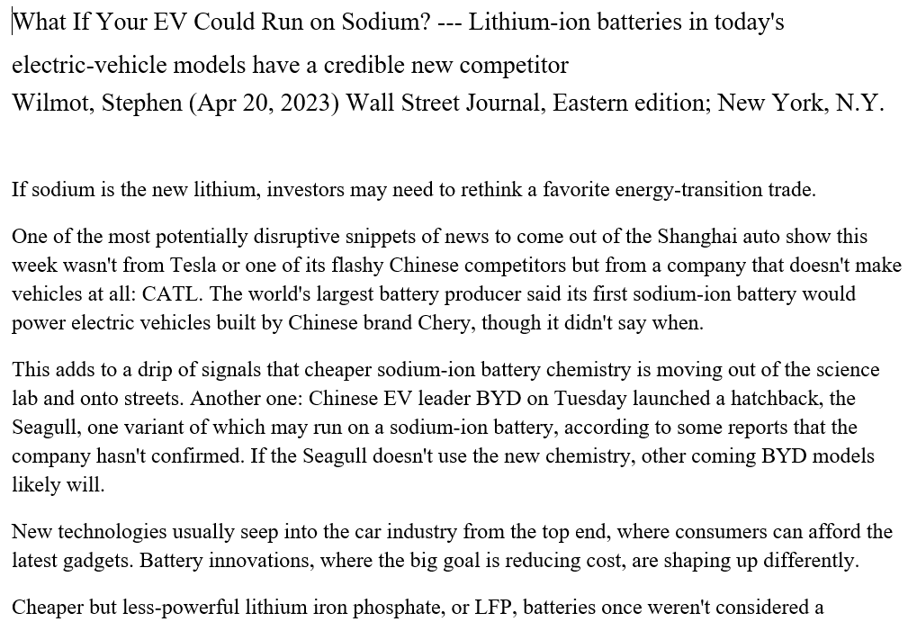

Slide 25
Engineering (“stacks/dependencies”)

Slide 26
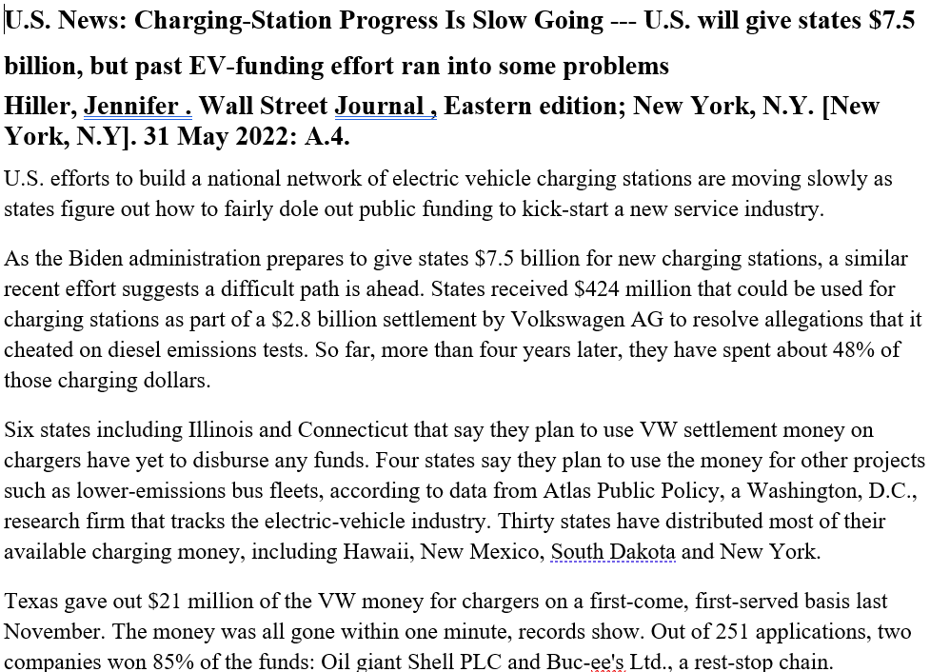

Slide 27
Product Timing

Slide 28
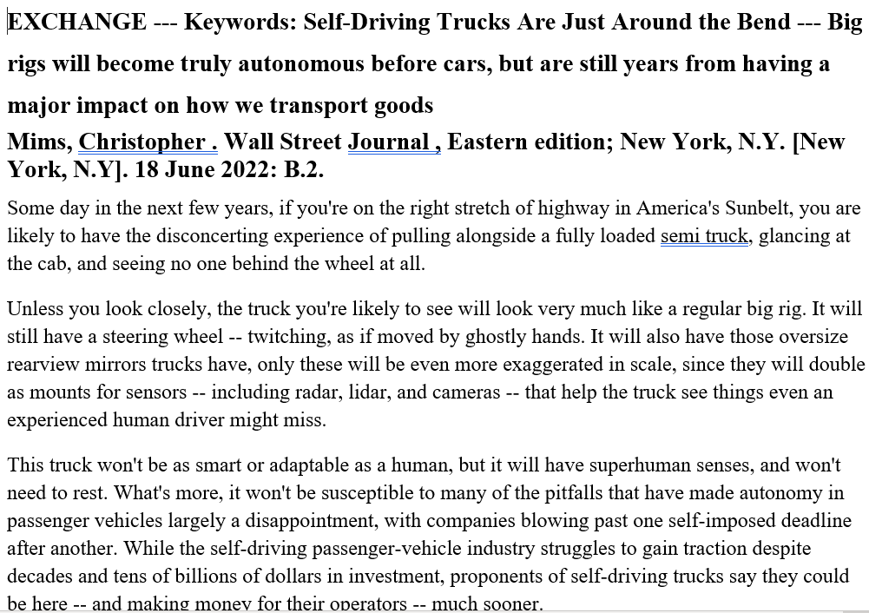

Slide 29
Product Change

Slide 30
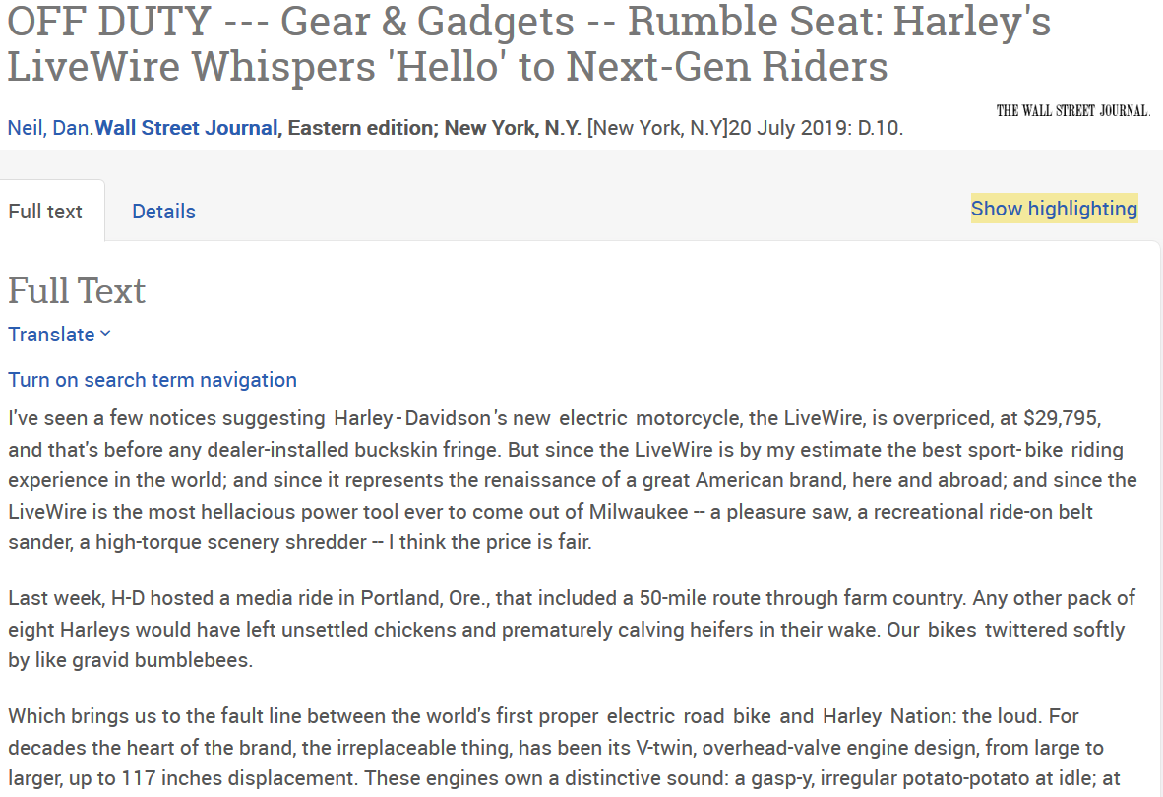

Slide 31
Process Change

Slide 32
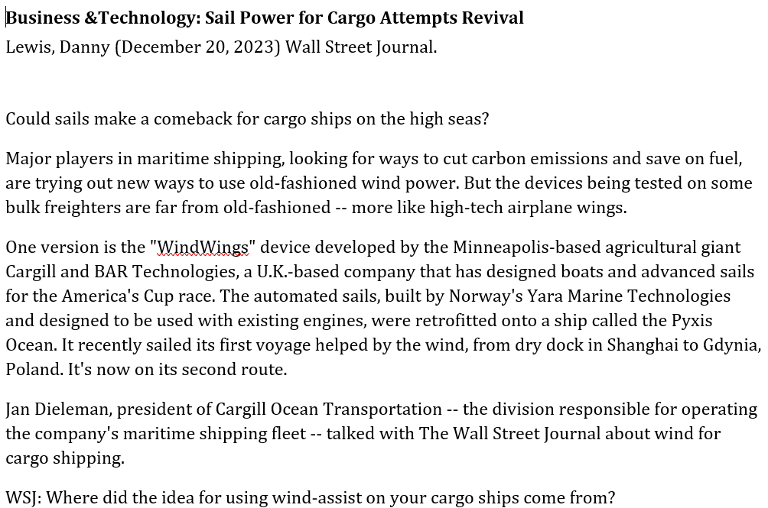

Slide 33
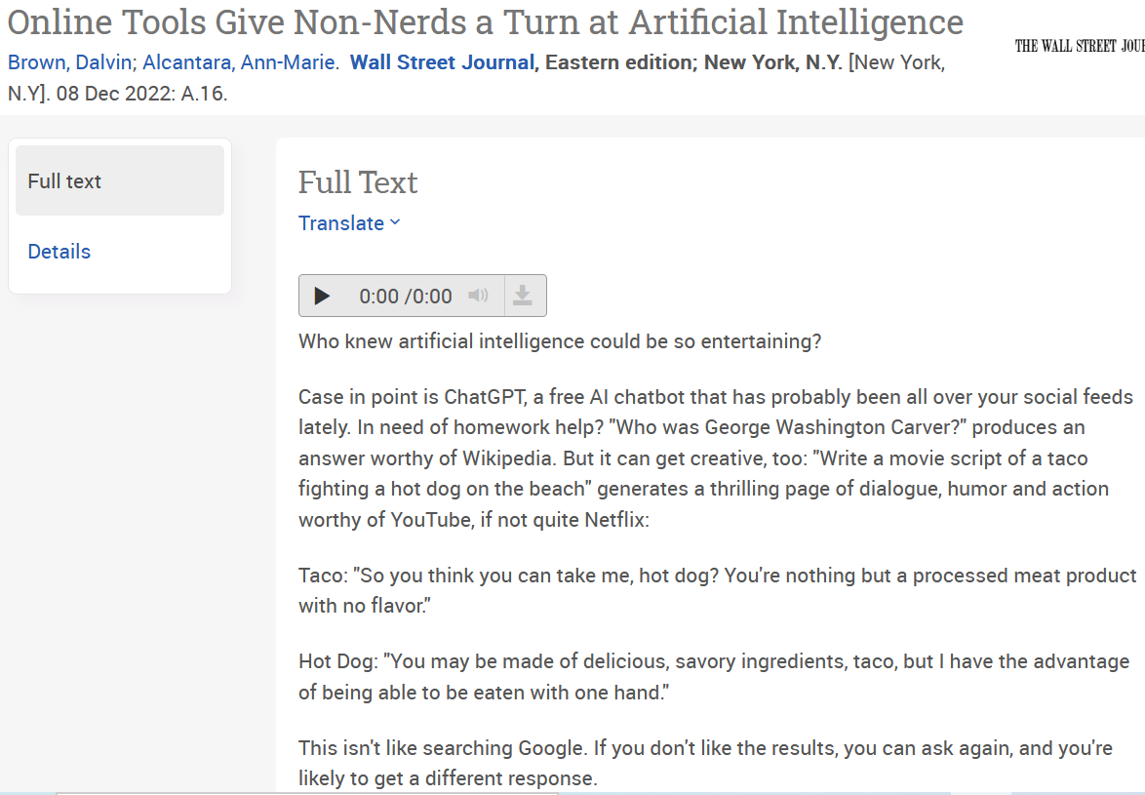

Slide 34
Entrepreneurship

Slide 35
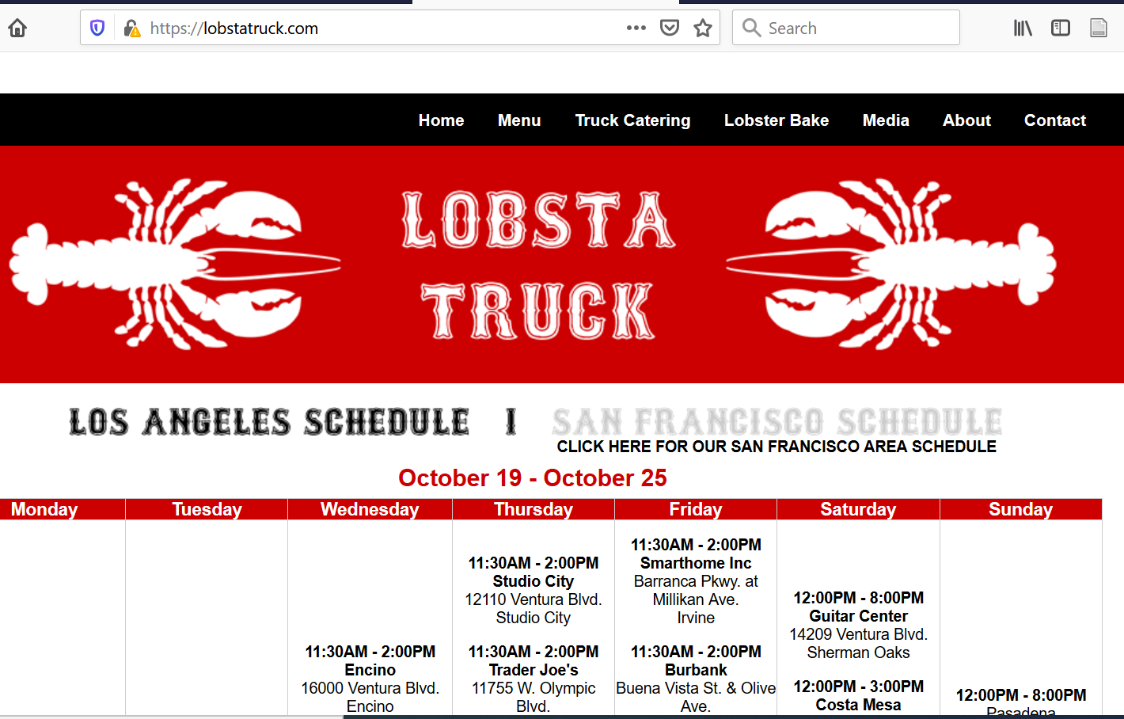

Slide 36
Sustainability

Slide 37
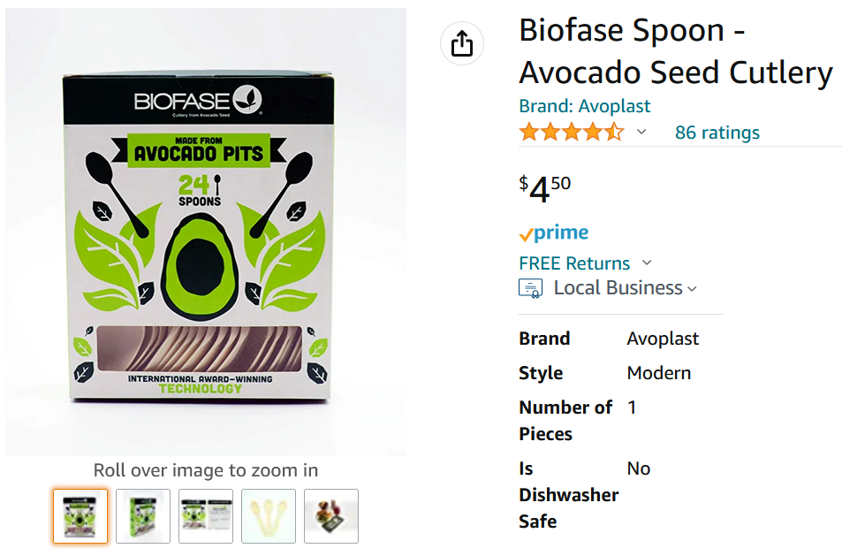

Slide 38
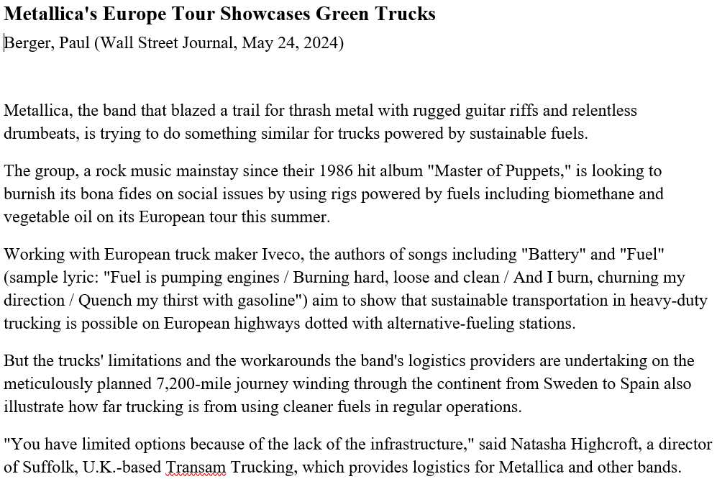

Slide 39
Business and Society

Slide 40
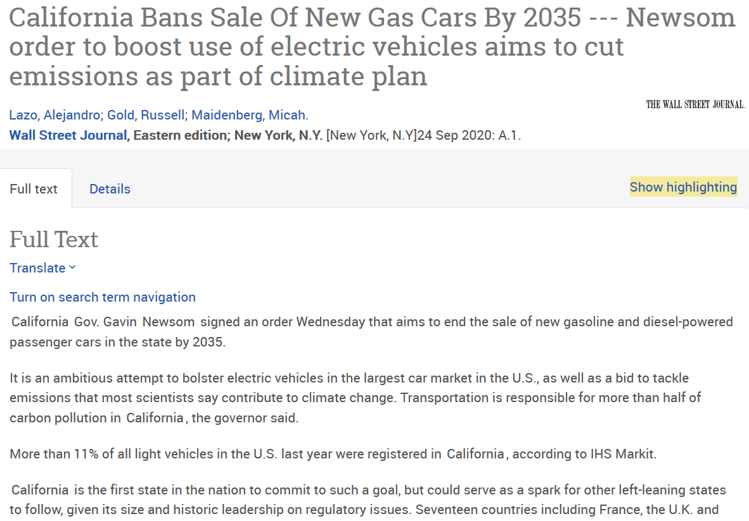

Slide 41
History

Slide 42
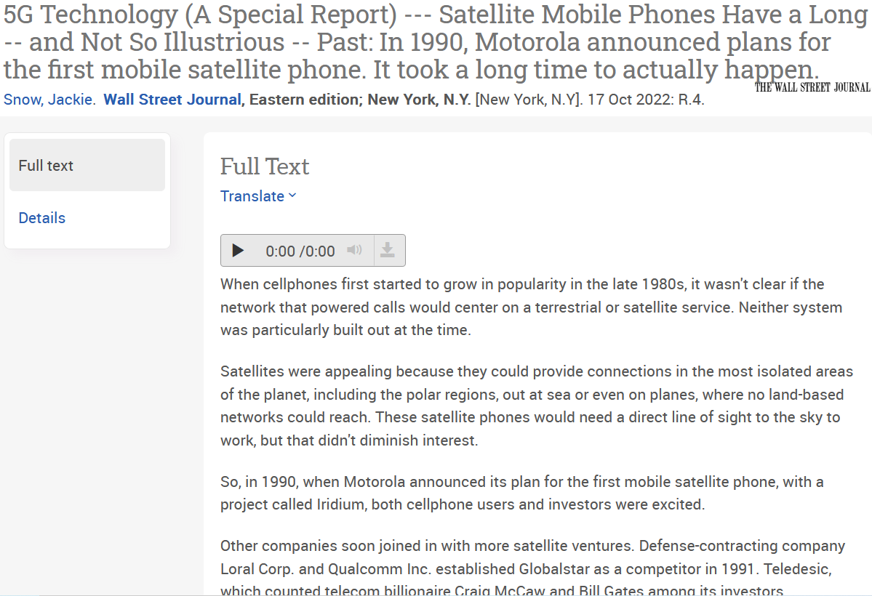

Slide 43
Value Proposition

Slide 44
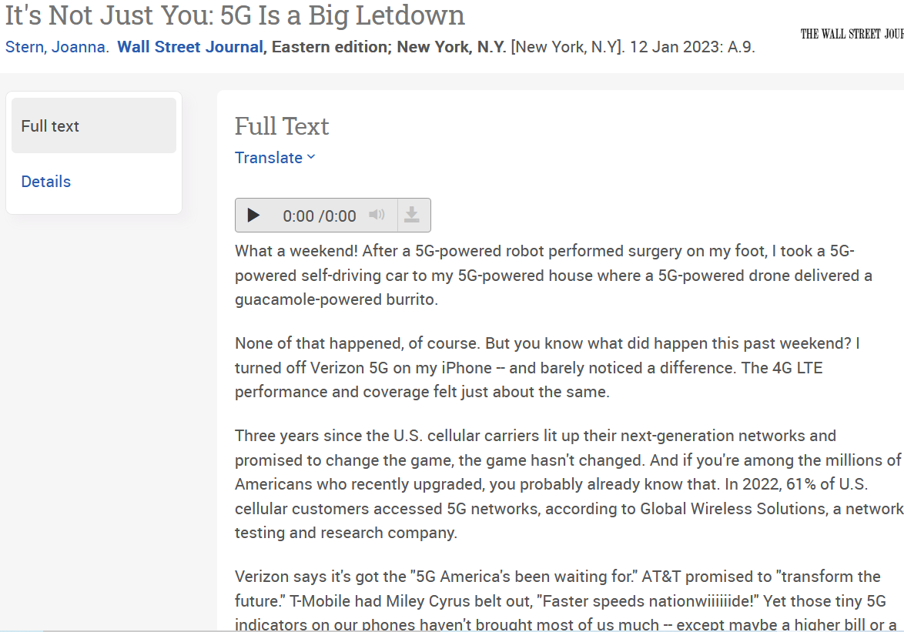

Slide 45
Counter-argument

Slide 46
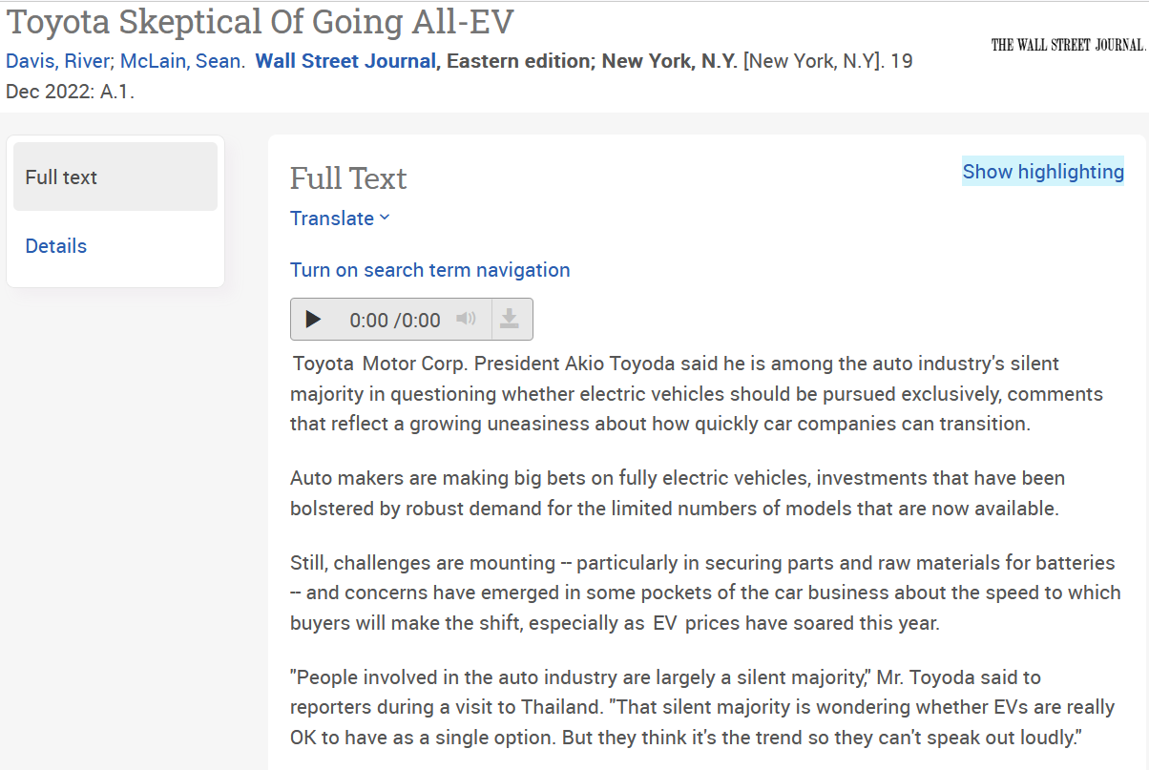

Slide 47
Socio-Technical Systems

Slide 48
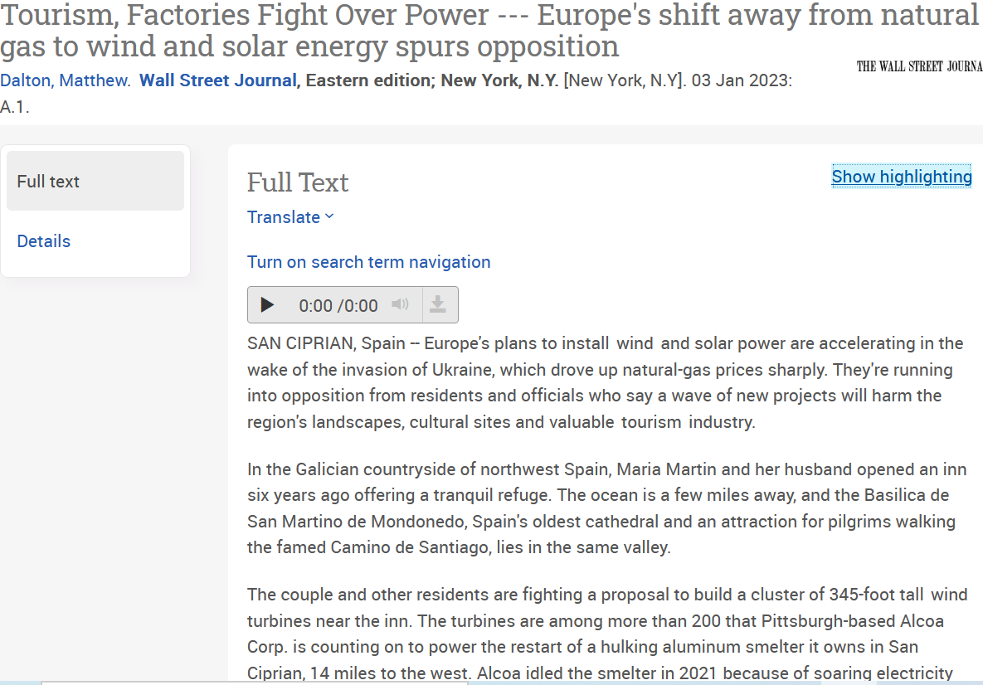

Slide 49
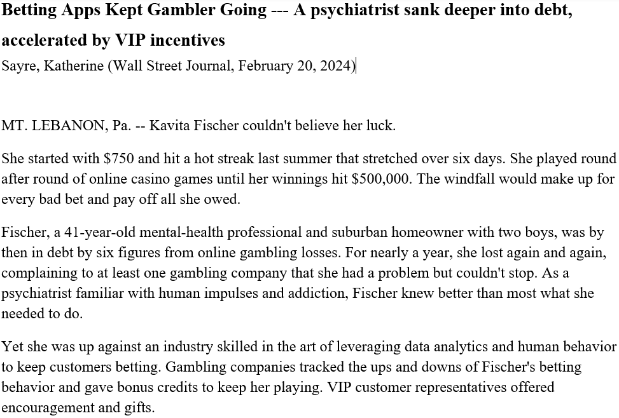

Slide 50
