Slide 1
Technology
Understanding technology and its impact on business
Wayne Smith, Ph.D.
Department of Management
CSU Northridge

Slide 2
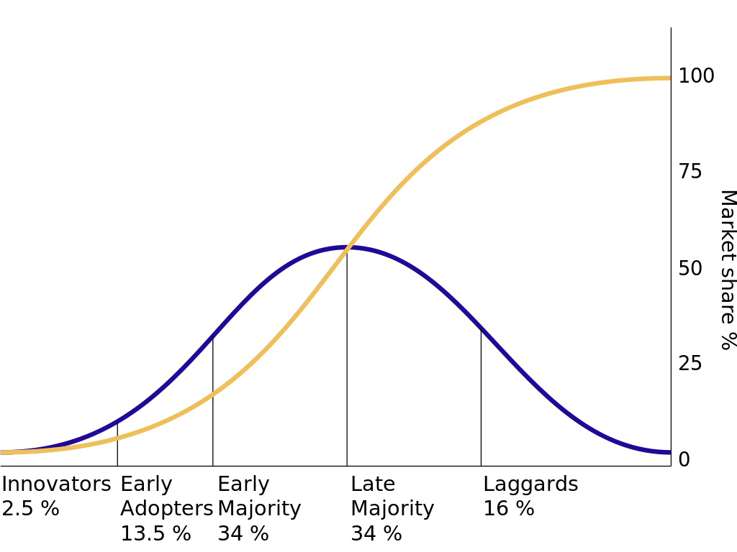
Diffusion of Innovation
Source: https://en.wikipedia.org/wiki/Diffusion_of_innovations

Slide 3
Technology mapped to UDC
Finance
Payback, Net Present Value, Return on Investment, Risk …
Operations
Quality, Productivity, Logistics, Supply Chain, Maintenance, …
Marketing
Market/Industry Growth, Customer Data, Adoption, Perception …
Management
Strategic alignment, Equity, Complexity, Training, Use, …

Slide 4
Technology mapped to LDC
Financial Accounting
Capital Budgeting, Annual Expense Planning, Depreciation, Audit, …
Managerial Accounting
Break-even, Cost Allocation by Piece/Use/Department, …
Micro-Economics
Life-cycle, Vendor Lock-in, Product Ecosystem, Bandwagon Effects, …
Macro-Economics
Origin Country, Cross-country requirements, Controls, Governance …
Business Statistics
Uncertainty, Variation, Explanation, Prediction, …
Business Law
Licensing, Intellectual Property, “Right to Fix”, Privacy, …

Slide 5
Technology mapped to Lower-Division Business Skills
Business Math/Calculus
Time, Scale, Change, Speed, Equations, Algorithms, Precision …
Information Systems/ Computer Science
Architecture, Systems, Integration, Security, Upgrades, Replacement, …
Business Communications
Clear and Compelling Rationale, Use Case, Government Requirements, …

Slide 6
Technology mapped to General-Education Skills
English Language Communication and Critical Thinking
Documentation, Understanding, Contingencies, “Open Technologies”, …
Scientific Inquiry and Quantitative Reasoning
Next Generation Technology, Data Literacy, Computational Literacy, …
Arts and Humanities
Aesthetics, Interaction, Experience, Technological Determinism, …
Social Sciences and U.S. History and Government
“Network effects”, Mis/Information, Government subsidies, Export Controls …
Lifelong Learning
Continuous Learning, Career Development, Professional Education, Skills, …
Comparative Cultural Studies/Gender, Race, Class, and Ethnicity Studies, and Foreign Languages
Justice, Diversity, Equity, Inclusion, Translation, Access, “Digital Divides” …

