Slide 1
Student Success: The Multiple Perspectives of a Business Student

Slide 2
Let’s start simple: The train ride for kids in 2010 at the Northridge Mall (Note: This ride is currently at the Promenade Mall)

Slide 3
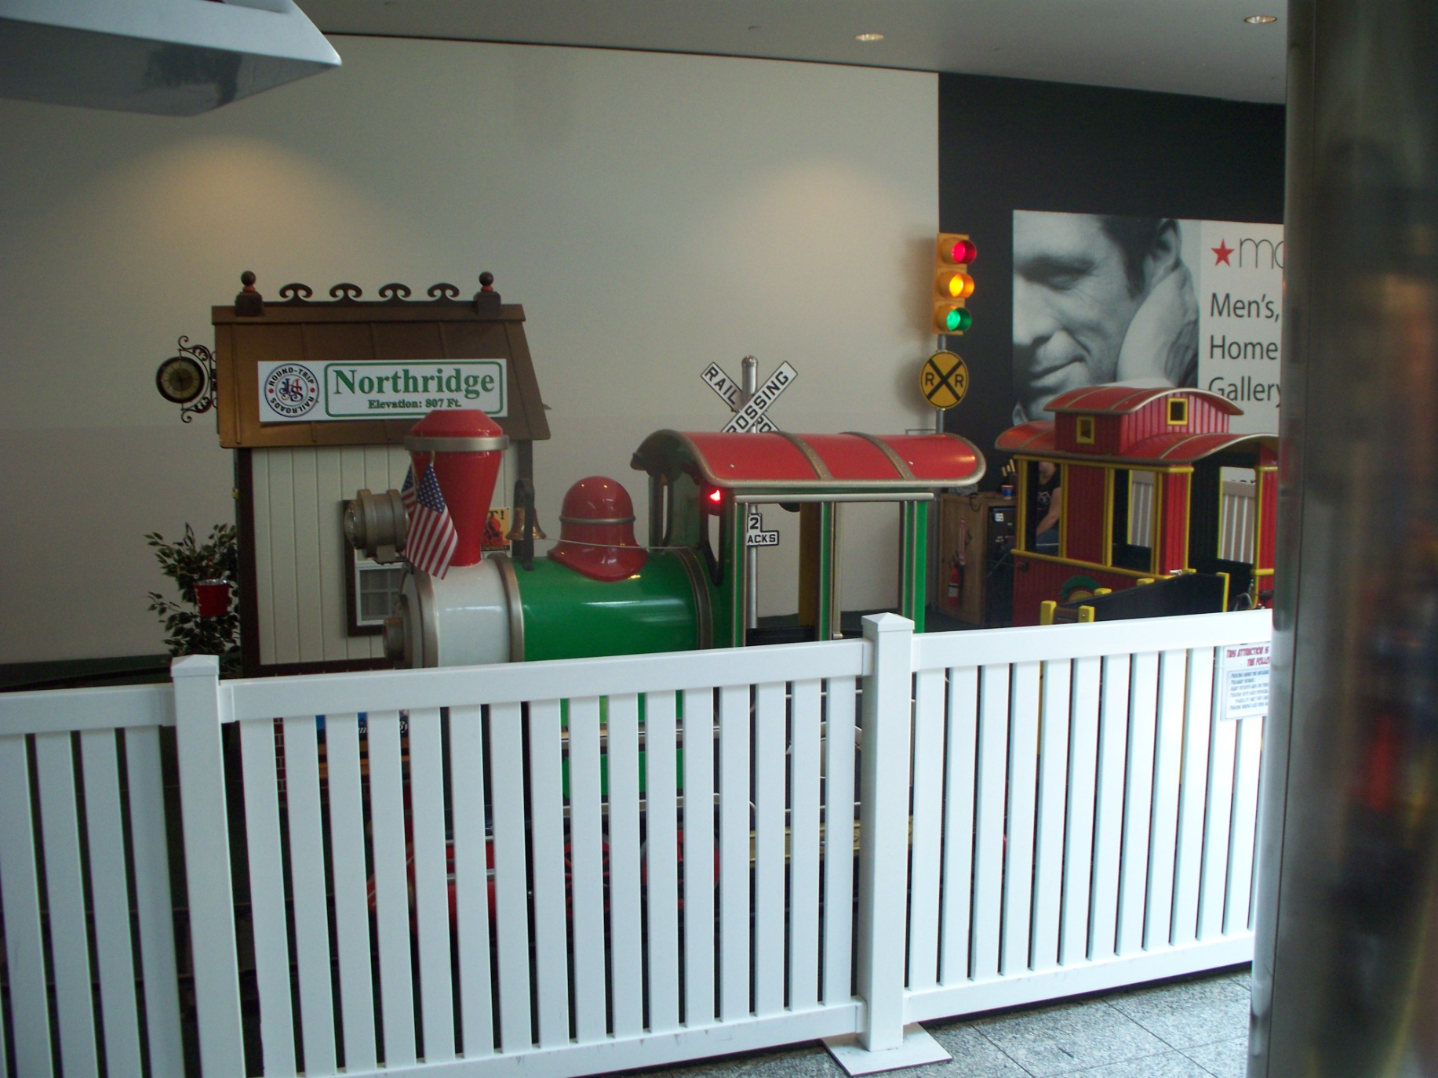
Supply/Demand – Train - 1

Slide 4
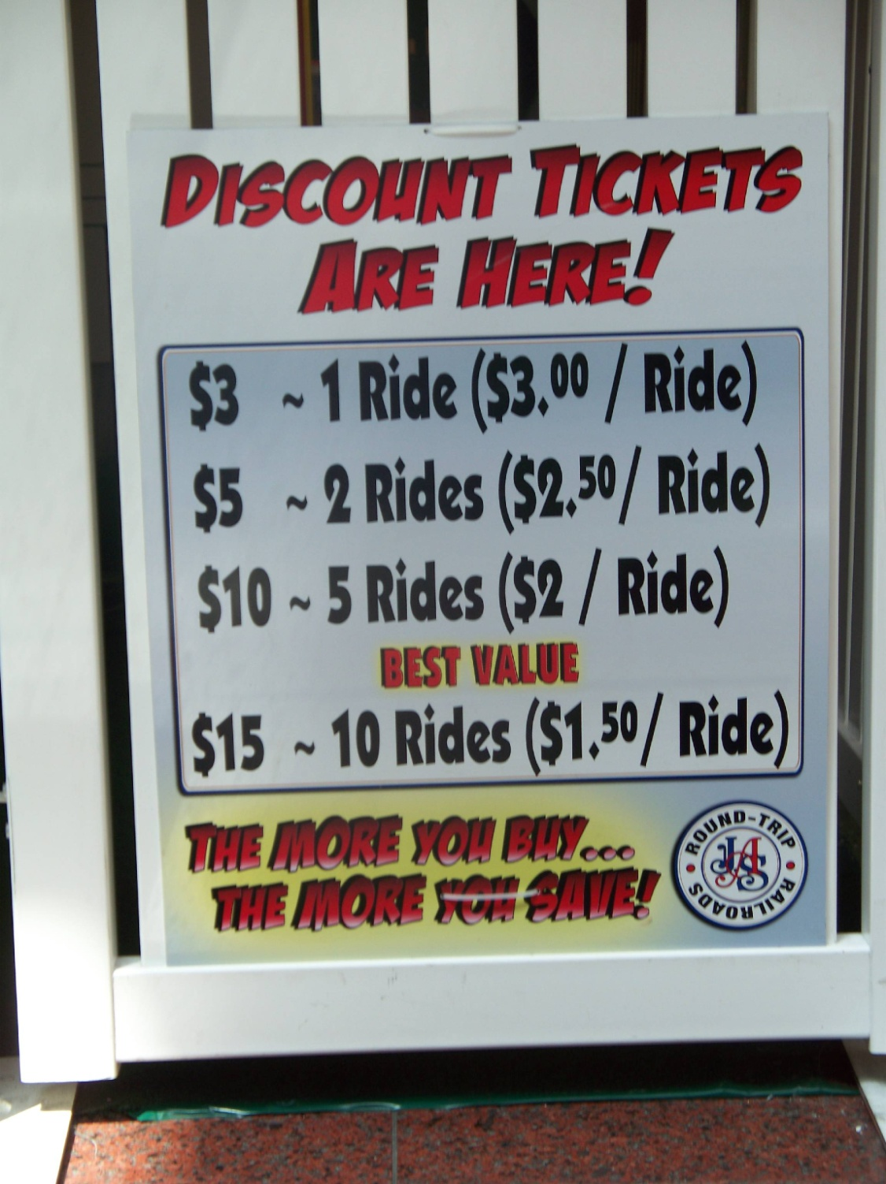
Supply/Demand – Train - 2

Slide 5
Student Success: (GE—“Basic Skills”)
How does the price per unit change?
Math
Northridge
Train Rides
What is the meaning of “best”?
English/Writing
Which elements of the train ride product and process can be automated?
Computing

Slide 6
Student Success: (Business Core—Lower-Division Classes)
Has the weekly cash flow been audited?
Financial Accounting
What is the break-even point for train rides?
Managerial Accounting
What is the market price
for train rides?
Northridge
Train Rides
Micro- Economics
Macro- Economics
What is the ticket price
in 2007 dollars?
Business Law
What are the terms of the insurance policy?
Business Statistics
How do we confidently estimate the risks and uncertainties of train rides?

Slide 7
Student Success: (GE—“Subject Exploration” Classes)
What is the propulsion system on this train ride?
Natural Science
How did trains, in general, change SoCal?
History
Are we prepared for the Cal OSHA
field visit?
Government
Northridge
Train Rides
Are the instructions to riders clear?
Oral Communication
Comparative Cultures
Do images and patterns of train rides differ by population sub-group?
Arts and Humanities
Is the train whistle on the train ride authentic?
Critical Reasoning
Is a train ride the best, optimal use of our scarce Mall resources?

Slide 8
Student Success: (Business Core—Upper-Division Classes)
What is the return-on-investment of train rides?
Finance
How do we deal with long lines during
peak times?
Operations
How do we create a train ride customer?
Northridge
Train Rides
Marketing
Management
Is the operator the right person in the right place at the right time?
“Gateway Experience”
How do teams, case studies, and ethics improve our decisions?
“Capstone Strategy”
Are train rides aligned with our overall organizational Mall strategy?

Slide 9
Let’s take a more complicated example:

Slide 10
The photograph on the next slide is a remodeling of the Jack in the Box near the corner of Reseda and Plummer (as of 8/16/2012)

Slide 11
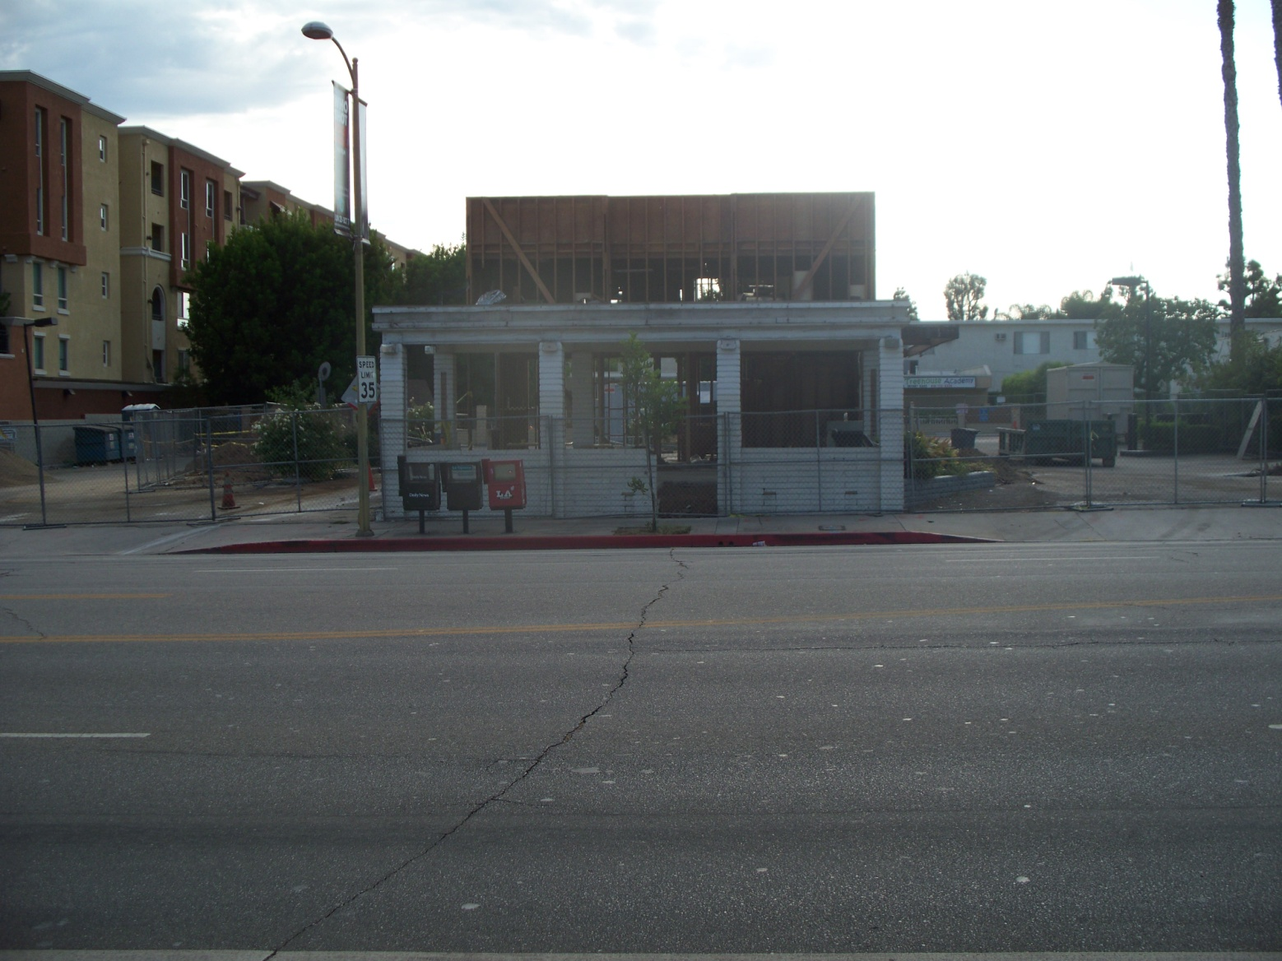
Jack-in-the-Box remodel near the corner of Reseda and Plummer in Northridge (8/16/2012)
What key concepts from all of our courses do we need to ask and answer to address the issues associated with this change?

Slide 12
Let’s take one even more complicated example:

Slide 13
Facebook as a business
Losse, K. (2012), “The Woman in the Facebook Frat House”, Wall Street Journal, Jun. 22. online.
Management Theories/Models/Frameworks?
Raice, S. (2012), “Inside Facebook’s Push to Woo Big Advertisers”, Wall Street Journal, Aug. 15. online.
Marketing Theories/Models/Frameworks?
Russolillo, S. (2012), “Facebook: Is it a buy at $20?”, Wall Street Journal, Aug. 16. online.
Finance Theories/Models/Frameworks?
Troianovski, A., and Raice, S. (2012), “Facebook Explores Giving Kids Access”, Wall Street Journal, Jun. 4. online.
Operations/Info. Sys. Theories/Models/Frameworks?

Slide 14
Let’s take an even more complicated example:

Slide 15
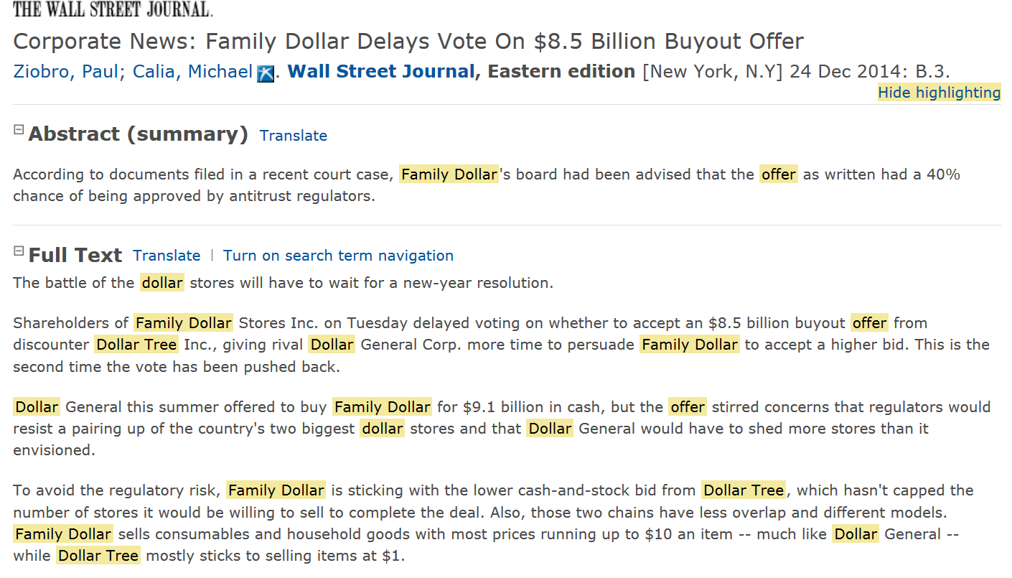
Supply/Demand – Train - 1

Slide 16
Your task as a business student
We all have biases.
The only way to deal with them is:
acknowledge them, and…
to confront them systematically.
You are a business student.
If you haven’t done so already, change your mindset and thinking…
from an employee to an owner, and…
from a customer to an investor.

Slide 17
COBAE Upper-Division Core courses
FIN 303 – Financial Management
Fiduciary Responsibility
Meeting Capital Requirements
Structuring Market Investments
MKT 304 – Marketing Management
Consumer Behavior
Product Development and Sales
Public/Community Relations
SOM 306 – Operations Management
Project Management
Optimal Allocation of Resources
Continuous Quality Improvement
MGT 360 –Management and Organizational Behavior
Leadership Development
Organizing Intangibles
Human Resources Effectiveness

Slide 18
COBAE Upper-Division Core Courses (primary perspectives)
FIN 303
Financial
Management
MKT 304
Marketing
Management
External
Orientation
MGT 360
Mgt. and
Organizational
Behavior
SOM 306
Operations
Management
Internal
Orientation
Economic
Capital
Human
Capital

