Slide 1
Fundamentals and Your Career
Lower-Division Core Courses
- Micro-ECON, Macro-ECON, FIN ACCT, MGT ACCT, BLAW, STAT, IS, BUSCOMM
Wayne Smith, Ph.D.
Department of Management
CSU Northridge

Slide 2
Micro-Economics

Slide 4
Macro-Economics

Slide 5
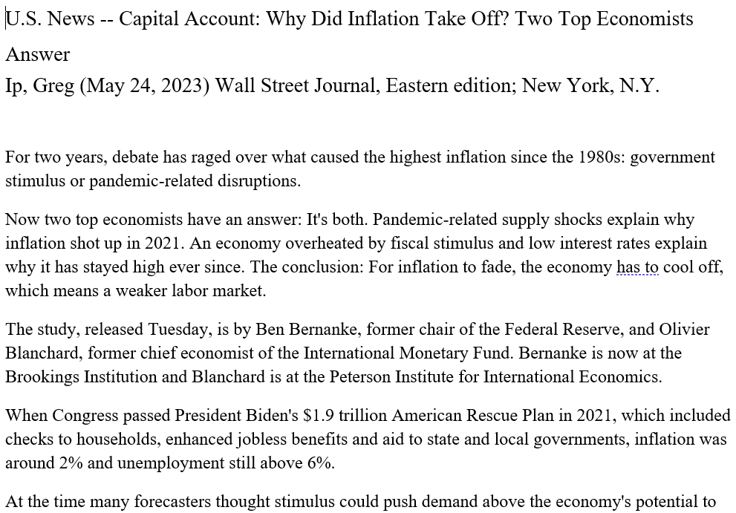

Slide 6
Financial Accounting

Slide 7
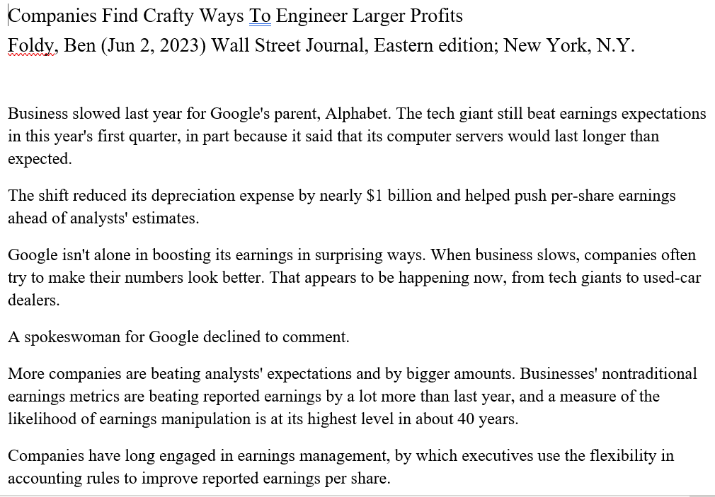

Slide 8
Managerial Accounting

Slide 9
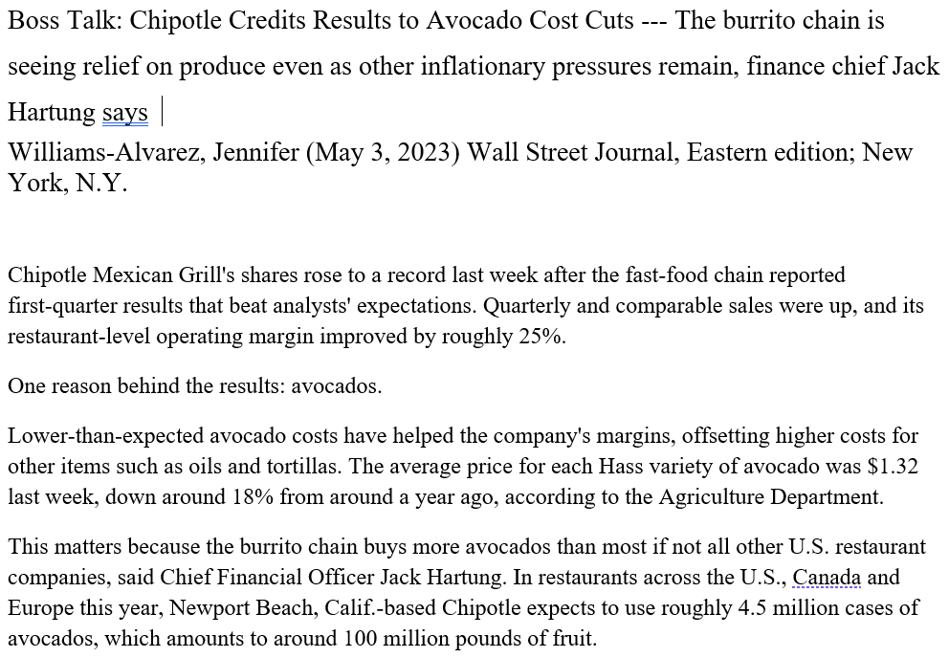

Slide 10
Business Law

Slide 11
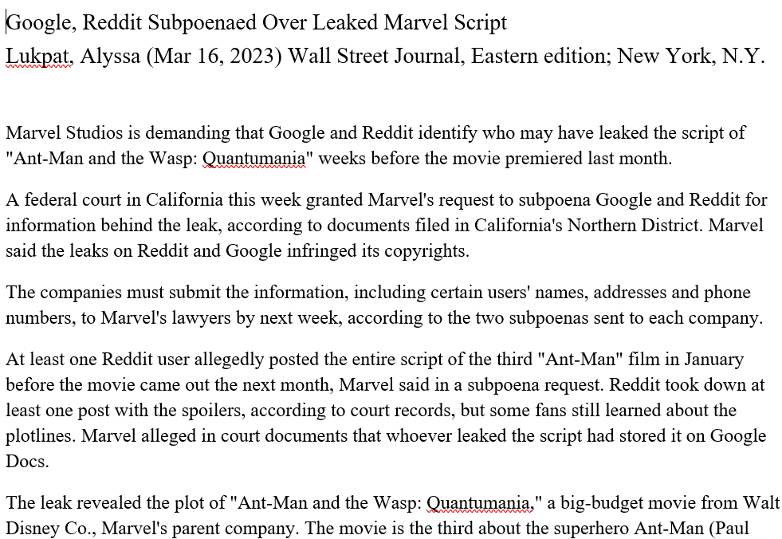

Slide 12
Business Statistics

Slide 13
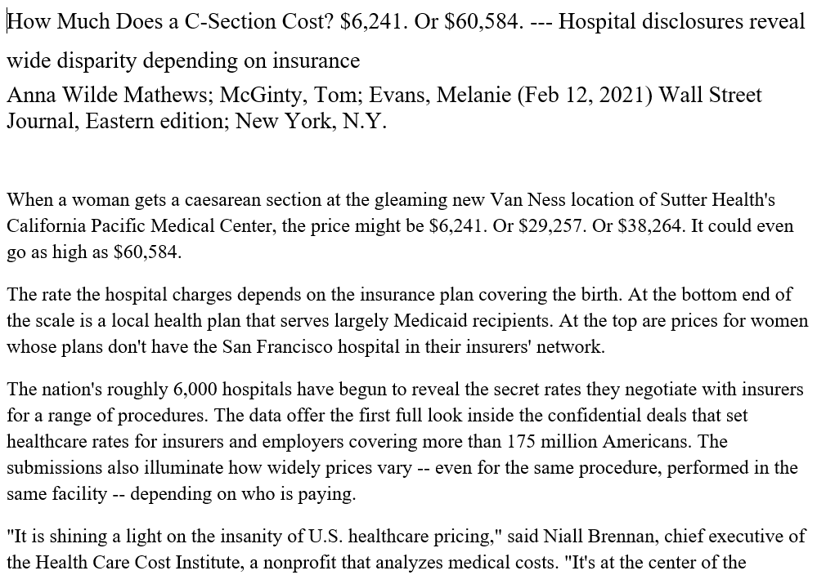

Slide 14
Information Systems

Slide 15
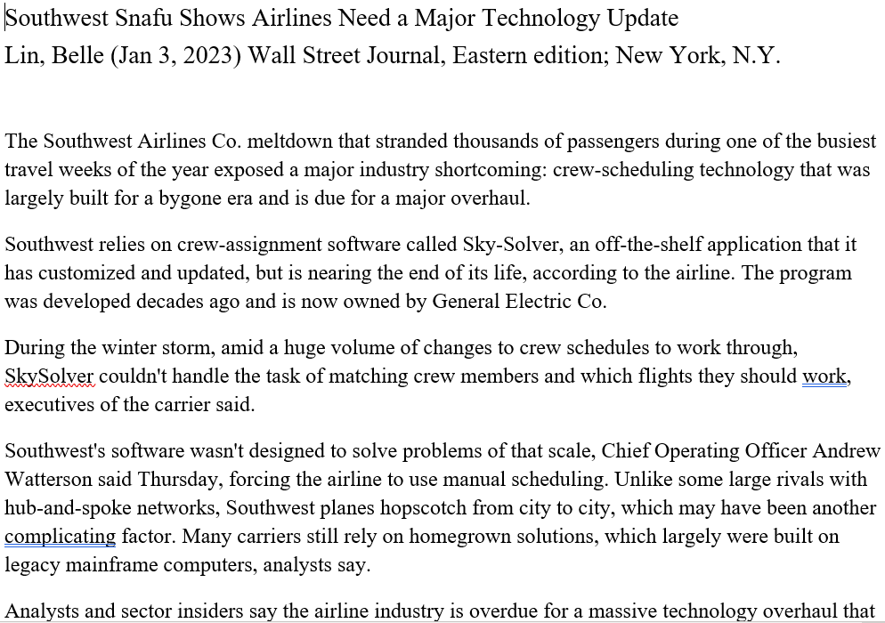

Slide 16
Business Communication

Slide 17
