Slide 1
Business Analytics
Understanding how to collect, transform, analyze, and interpret data to assist in management decision-making
Wayne Smith, Ph.D.
Department of Management
CSU Northridge

Slide 2
Management Decision-making (from a Quantitative perspective)
Artificial Intelligence (“Machine Learning”, “Algorithms”)
Business Research (“Statistics”, “Hypothesis Testing”)
Big Data (generally, linked data in the “cloud”)
Data Science (“using reproducible tools for visualization/analysis”)
Business Analytics (“simpler approaches, augments decisions”)
Our task (at least from a technology perspective) is to
Capture, transform, analyze, and report data, and…
In reporting, to be quite technical, “copy-paste-adjust (for the audience)”

Slide 3
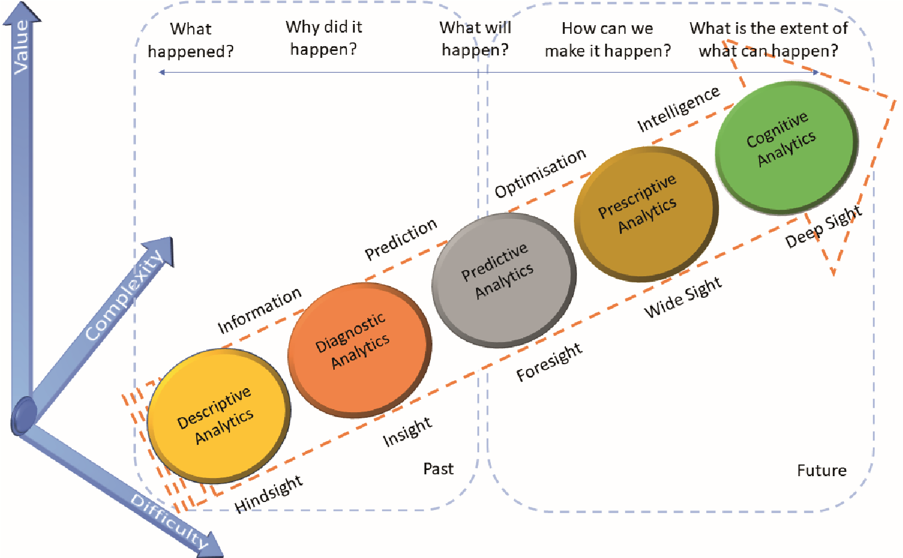
Conceptual Model

Slide 4
Information Dynamics
Wisdom
Extraordinary Insight (Explanation) for Foresight (Prediction)
Restaurant: How should our menu change in the future to best optimize nightly sales?
Knowledge
Combination of Explicit Information and Tacit Information
Restaurant: What action led to the change in last night’s sales?
Information
Meaningful Data
Restaurant: How does last night’s sales compare to that night the previous year? How does last night’s sales compare to our goals?
Data
Raw, atomic, basic
Restaurant: What were the total sales for last night?

Slide 5
Analytics for Business Decision-making
Prescriptive Analytics
What should we do?
HR Department: What should we (the HR Department) do to meet or exceed the organization’s hiring and retention goals for next year? What data/information/knowledge/wisdom should we provide to our hiring and technical managers to help? What are we missing?
Predictive Analytics
What is likely to happen?
HR Department: How many new employees will our organization need next year? How will the mix change? What is our competition likely to do?
Diagnostic Analytics
Why did it happen?
HR Department: Did our emphasis on recruiting from campus A (over campus B, etc.) matter? What do the managers of these entry-level employees think?
Descriptive Analytics
What happened?
HR Department: How many entry-level professionals did we hire last year? How many of them are still with us now?

Slide 6
Your Analytics-related Courses
Type of Analytics | Existing Course | Future Course
Prescriptive | SOM 306 (Operations) | SOM (several), FIN, MKT
Predictive | MATH 140/SOM 120 (Basic Statistics) BUS 302 (Gateway) | SOM (mostly BANA), FIN, MKT
Diagnostic | MATH 140/SOM 120 (Basic Statistics) BUS 302 (Gateway) | SOM (several), MKT
Descriptive | MATH 140/SOM 120 (Basic Statistics) BUS 302 (Gateway) | SOM (BANA)
(Technology courses)
IS 212 or CompSci 100 (Computers using Excel)

Slide 7
Your Future Analytics Knowledge
Type of Analytics | Course | Existing Knowledge | Future Knowledge
Prescriptive | Operations Management (SOM 306) | Linear Program-ming, Assignment, Portfolio Mixes | Mixed Integer Programming, Convex Optimization
Predictive | Basic Statistics Gateway | Linear Regression | Multiple Regression, Non-linear, GLM
Diagnostic | Basic Statistics Gateway | Inferential Statistics, Basic Probability Dist. | Other Probability Distributions, Bayesian Methods
Descriptive | Basic Statistics Gateway | Central Tendency, Dispersion, Basic Visualization | Rich Visualization, Reproducible Reporting, Dashboards

Slide 8
Excel’s “Add-in’s”
Type of Analytics | Add-in | Feature
Prescriptive | Solver | Linear Programming
Predictive | Data Analysis | Correlation, Regression, Moving Average, Exponential Smoothing
Diagnostic | Data Analysis | Z-test, t-test, F-text, Anova, Random Number Generation, Sampling
Descriptive | Data Analysis | Rank and Percentile, Histogram, Covariance
(Enable)
Select “File | More | Options |Add-ins | Go (it’s near the bottom)”
Check both the “Analysis Toolkit” box and the “Solver add-in” box
(Use)
Select “Data” (and look to the right of the top part of the screen)
Click on “Analysis” or “Solver” as desired

Slide 9
Excel’s (Office 365) “Analyze Data”
(look in the upper-right hand corner of the top Ribbon)
Like grapahs, you select the data first…
Then it “suggests” various analyses
Rank
Which item is significantly larger or smaller than the rest?
Trend
Which items form a significant pattern over time?
Outliers
Which items in time series might be outliers?
Majority
Which items form a majority of a total value that can be attributed to a single factor?
More information?
https://support.microsoft.com/en-us/office/analyze-data-in-excel-3223aab8-f543-4fda-85ed-76bb0295ffc4

Slide 10
From Analytics Knowledge to Analytics Skills
Type of Analytics | Existing Knowledge | Existing Skills
Prescriptive | Linear Programming, Assignment, Portfolio Mixes | MS-Excel (add-ins)
Predictive | Linear Regression | Calculator (elementary), MS-Excel, GoogleDocs
Diagnostic | Inferential Statistics, Basic Probability Dist. | Calculator (elementary), MS-Excel, GoogleDocs
Descriptive | Central Tendency, Dispersion, Basic Visualization | Calculator (elementary), MS-Excel, GoogleDocs, Apple Numbers, LibreOffice (OpenOffice)

Slide 11
From Existing Analytics Skills to Future Analytics Skills
Type of Analytics | Existing Skills | Future GUI Skills | Future CLI Skills
Prescriptive | MS-Excel (add-ins) | IBM CPLEX, Gurobi, MOSEK | R (lpSolve, COINS) Python (pyomo, scipy.optimize) Julia (JuliaOpt, Convex)
Predictive | Calculator, MS-Excel, GoogleDocs | Alteryx, Microstrategy | R (base, caret, tidymodels) Python (scikit-learn) Julia (GLM, MixedModels)
Diagnostic | Calculator, MS-Excel, GoogleDocs | SAS, Stata, IBM SPSS, M-Plus | R (base, MASS, tidymodels) Python (Statsmodels, PyMC) Julia (base, Statistics, Distributions)
Descriptive | Calculator, MS-Excel, GoogleDocs, Apple Numbers, LibreOffice | MS-Power Tools, MS-Power BI, Tableau | R (base, DT, tidyverse) Python (pandas, matplotlib, seaborn) Julia (base, DataFrames, Plots, StatsPlots)

Slide 12
Access and Transform
Access
What is the source of the data (e.g., server, web page, etc.)?
What is the format of the data (e.g., .xlsx file, .csv file, database file, etc.)?
Is it public (no credentials) or private (need login credentials)
Transform
Rows: one per record?, how many?, any missing?
Fields: one per variable?, how many?, any missing?
Field Separators”, Meta-data, links to other files, etc.
In Data Science, this process is formally called Extract, Transform, and Load (ETL, for short)
This must be done *before* any analysis can be done

Slide 13
Value
Value means various superior outcomes, such as…
better decision-making,
improved performance,
realization of organizational objectives,
and enhanced competitiveness,
among others.

Slide 14
Difficulty
Difficulty…
the problem being studied
the challenges associated with extracting valuable knowledge from the data in a meaningful manner.
many unknowns
characterized by mutual dependencies between the variables
very difficult to formulate.
No established procedure (no rules)
requires advanced technological capabilities,
enhanced problem-formulation,
and problem-solving skills from the workforce.

Slide 15
Complexity
Complexity is is a measure of the amount of computing resources (with particular focus on time and memory requirements) that algorithms consume when they run.
Note that complexity does not only necessarily stem from large or big data.
Complexity can also arise when dealing with data for which computational need increases rapidly
(i.e., the procedure to solve the problem involves a computationally intensive algorithm that requires a relatively large number of steps to complete.)

Slide 16
Requirements for Analytics Models
Independent of the application area, certain requirements should be considered while developing analytics models.
These requirements include…
business relevance,
statistical performance (predictive capacity in terms of relevant performance measures),
interpretability,
explainability,
justifiability,
operational efficiency,
Running/completion time,
and economic cost.
All of the above are trade-offs
More of one generally means less of another

Slide 17
Big Data
Big data pose a series of challenges which stem from their characteristics:
Volume (they have many variables and/or many observations,
Velocity (they are created and updated frequently,
Variety (they are of all different types,
Veracity (they are all of different quality.
As a result, performing data analytics on massive data sets becomes more challenging.
Data Analytics can also be performed on qualitative (words) data.
For example, we look for “patterns” or “distinctiveness” in the narrative.
Useful in Law and Marketing.

Slide 18
When Descriptive Analytics Goes Wrong

Slide 19
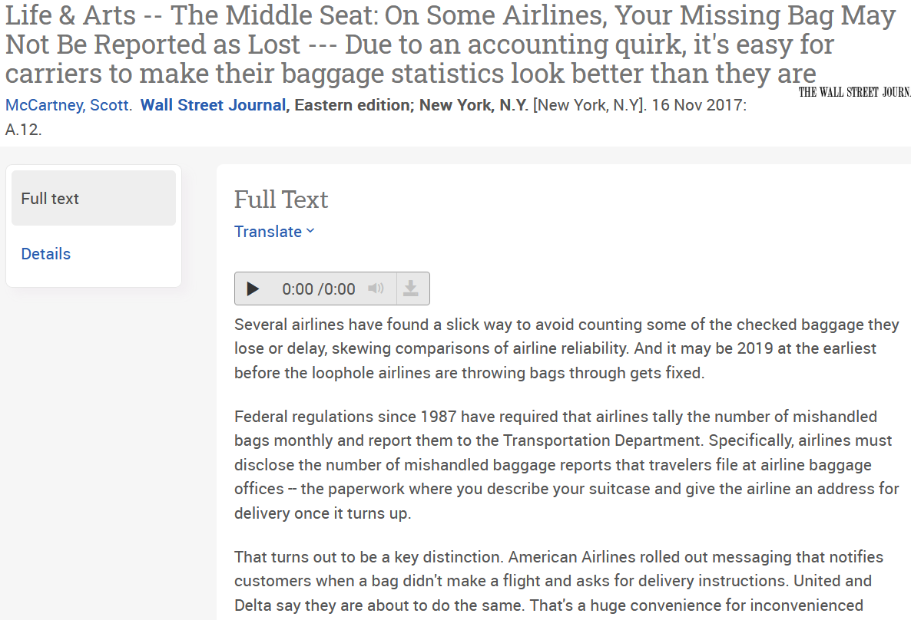

Slide 20
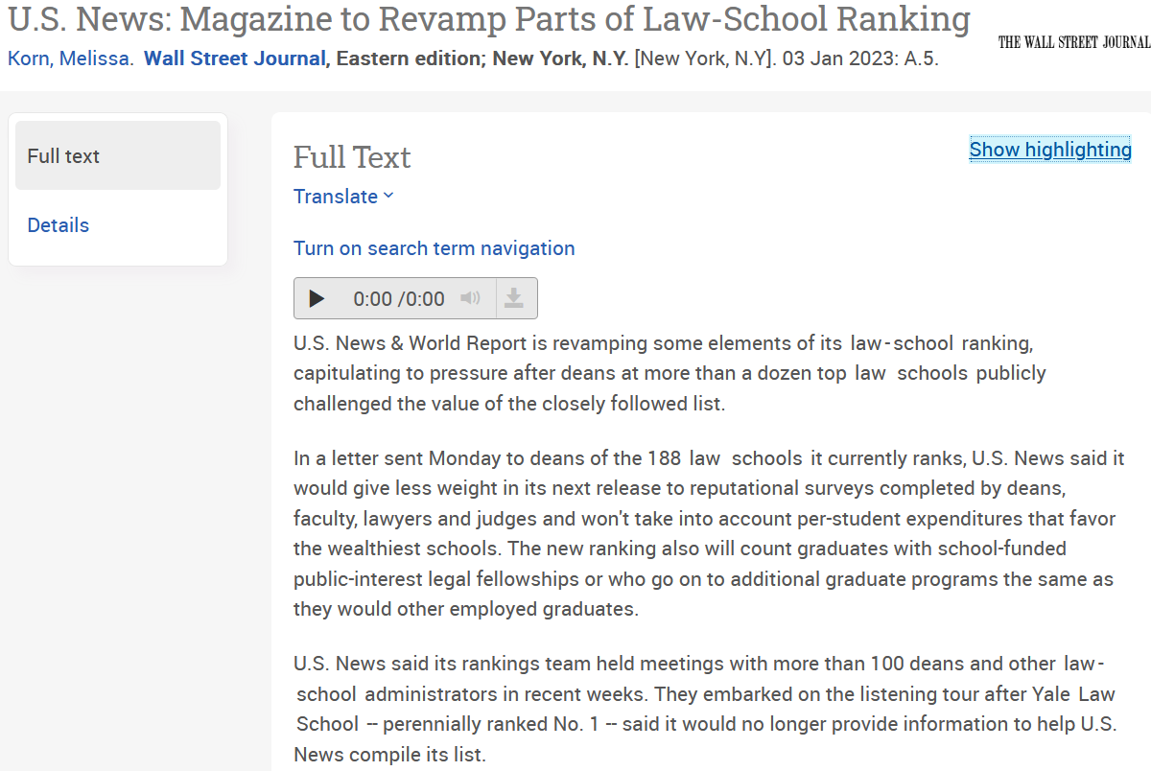

Slide 21
When Diagnostic Analytics Goes Wrong

Slide 22
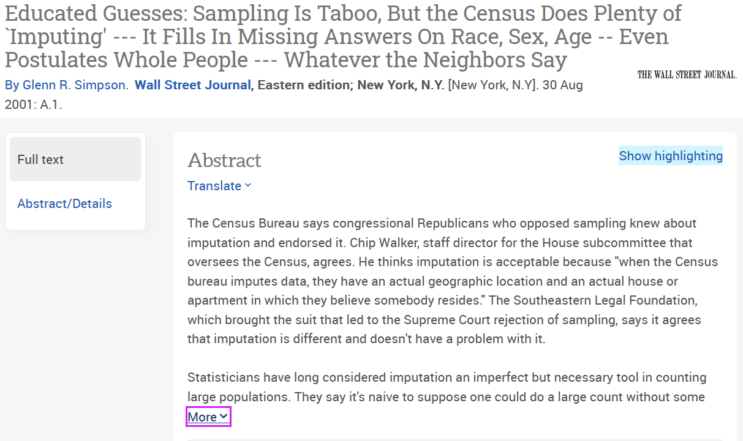

Slide 23
When Predictive Analytics Goes Wrong

Slide 24
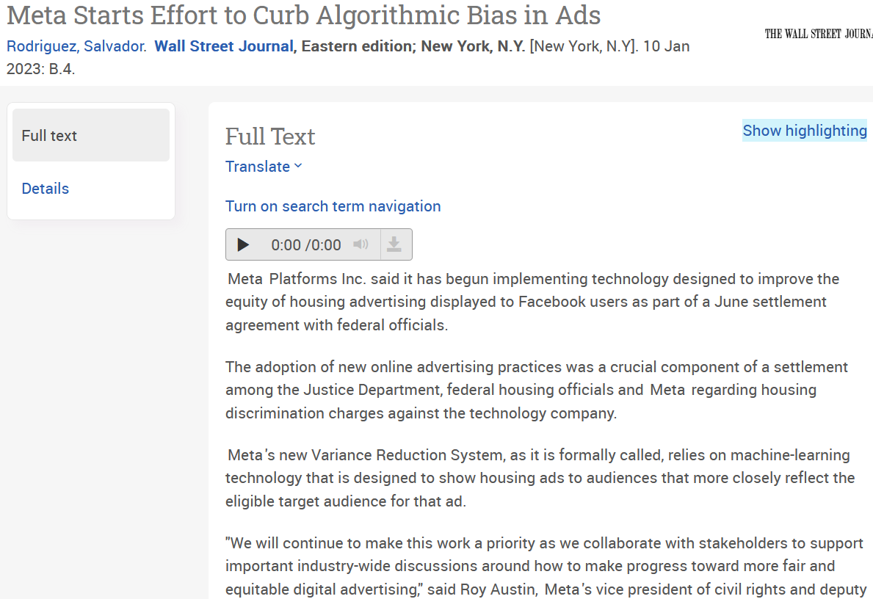

Slide 25
When Prescriptive Analytics Goes Wrong

Slide 26
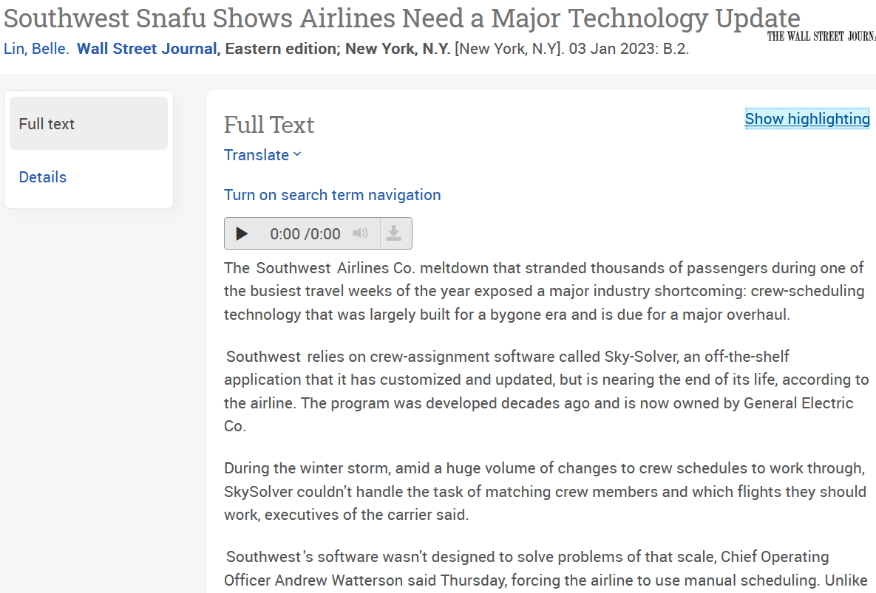

Slide 27
Sources
Some parts of this presentation were excerpted and adapted from:
Charles, V., et .al (December, 2022) Why Data Analytics is an Art. Significance (Royal Statistical Society) (volume 9, issue 16, pp. 42-45)

