Slide 1
Technology and Analytics
Understanding technology changes and adoption, and understanding how to gather, transform, analyze, and report strategic data?
Wayne Smith, Ph.D.
Department of Management
CSU Northridge

Slide 2
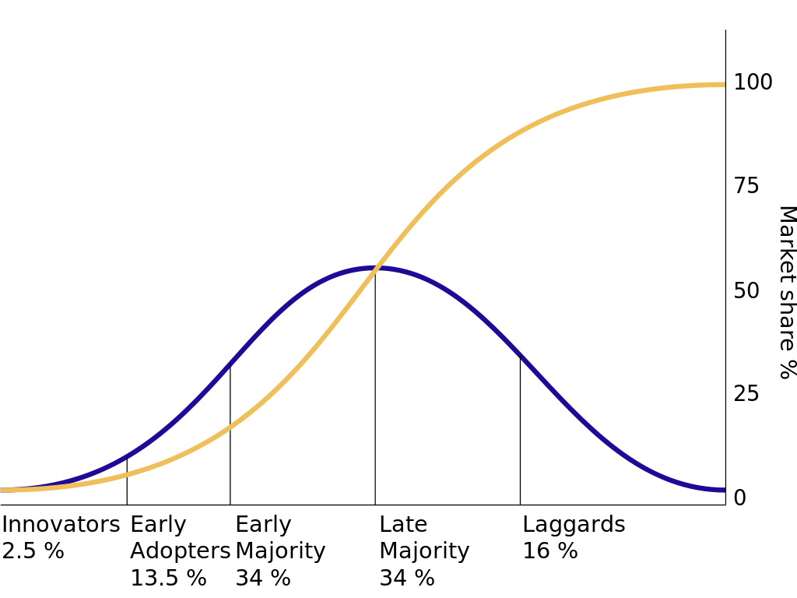
Diffusion of Innovation
Source: https://en.wikipedia.org/wiki/Diffusion_of_innovations

Slide 3
Technology mapped to UDC
Finance
Resource Allocation, ROI/IRR, Industry standards, …
Operations
Quality, Productivity, Logistics, Supply Chain, Maintenance, …
Marketing
Market/Industry Growth, Customer Data, Adoption, Perception …
Management
Strategy alignment, Equity, Complexity, Training, Use, …

Slide 4
Technology mapped to LDC
Financial Accounting
Capital Budgeting, Annual Expense Planning, Depreciation, Audit, …
Managerial Accounting
Break-even, Cost Allocation by Piece/Use/Department, …
Micro-Economics
Life-cycle, Vendor Lock-in, Product Ecosystem, Bandwagon Effects, …
Macro-Economics
Origin Country, Cross-country requirements, Controls, Exchange rates …
Business Statistics
Reliability/Error rates, Data Warehouses, Data Science access, Estimates…
Business Law
Licensing, Intellectual Property, “Right to Fix”, Privacy, “West Coast Law”, …

Slide 5
Technology mapped to Lower-Division Business Skills
Business Math/Calculus
Scale (Century, Decades, Years, Months), Rates of Change, …
Information Systems/ Computer Science
Architecture, Systems, Integration, Security, Upgrades, Replacement, …
Business Communications
Clear and Compelling Rationale, Use Case, Government Requirements, …

Slide 6
Technology mapped to General-Education Skills
English Language Communication and Critical Thinking
Documentation, Understanding, Contingencies, “Open Technologies”, …
Scientific Inquiry and Quantitative Reasoning
Next Generation Technology, Data Literacy, Computational Literacy, …
Arts and Humanities
Aesthetics, Interaction, Experience, Technological Determinism, …
Social Sciences and U.S. History and Government
“Network effects”, Mis/Information, Government subsidies, Export Controls …
Lifelong Learning
Continuous Learning, Career Development, Professional Education, Skills, …
Comparative Cultural Studies/Gender, Race, Class, and Ethnicity Studies, and Foreign Languages
Justice, Diversity, Equity, Inclusion, Translation, Access, “Digital Divides” …

Slide 8
Management Decision-making (from a Quantitative perspective)
Artificial Intelligence (“Machine Learning”, “Algorithms”)
Business Research (“Statistics”, “Hypothesis Testing”)
Big Data (generally, linked data in the “cloud”)
Data Science (“using reproducible tools for visualization/analysis”)
Business Analytics (“simpler approaches, augments decisions”)
Our task (at least from a technology perspective) is to
Capture, transform, analyze, and report data, and…
sometimes, to be quite technical, this means to “copy-paste-adjust”

Slide 9
Information Dynamics
Wisdom
Extraordinary Insight (Explanation) for Foresight (Prediction)
Restaurant: How should our menu change in the future to best optimize nightly sales?
Knowledge
Combination of Explicit Information and Tacit Information
Restaurant: What action led to the change in last night’s sales?
Information
Meaningful Data
Restaurant: How does last night’s sales compare to that night the previous year? How does last night’s sales compare to our goals?
Data
Raw, atomic, basic
Restaurant: What were the total sales for last night?

Slide 10
Analytics for Management Decision-making
Prescriptive Analytics
What should we do?
HR Department: What should we (the HR Department) do to meet or exceed the organization’s hiring and retention goals for next year? What data/information/knowledge/wisdom should we provide to our hiring and technical managers to help? What are we missing?
Predictive Analytics
What is likely to happen?
HR Department: How many new employees will our organization need next year? How will the mix change? What is our competition likely to do?
Diagnostic Analytics
Why did it happen?
HR Department: Did our emphasis on recruiting from campus A (over campus B, etc.) matter? What do the managers of these entry-level employees think?
Descriptive Analytics
What happened?
HR Department: How many entry-level professionals did we hire last year? How many of them are still with us now?

Slide 11
A Continuum of Choices
Commercial Off-the-Shelf solutions (software as a service)
Salesforce?, Workday?, SAP?, Intuit?, Google Analytics/AdSense?, Shopify?
Tableau
Telling stories with data?, slicing/dicing?, integrated maps?, fin. analysis?
MS-Excel
Indispensable?, GoogleSheets?, Apple Numbers?, Libredocs?
Office Productivity Tools
Individual/collaborative?, shared drives?, remote access?, security?
SPSS, SAS, Stata, M-Plus, MATLAB
Industry-wide standard?, Enterprise-wide standard? Unit-wide standard?
Custom Programming
Databases?, SQL?, VBA?
R?, Python?, Julia?, Scala?, others?

