Slide 1
Strategy and Culture
How does an organization leverage opportunities without succumbing to hidden challenges?
Wayne Smith, Ph.D.
Department of Management
CSU Northridge

Slide 2
SFVSC T-shirt

Slide 3
How complete is your vision and how deep is your effort?

Slide 4
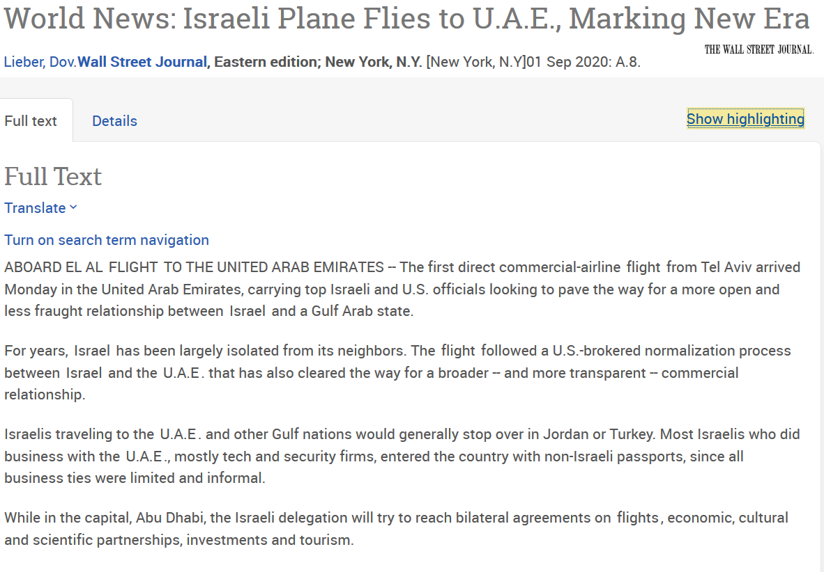

Slide 5
Do you truly understand the history and depth of culture of another country?

Slide 6
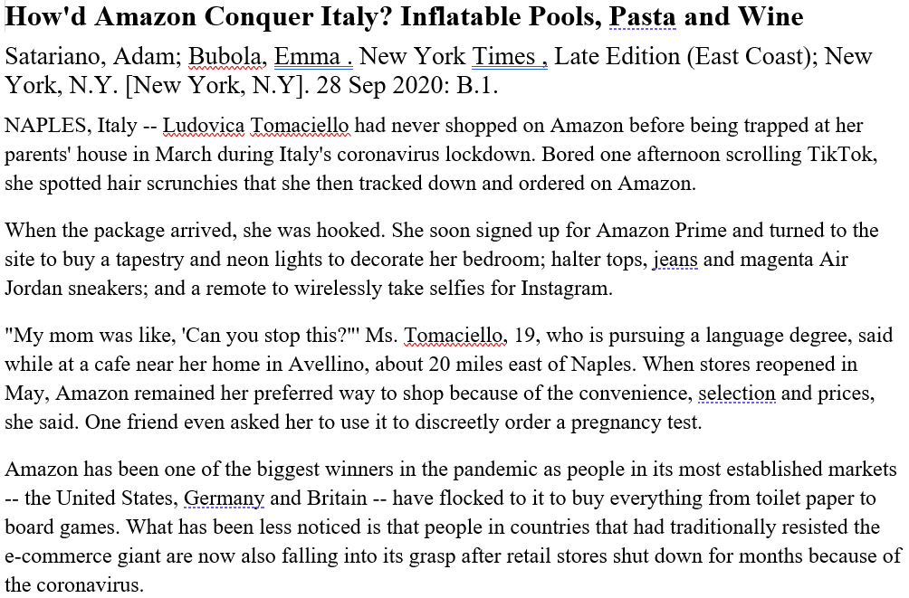

Slide 7
Do you know who the stakeholders are and what they value?

Slide 9
Have you partnered with a local organization that understands the local environment?

Slide 10
Example: Mercedes-Benz
When Mercedes-Benz initially entered the Chinese market, the company chose a Mandarin Chinese name that sounded similar to “Benz”: Bēnsǐ.
That name, Bēnsǐ, translates to “rush to death” in Mandarin Chinese.
The company quickly adapted, changing its Chinese name to Bēnchí, which translates to “run quickly, speed, or gallop.”

Slide 11
Do you know the fine line between “gifts” and “bribes?”

Slide 12
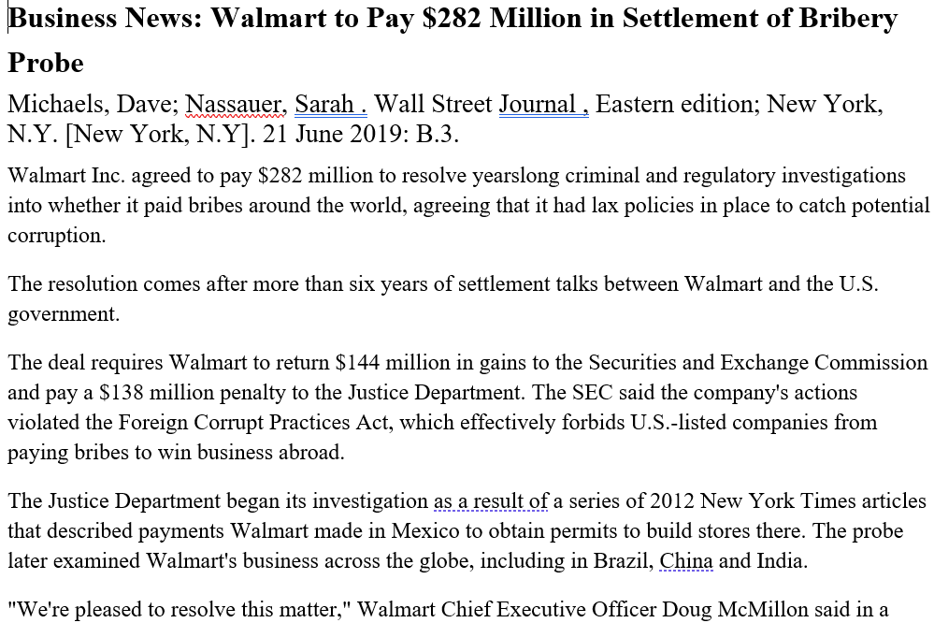

Slide 13
Do you know the long-term plans on the country in which to wish to invest?

Slide 14
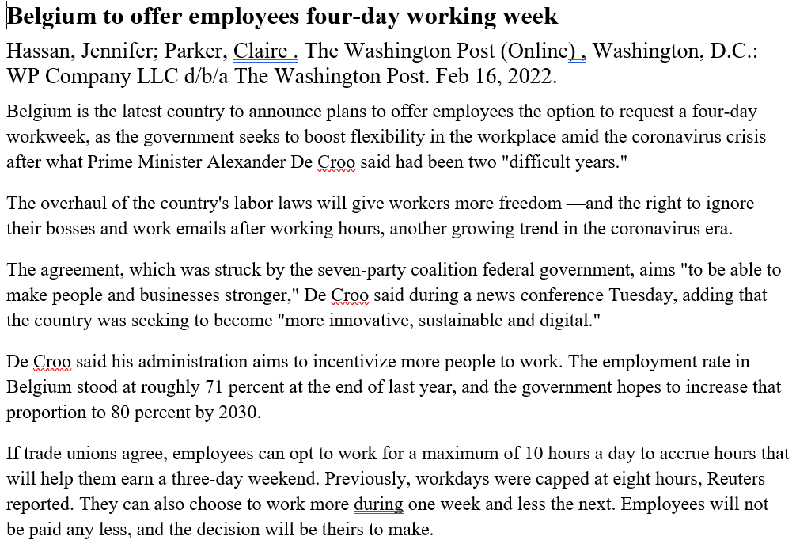

Slide 15
Does the “executive class” truly understand the “working class?”

Slide 16
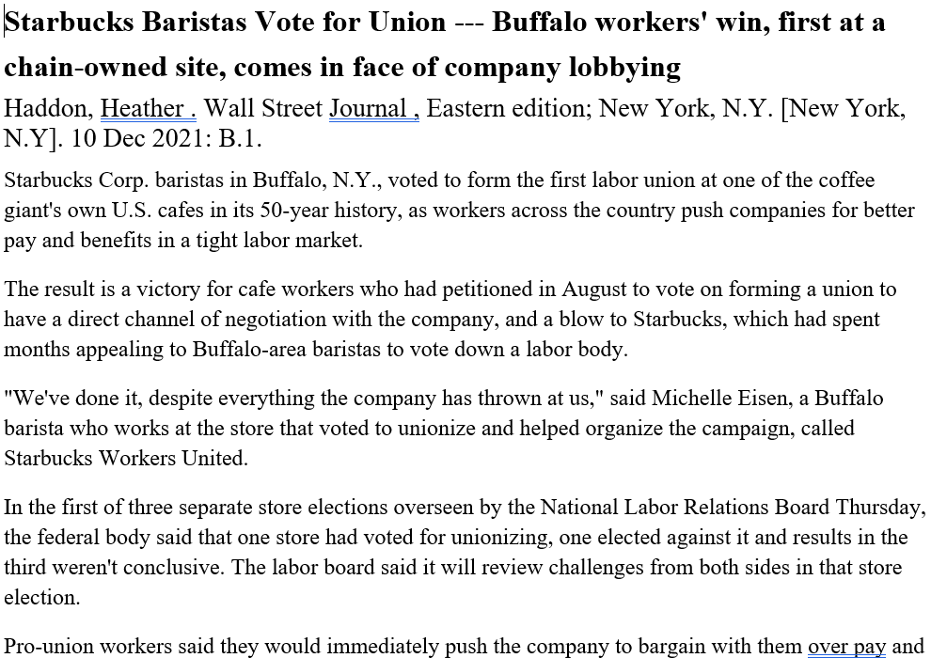

Slide 17
