Slide 1
Business Models and Profit Models
Examples
Wayne Smith, Ph.D.
Department of Management
CSU Northridge

Slide 2
Business Models

Slide 3
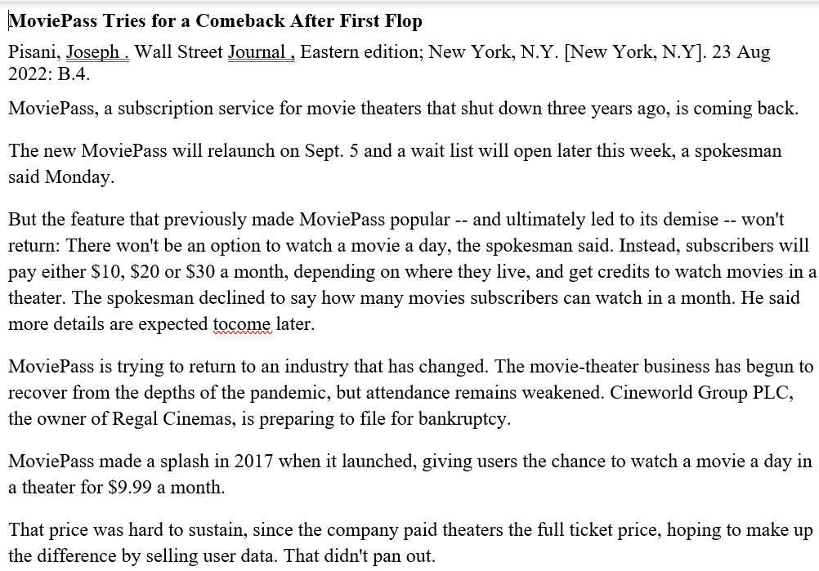

Slide 4
Profit Models

Slide 5
