Slide 1
Examples of many good (and a few not-so-good) student PowerPoint presentations
BUS 302
“The Gateway Experience”
Wayne Smith, Ph.D.
Department of Management
CSU Northridge
wayne.smith@csun.edu

Slide 2
Clear and Unambiguous Introduction

Slide 3
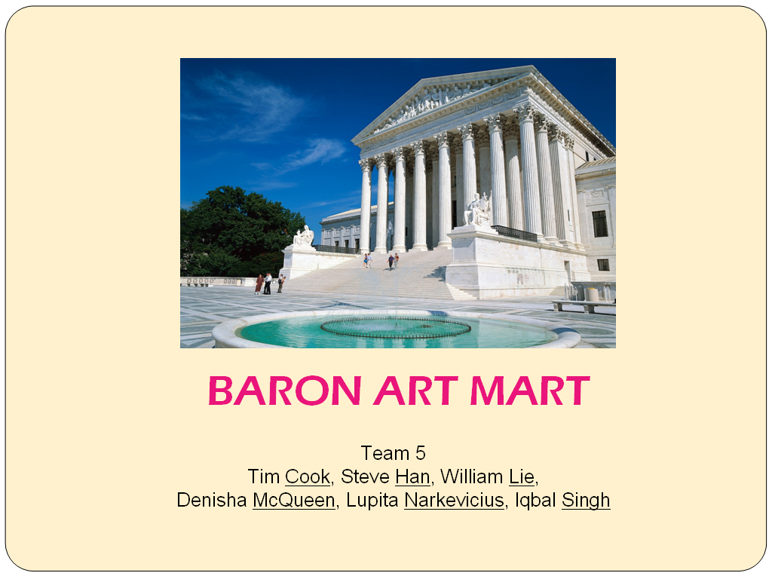

Slide 4
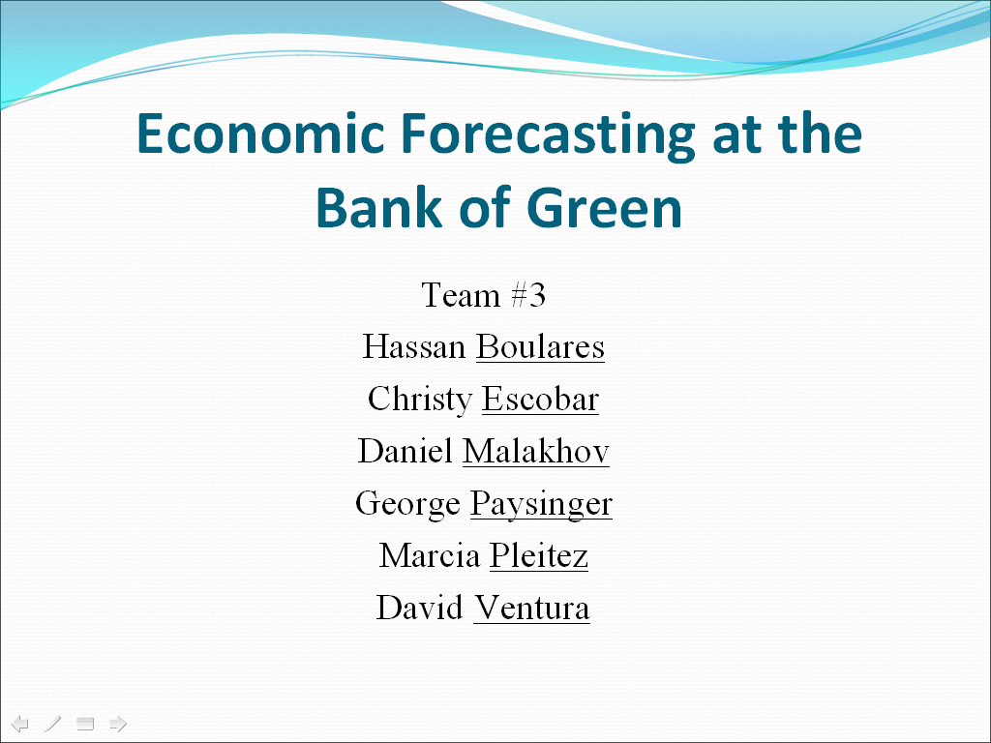

Slide 5
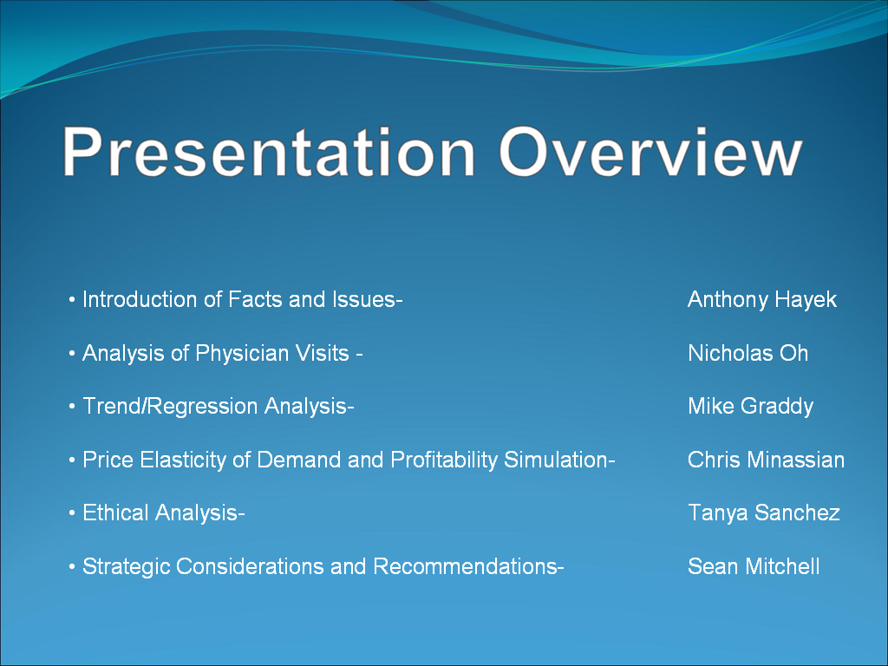

Slide 6
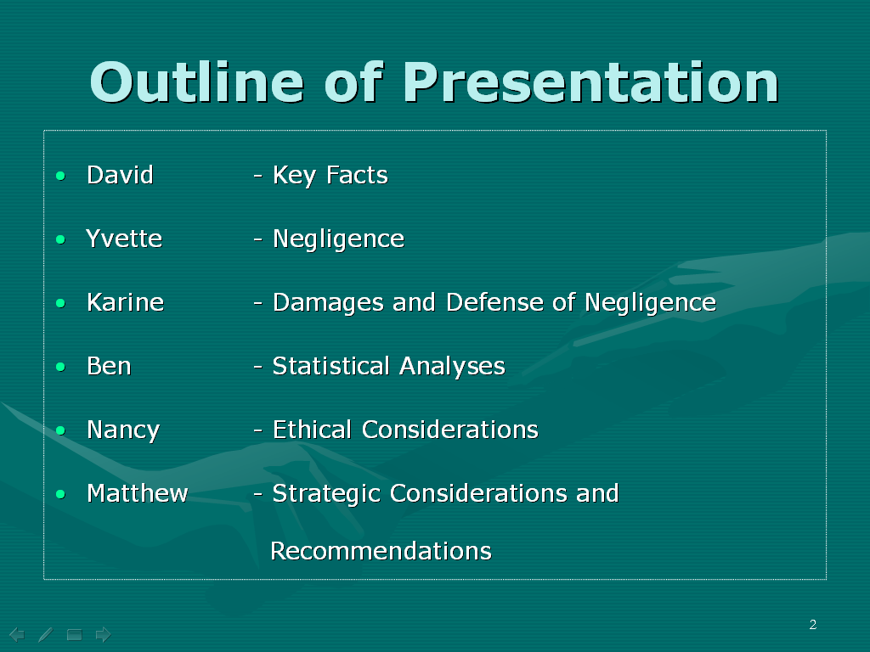

Slide 7
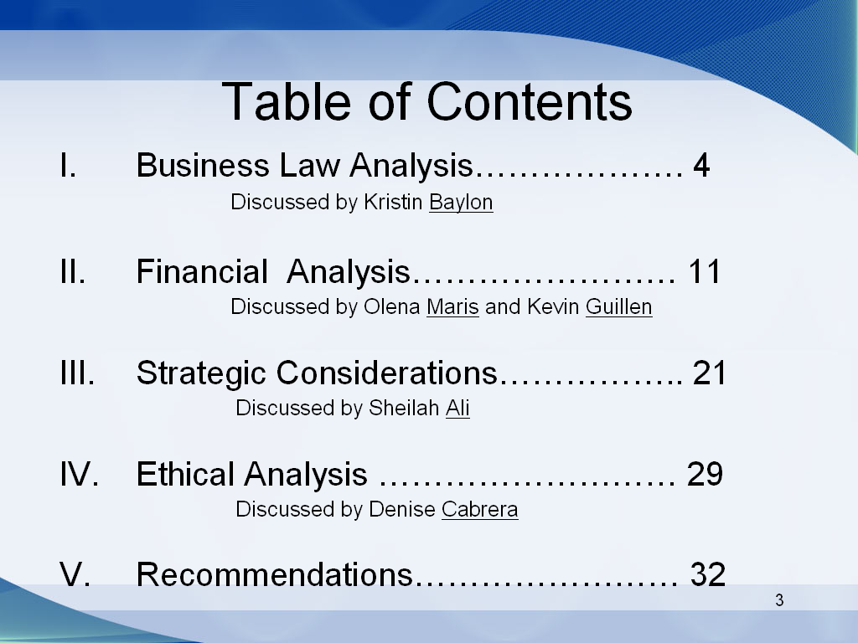

Slide 8
Establish “Ground Rules” for the presentation

Slide 9
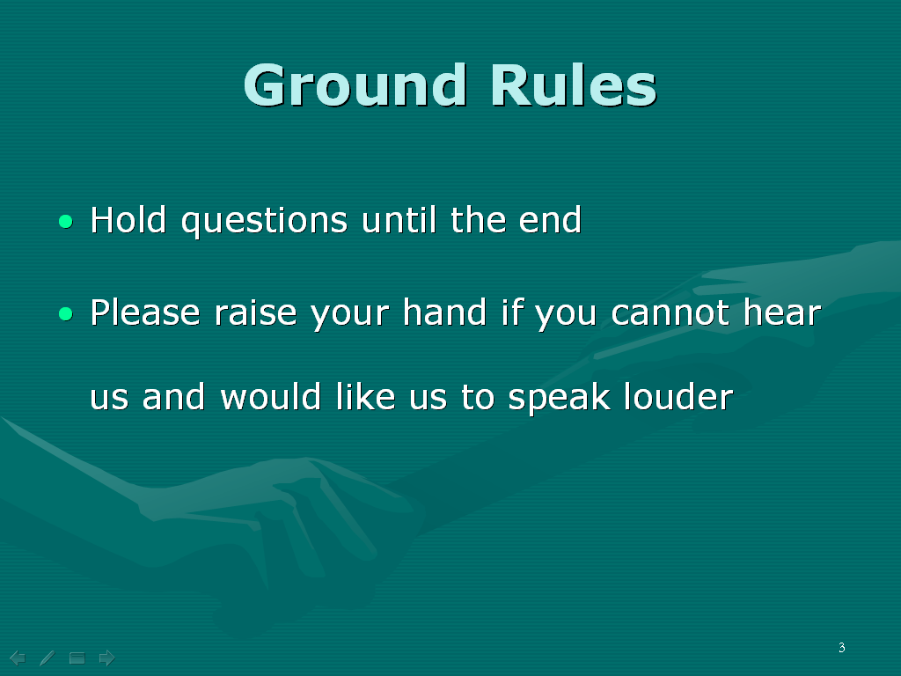

Slide 10
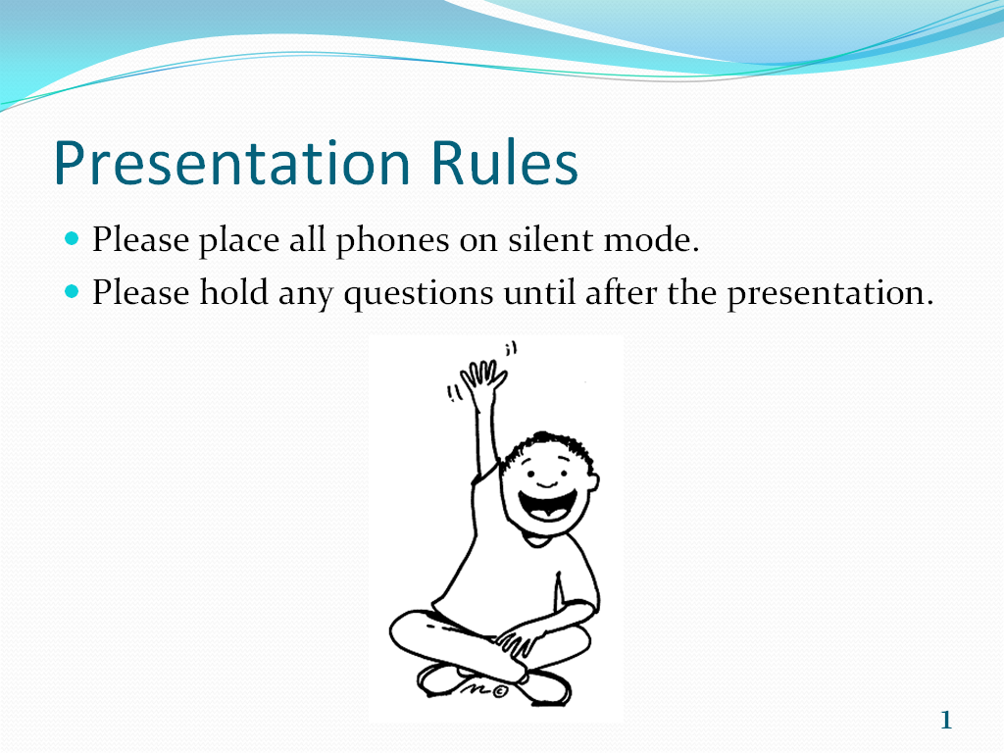

Slide 11
Repeat names as needed

Slide 12
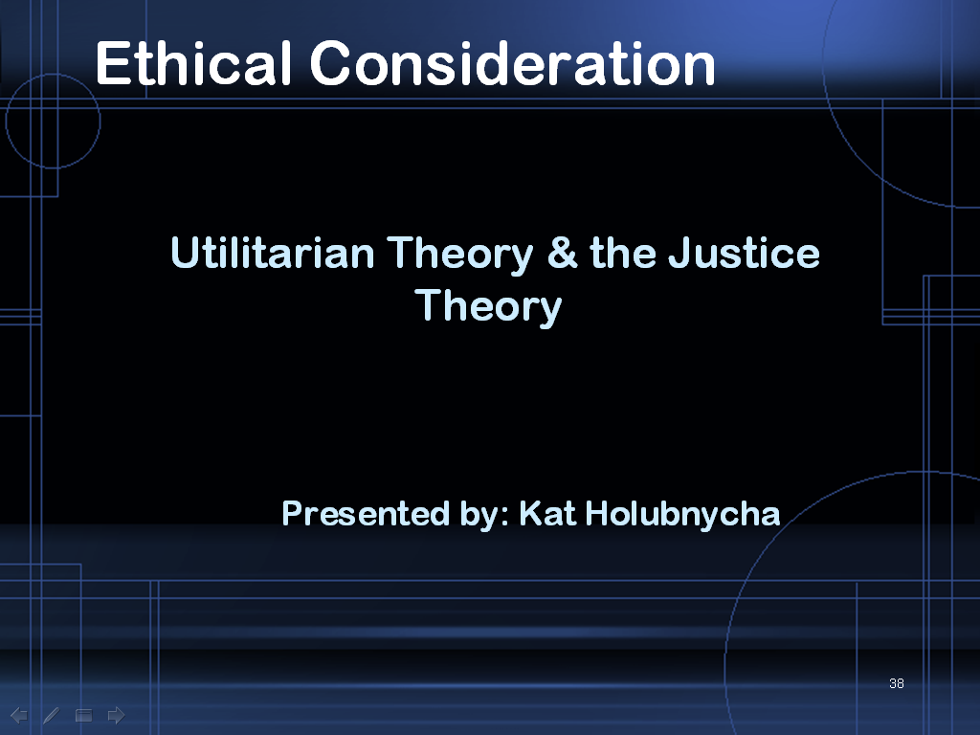

Slide 13
Use Relevant Graphics Early to “Connect” with the Audience

Slide 14
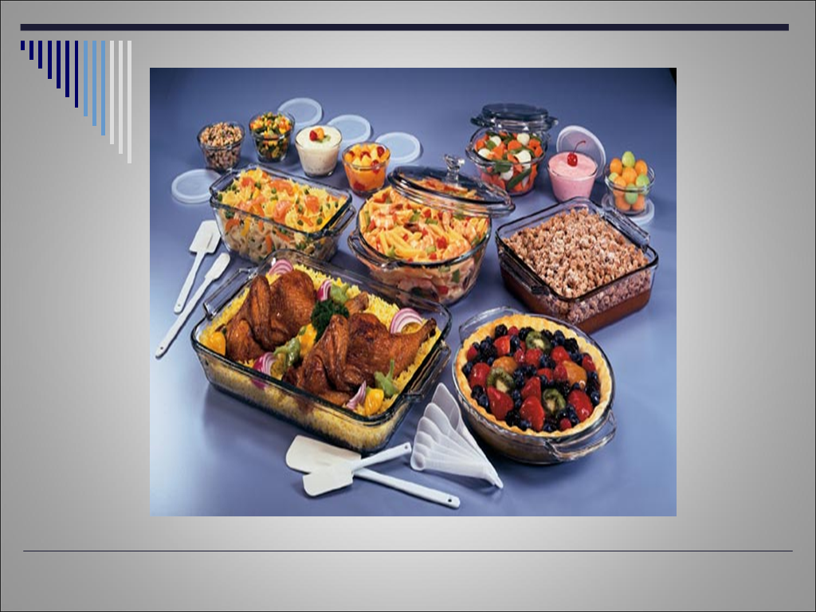

Slide 15
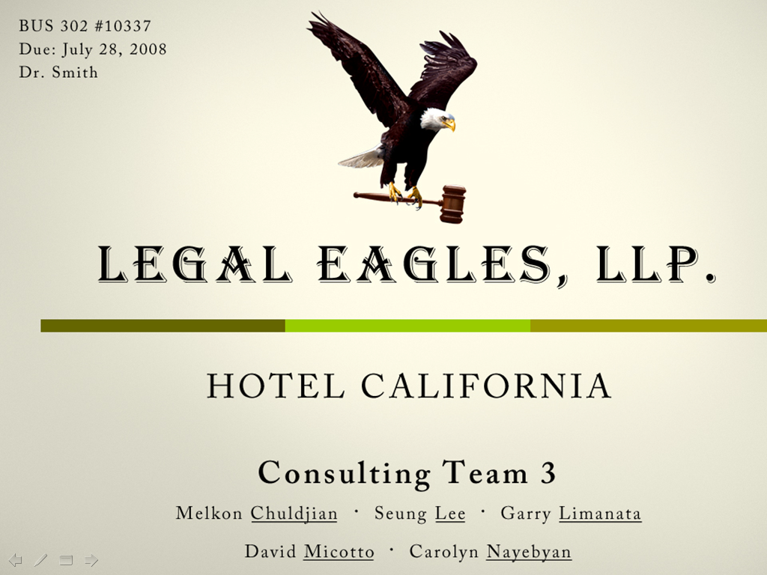

Slide 16
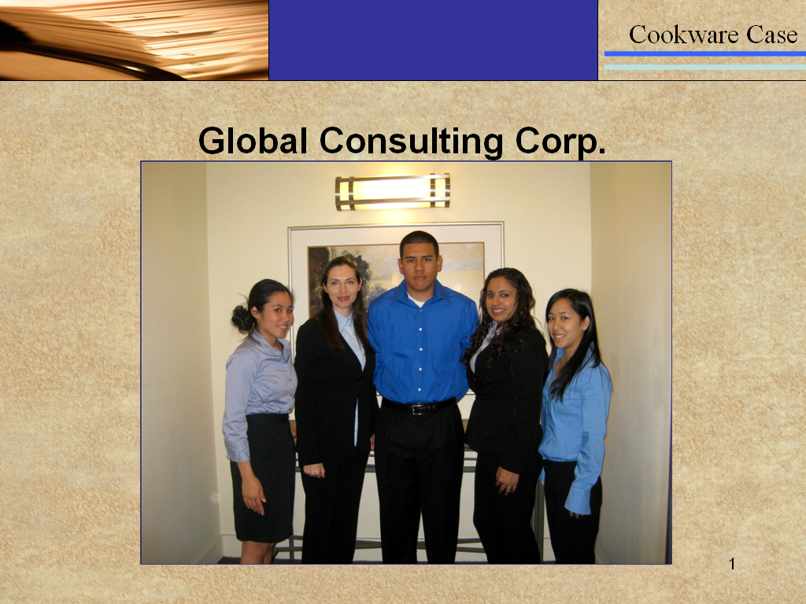

Slide 17


Slide 18
Consistent Visual Theme

Slide 19


Slide 20
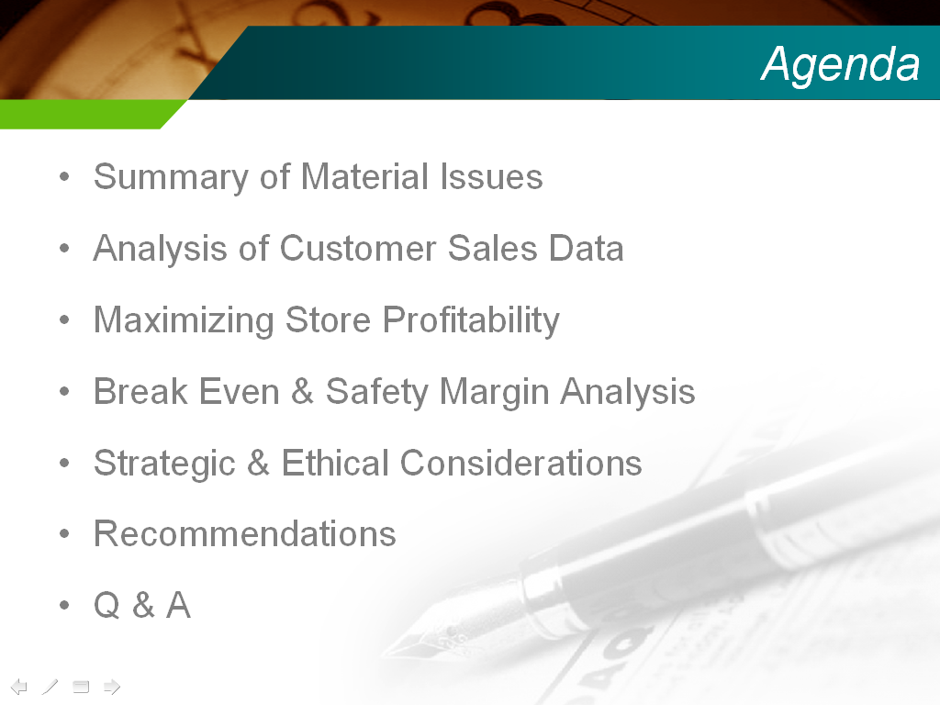

Slide 21

Branchwell Consulting
“We help you take root and grow.”
Team 6
Melik Khanamiryan | Lindsay Romo | Ozzie Canizalez | Sally Moreno | Ivelis Alday | Melissa Stephens

Slide 22



Please . . .
Hold all questions and comments until the end.
Note the associate’s name and slide number in question.
Silence all electronic devices.
If you can not hear the speaker, raise
your hand.
Melik
22
Notes:
22

Slide 23
Consistent Conceptual Theme

Slide 24
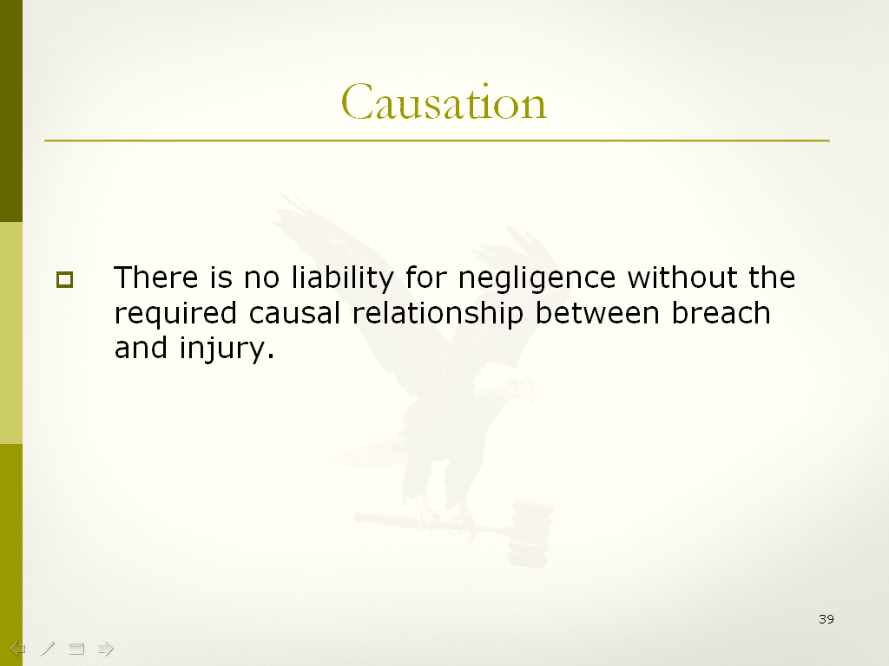

Slide 25
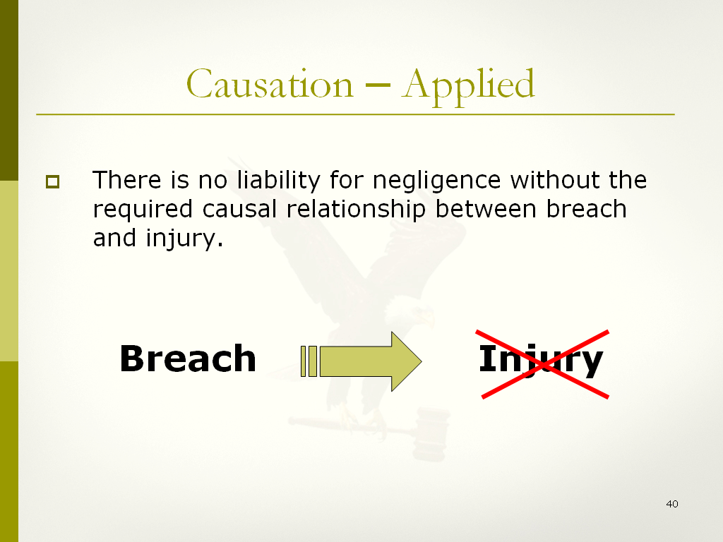

Slide 26
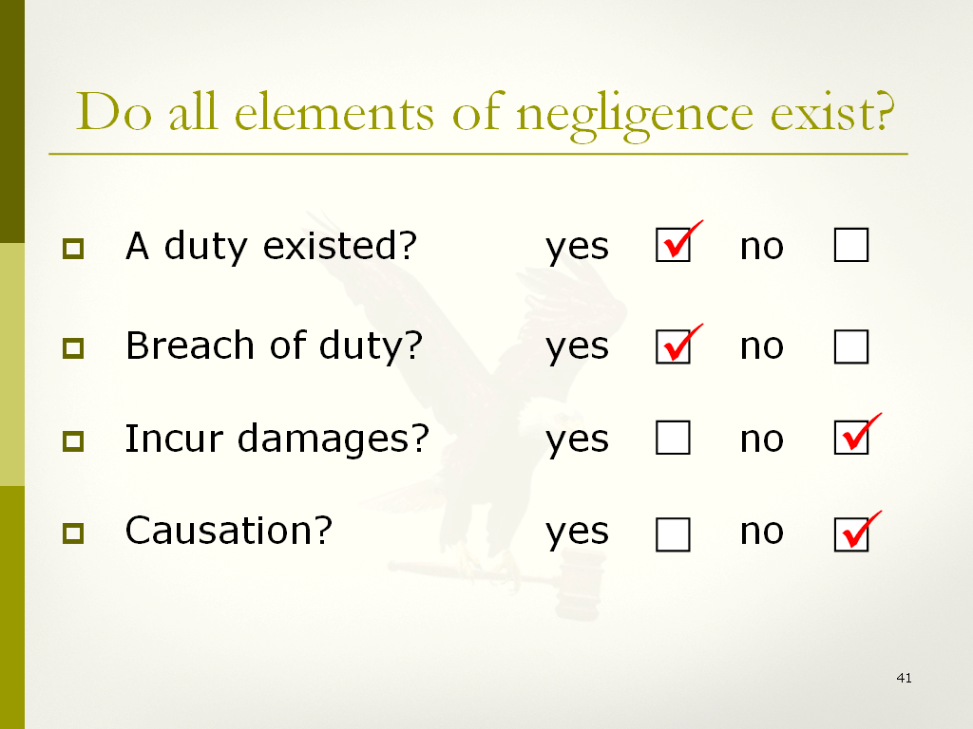

Slide 27
Purposeful Transitions

Slide 28


Slide 29
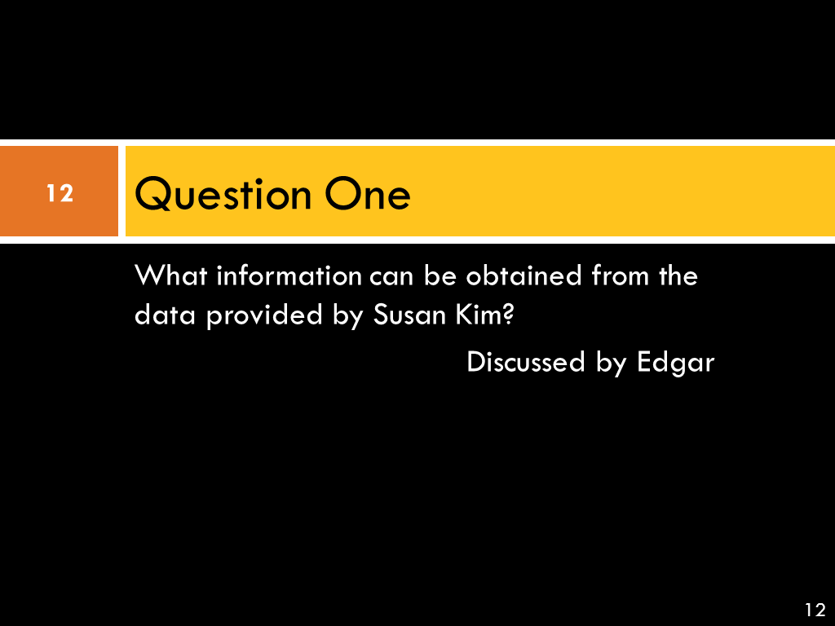

Slide 30
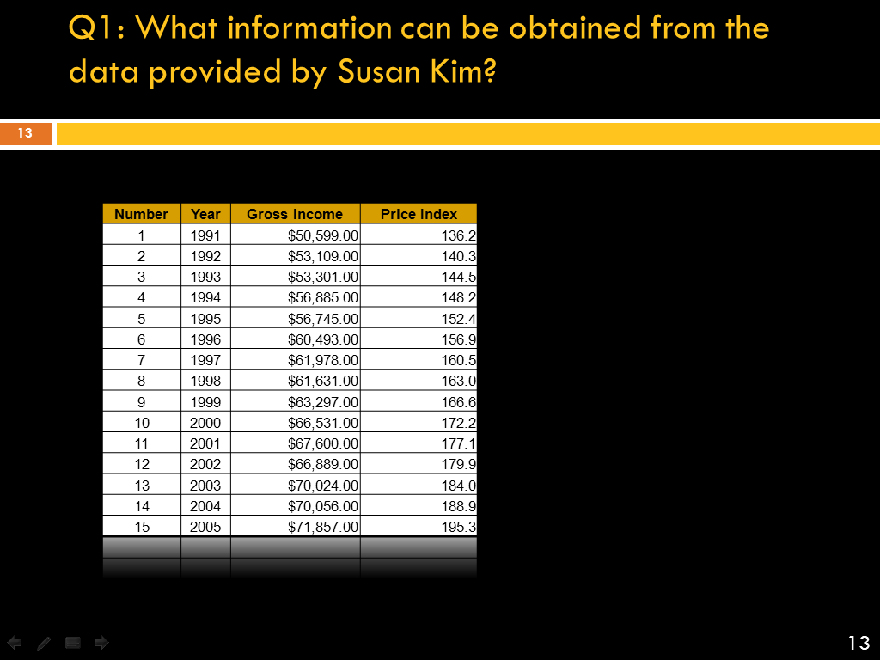

Slide 31
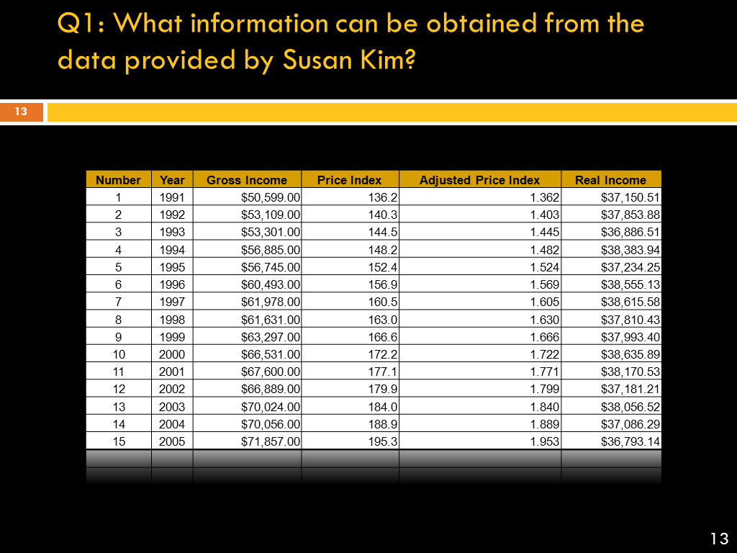

Slide 32
Judicious Use of Symbols

Slide 33
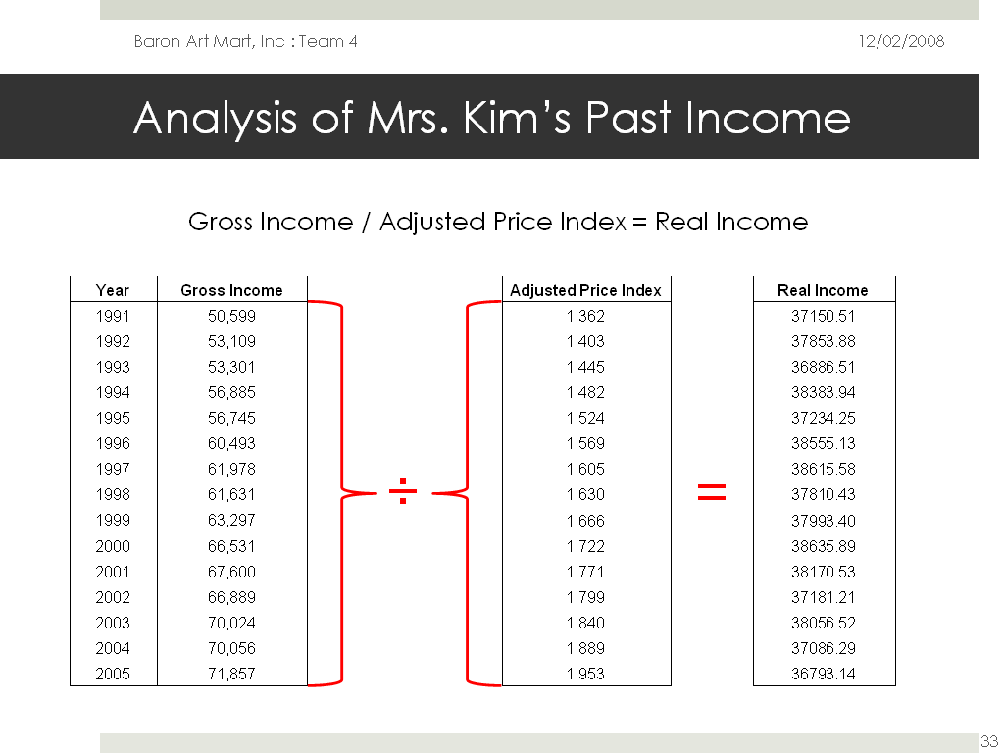

Slide 34
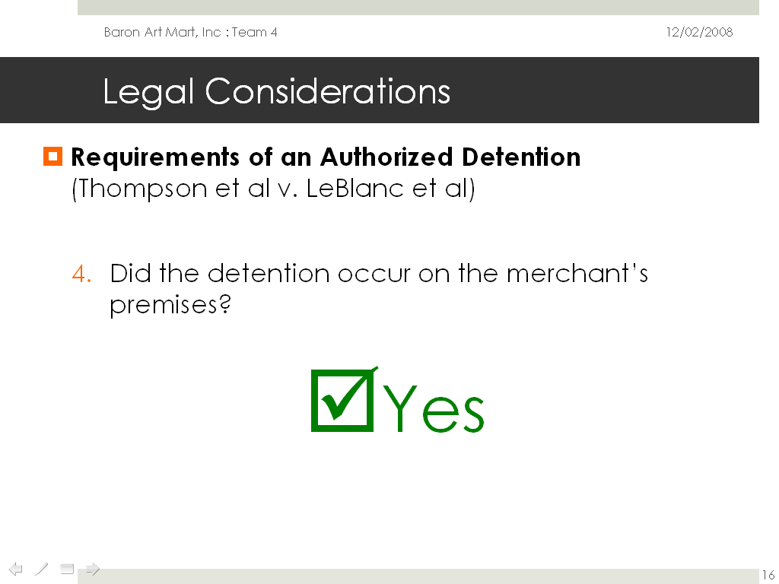

Slide 35
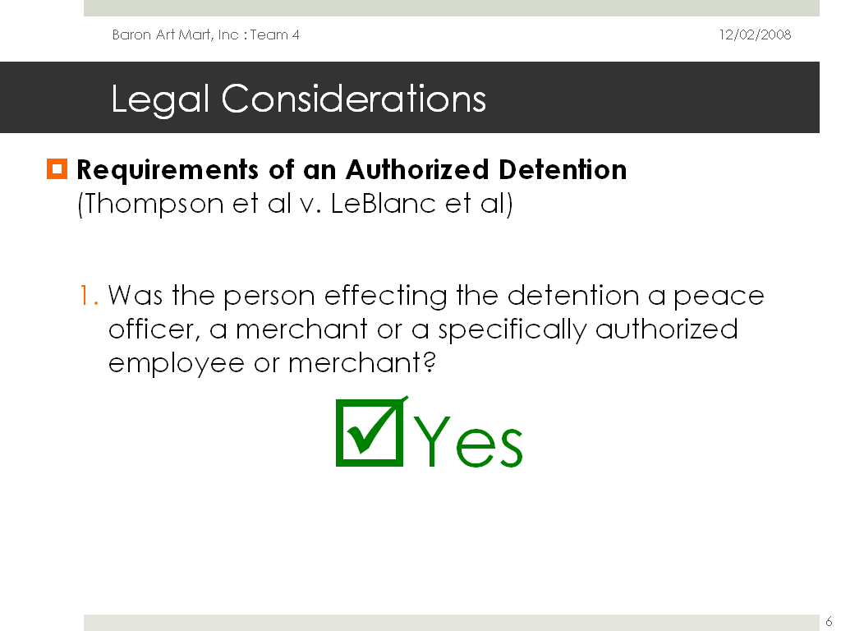
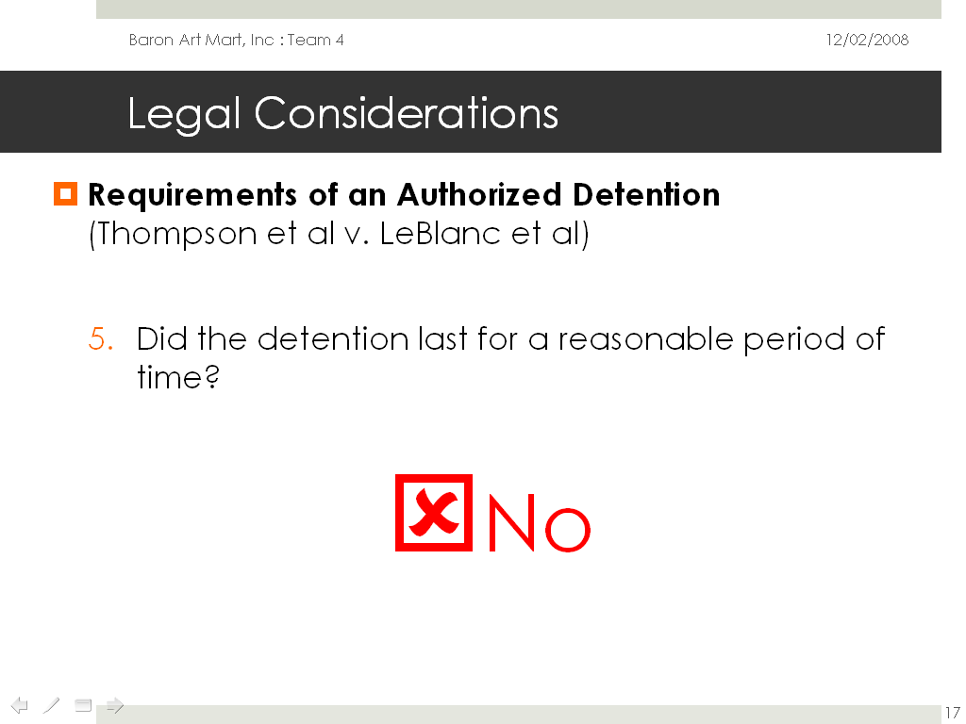

Slide 36
Judicious Use of Diagrams

Slide 37
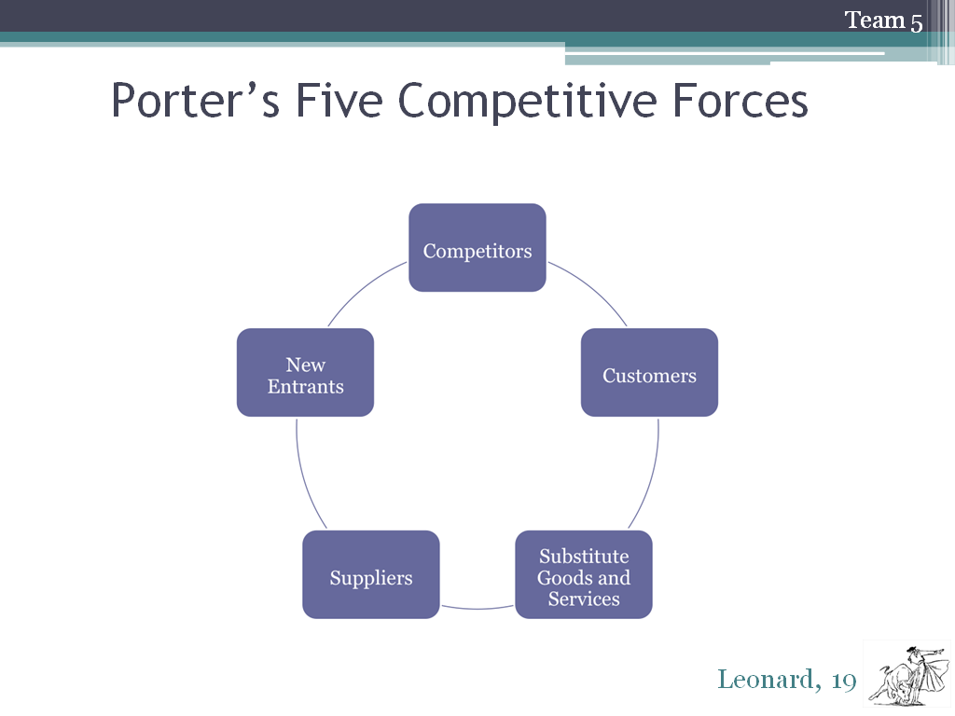

Slide 38
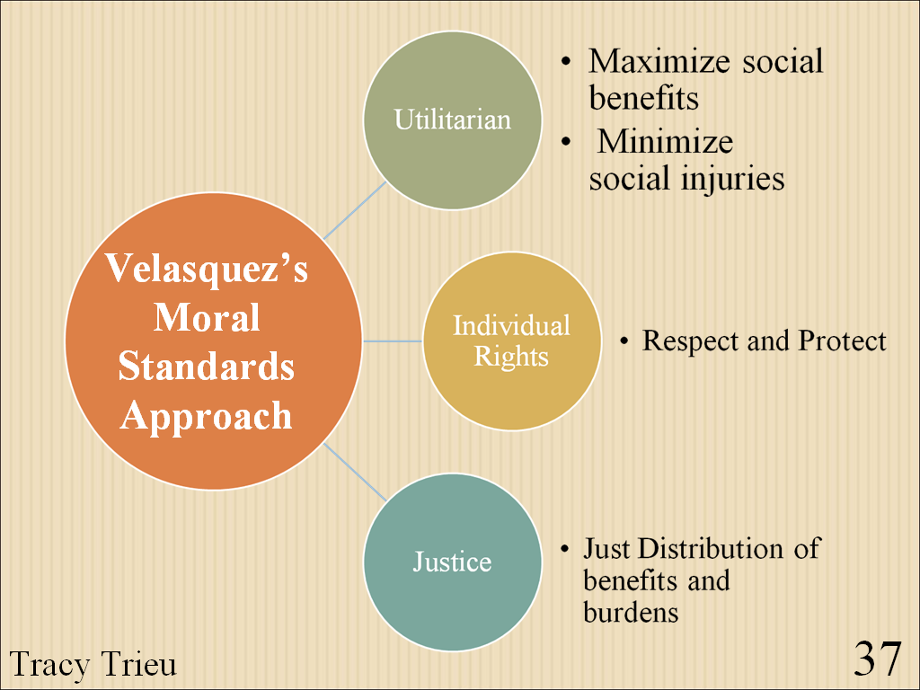

Slide 39
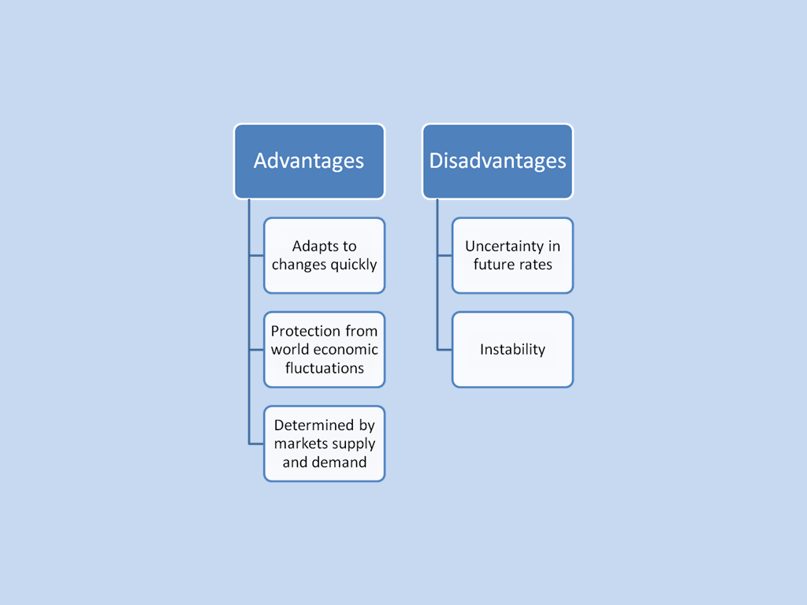

Slide 40
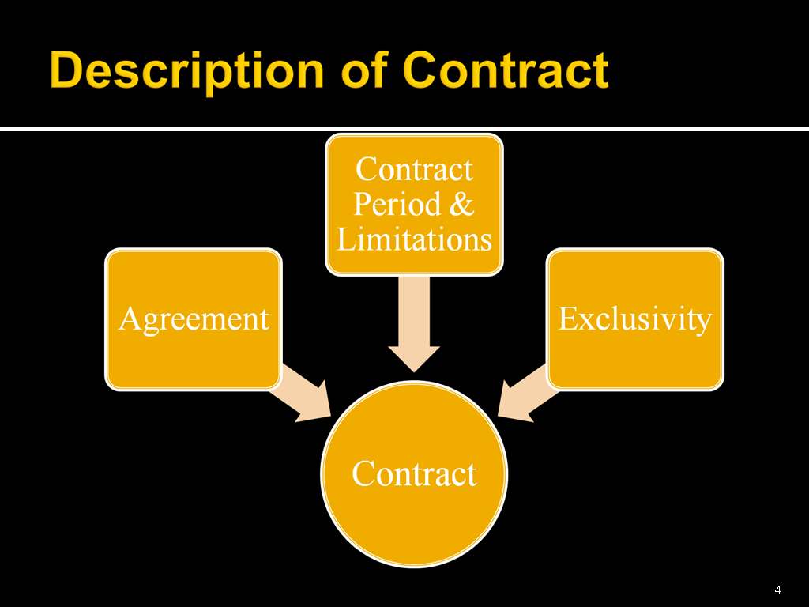

Slide 41
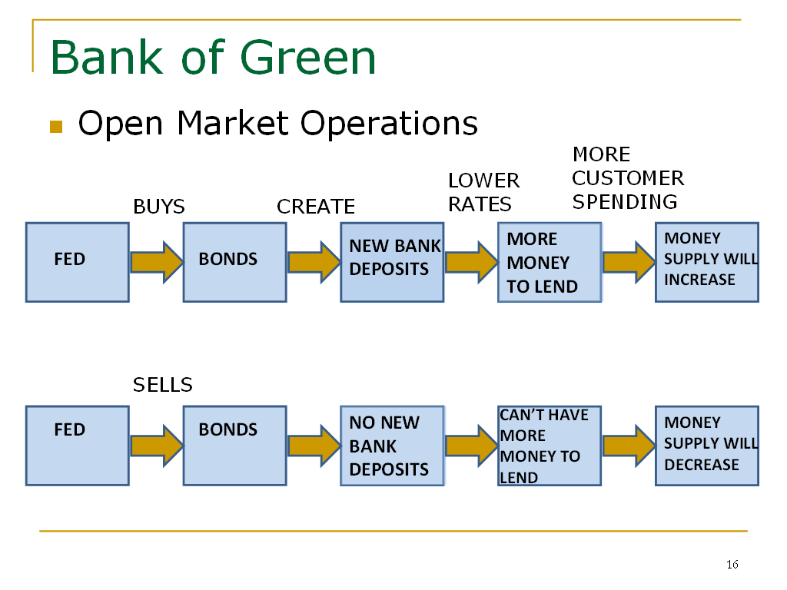
Judicious Use of Diagrams

Slide 42
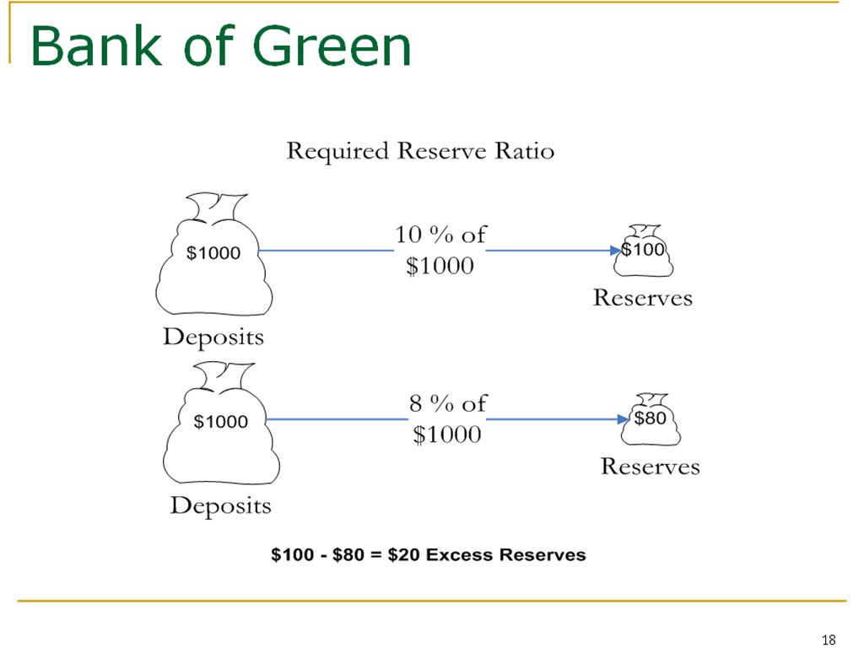

Slide 43
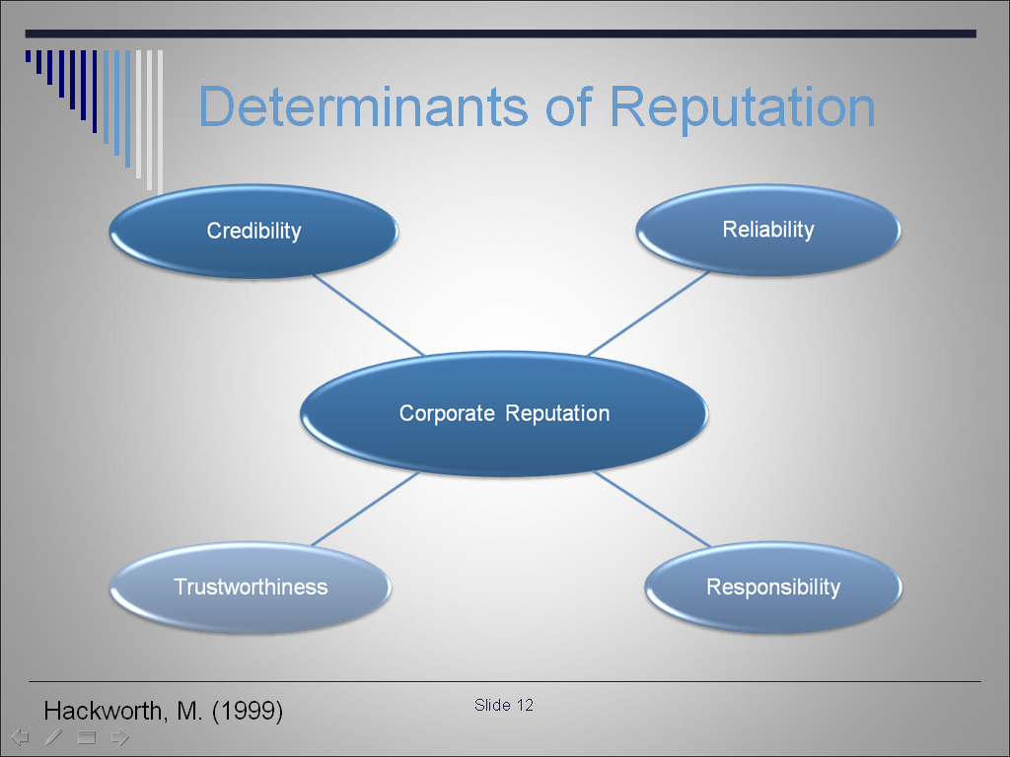

Slide 44
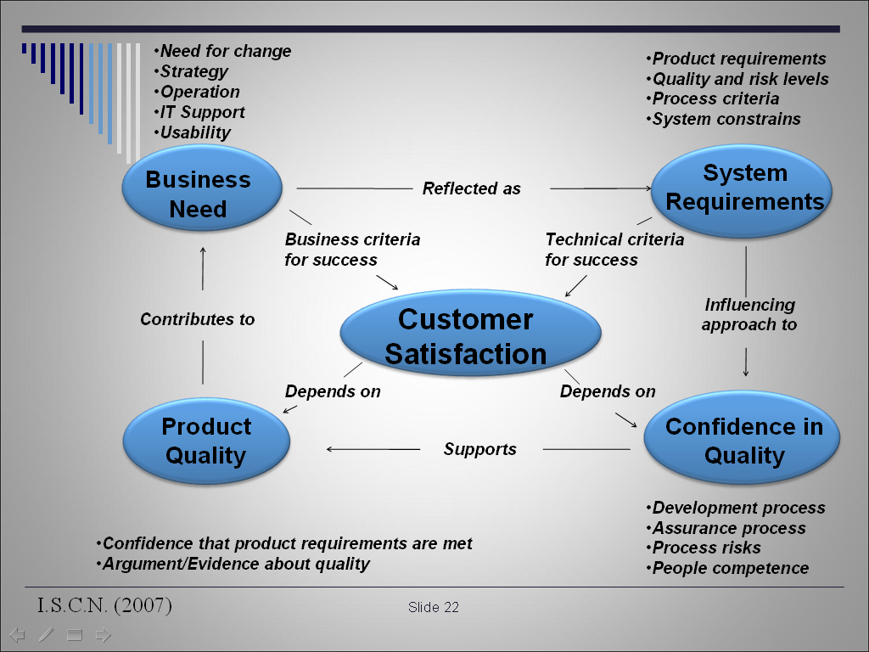

Slide 45
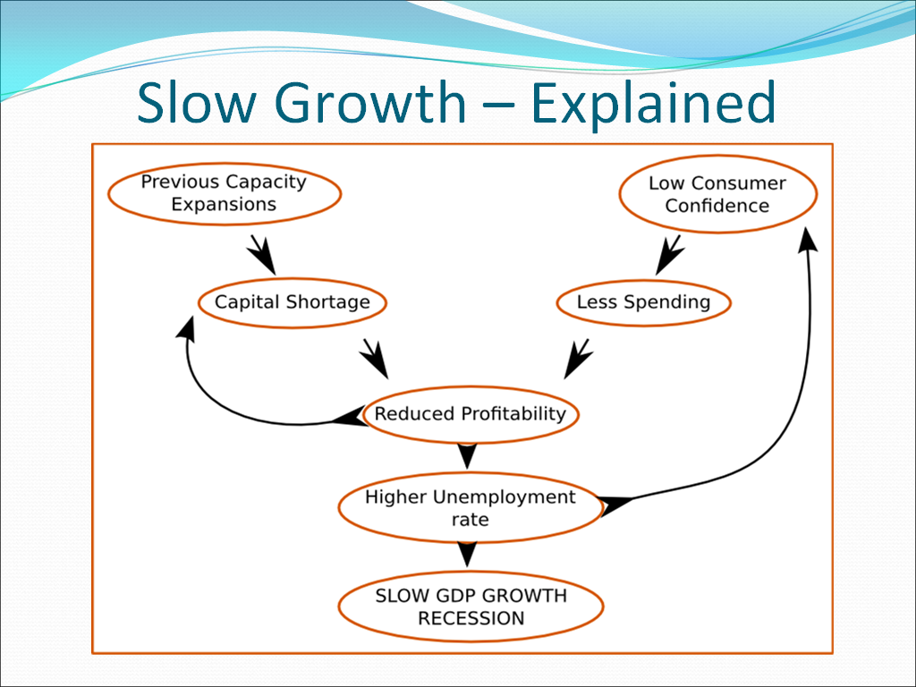

Slide 46
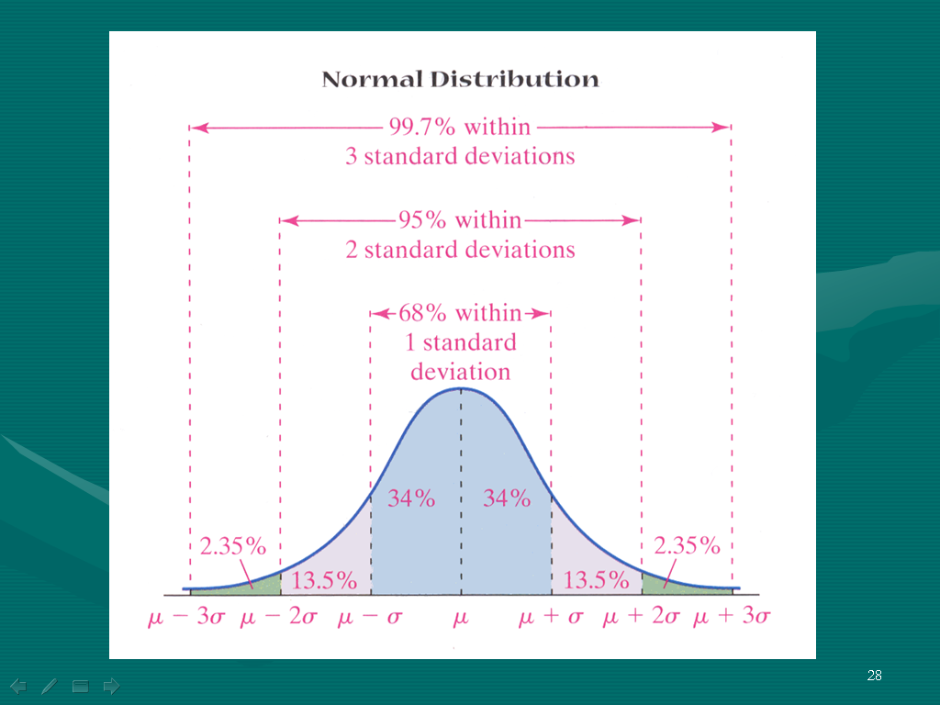

Slide 47
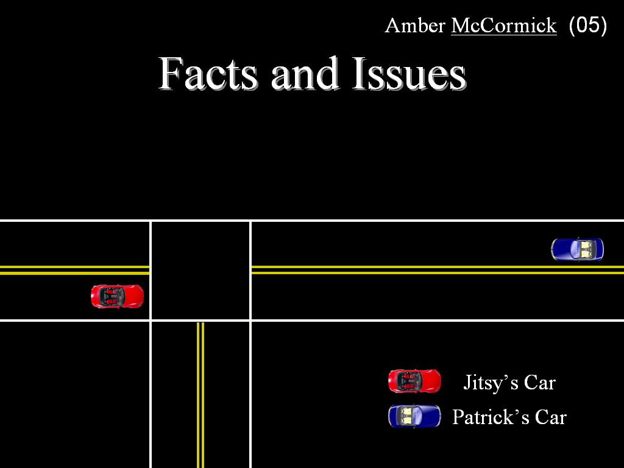

Slide 48
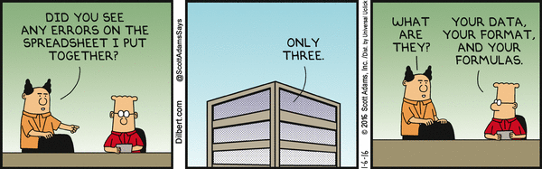

Slide 49
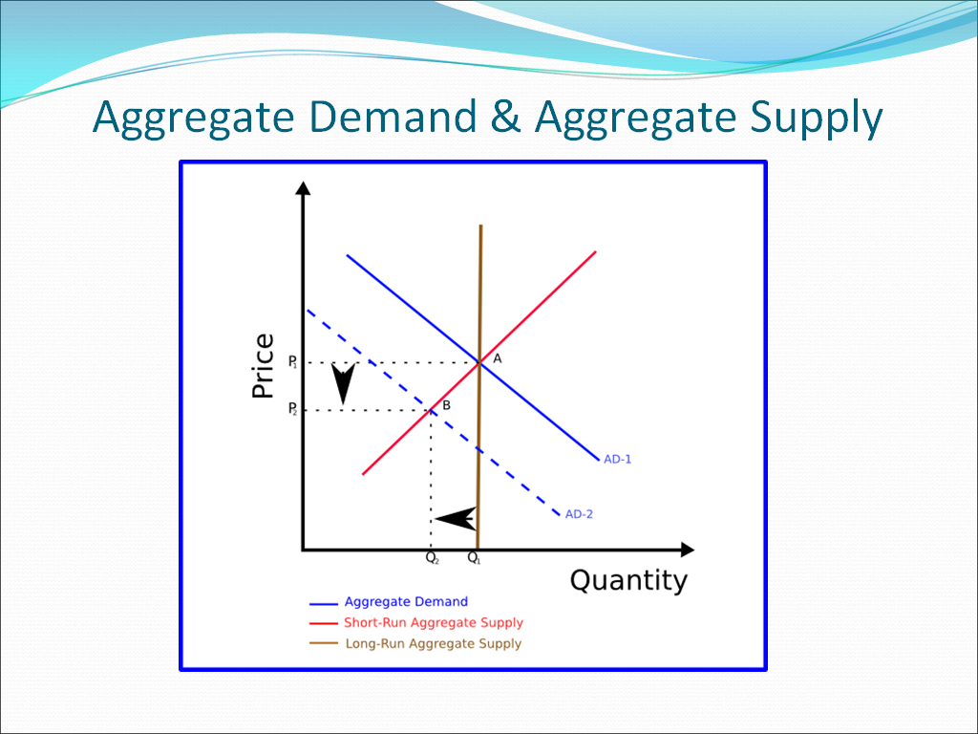
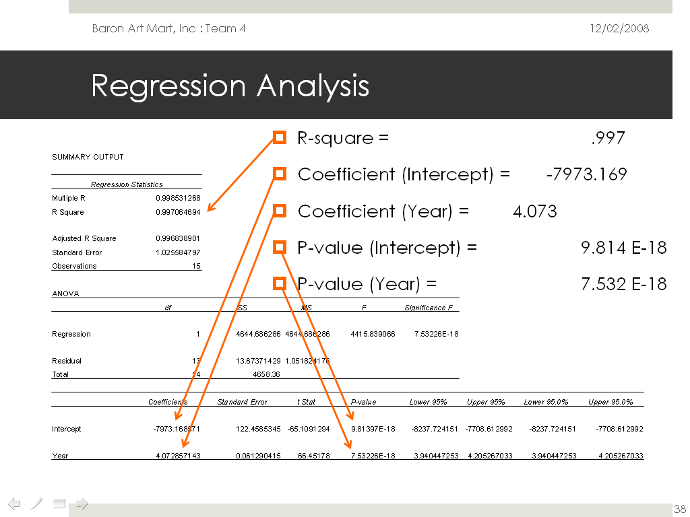
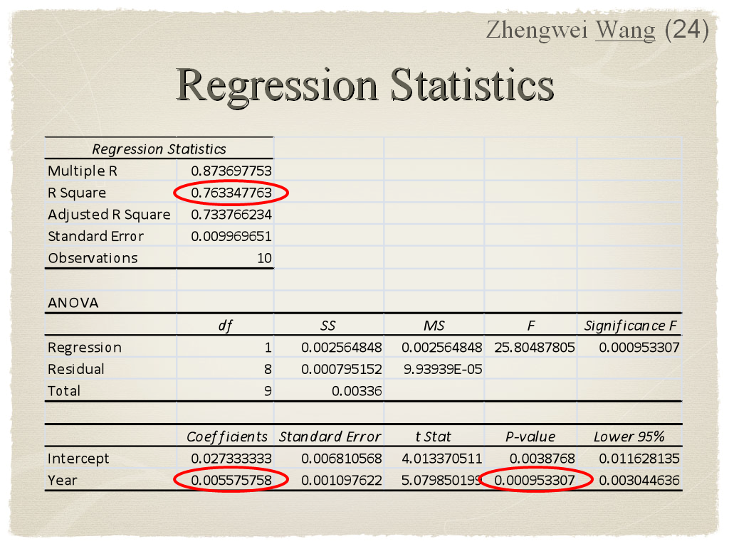

Slide 50
Judicious Use of Animation

Slide 51
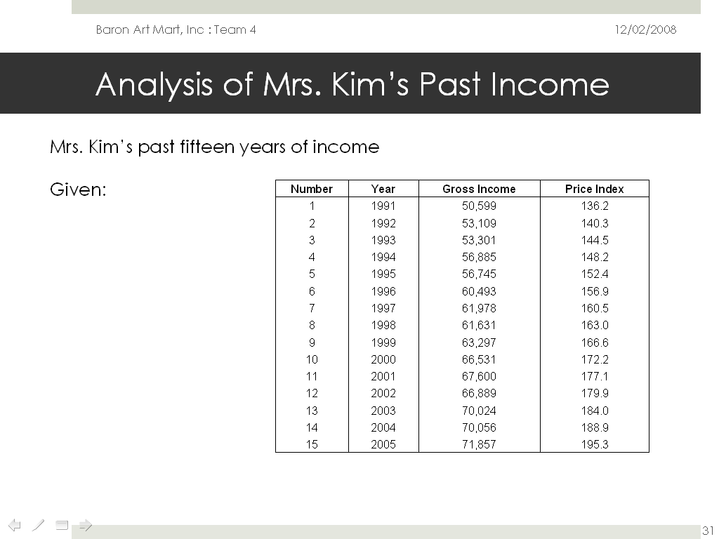

Slide 52
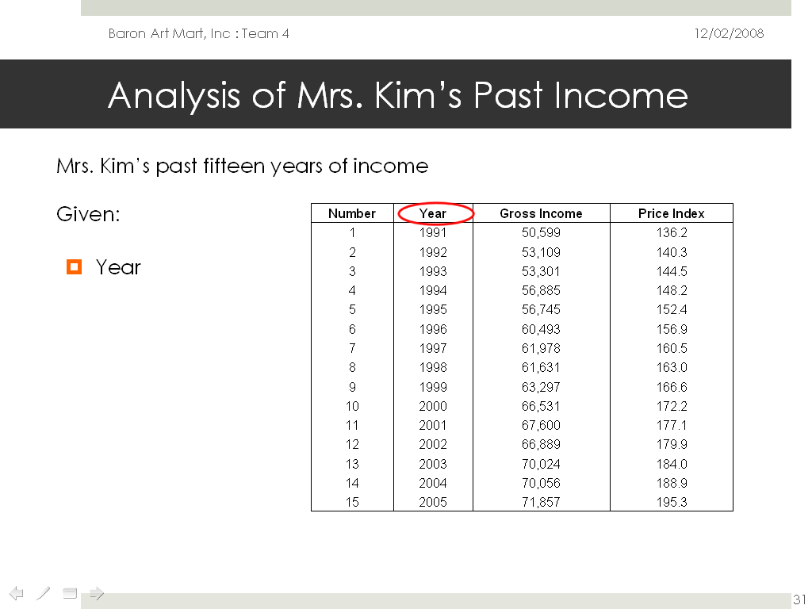

Slide 53
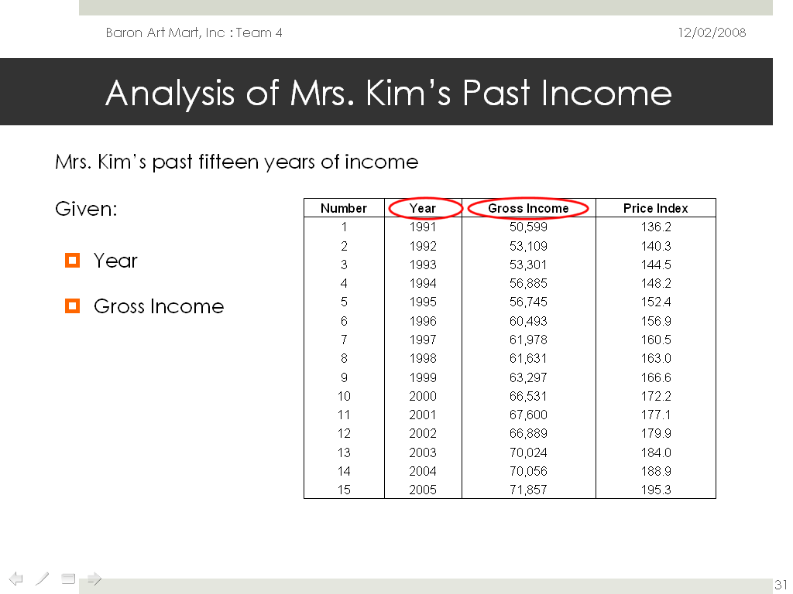

Slide 54
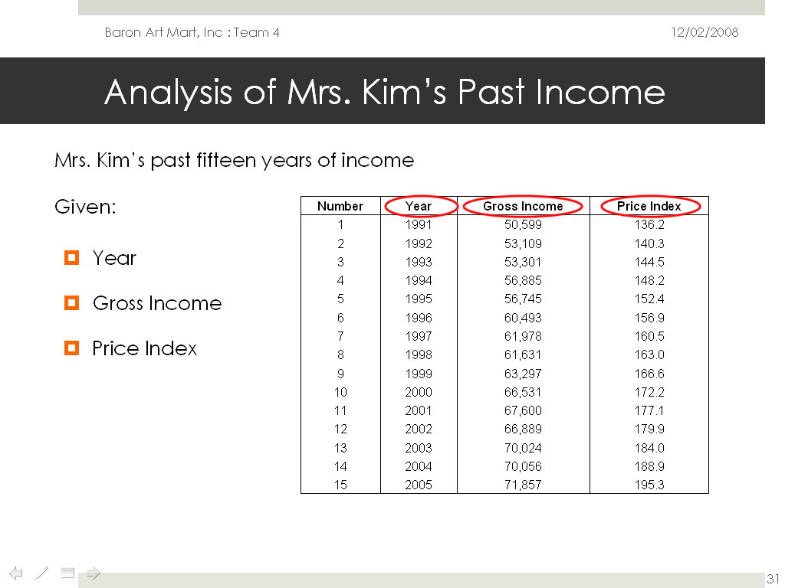

Slide 55
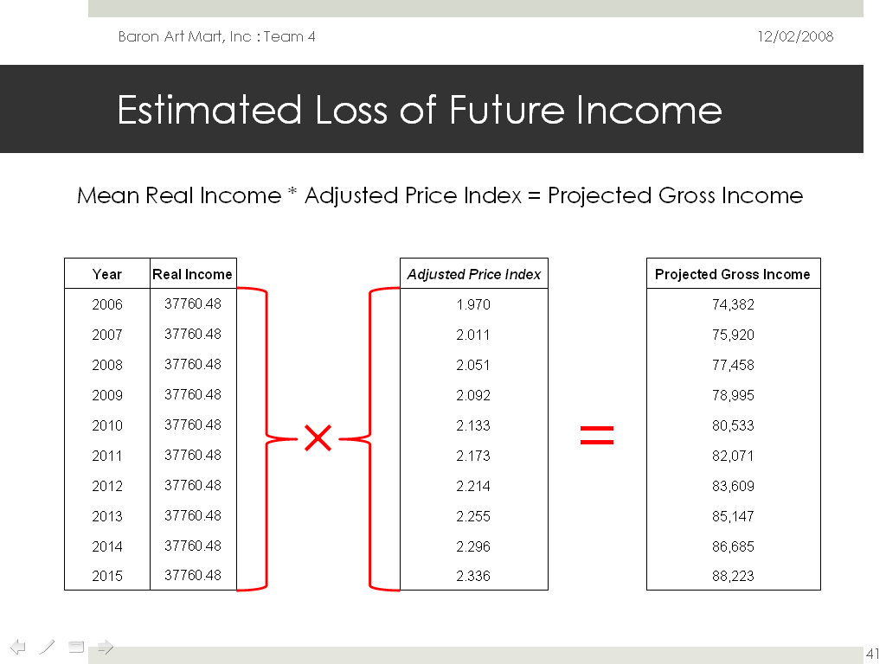

Slide 56
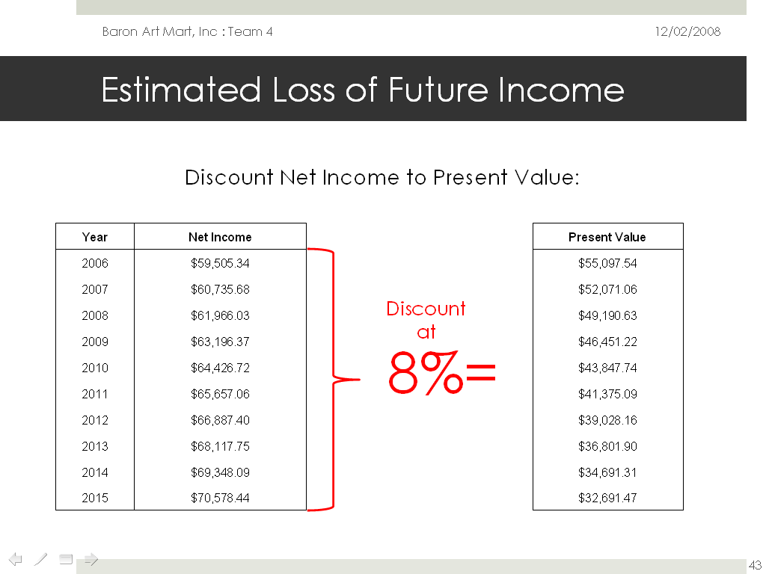

Slide 57
“Above all else, show the data”

Slide 58
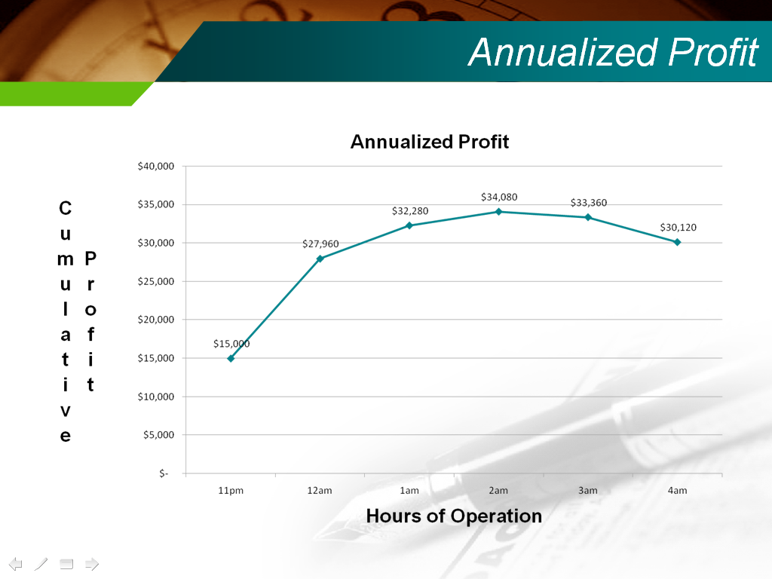

Slide 59
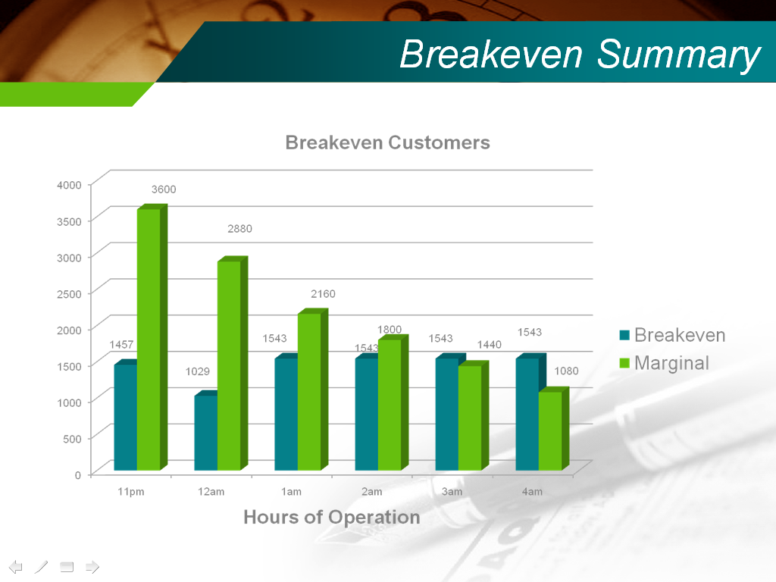

Slide 60
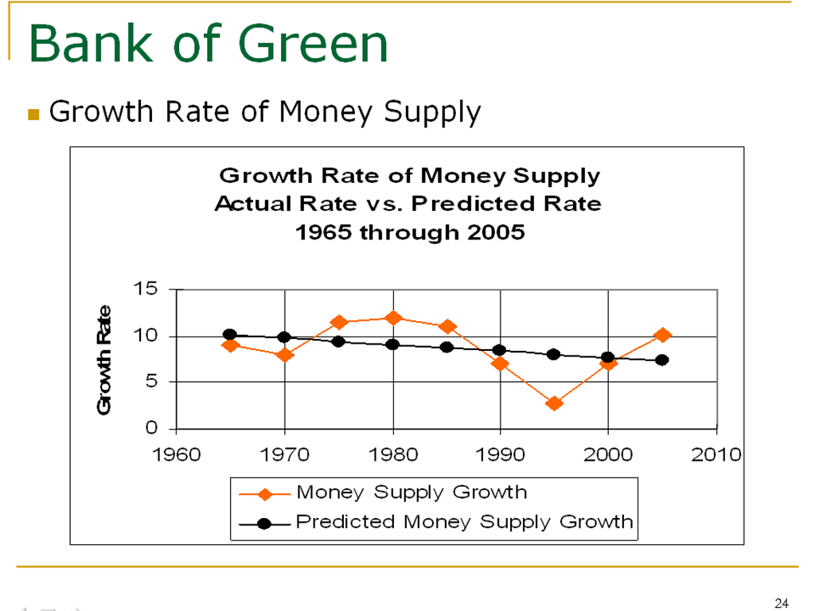

Slide 61
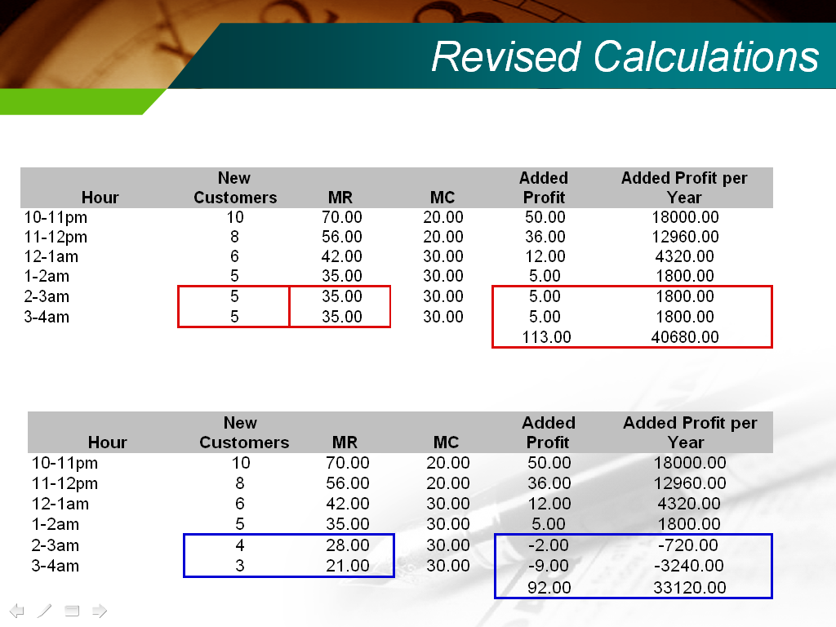

Slide 62

Troy Guanzon
(28)
CPI Index 1999-2008
Year | Year End CPI Value | Change in CPI | Inflation Rate
1999 | 148.2
2000 | 152.4 | 4.2 | 2.8
2001 | 156.6 | 4.2 | 2.8
2002 | 162.5 | 5.9 | 3.8
2003 | 166.2 | 3.7 | 2.3
2004 | 169.8 | 3.6 | 2.2
2005 | 176.0 | 6.2 | 3.7
2006 | 183.1 | 7.1 | 4.0
2007 | 192.6 | 9.5 | 5.2
2008 | 199.0 | 6.4 | 3.3
Mean Inflation Rate |  |  | 3.30%
Inflation Rate = CPI This Year - CPI Previous Year / CPI Previous Year * 100
(152.4 - 148.2) / 148.2 = 4.2
4.2 / 148.2 = 0.028
0.028 * 100 = 2.8%

Slide 63
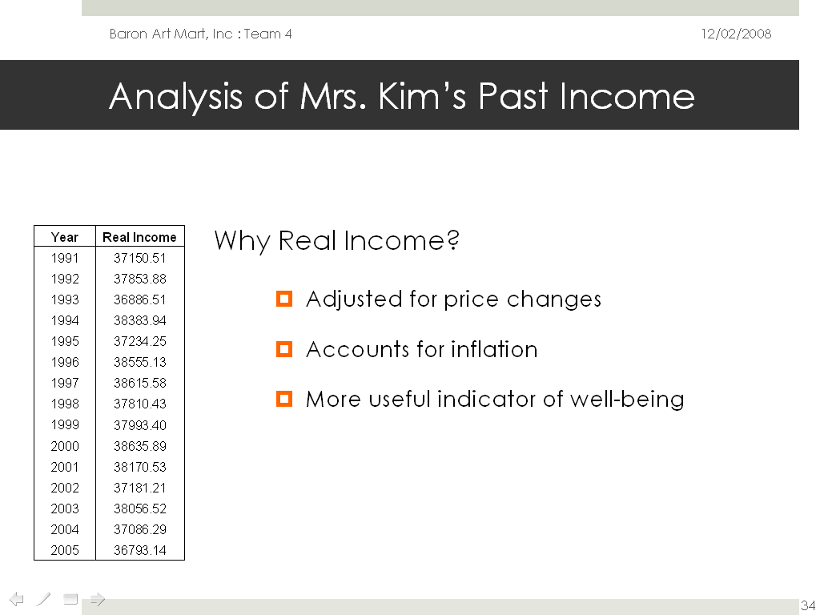

Slide 64
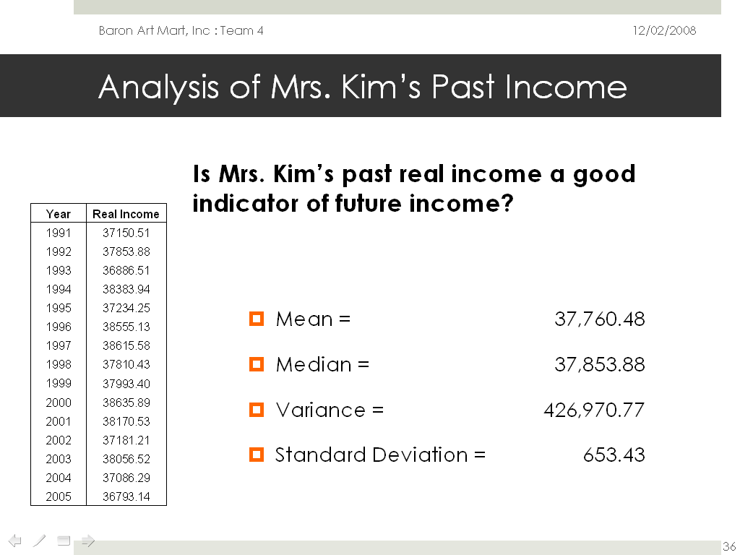

Slide 65
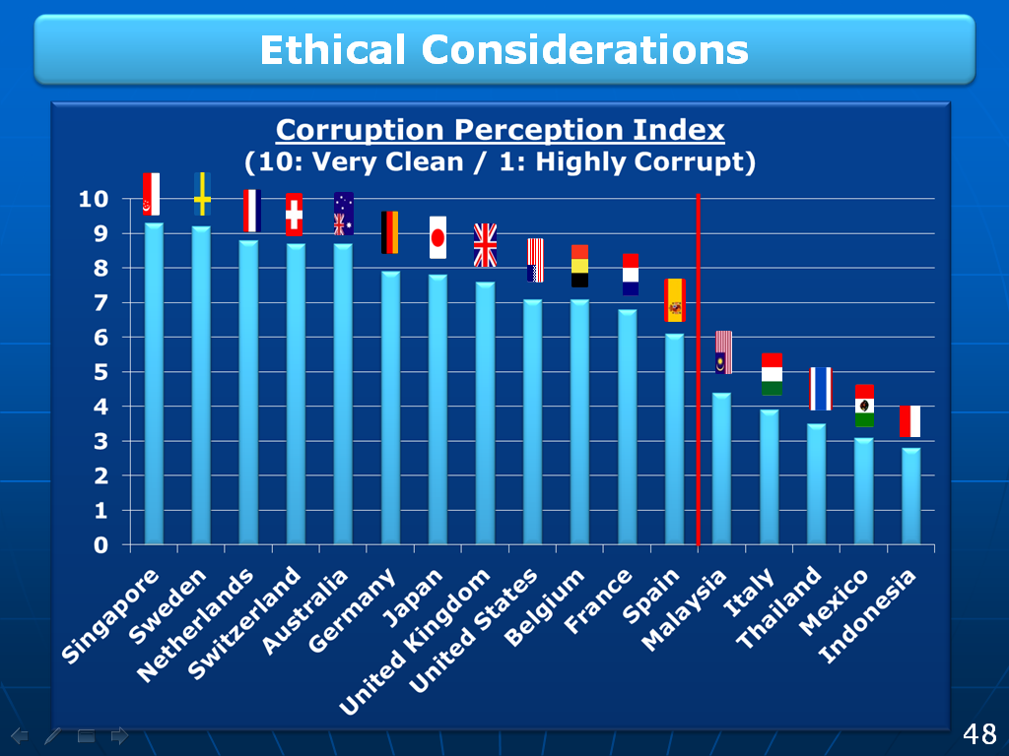

Slide 66
All Figures Right-Aligned

Slide 67


Slide 68
Pay special attention to equations and formulas

Slide 69

Don’t neglect your equations and theoretical distributions

Slide 70


Slide 71


Slide 72
You can always print and handout a few detailed slides

Slide 73


Slide 74
Can be “too few”—but your job is to fill in the details

Slide 75


Slide 76


Slide 77
Neither “too few” nor “too many” words or long sentences

Slide 78


Slide 79
Too “Wordy”

Slide 80


Slide 81


Slide 82
Sometimes Too “Wordy” can be OK—it’s just an overall image

Slide 83


Slide 84
Good (but not overdone) Use of Color

Slide 85


Slide 86


Slide 87
Good (but possibly overdone) Use of Color

Slide 88


Slide 89
Not enough color contrast

Slide 90


Slide 91
Use plenty of space between different items on a slide

Slide 92


Slide 93


Slide 94


Slide 95
You Still Need References

Slide 96


Slide 97


Slide 98


Slide 99
Always end with a “contact” slide

Slide 100


Slide 101
Express Sincere Gratitude

Slide 102


Slide 103


Slide 104
Prepare “Back Pockets” Slides

Slide 105


Slide 106
Consider reading—
Duarte, N. (2008), Slide:ology: The Art and Science of Creating Great Presentations, O’Reilly Media.

