Slide 1
Examples of many good (and a few not-so-good) student PowerPoint presentations
Wayne Smith, Ph.D.
Department of Management
CSU Northridge
wayne.smith@csun.edu

Slide 2
Clear and Unambiguous Introduction

Slide 3
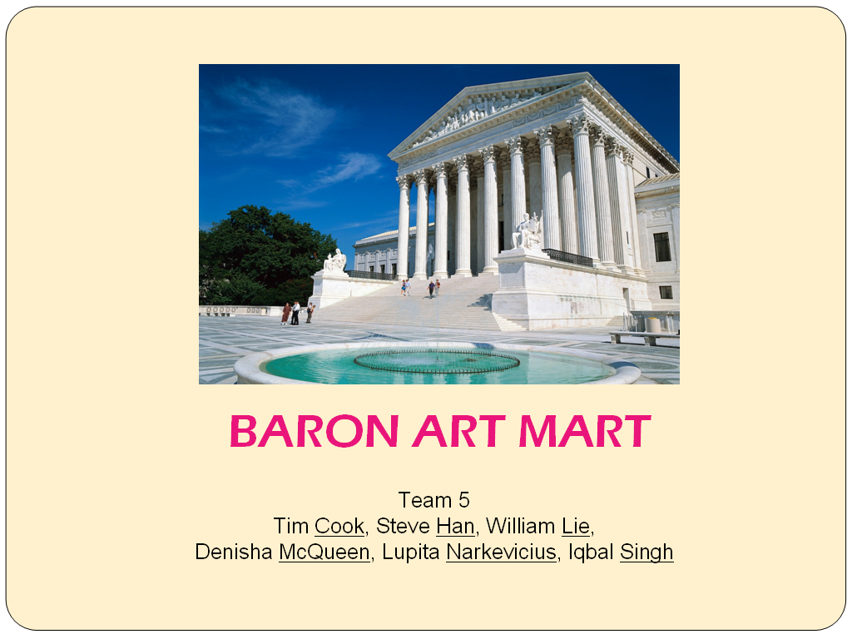

Slide 4
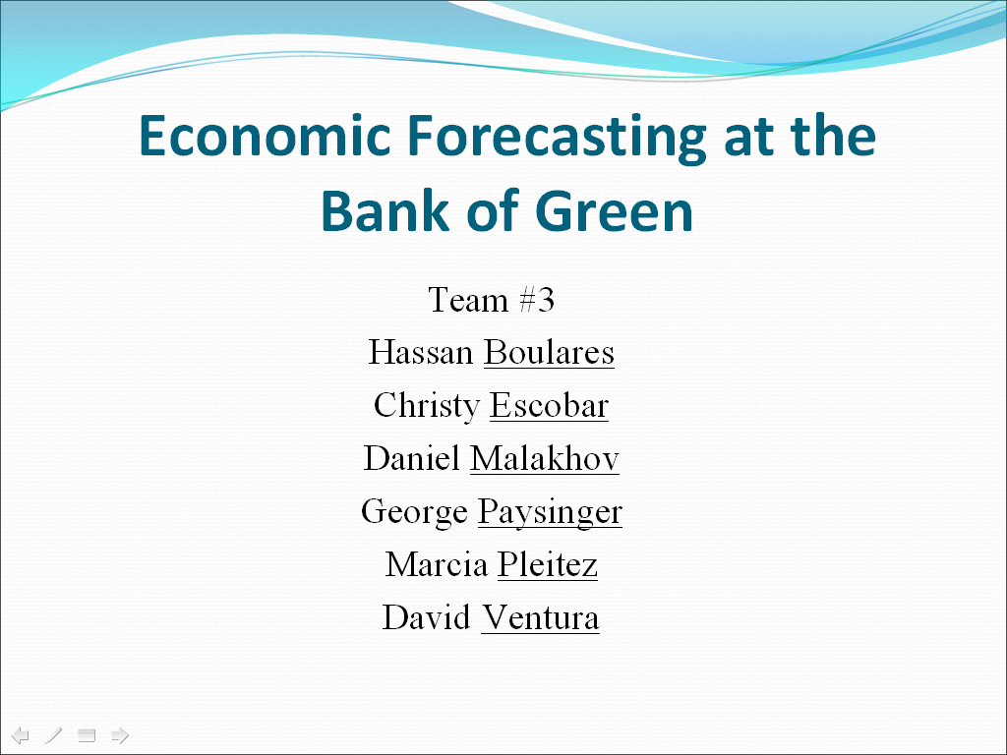

Slide 5
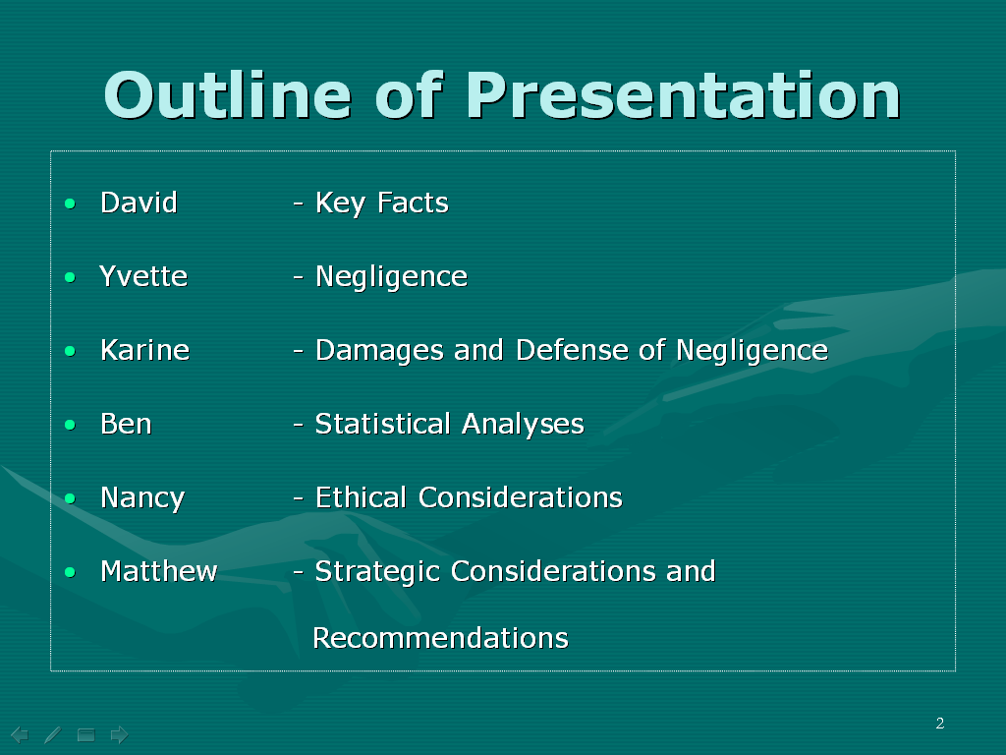

Slide 6
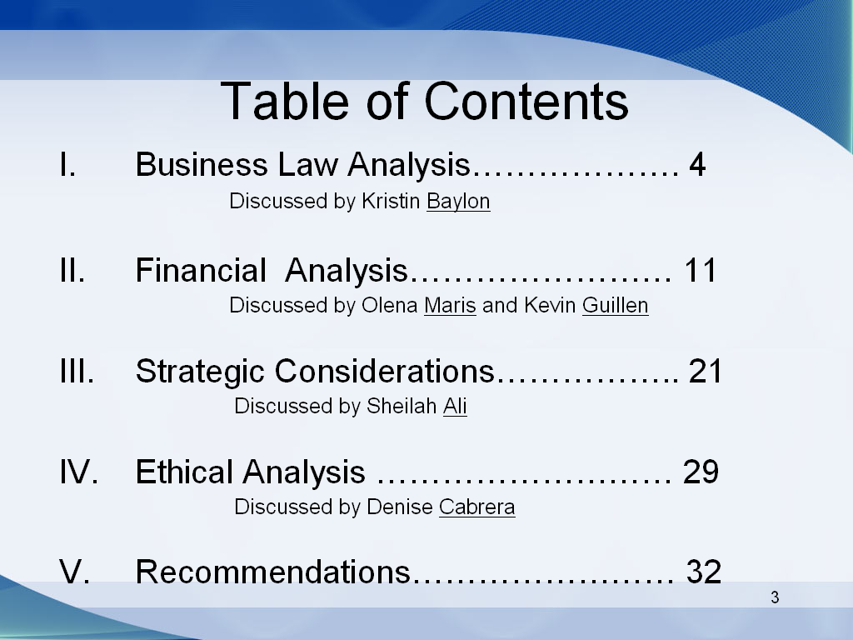

Slide 7
Repeat names as needed

Slide 8
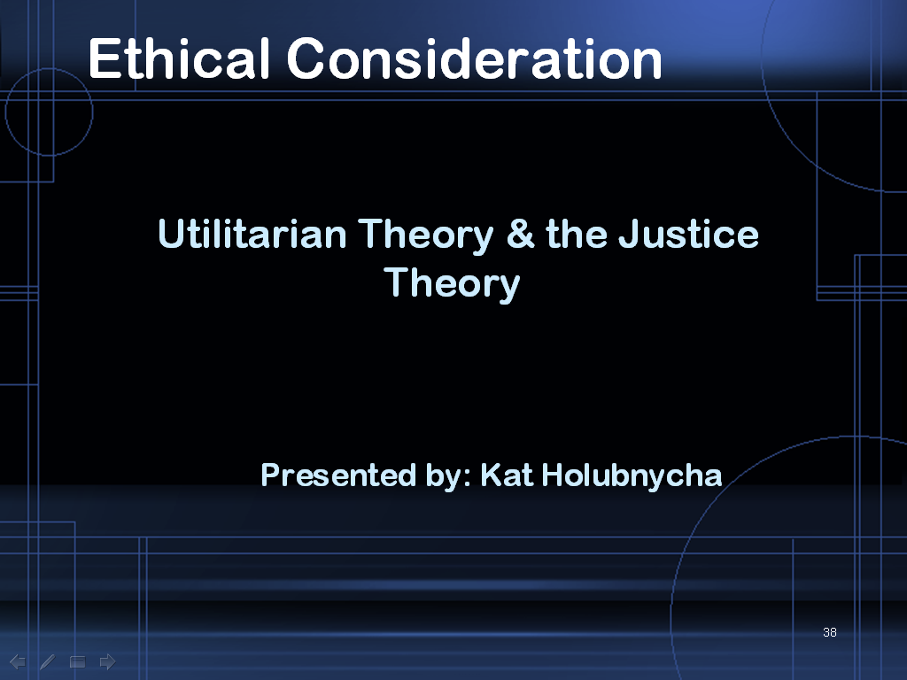

Slide 9
Use Relevant Graphics Early to “Connect” with the Audience

Slide 10
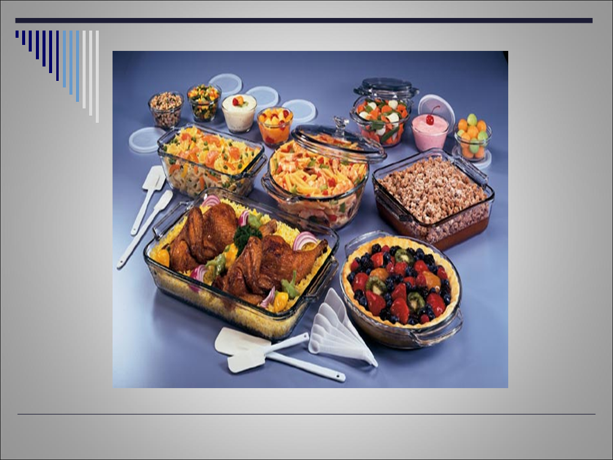

Slide 11
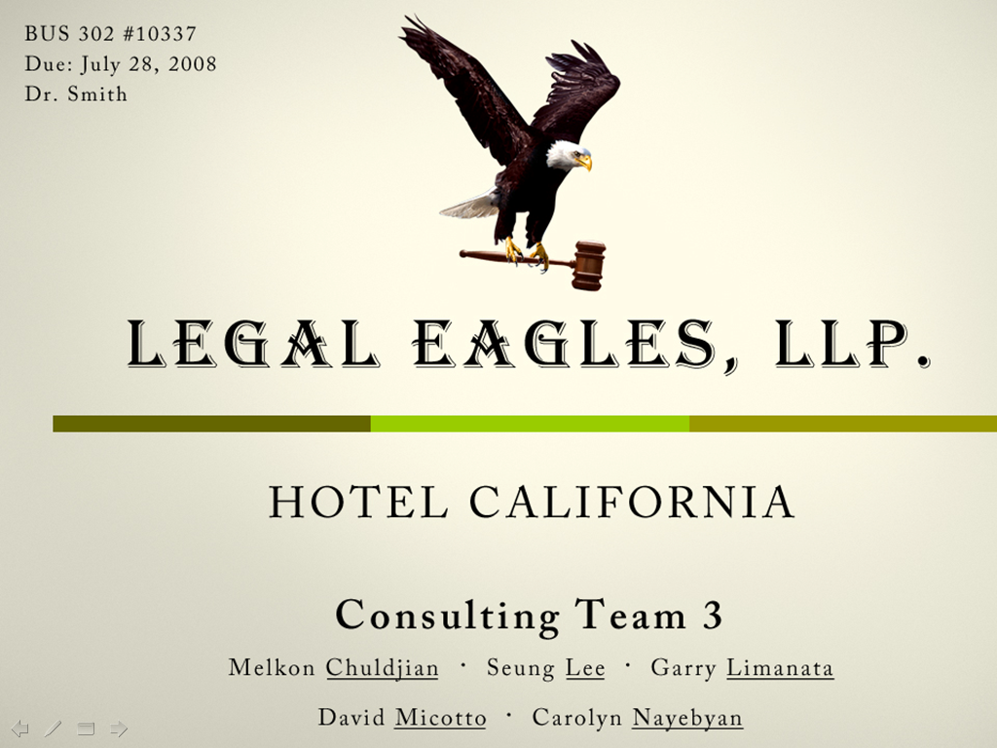

Slide 12


Slide 13


Slide 14
Consistent Visual Theme

Slide 15


Slide 16
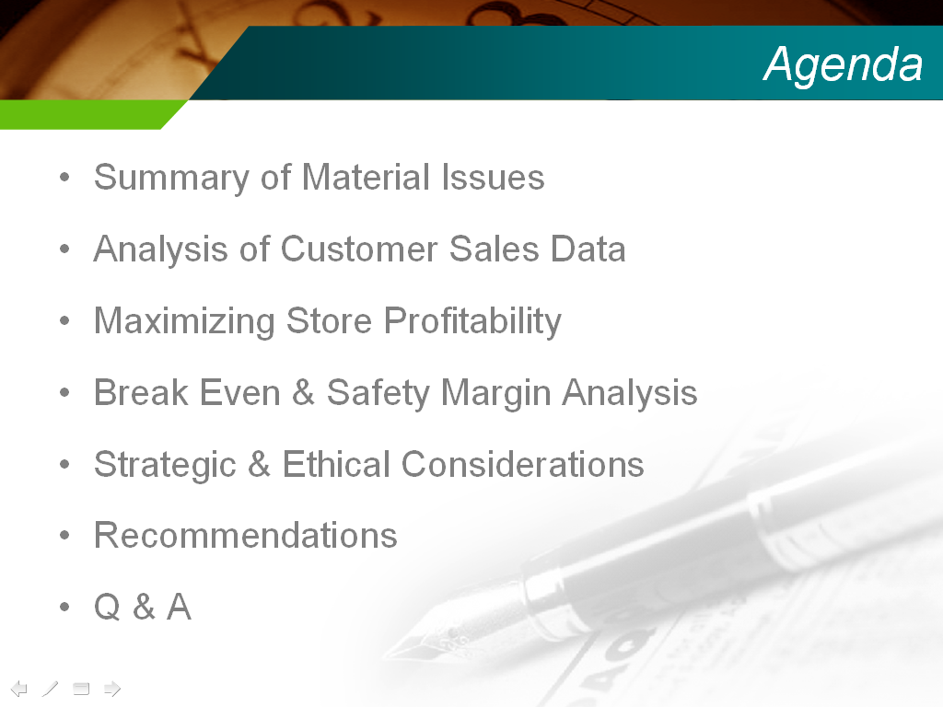

Slide 17

Branchwell Consulting
“We help you take root and grow.”
Team 6
Melik Khanamiryan | Lindsay Romo | Ozzie Canizalez | Sally Moreno | Ivelis Alday | Melissa Stephens

Slide 18



Please . . .
Hold all questions and comments until the end.
Note the associate’s name and slide number in question.
Silence all electronic devices.
If you can not hear the speaker, raise
your hand.
Melik
18
Notes:
18

Slide 19
Purposeful Transitions

Slide 20


Slide 21
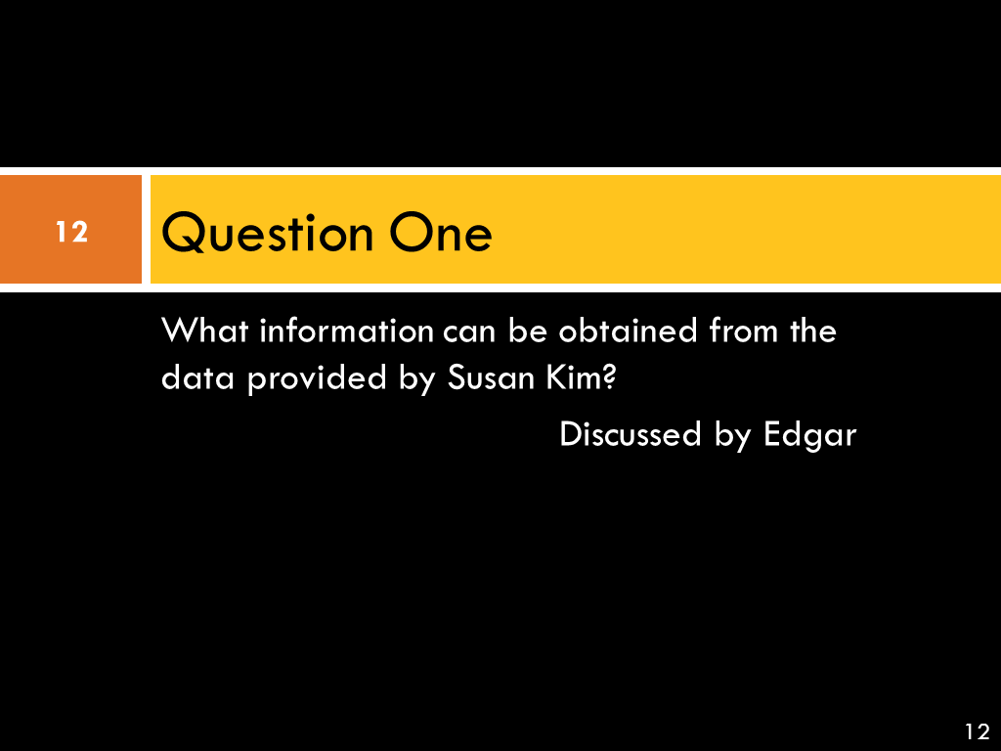

Slide 22
Judicious Use of Diagrams

Slide 23
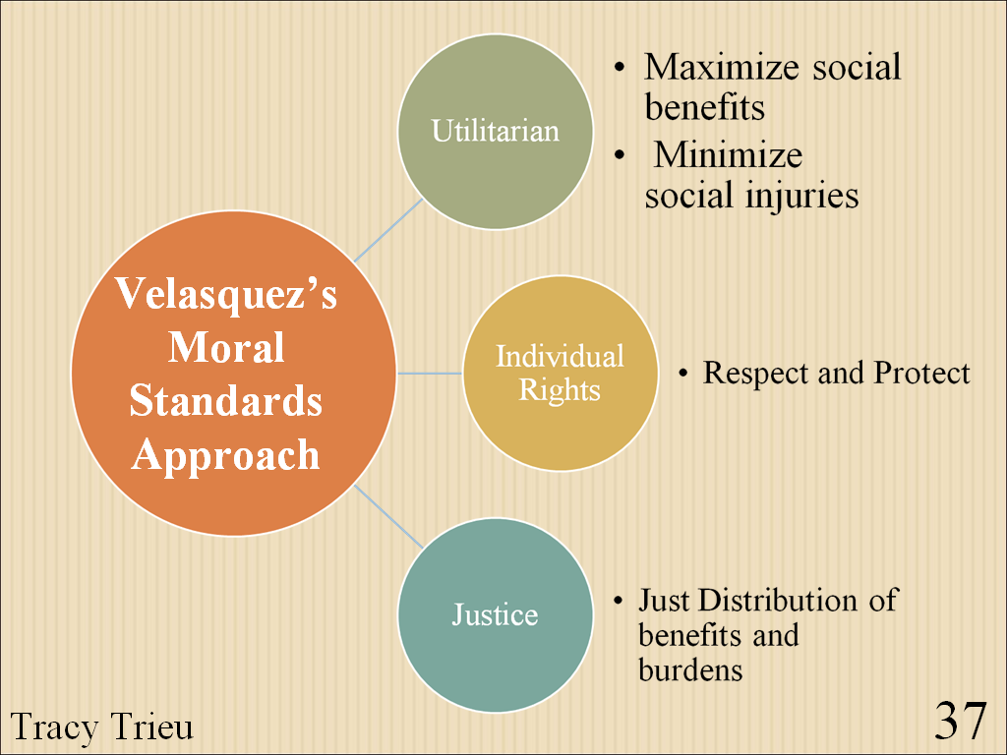

Slide 24
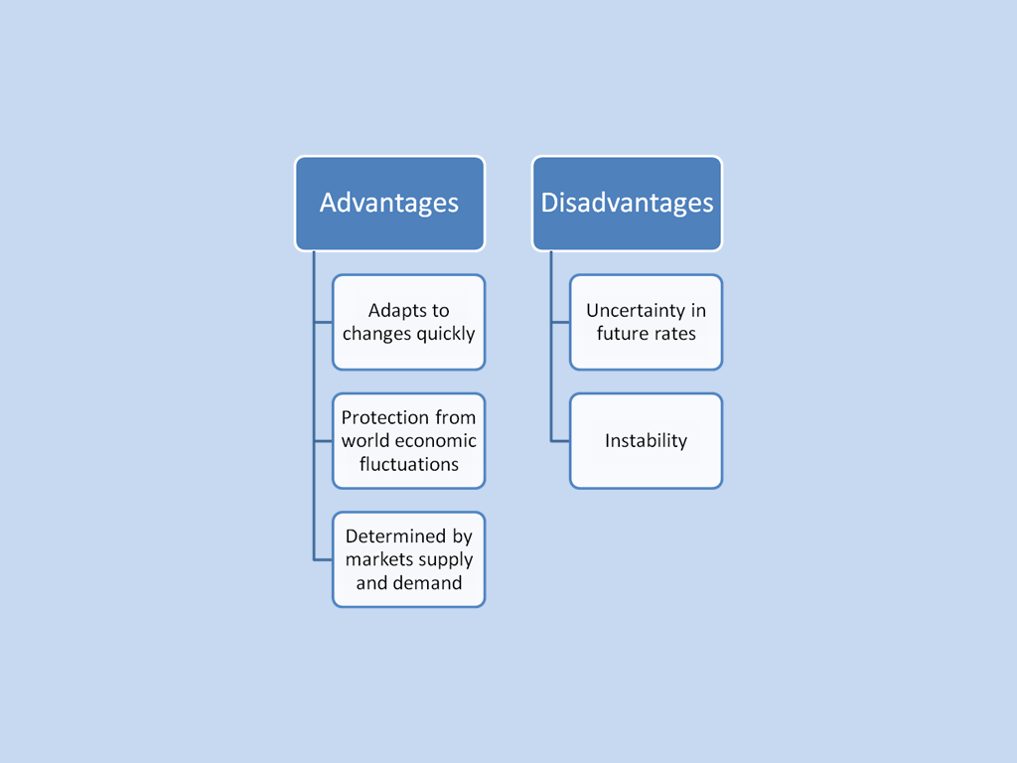

Slide 25
Appropriate Level of Abstraction

Slide 26
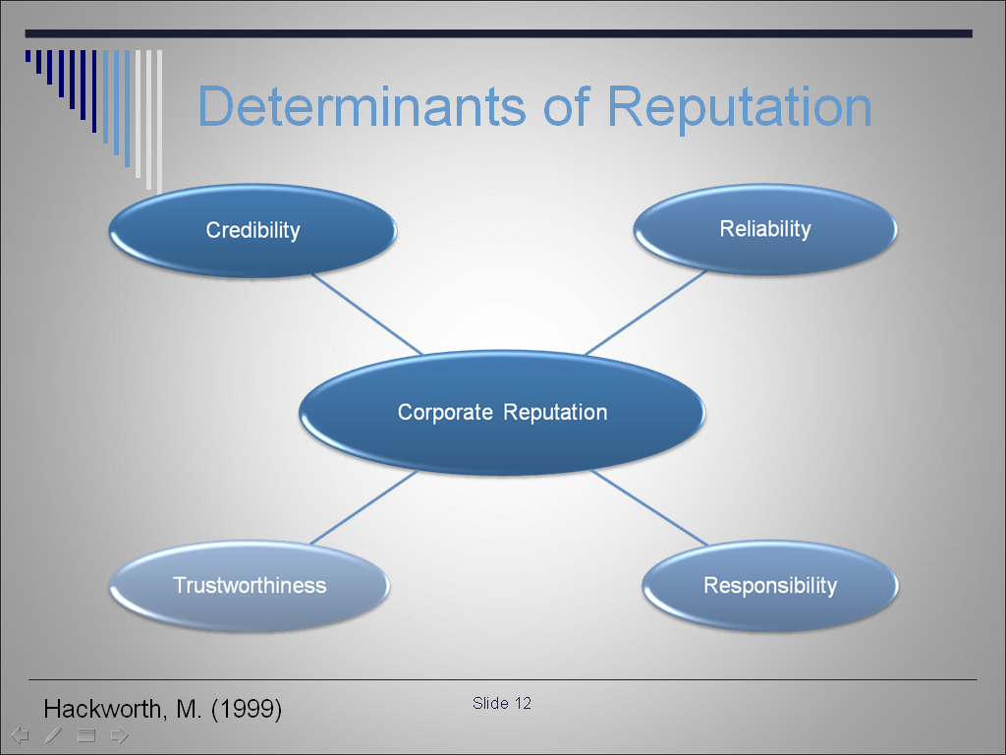

Slide 27
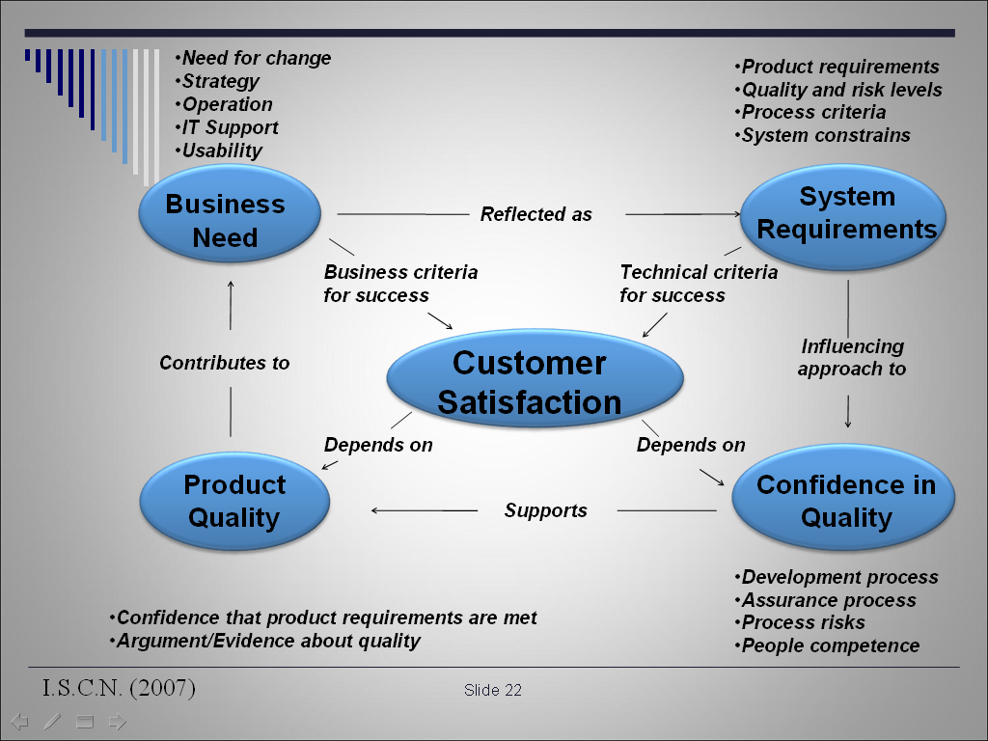

Slide 28
Don’t be afraid to go mathematical or technical

Slide 29
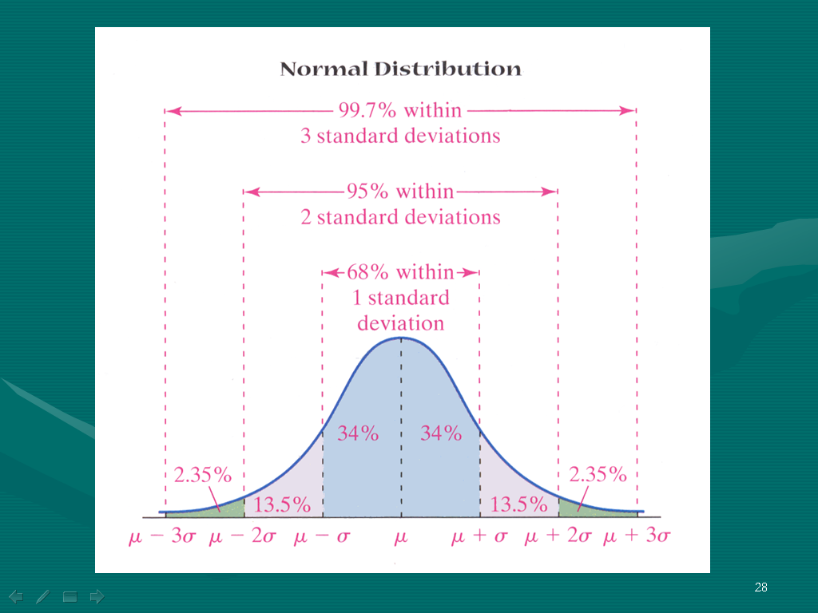

Slide 30
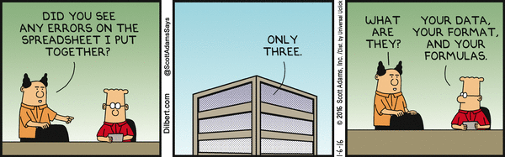

Slide 31
Highlight Important Details

Slide 32
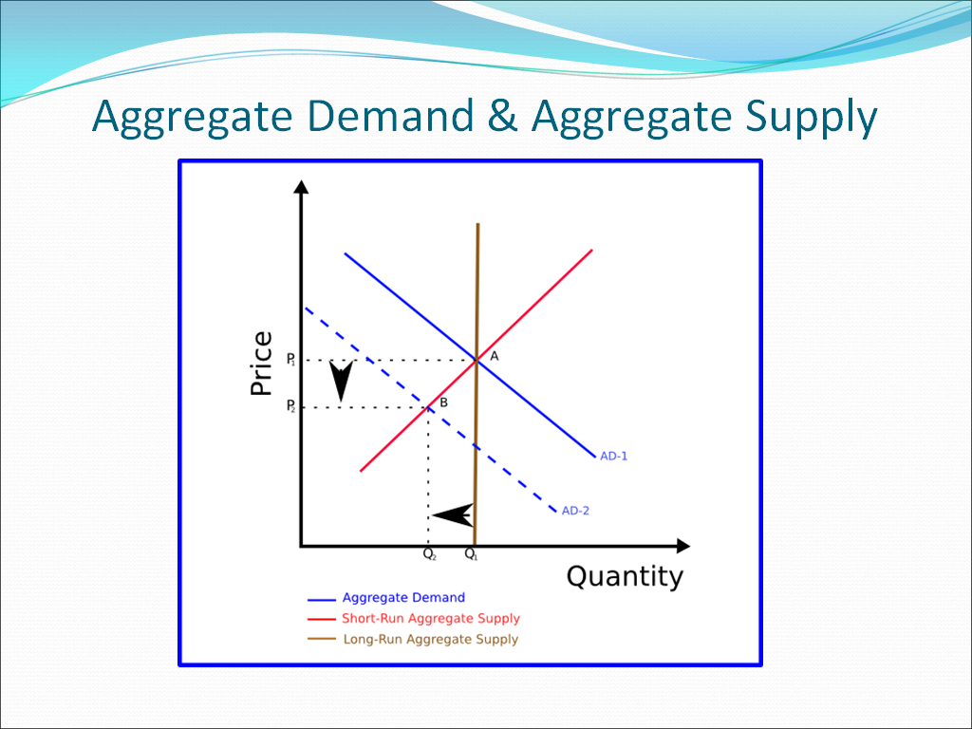
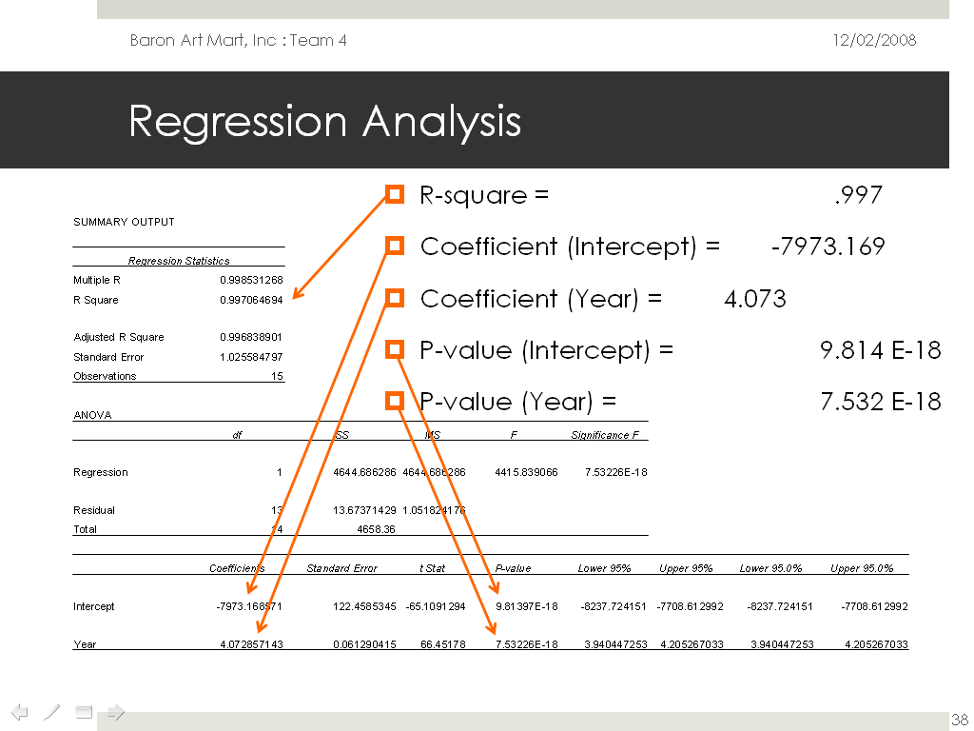
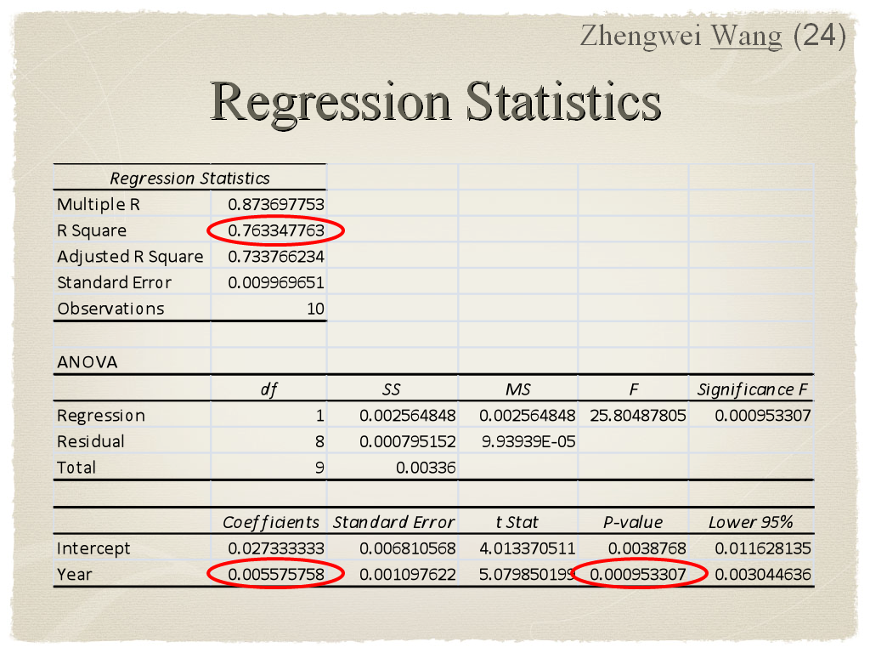

Slide 33
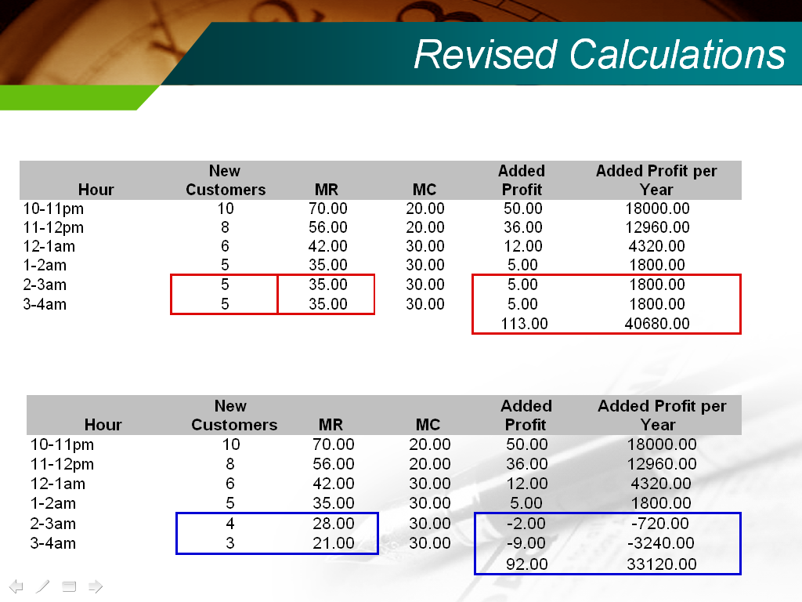

Slide 34
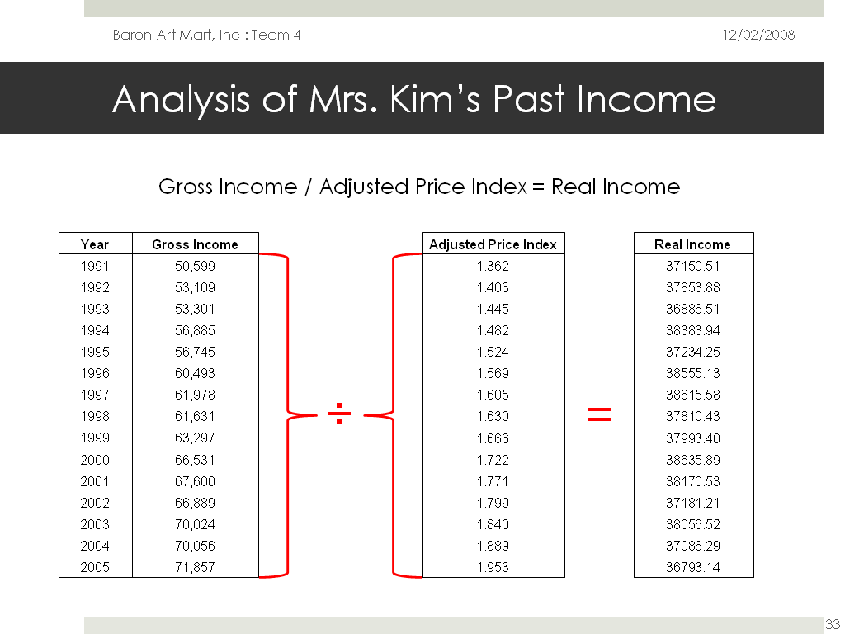

Slide 35
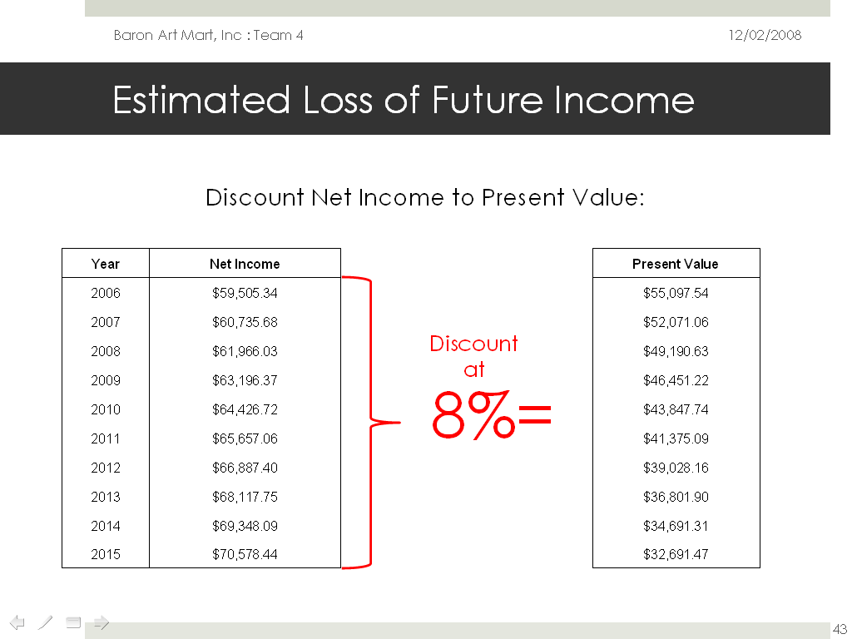

Slide 36
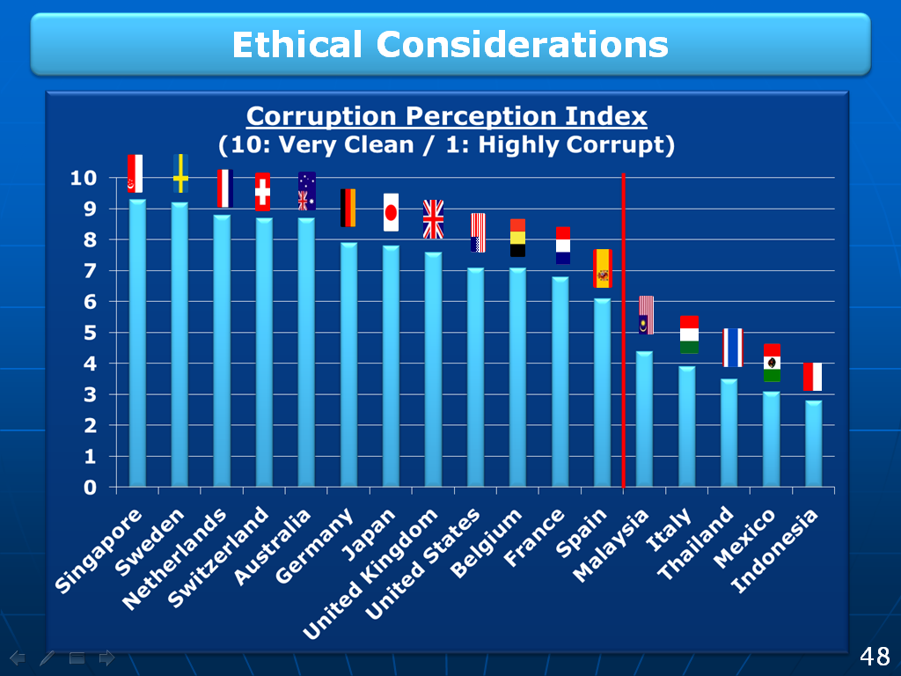

Slide 37
Judicious Use of Animation

Slide 38
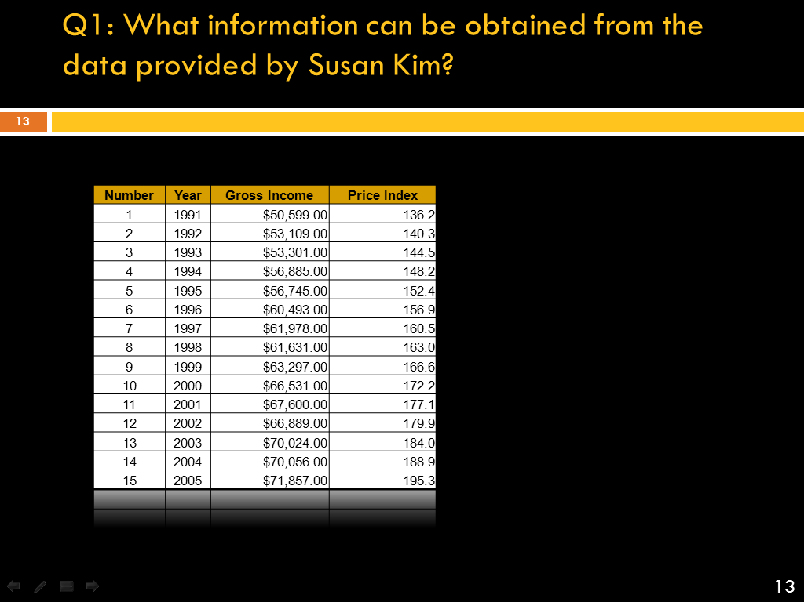

Slide 39
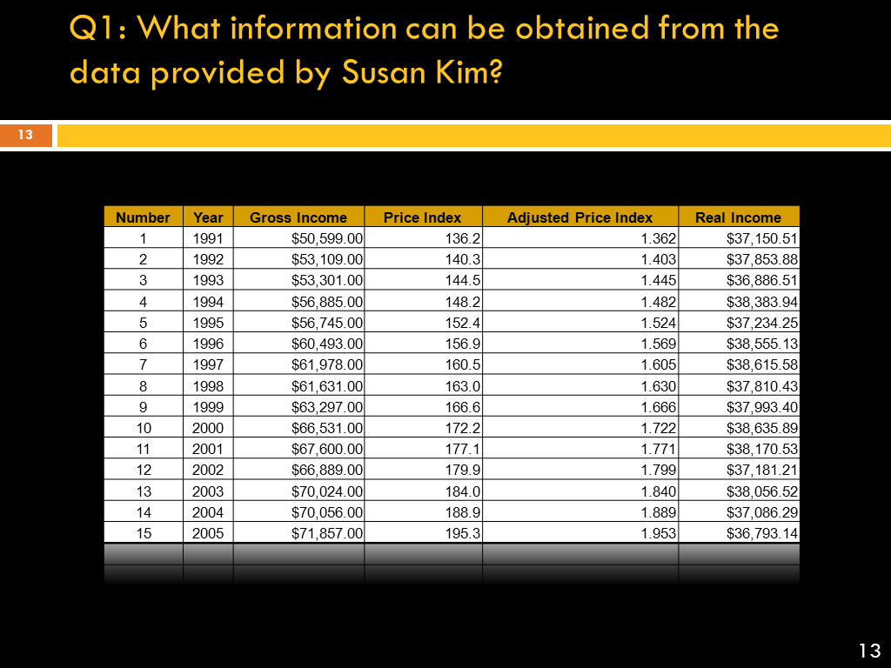

Slide 40
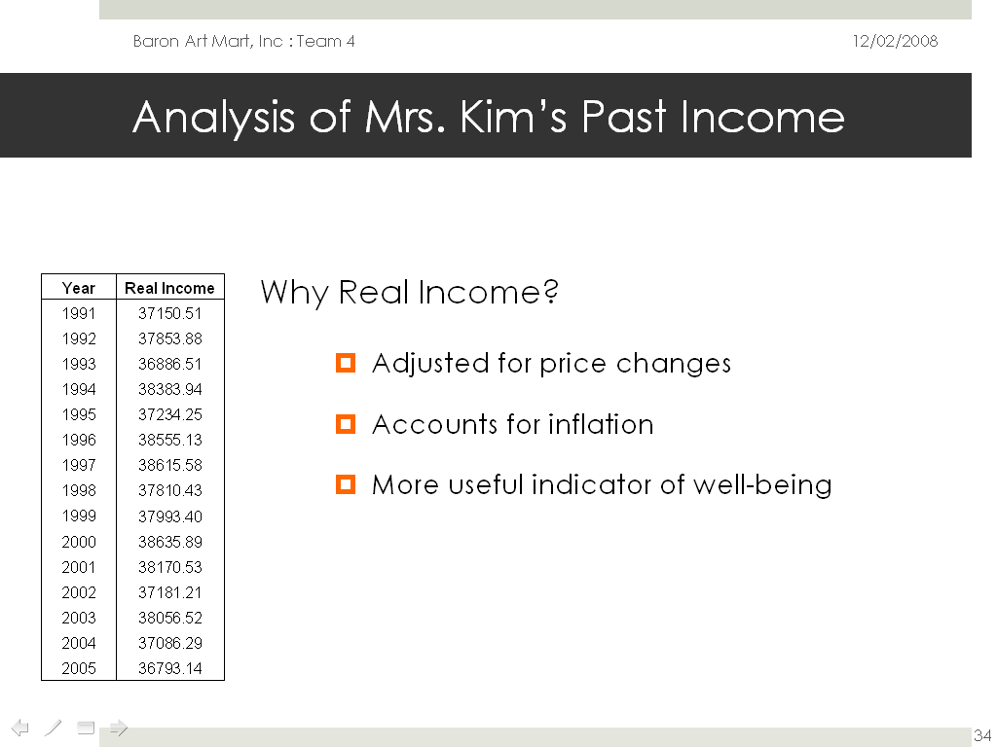

Slide 41
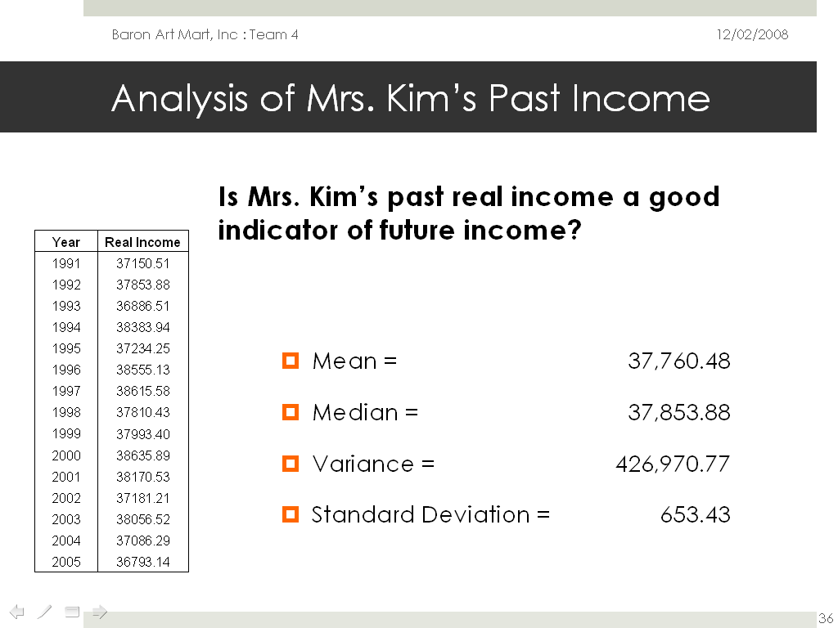

Slide 42
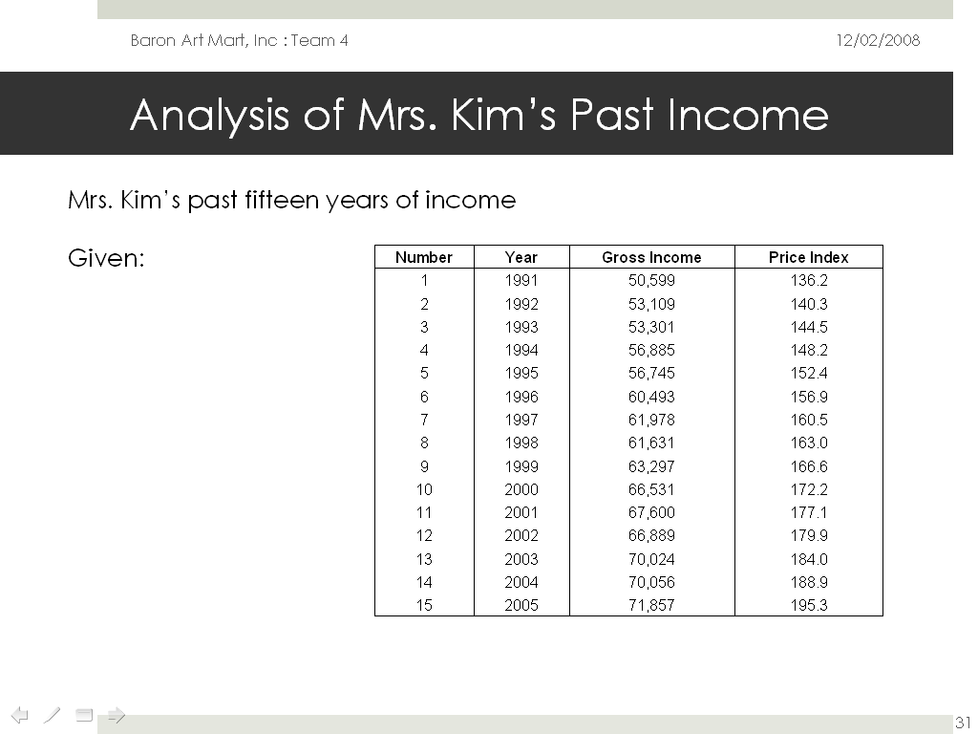

Slide 43
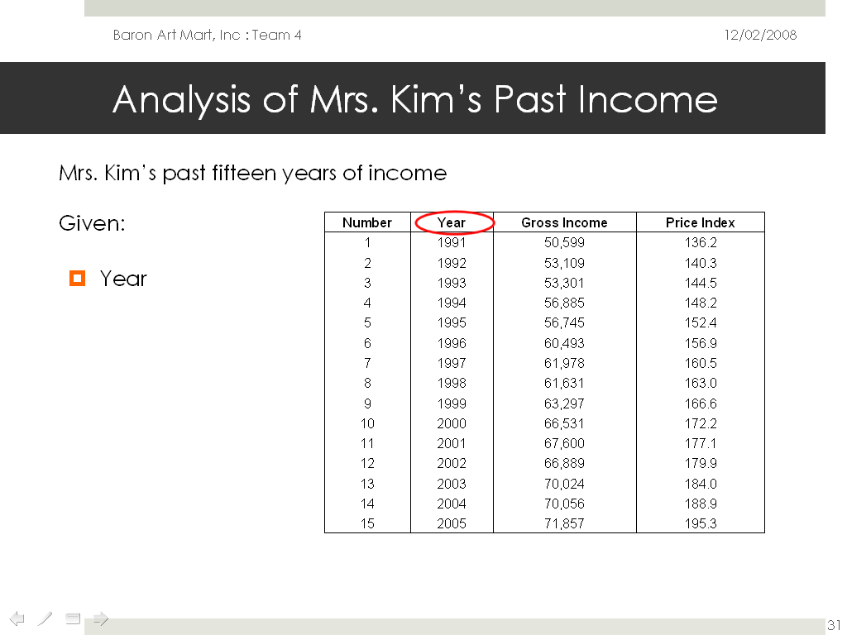

Slide 44
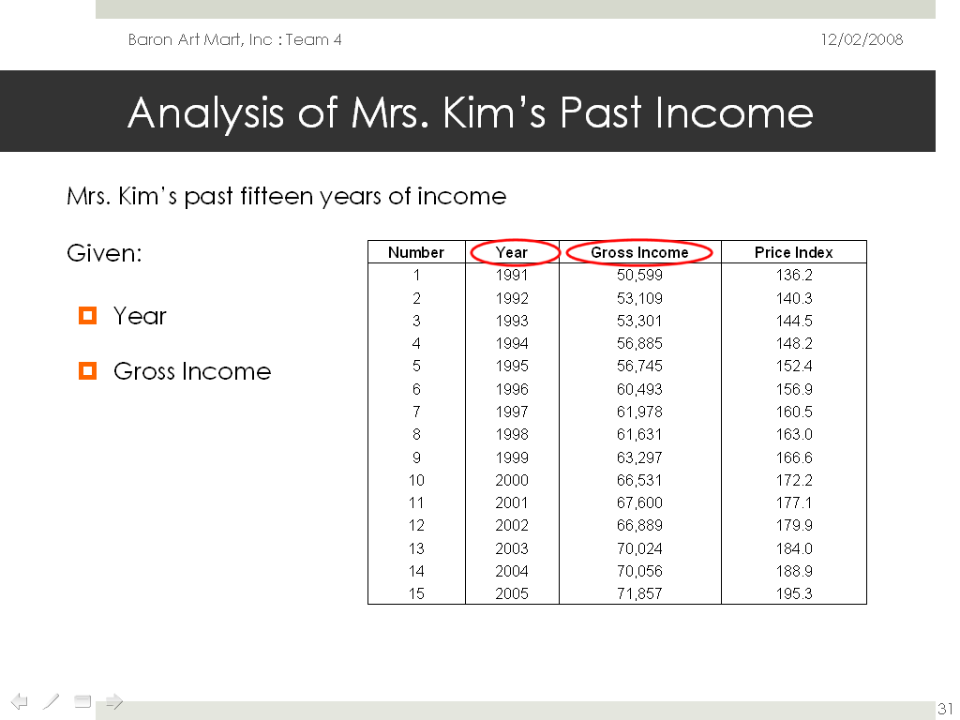

Slide 45
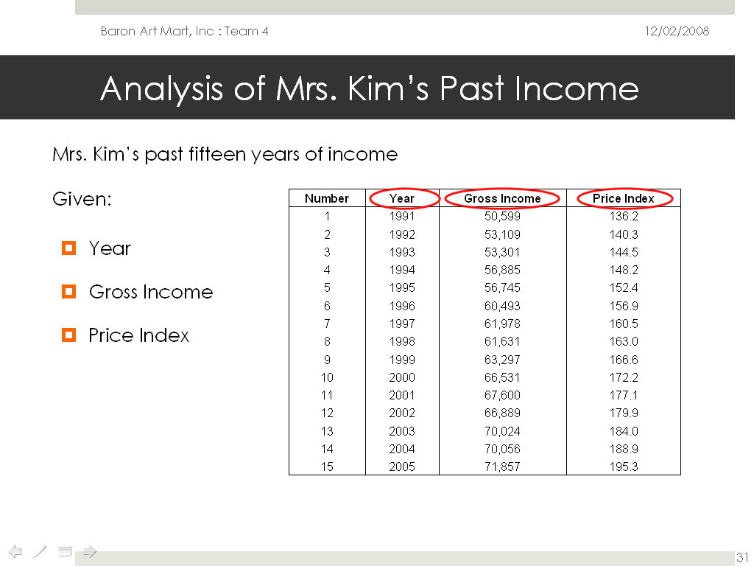

Slide 46
“Above all else, show the data”

Slide 47
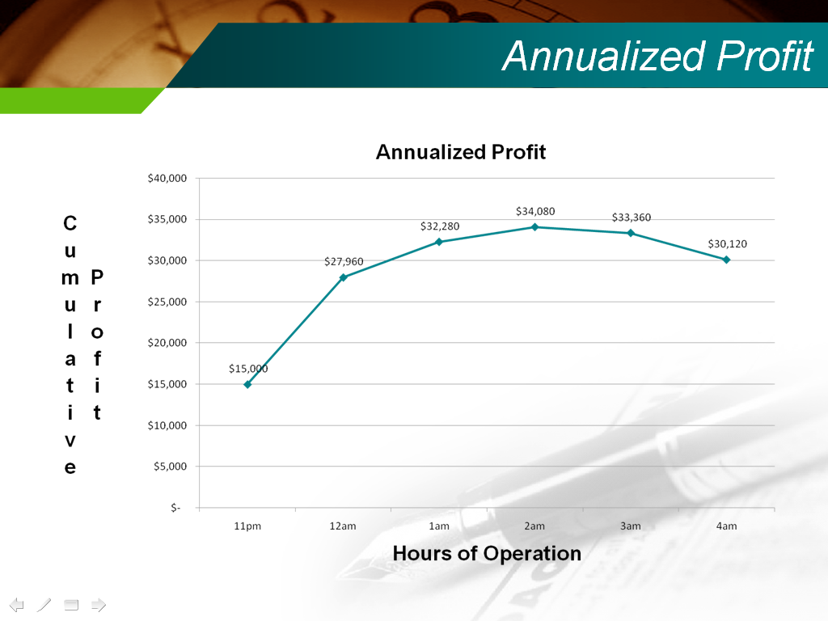

Slide 48
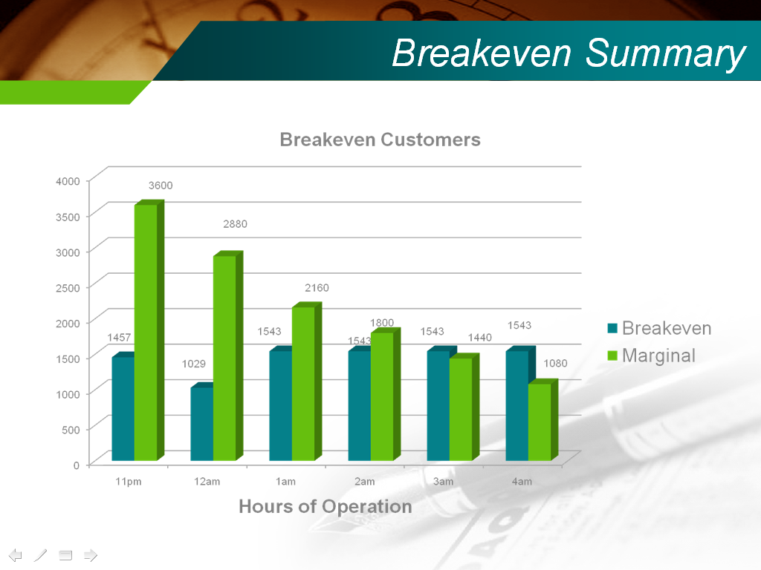

Slide 49
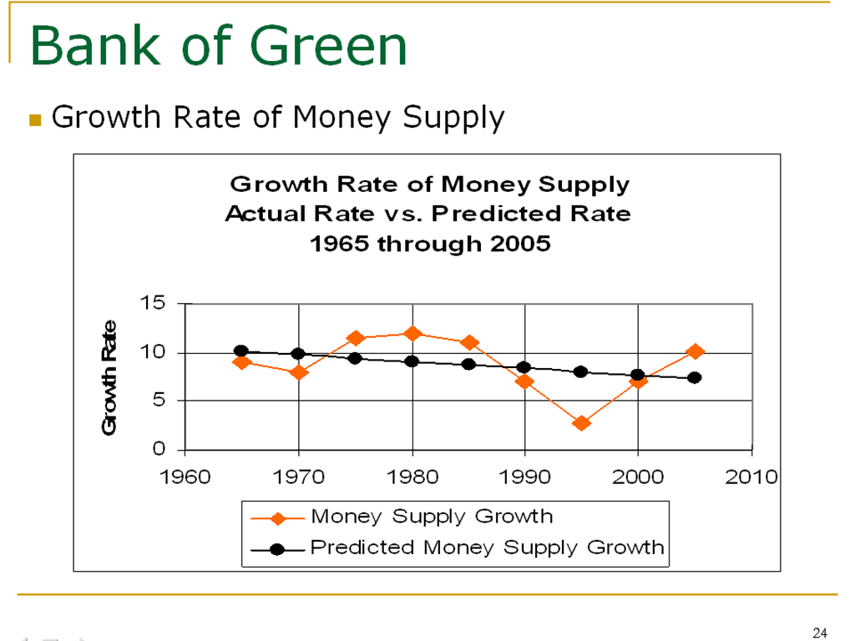

Slide 50
All Figures Right-Aligned

Slide 51
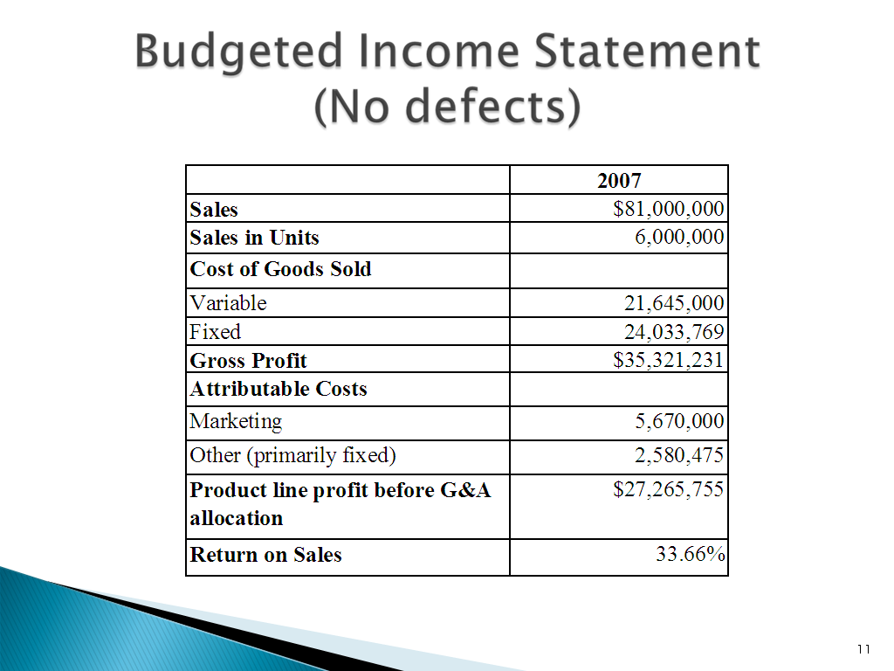

Slide 52
Pay special attention to equations and formulas

Slide 53
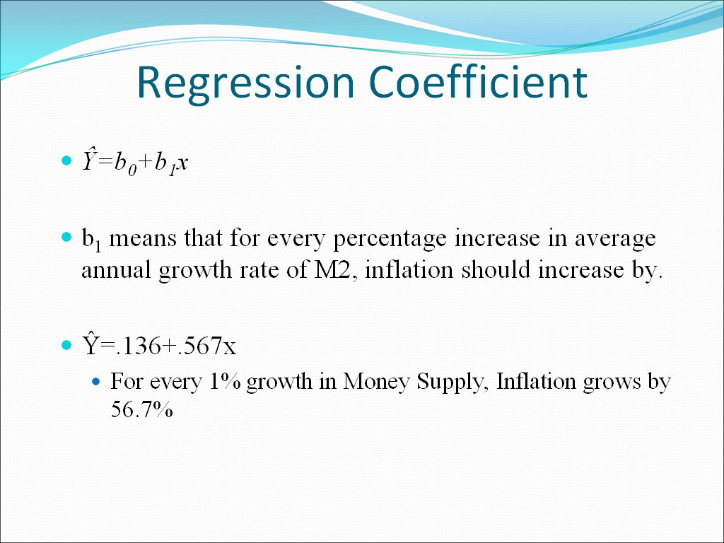

Slide 54
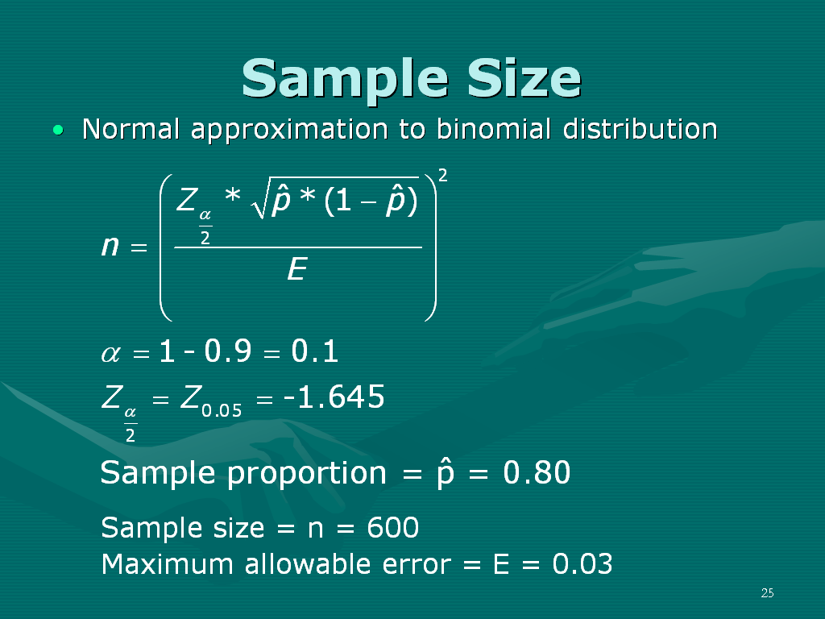

Slide 55
Neither “too few” nor “too many” words or long sentences

Slide 56
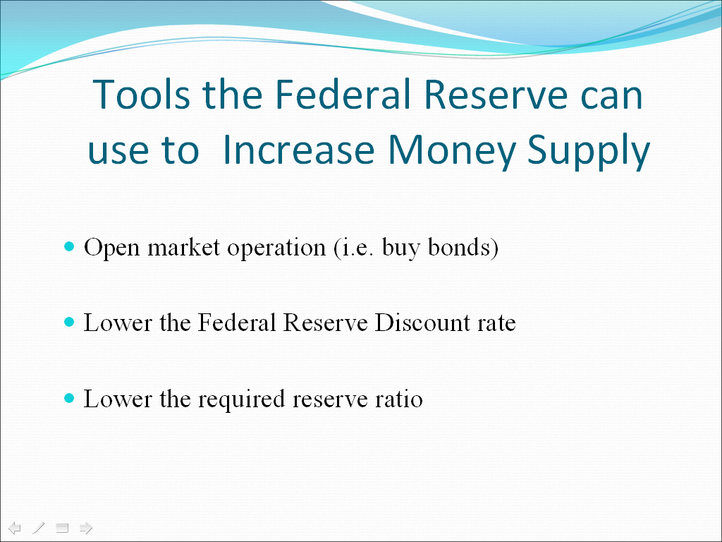

Slide 57
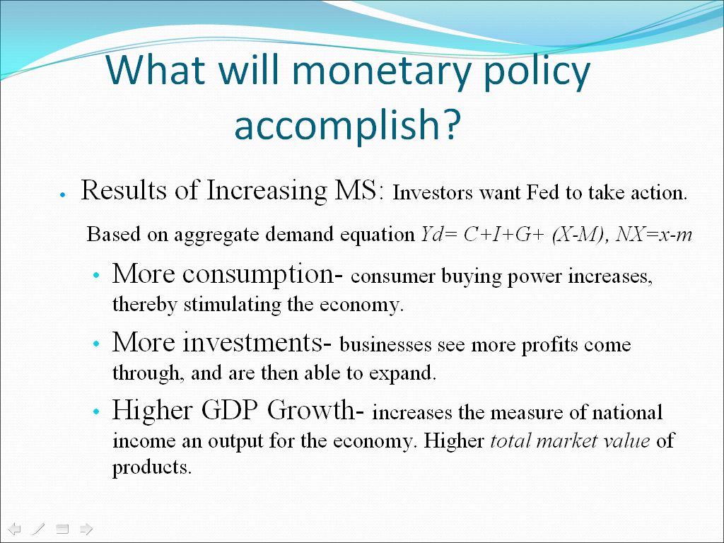

Slide 58
Too “Wordy”

Slide 59
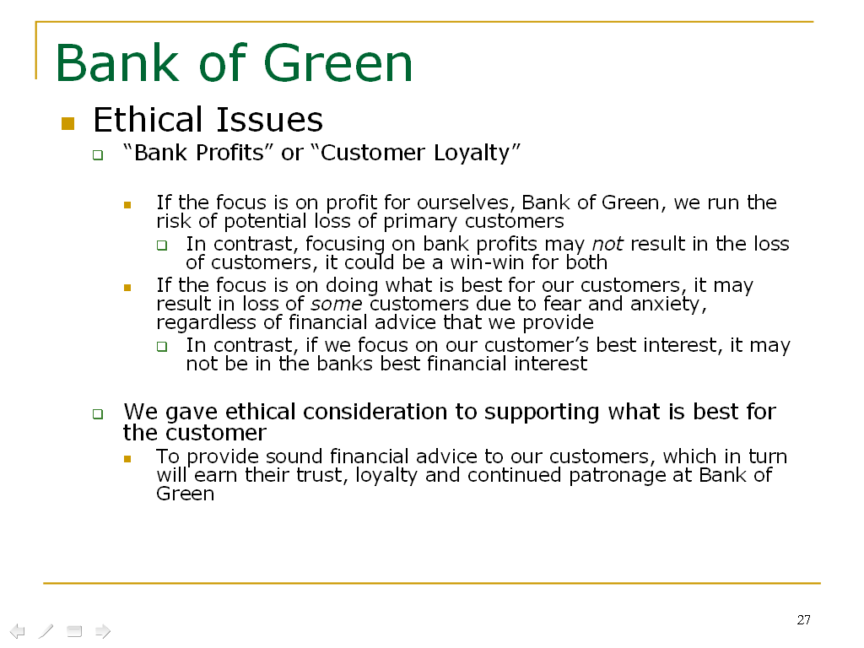

Slide 60
Good (but not overdone) Use of Color

Slide 61
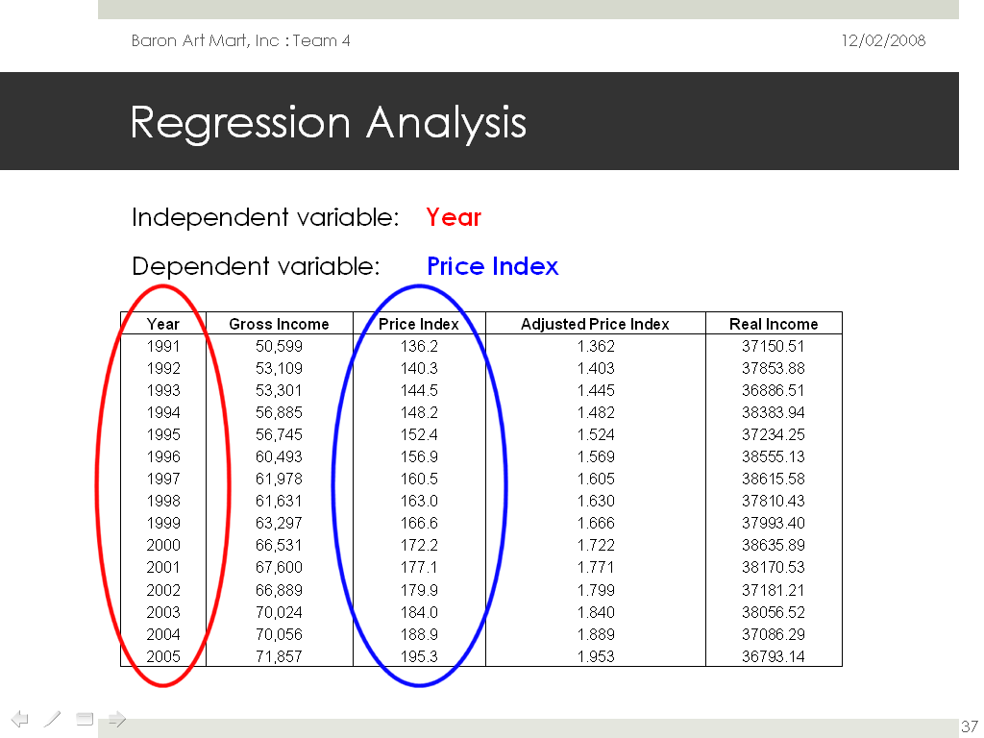

Slide 62
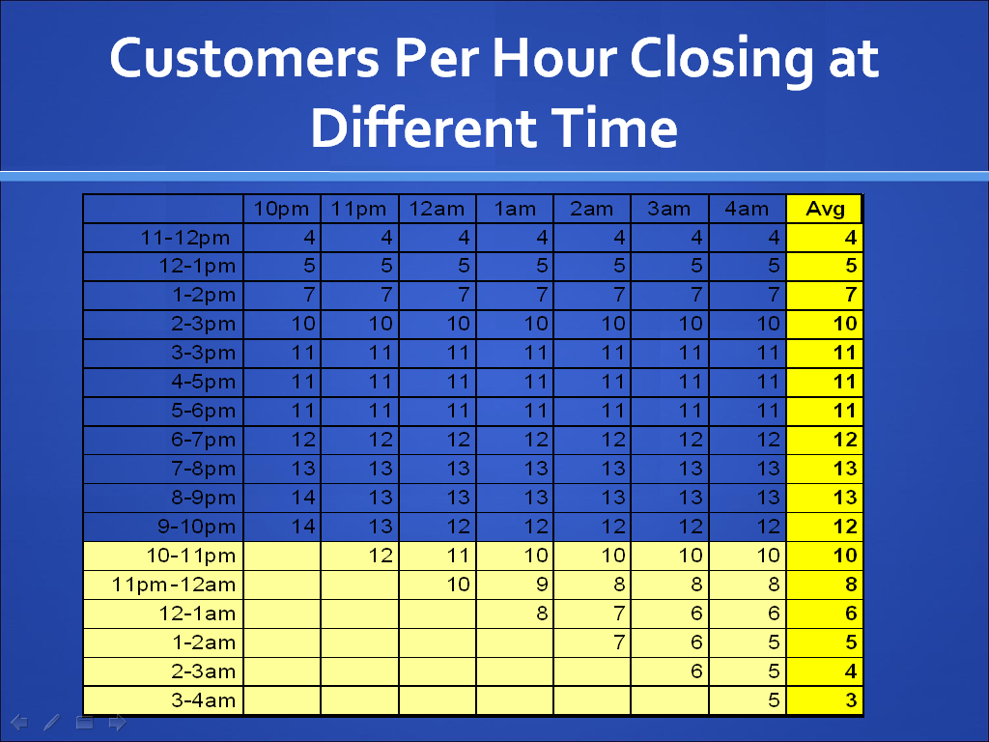

Slide 63
Good (but possibly overdone) Use of Color

Slide 64
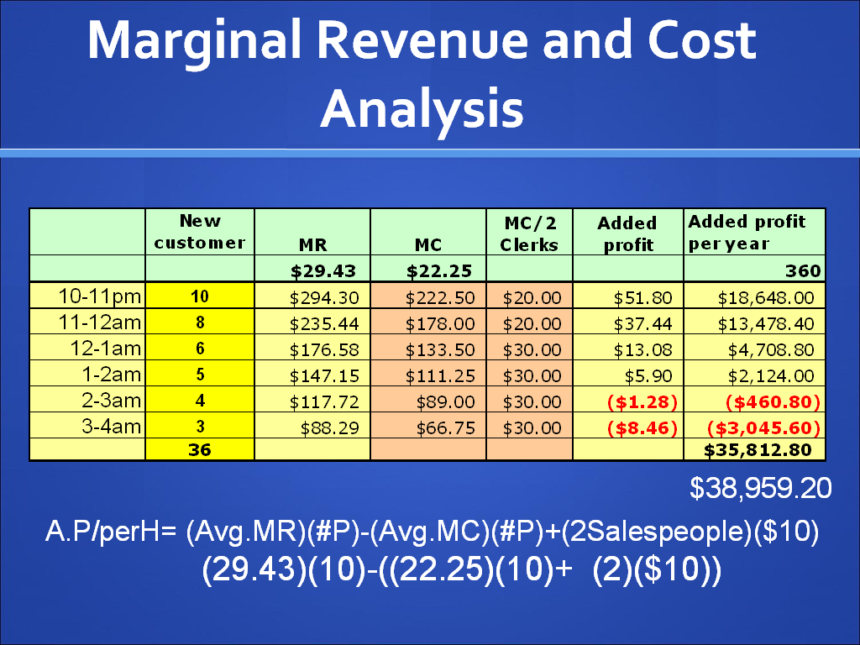

Slide 65
Not enough color contrast

Slide 66
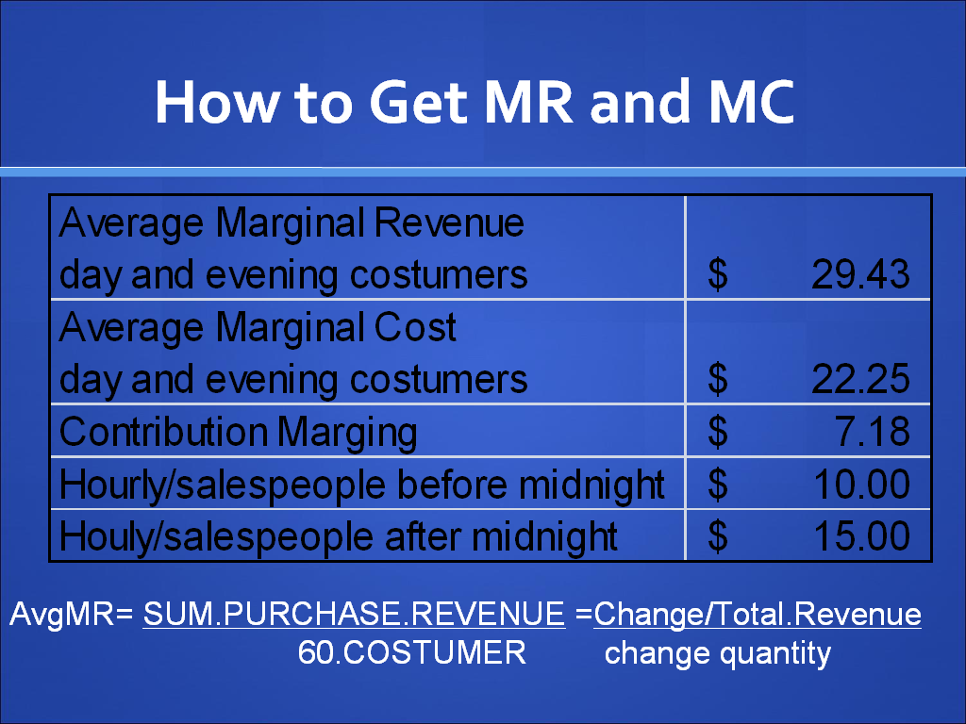

Slide 67
Use plenty of space between different items on a slide

Slide 68
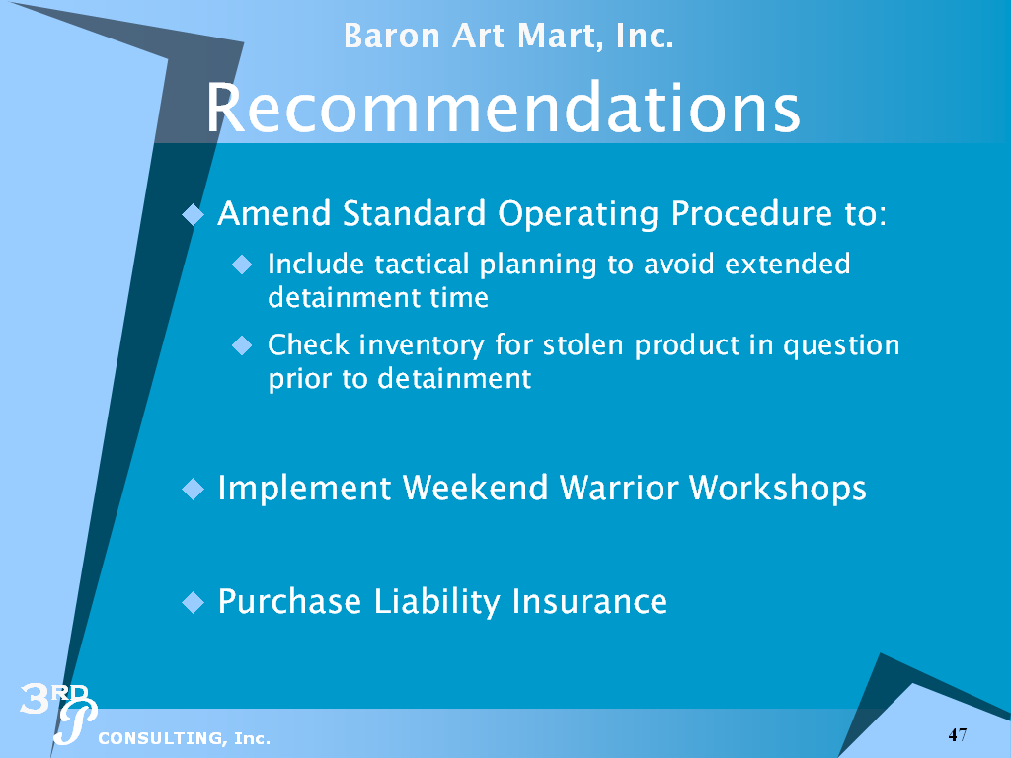

Slide 69
You Still Need References

Slide 70
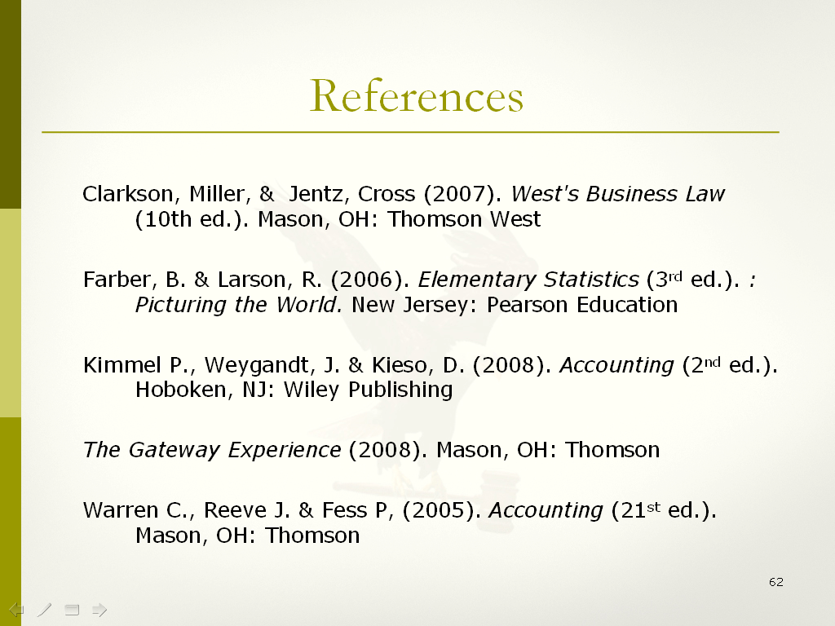

Slide 71
Always end with a “contact” slide

Slide 72


Slide 73
Express Sincere Gratitude

Slide 74


Slide 75


