Slide 1
Business Analytics (Introduction)
Understanding how to collect, transform, analyze, and interpret data to assist in management decision-making
Wayne Smith, Ph.D.
Department of Management
CSU Northridge

Slide 2
Management Decision-making (from a Quantitative perspective)
Artificial Intelligence (“Machine Learning”, “Algorithms”)
Business Research (“Statistics”, “Hypothesis Testing”)
Big Data (generally, linked data in the “cloud”)
Data Science (“using reproducible tools for visualization/analysis”)
Business Analytics (“simpler approaches, augments decisions”)
Our task (at least from a technology perspective) is to
Capture, transform, analyze, and report data, and…
In reporting, to be quite technical, “copy-paste-adjust (for the audience)”

Slide 3
Information Dynamics
Wisdom
Extraordinary Insight (Explanation) for Foresight (Prediction)
Restaurant: How should our menu change in the future to best optimize nightly sales?
Knowledge
Combination of Explicit Information and Tacit Information
Restaurant: What action led to the change in last night’s sales?
Information
Meaningful Data
Restaurant: How does last night’s sales compare to that night the previous year? How does last night’s sales compare to our goals?
Data
Raw, atomic, basic
Restaurant: What were the total sales for last night?

Slide 4
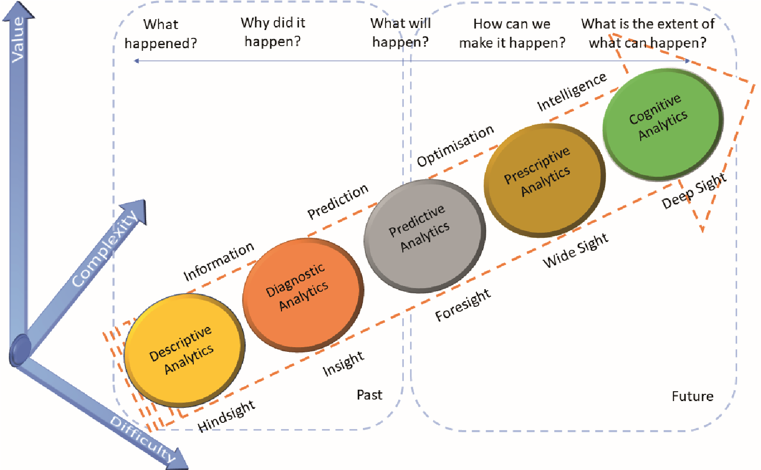
Conceptual Model

Slide 5
Analytics for Business Decision-making
Prescriptive Analytics
What should we do?
HR Department: What should we (the HR Department) do to meet or exceed the organization’s hiring and retention goals for next year? What data/information/knowledge/wisdom should we provide to our hiring and technical managers to help? What are we missing?
Predictive Analytics
What is likely to happen?
HR Department: How many new employees will our organization need next year? How will the mix change? What is our competition likely to do?
Diagnostic Analytics
Why did it happen?
HR Department: Did our emphasis on recruiting from campus A (over campus B, etc.) matter? What do the managers of these entry-level employees think?
Descriptive Analytics
What happened?
HR Department: How many entry-level professionals did we hire last year? How many of them are still with us now?

Slide 6
Excel’s “Add-in’s”
Type of Analytics | Add-in | Feature
Prescriptive | Solver | Linear Programming
Predictive | Data Analysis | Correlation, Regression, Moving Average, Exponential Smoothing
Diagnostic | Data Analysis | Z-test, t-test, F-text, Anova, Random Number Generation, Sampling
Descriptive | Data Analysis | Rank and Percentile, Histogram, Covariance
(Enable)
Select “File | More | Options |Add-ins | Go (it’s near the bottom)”
Check both the “Analysis Toolkit” box and the “Solver add-in” box
(Use)
Select “Data” (and look to the right of the top part of the screen)
Click on “Analysis” or “Solver” as desired

Slide 7
Analytics Dimensions
Volume
What is the scale of the data?
Variety
What are the different forms of data?
Velocity
What is the speed of change of the data? How does it stream?
Veracity
What is the level of uncertainty of the data?
Examples…

Slide 8
Communicating Data in Context
Remember, at an atomic level, each data is a number, and that number has a specific meaning…
In general, the five basic communication contexts about a number in business are Change, Comparative, Goal, Ideal, or Stakeholder
For example, in reading or writing sales volume and percentages, the context needs to be very clear.
E.g., “Sales volume increased 4% last quarter; this was a positive improvement.”
E.g., “Sales volume increased 4% last quarter; but our competition did better.”
E.g., “Sales volume increased 4% last quarter; however, our goal was 6%.”
E.g., “Sales volume increased 4% last quarter; ideally, we can continue this.”
E.g., “Sales volume increased 4% last quarter as we mentioned to our investors.”
You may need to do due diligence to express (when writing or speaking) or learn (when reading or listening) the context each number, or data.

Slide 9
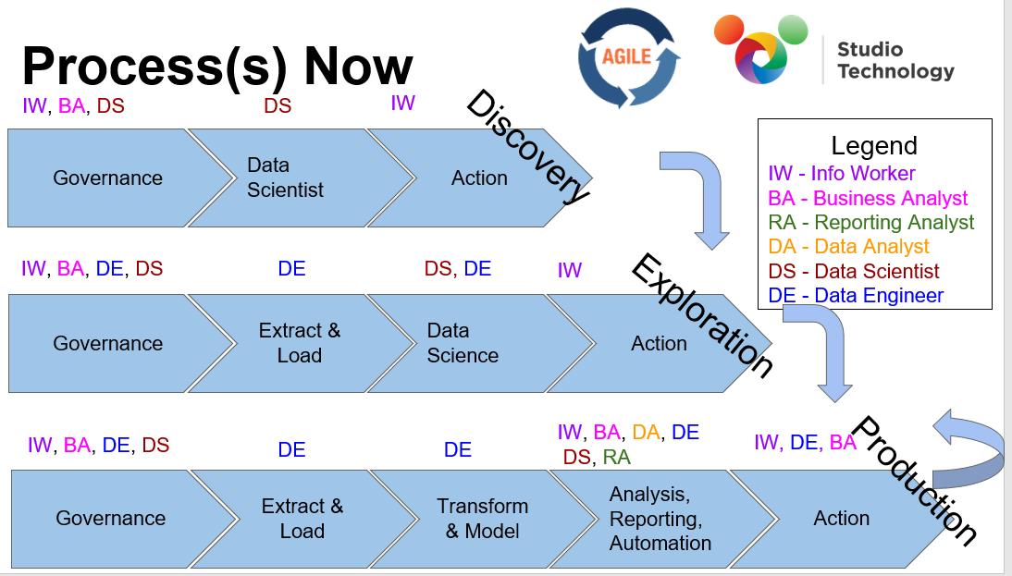
Example - Disney

Slide 10
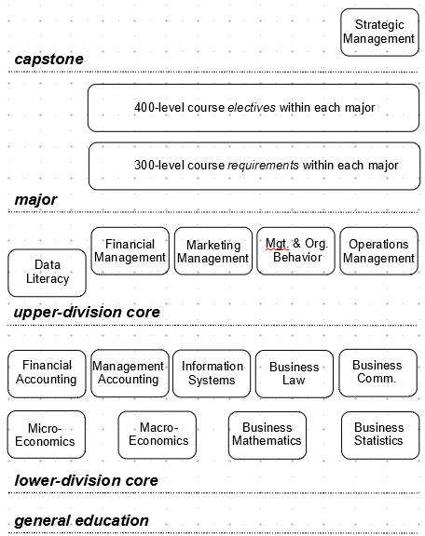

Slide 11
Sources
Some parts of this presentation were excerpted and adapted from:
Charles, V., et .al (December, 2022) Why Data Analytics is an Art. Significance (Royal Statistical Society) (volume 9, issue 16, pp. 42-45)

