Slide 1
Introduction to Business Analytics
© 2022 McGraw Hill. All rights reserved. Authorized only for instructor use in the classroom. No reproduction or further distribution permitted without the prior written consent of McGraw Hill.

Slide 2
Obtain the Data: An Introduction to Business Data Sources
Chapter 2
© 2022 McGraw Hill. All rights reserved. Authorized only for instructor use in the classroom2 No reproduction or further distribution permitted without the prior written consent of McGraw Hill.
© McGraw Hill LLC. All rights reserved. No reproduction or distribution without the prior written consent of McGraw Hill LLC.

Slide 3
2.1
Identify common internal and external sources of data.
2.2
Identify the two most common formats requested for data.
2.3
Identify the different types of structured data.
2.4
Understand how to prepare data for analysis.
2.5
Identify common tools used to prepare data for analysis.
2.6
Define data ethics and describe how to gather and use personally identifiable information in an ethical manner.
© McGraw Hill LLC. All rights reserved. No reproduction or distribution without the prior written consent of McGraw Hill LLC.

Slide 4
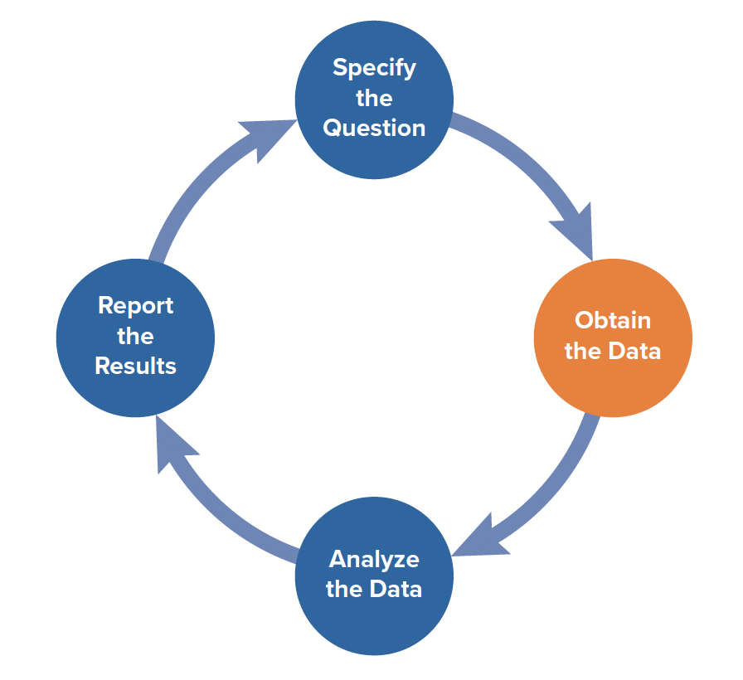
The SOAR Analytics Model
Specify the Question
Obtain the Data
Analyze the Data
Report the Results
EXHIBIT 2.1 The SOAR Analytics Model
© McGraw Hill LLC. All rights reserved. No reproduction or distribution without the prior written consent of McGraw Hill LLC.

Slide 5
Internal and External Data Sources
LO 2.1
© 2022 McGraw Hill. All rights reserved. Authorized only for instructor use in the classroom. No reproduction or further distribution permitted without the prior written consent of McGraw Hill.
© McGraw Hill LLC. All rights reserved. No reproduction or distribution without the prior written consent of McGraw Hill LLC.

Slide 6
Internal Data Sources
Enterprise System (also called Enterprise Resource Planning Systems (ERP))
  A Company’s Interconnected Information Systems that Connect to Each Other.
  Centralized Database
  Examples include SAP, Oracle, and Workday
© McGraw Hill LLC. All rights reserved. No reproduction or distribution without the prior written consent of McGraw Hill LLC.

Slide 7
Three Basic Components of a Relational Database
Relational Databases are an efficient means of storing data in one place, in one table instead of multiple places and have the following components:
  Tables – data organized into sets of columns (fields) and rows (records).
  Fields – these are the columns that contain descriptive information about the observations in the table (including primary and foreign keys).
  Records – these are the rows in a table; each row, or record, corresponds to a unique instance of what is being described in the table.
© McGraw Hill LLC. All rights reserved. No reproduction or distribution without the prior written consent of McGraw Hill LLC.

Slide 8
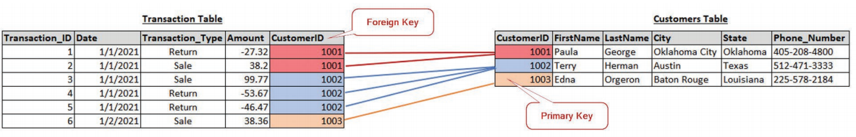
How Tables Connect Together in a Relational Database
Common fields connect individual tables to each other.
Primary Key – Unique identifier in each table, Transaction_ID in Transaction Table; CustomerID in Customer Table
Foreign Key - Exist to create relationships or links between two tables
EXHIBIT 4.1 Transaction and Customers Tables
© McGraw Hill LLC. All rights reserved. No reproduction or distribution without the prior written consent of McGraw Hill LLC.

Slide 9
External Data Sources
Social Media Data
Census Data
Small Business Administration Data
Publicly Available Data
  Financial Statements of All Publicly Traded Companies
  Stock Price Data
  Summarized Financial Data
© McGraw Hill LLC. All rights reserved. No reproduction or distribution without the prior written consent of McGraw Hill LLC.

Slide 10
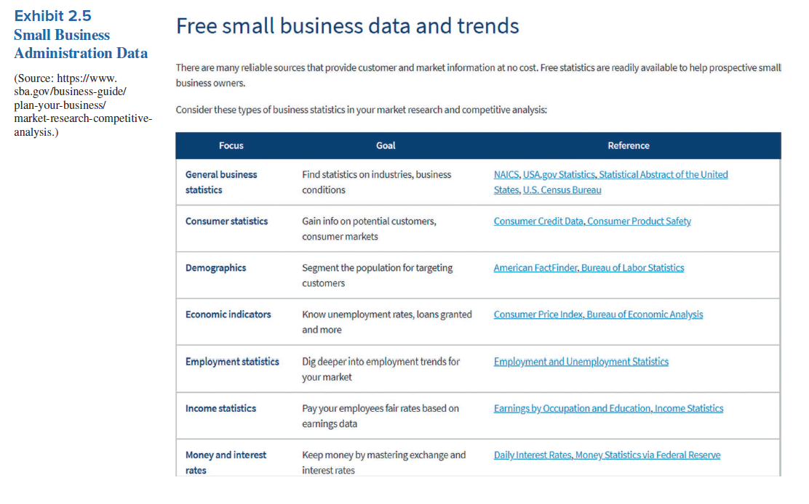
Example of Available External Data Sources
© McGraw Hill LLC. All rights reserved. No reproduction or distribution without the prior written consent of McGraw Hill LLC.

Slide 11
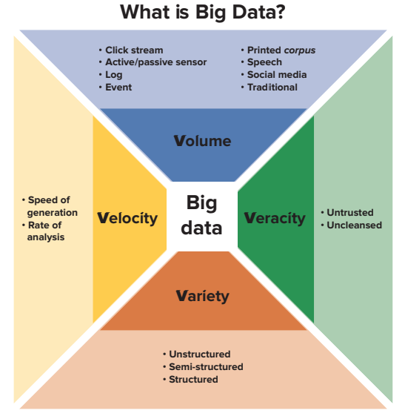
The Four V’s of Big Data
Volume
  Click stream
  Active/passive sensor
  Log
  Event
  Printed corpus
  Speech
  Social media
  Traditional
Velocity
  Speed of generation
  Rate of analysis
Variety
  Unstructured
  Semi-structured
  Structured
Veracity
  Untrusted
  Uncleansed
EXHIBIT 2.1 The Four Vs of Big Data: Volume, Variety, Velocity and Veracity Source: EY, “Big Data: Changing the Way Businesses Compete and Operate,” Insights on Governance, Risk, and Compliance, April 2014, p. 2, https://www.ey.com/ Publication/vwLUAssets/ EY_-_Big_data:_changing _the_way_businesses _operate/%24FILE/ EY-Insights-on-GRC -Big-data.pdf.
© McGraw Hill LLC. All rights reserved. No reproduction or distribution without the prior written consent of McGraw Hill LLC.

Slide 12
Variety of Data
Structured Data – Highly Organized Data that Fit Nicely in a Table or Database
  Financial Statements
  Database of Customer Orders and Preferences
Unstructured Data – Data without Organization or Structure
  Blogs, tweets, pictures
Semi-structured Data – Elements of Both Structured and Unstructured Data
© McGraw Hill LLC. All rights reserved. No reproduction or distribution without the prior written consent of McGraw Hill LLC.

Slide 13
Progress Check 2.1
Q: How would you rate Tesla’s Financial Statements published four times a year based on the four V’s of Big Data (Volume, Variety, Velocity, and Veracity)?
© McGraw Hill LLC. All rights reserved. No reproduction or distribution without the prior written consent of McGraw Hill LLC.
© 2022 McGraw Hill. All rights reserved. Authorized only for instructor use in the classroom. No reproduction or further distribution permitted without the prior written consent of McGraw Hill.

Slide 14
Obtaining the Data
LO 2.2
© McGraw Hill LLC. All rights reserved. No reproduction or distribution without the prior written consent of McGraw Hill LLC.
© 2022 McGraw Hill. All rights reserved. Authorized only for instructor use in the classroom. No reproduction or further distribution permitted without the prior written consent of McGraw Hill.

Slide 15
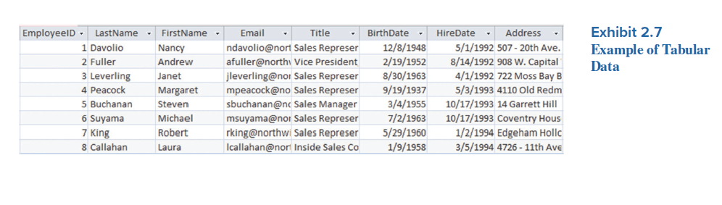
Data Formats
Text Data
  Tweets, Hashtags, Word Document, etc.
Tabular Data
  Data Structured into Rows and Columns
© McGraw Hill LLC. All rights reserved. No reproduction or distribution without the prior written consent of McGraw Hill LLC.

Slide 16
File Formats
Data usually delivered as comma-separated files with the file extension .csv
.csv files store data as text, but they convert rapidly to a tabular format when they are imported into spreadsheet applications or used with programming languages.
.csv files do not have the same row and column limits that Excel has, which allows .csv files to hold Big Data that exceed Excel’s size limit.
© McGraw Hill LLC. All rights reserved. No reproduction or distribution without the prior written consent of McGraw Hill LLC.

Slide 17
Level of Aggregation
How do you want it?
  Aggregated Data
    Data Already Processed and Transformed
    Already Combined into Subtotals, Counts, Sums or Averages
  Raw Data
    Give the Analyst the Flexibility to Process Data as They See Fit
© McGraw Hill LLC. All rights reserved. No reproduction or distribution without the prior written consent of McGraw Hill LLC.

Slide 18
Progress Check 2.2
Q. When would the analyst prefer raw data to aggregated data?
© McGraw Hill LLC. All rights reserved. No reproduction or distribution without the prior written consent of McGraw Hill LLC.
© 2022 McGraw Hill. All rights reserved. Authorized only for instructor use in the classroom. No reproduction or further distribution permitted without the prior written consent of McGraw Hill.

Slide 19
Structured Data Types: Categorical versus Numerical
LO 2.3
© McGraw Hill LLC. All rights reserved. No reproduction or distribution without the prior written consent of McGraw Hill LLC.
© 2022 McGraw Hill. All rights reserved. Authorized only for instructor use in the classroom. No reproduction or further distribution permitted without the prior written consent of McGraw Hill.

Slide 20
Data Types
Categorical - tend to be represented by words – such as categorizing a group of people by gender (male, female, nonbinary), or categorizing transaction types (sales versus returns).
Numerical - meaningful numbers, such as transaction amount, net income, age, or the score on an exam.
© McGraw Hill LLC. All rights reserved. No reproduction or distribution without the prior written consent of McGraw Hill LLC.

Slide 21
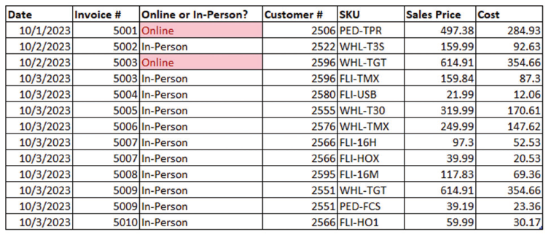
Categorical Data
Nominal Data – Categorical data that cannot be ranked
  Gender – Male or Female
  Transaction Type – Sale or Return
  Location of Sale
Summarize by
  Counting and grouping
  Proportion
EXHIBIT 2.9 Analysis of Categorical Data (Online vs. In-Person Transactions
© McGraw Hill LLC. All rights reserved. No reproduction or distribution without the prior written consent of McGraw Hill LLC.

Slide 22
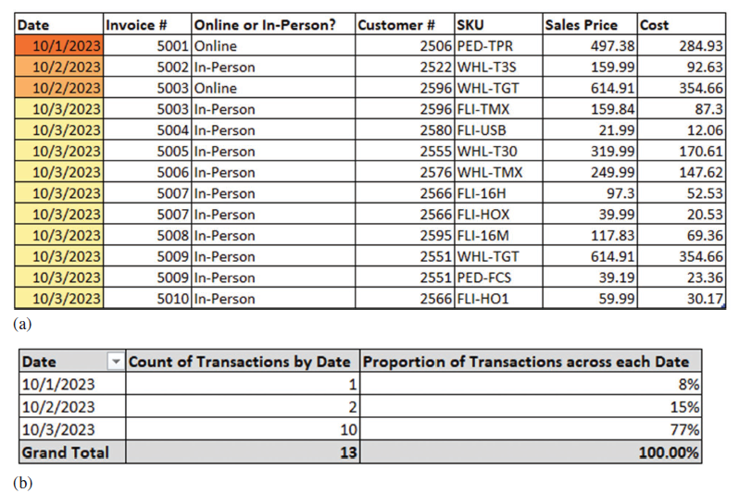
Categorical Data
Ordinal Data – Categorical data that allows/implies ranking and sorting
  Gold, Silver and Bronze
  Survey Answers: Agree, Indifferent, Disagree
  Transaction Dates
Summarize by
  Counting and grouping
  Proportion
  Ranking (Because Ordinal Data is Ranked)
EXHIBIT 2.10 Count of Transactions by Date
© McGraw Hill LLC. All rights reserved. No reproduction or distribution without the prior written consent of McGraw Hill LLC.

Slide 23
Numerical Data
Interval Data – an equal interval between each observation, so that not only does summing the data make sense, so does multiplication and other more complex numerical calculations.
  SAT Scores
  Fahrenheit Temperature Scale
Summarize by
  Counting and grouping
  Proportion
  Summing
  Averaging
Ratio Data – numerical data with an equal and definitive ratio between each data point and absolute “zero” (meaning absence of) in ratio data is the point of origin.
  Height, Weight
  Most accounting figures, sales, net income, depreciation expense
  Kelvin Temperature Scale
© McGraw Hill LLC. All rights reserved. No reproduction or distribution without the prior written consent of McGraw Hill LLC.

Slide 24
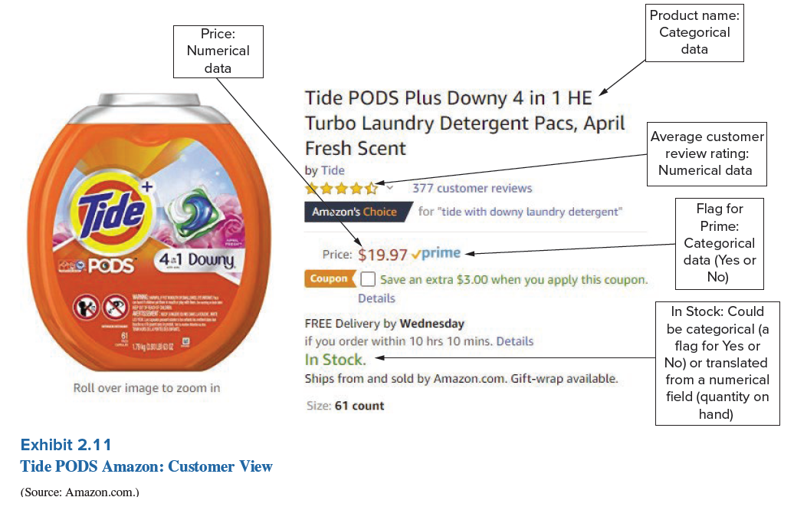
Tide PODS and Data Types
© McGraw Hill LLC. All rights reserved. No reproduction or distribution without the prior written consent of McGraw Hill LLC.

Slide 25
Progress Check 2.3
Q: In general, how do categorical and numerical data differ? Why is it important to collect both types of data to perform your analysis?
© McGraw Hill LLC. All rights reserved. No reproduction or distribution without the prior written consent of McGraw Hill LLC.

Slide 26
Preparing Data for Analysis
LO 2.4
© McGraw Hill LLC. All rights reserved. No reproduction or distribution without the prior written consent of McGraw Hill LLC.
© 2022 McGraw Hill. All rights reserved. Authorized only for instructor use in the classroom. No reproduction or further distribution permitted without the prior written consent of McGraw Hill.

Slide 27
Preparing Data for Analysis
Ensure Data Quality
  Data Types for each Attribute are Appropriate
Validate the Data for Completeness and Integrity
  Were the Data Completely Extracted from Original Source?
  Were any Data Manipulated or Tampered during Extraction Process?
Cleanse the Data
  Use Trim and Clean Function to Prepare the Data for Analysis
  Address Missing Data
Perform Preliminary Exploratory Analysis
© McGraw Hill LLC. All rights reserved. No reproduction or distribution without the prior written consent of McGraw Hill LLC.

Slide 28
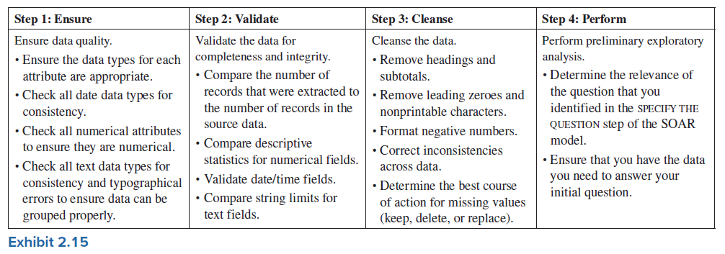
Preparing Data for Analysis
© McGraw Hill LLC. All rights reserved. No reproduction or distribution without the prior written consent of McGraw Hill LLC.

Slide 29
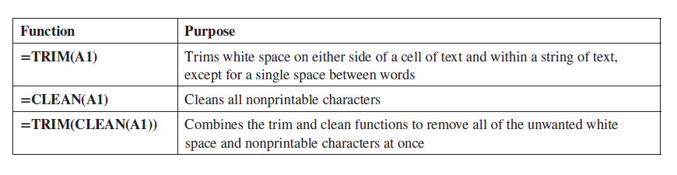
Different Functions to Trim and Clean the Data
Trim Functions Remove White Space on Either Side of a Cell of Text
Clean Functions Remove Nonprintable Characters
© McGraw Hill LLC. All rights reserved. No reproduction or distribution without the prior written consent of McGraw Hill LLC.

Slide 30
Three Choices Regarding Missing Values
Leave the Missing Values As Is.
Remove the Records that Have Missing Values.
Impute Values to Replace the Missing Values.
© McGraw Hill LLC. All rights reserved. No reproduction or distribution without the prior written consent of McGraw Hill LLC.

Slide 31
Progress Check 2.4
Q. What is the Difference Between Data Completeness and Data Integrity? Why are Both Important?
© McGraw Hill LLC. All rights reserved. No reproduction or distribution without the prior written consent of McGraw Hill LLC.
© 2022 McGraw Hill. All rights reserved. Authorized only for instructor use in the classroom. No reproduction or further distribution permitted without the prior written consent of McGraw Hill.

Slide 32
Tools Used to Prepare Data for Analysis
LO 2.5
© McGraw Hill LLC. All rights reserved. No reproduction or distribution without the prior written consent of McGraw Hill LLC.
© 2022 McGraw Hill. All rights reserved. Authorized only for instructor use in the classroom. No reproduction or further distribution permitted without the prior written consent of McGraw Hill.

Slide 33
Available Software Tools
► Microsoft Excel – basic data analysis
► Tableau – basic data visualizations
► Microsoft Power BI – basic data visualizations
► Microsoft Power Query – Used to Manipulate and Clean Data in Preparation for Analysis
► Tableau Prep – Used to Manipulate and Clean Data in Preparation for Analysis
► Alteryx – Used to Manipulate and Clean Data in Preparation for Analysis
► Open-source Tools – Free Software Tools Used with Tableau and Excel
► Gretl – Primary used to Run Statistical Tests on the Data
► R and Python – Programming Languages Used to Clean Data and Perform Data Analysis
© McGraw Hill LLC. All rights reserved. No reproduction or distribution without the prior written consent of McGraw Hill LLC.

Slide 34
Progress Check 2.5
Q: Which software tools emphasize data preparation vs. data visualization?
© McGraw Hill LLC. All rights reserved. No reproduction or distribution without the prior written consent of McGraw Hill LLC.

Slide 35
Gathering and Protecting Data Ethically
LO 2.6
© McGraw Hill LLC. All rights reserved. No reproduction or distribution without the prior written consent of McGraw Hill LLC.
© 2022 McGraw Hill. All rights reserved. Authorized only for instructor use in the classroom. No reproduction or further distribution permitted without the prior written consent of McGraw Hill.

Slide 36
Definition of Data Ethics
Data Ethics refers to the moral responsibility associated with gathering, using and protecting personally identifiable information.
© McGraw Hill LLC. All rights reserved. No reproduction or distribution without the prior written consent of McGraw Hill LLC.

Slide 37
Gathering Data
Questions a Company Must Address to Handle Data Ethically
Does the company send a privacy notice to individuals when their personal data are collected? Can individuals opt out of personal data collection?
Do the company’s third-party data providers follow ethical practices when gathering and sharing sensitive data?
© McGraw Hill LLC. All rights reserved. No reproduction or distribution without the prior written consent of McGraw Hill LLC.

Slide 38
Protecting Data
Questions a Company Must Address to Handle Data Ethically
If credit card information is taken, what assurance do customers have that their credit card number will be protected?
Does the company keep the data secure and private, and does it have safeguards in place to protect the data?
Has the company established effective practices to mitigate the risks of data misuse? Are penalties enforced for data misuse?
© McGraw Hill LLC. All rights reserved. No reproduction or distribution without the prior written consent of McGraw Hill LLC.

Slide 39
Progress Check 2.6
Q. Why would an address be considered personally identifiable information?
© McGraw Hill LLC. All rights reserved. No reproduction or distribution without the prior written consent of McGraw Hill LLC.
© 2022 McGraw Hill. All rights reserved. Authorized only for instructor use in the classroom. No reproduction or further distribution permitted without the prior written consent of McGraw Hill.

Slide 40
Labs Associated with Chapter 2
Lab # | Lab Name
2.1 | Excel: Identifying and Working with Different Data Types
2.2 | Tableau: Preparing Different Data Types for Analysis
2.2 | Power BI: Preparing Different Data Types for Analysis
2.3 | Tableau: Conducting Preliminary Data Analysis
2.3 | Power BI: Conducting Preliminary Data Analysis
2.4 | Excel: Aggregating and Visualizing Different Data Types
© McGraw Hill LLC. All rights reserved. No reproduction or distribution without the prior written consent of McGraw Hill LLC.

