Slide 1
Introduction to Business Analytics
© 2022 McGraw Hill. All rights reserved. Authorized only for instructor use in the classroom. No reproduction or further distribution permitted without the prior written consent of McGraw Hill.

Slide 2
Specify the Question: Using Business Analytics to Address Business Questions
Chapter 1
© McGraw Hill LLC. All rights reserved. No reproduction or distribution without the prior written consent of McGraw Hill LLC.

Slide 3
1.1
Define a business process and explain why increased data availability has given rise to the role of business analyst.
1.2
Differentiate between data and information.
1.3
Summarize the role of the business analyst.
1.4
Describe how business functions use business analytics.
1.5
Identify the components of the SOAR analytics model.
1.6
Describe the use of exploratory data visualizations and explanatory data visualizations

Slide 4
Businesses Create Value
LO 1.1
© 2022 McGraw Hill. All rights reserved. Authorized only for instructor use in the classroom. No reproduction or further distribution permitted without the prior written consent of McGraw Hill.
© McGraw Hill LLC. All rights reserved. No reproduction or distribution without the prior written consent of McGraw Hill LLC.

Slide 5
Business Value and Business Processes
Business value refers to all the items, events, and interactions that determine a company’s financial health.
A business process is a coordinated, standardized set of activities conducted by both people and equipment to accomplish a specific business task.
Companies perform thousands, and sometimes millions, of processes each day to create business value.
Examples include:
  DoorDash pays its drivers, who are independent contractors, for making deliveries.
  Tesla produces an electric vehicle to sell in China.
  Procter & Gamble (P&G) addresses customer complaints, sometimes by giving refunds.
© McGraw Hill LLC. All rights reserved. No reproduction or distribution without the prior written consent of McGraw Hill LLC.

Slide 6
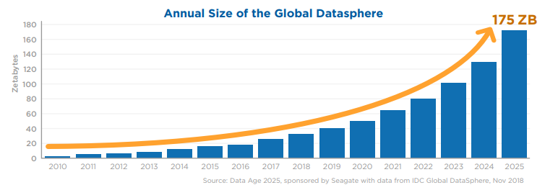
The Increasing Availability of Data
EXHIBIT 1.1 Data Growth Since 2010 Source: IDC Global DataSphere, November 2018, p. 6, https://www.seagate .com/files/www-content/our -story/trends/files/idc-seagate -dataage-whitepaper.pdf (accessed July 3, 2019)
© McGraw Hill LLC. All rights reserved. No reproduction or distribution without the prior written consent of McGraw Hill LLC.

Slide 7
The Business Analyst
A business analyst is a data specialist who curates and uses data to help an organization make effective business decisions.
Source: How Much Data Do We Create Every Day? The Mind-Blowing Stats Everyone Should Read, https://www.forbes.com/sites/bernardmarr/2018/05/21/how-much-data-do-we-create-every-day-the-mind-blowing-stats-everyone-should-read/#6ddf004d60ba, accessed 2/8/19
© McGraw Hill LLC. All rights reserved. No reproduction or distribution without the prior written consent of McGraw Hill LLC.

Slide 8
Data Helps and Hinders the Analyst Role
Helps: More Data = More Data-derived Insights for Decision Making
Hinders: The increasing amount of data may hinder the work of the analyst through data overload, where too much data may not be properly synthesized or interpreted.
© McGraw Hill LLC. All rights reserved. No reproduction or distribution without the prior written consent of McGraw Hill LLC.

Slide 9
Progress Check 1.1
Q: How does increasing the amount of data available to address business questions help the business analyst?
© McGraw Hill LLC. All rights reserved. No reproduction or distribution without the prior written consent of McGraw Hill LLC.
© 2022 McGraw Hill. All rights reserved. Authorized only for instructor use in the classroom. No reproduction or further distribution permitted without the prior written consent of McGraw Hill.

Slide 10
The Difference Between Data and Information
LO 1.2
© McGraw Hill LLC. All rights reserved. No reproduction or distribution without the prior written consent of McGraw Hill LLC.
© 2022 McGraw Hill. All rights reserved. Authorized only for instructor use in the classroom. No reproduction or further distribution permitted without the prior written consent of McGraw Hill.

Slide 11
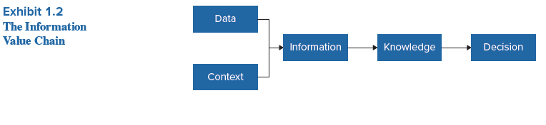
Information Value Chain
Data - Raw Facts that have Little Meaning on their Own
Context – The Setting, Event, Statement or Situation
Information - Data Organized in a Way to Be Useful to the Analyst or User Combining Data with Context
Knowledge – Understanding or Familiarity With Information Gained
Decisions - Conclusion reached after Consideration of Knowledge is Considered
© McGraw Hill LLC. All rights reserved. No reproduction or distribution without the prior written consent of McGraw Hill LLC.

Slide 12
Information Value Chain
(Example for Tide Pods)
Data – Data Dump of Instagram Posts
Context – Instagram Posts regarding Tide (detergent) Pods
Information – Current Level of Consumer Sentiment Regarding Tide Pods
Knowledge – Knowledge of Current and Planned Marketing Campaign and Consumer Response on Tide Pods
Decisions – Decisions Regarding Future Marketing Campaign of Tide Pods
© McGraw Hill LLC. All rights reserved. No reproduction or distribution without the prior written consent of McGraw Hill LLC.

Slide 13
Progress Check 1.2
Q. How could a set of Instagram posts about the quality of a new Ford Maverick Truck turn into knowledge capable of affecting a decision at Ford?
© McGraw Hill LLC. All rights reserved. No reproduction or distribution without the prior written consent of McGraw Hill LLC.
© 2022 McGraw Hill. All rights reserved. Authorized only for instructor use in the classroom. No reproduction or further distribution permitted without the prior written consent of McGraw Hill.

Slide 14
The Role of the Business Analyst
LO 1.3
© McGraw Hill LLC. All rights reserved. No reproduction or distribution without the prior written consent of McGraw Hill LLC.
© 2022 McGraw Hill. All rights reserved. Authorized only for instructor use in the classroom. No reproduction or further distribution permitted without the prior written consent of McGraw Hill.

Slide 15
Who Gets Involved With Data?
Decision Maker – Needs Knowledge and Information to Make Decisions
Data Scientist – a specialist who knows how to work with, manipulate, and statistically test data
Business/Data Analyst – The Interpreter or Liaision. The one that knows business, knows what data is needed, and knows how to communicate with both the decision maker and the data scientist
© McGraw Hill LLC. All rights reserved. No reproduction or distribution without the prior written consent of McGraw Hill LLC.

Slide 16
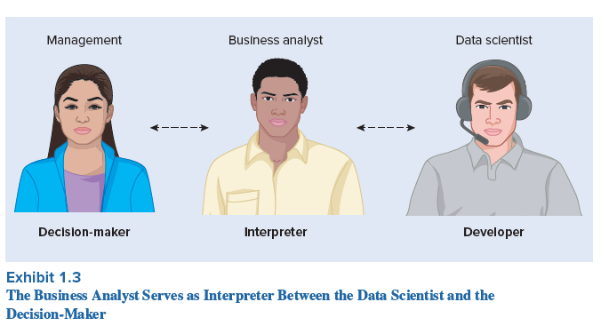
The Role of the Business Analyst – Interpreter or Liaison
© McGraw Hill LLC. All rights reserved. No reproduction or distribution without the prior written consent of McGraw Hill LLC.

Slide 17
Progress Check 1.3
Q. Choosing between the data scientist and the business analyst, which individual is likely to know which data will most directly address business questions?
What skills does each one have?
© McGraw Hill LLC. All rights reserved. No reproduction or distribution without the prior written consent of McGraw Hill LLC.
© 2022 McGraw Hill. All rights reserved. Authorized only for instructor use in the classroom. No reproduction or further distribution permitted without the prior written consent of McGraw Hill.

Slide 18
Business Analytics Across the Different Business Functions
LO 1.4
© 2022 McGraw Hill. All rights distribution permitted without the prior written consent of McGraw Hill.
© McGraw Hill LLC. All rights reserved. No reproduction or distribution without the prior written consent of McGraw Hill LLC.

Slide 19
Business Analytics
Defined as the use of data to create knowledge, to help draw conclusions and address business questions.
Different business functions have different business analytic needs.
Marketing needs are different from financial analytics; accounting analytics different from operations analytics.
© McGraw Hill LLC. All rights reserved. No reproduction or distribution without the prior written consent of McGraw Hill LLC.

Slide 20
Marketing Analytics
Marketing is the act or business of promoting and selling products or services.
Marketing analytics measures and attempts to improve its marketing performance.
Arguably, the most important component of marketing analytics is providing insights into customer preferences and trends.
Chapter 7 is focused on Marketing Analytics.
© McGraw Hill LLC. All rights reserved. No reproduction or distribution without the prior written consent of McGraw Hill LLC.

Slide 21
Accounting Analytics
Accounting works to measure, record and communicate financial performance to decision makers, including shareholders, management, customers, suppliers and regulators.
Accounting Analytics uses business analytics to help measure accounting performance and address accounting questions in the audit, financial accounting, managerial accounting and tax areas.
Chapter 8 is focused on Accounting Analytics.
© McGraw Hill LLC. All rights reserved. No reproduction or distribution without the prior written consent of McGraw Hill LLC.

Slide 22
Financial Analytics
Finance is the management of money by investing, borrowing, lending, budgeting, saving and forecasting financial capital (money).
Financial Analytics uses business analytics to help a company measure and evaluate its financial performance, from predicting receivables collection from its customers to helping management evaluate future investments based on expected investment performance, such returns to investments in equipment or employee training or stocks and bonds.
Chapter 9 is focused on Financial Analytics.
© McGraw Hill LLC. All rights reserved. No reproduction or distribution without the prior written consent of McGraw Hill LLC.

Slide 23
Operations Analytics
Operations includes an evaluation of a company’s human resource (evaluation of employee efficiency and turnover), IT operations, and supply chain (e.g., sourcing, manufacturing, distribution and logistics).
Operations Analytics measure and improve the efficiency and effectiveness of the company’s operations, since operations is all actions needed to run the company and generate income.
Getting the “Right Product in the Right Place at the Right Time” requires extensive data analysis to ensure product fulfilment.
Chapter 10 is focused on Operations Analytics.
© McGraw Hill LLC. All rights reserved. No reproduction or distribution without the prior written consent of McGraw Hill LLC.

Slide 24
Progress Check 1.4
Q. Which type of business function analytics is more likely to address the most efficient way to source a cigarette lighter from Shenzhen, China to a convenience store on Green Street in Champaign, IL?
© McGraw Hill LLC. All rights reserved. No reproduction or distribution without the prior written consent of McGraw Hill LLC.
© 2022 McGraw Hill. All rights reserved. Authorized only for instructor use in the classroom. No reproduction or further distribution permitted without the prior written consent of McGraw Hill.

Slide 25
The Analytics Mindset and the SOAR Analytics Model
LO 1.5
© McGraw Hill LLC. All rights reserved. No reproduction or distribution without the prior written consent of McGraw Hill LLC.
© 2022 McGraw Hill. All rights reserved. Authorized only for instructor use in the classroom. No reproduction or further distribution permitted without the prior written consent of McGraw Hill.

Slide 26
Analytics Mindset
An analytics mindset is the ability to:
► Ask the right questions;
► Extract, transform and load relevant data;
► Apply appropriate data analytic techniques; and
► Interpret and share the results with stakeholders.
Source: Ernst & Young Foundation: E&Y Academic Resource Center (EYARC). 2017. The Analytics Mindset.
Available online at http://aaahq.org/Education/Webinars/6-7-17-EY-Academic-Resource-Center-An-
Overview-of-Analytics-Mindset-Competencies-and-Case-Offerings.
© McGraw Hill LLC. All rights reserved. No reproduction or distribution without the prior written consent of McGraw Hill LLC.

Slide 27
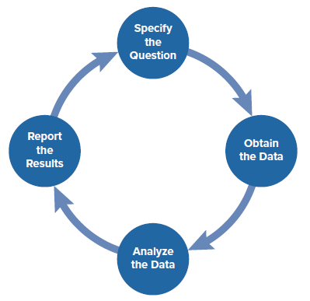
The SOAR Analytics Model
Specify the Question
Obtain the Data
Analyze the Data
Report the Results
EXHIBIT 1.4 The Recursive SOAR Analytics Model
© McGraw Hill LLC. All rights reserved. No reproduction or distribution without the prior written consent of McGraw Hill LLC.

Slide 28
SOAR: Specify the Question:
Sample Business Questions
(Potentially Answerable With Data):
How is the customer demographic profile (age, gender, disposable income, etc.) changing for typical customer shopping at McDonald’s?
If we purchase a new, more efficient copier, will the realized savings be sufficient to justify the more expensive price tag?
How much will the lead ordering deadline for Christmas products change if we source the products from Mexico versus Indonesia?
How will Chinese tariffs affect the sourcing of Walmart products to the US?
How will our increasing employee health insurance rates affect our level of sales needed to break even?
© McGraw Hill LLC. All rights reserved. No reproduction or distribution without the prior written consent of McGraw Hill LLC.

Slide 29
SOAR: Specify the Question
Different Questions Lead to Different Analytics Types
Five General Types of Business Questions and their Respective Analytics Type:
  Descriptive Analytics: What Happened?
  Diagnostic Analytics: Why did it Happen?
  Predictive Analytics: What is Likely to Happen in the Future?
  Prescriptive Analytics: What Action(s) should we Take, based on What we Expect Will Happen?
  Adaptive Analytics: How does the System Adapt to Changes?
© McGraw Hill LLC. All rights reserved. No reproduction or distribution without the prior written consent of McGraw Hill LLC.

Slide 30
SOAR: Obtain the Data
Which data is available?
Which data needs to be collected?
Will the data actually adequately address the question?
Is the data relevant to the question being asked and/or reliable enough to address the question?
Is it clean of errors or inconsistencies?
Does it have lots of missing data?
Is the data biased in some way?
© McGraw Hill LLC. All rights reserved. No reproduction or distribution without the prior written consent of McGraw Hill LLC.

Slide 31
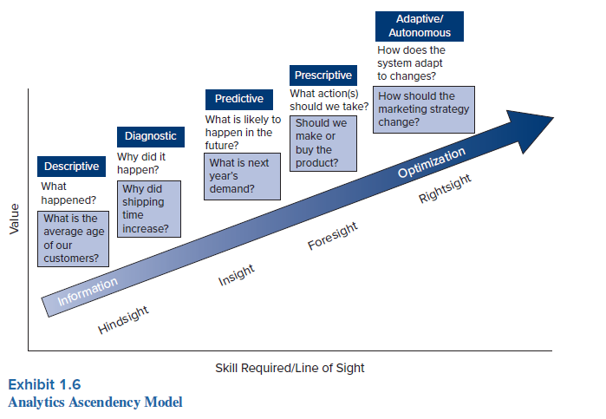
SOAR: Analyze the Data
© McGraw Hill LLC. All rights reserved. No reproduction or distribution without the prior written consent of McGraw Hill LLC.

Slide 32
SOAR: Report the Results
What is the best way to communicate what we’ve found in our data analysis?
Static Visualizations
  Reports
  Graphs
  Tables
Dynamic Visualizations
  Dashboards
© McGraw Hill LLC. All rights reserved. No reproduction or distribution without the prior written consent of McGraw Hill LLC.

Slide 33
The SOAR Analytics Model
Specify the Question
Obtain the Data
Analyze the Data
Report the Results
EXHIBIT 1.4 The Recursive SOAR Analytics Model
© McGraw Hill LLC. All rights reserved. No reproduction or distribution without the prior written consent of McGraw Hill LLC.

Slide 34
Progress Check 1.5
Q. If a company was trying to track its actual daily sales as compared to its sales targets, would you use a dynamic or static report?
© McGraw Hill LLC. All rights reserved. No reproduction or distribution without the prior written consent of McGraw Hill LLC.
© 2022 McGraw Hill. All rights reserved. Authorized only for instructor use in the classroom. No reproduction or further distribution permitted without the prior written consent of McGraw Hill.

Slide 35
Data Visualizations in Business Analytics
LO 1.6
© McGraw Hill LLC. All rights reserved. No reproduction or distribution without the prior written consent of McGraw Hill LLC.
© 2022 McGraw Hill. All rights reserved. Authorized only for instructor use in the classroom. No reproduction or further distribution permitted without the prior written consent of McGraw Hill.

Slide 36
Data Visualizations
Defined as graphic representation of data, usually in the form of a graph, chart or other image.
Two types of data visualizations:
Exploratory Data Visualizations - useful for uncovering patterns and useful insights in the data, generally as part of descriptive or diagnostic analytics.
  Part of the “Analyze the Data” step of the SOAR analytics model.
Explanatory Data Visualizations – important means of reporting the findings of the business analytics to stakeholders.
  Part of the “Report the Results” step of the SOAR analytics model.
© McGraw Hill LLC. All rights reserved. No reproduction or distribution without the prior written consent of McGraw Hill LLC.

Slide 37
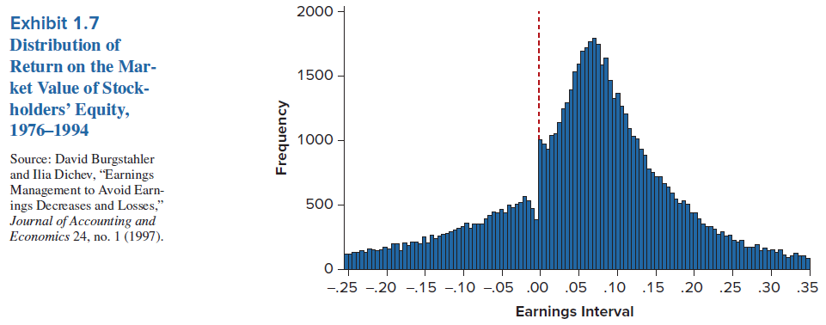
Exploratory Data Visualizations
The visualization displays the expected bell-shaped distribution of earnings for publicly traded companies from 1976-1994.
However, the visualization shows an anomaly—in this case, a discontinuity, right around zero. Just below zero, there seem to be missing observations or a lower-than-expected frequency, suggesting some type of an anomaly. And just above zero, there seem to be higher-than-expected frequency, again suggesting an anomaly.
Does this finding warrant additional investigation?
© McGraw Hill LLC. All rights reserved. No reproduction or distribution without the prior written consent of McGraw Hill LLC.

Slide 38
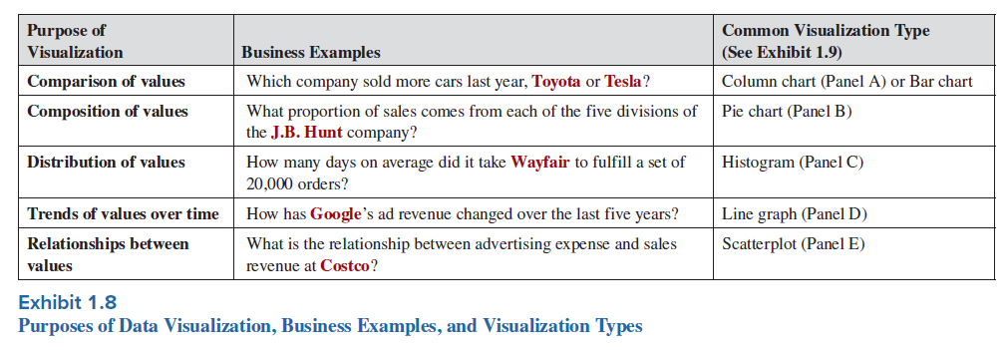
Explanatory Data Visualizations
Different Purposes Warrant Different Visualizations to Report the Results to the Decision Maker
  What are We Trying to Communicate?
Chapter 6 will discuss further.
© McGraw Hill LLC. All rights reserved. No reproduction or distribution without the prior written consent of McGraw Hill LLC.

Slide 39
Progress Check 1.6
Q. If people retain 95 percent of visual messages compared to 10 percent of text messages, how does that speak to the value of explanatory data visualizations to “Report the Results”?
© McGraw Hill LLC. All rights reserved. No reproduction or distribution without the prior written consent of McGraw Hill LLC.

Slide 40
Labs Associated with Chapter 1
Lab # | Lab Name
1.1 | Assessing Profitability of a Mowing Business
1.2 | Assessing Customer Profitability (using Excel, Tableau and/or Power BI)
1.3 | Assessing Product (SKU) Profitability (using Excel, Tableau and/or Power BI)
A | Excel Tutorial (Formatting, Sorting, Filtering, and PivotTables)
B | Tableau Tutorial
C | Power BI Tutorial
© McGraw Hill LLC. All rights reserved. No reproduction or distribution without the prior written consent of McGraw Hill LLC.

