Slide 1
Changes in Individual and Team Performance Over Time:
Informal (mid-point) Evaluation before the Formal (end-of-class) Evaluation
Wayne Smith, Ph.D.
Department of Management
CSU Northridge

Slide 2
Team Characteristics
Contributing to the Team’s Work
Strong: Does more or higher-quality work than expected.
Weak: Does not assist teammates. Quits if the work becomes difficult.
Interacting with Teammates
Strong: Asks for and shows an interest in teammates’ ideas and contributions.
Weak: Complains, makes excuses, or does not interact with teammates.
Keeping the Team on Track
Strong: Watches conditions affecting the team and monitors its progress.
Weak: Avoids discussing team problems, even when they are obvious.
Expecting Quality
Strong: Motivates the team to do excellent work.
Weak: Doubts that the team can meet its requirements.
Having Relevant Knowledge, Skills, and Abilities
Strong: Demonstrates the knowledge, skills, and abilities to do excellent work.
Weak: Unable to perform any of the duties of other team members.

Slide 3
Avoiding “Process Losses” and “Fault Lines” in Teams
The simplest tips prevent small problems from becoming large problems.
“Free-riding”
Review your trust and contract assignments
Team-based feedback—objective and subjective
Manage “air time”
Does everyone have a chance to speak and contribute?
“social—professional—social” —> 5%—85%—10%
Information Processing
Discuss non-common, privately-held, non-agreed-upon data too
Inadvertent filtering by perceived status or cognitive biases

Slide 4
What do the best teams do?
The best teams are those that…
…have the most tolerance for their teammates’ perspectives,
…have the greatest diversity in personalities, and
…have everyone exploring slightly different things but going in the same direction.
The best teams create a culture of “psychological safety” among its members.
This means that team members can share thoughts, ideas, and concerns without fear of ridicule or punishment.
Workplace teams that are most successful share some characteristics:
Each member of the team is engaged. Everyone talks and listens in roughly equal measure, and they talk with everyone.
There is a diversity of ideas, and everyone is willing to consider new ideas.
Everyone is involved in setting goals for a project
Source: Woo, S. (2017, Mar 13), "In Search of a Perfect Team: Who works best with whom? Now we know", Wall Street Journal

Slide 5
Managing Conflict
Conflict
A disagreement between people on:
Substantive issues regarding goals and tasks, allocation of resources, distribution of rewards, policies and procedures, and job assignments
Emotional issues arising from feelings of anger, distrust, dislike, fear, and resentment, as well as personality clashes
Functional Conflict (vigorous discussion and debate) that is well managed can help promote creativity and high performance
Dysfunctional Conflict (unproductive arguments and unresolved issues) that isn’t well managed can lead to a substantively less-cohesive team (and weak performance and lost points for the entire team)

Slide 6
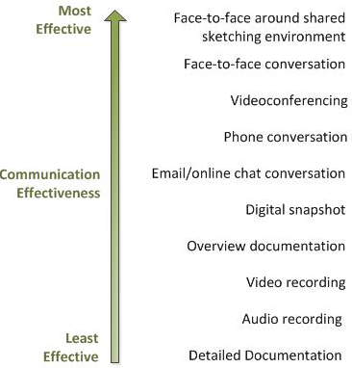
Communication Channels and Information Richness

Slide 7
Difficult Conversations
Professionals don’t need much help when things are going well.
But everyone needs help when things aren’t going well. Teams need to learn to discuss—openly and honestly—topics such as:
Clarifying Expectations
Review the Team Trust assignment (and expand upon it as necessary).
Perhaps revisit the Team Contract assignment (and extend it as needed).
Evaluating Performance
Understand how the work of even a single individual (in-class or out-of-class) can negatively impact the team and reduce the scores of all team members.
Help others create a culture of ownership.
Adjusting Behavior
Focus on recurring behavioral issues first.
Link individual attitudes with demonstrable action.
Learn how to be objective even on topics involving personality and perspective.
Remember….it is possible to be “voted off the island (team)”
The team needs to keep good documentation for the instructor.
The student(s) will then earn an automatic “F”.

Slide 8
How do you learn to improve yourself?
You need to learn to ask others (subordinates, professional peers, and bosses/managers/faculty) to provide you with constructive feedback.
You initiate that dialogue.
You need to learn how to 1) learn from others’ constructive feedback, 2), develop a action plan, and 3), change your behavior based on that action plan.
You are responsible for evaluating the changes and results of your plan.
You need to learn how to provide constructive feedback to others (especially professional peers and teammates).
You 1), choose the right time and place, 2), ensure that the feedback is reliable (is consistent) and valid (reflects reality), 3), make it direct and specific, and, 4), provide it in relatively small doses.
You need to learn to ask others (especially professional peers and teammates) how you can help them?
You initiate that dialogue.

Slide 9
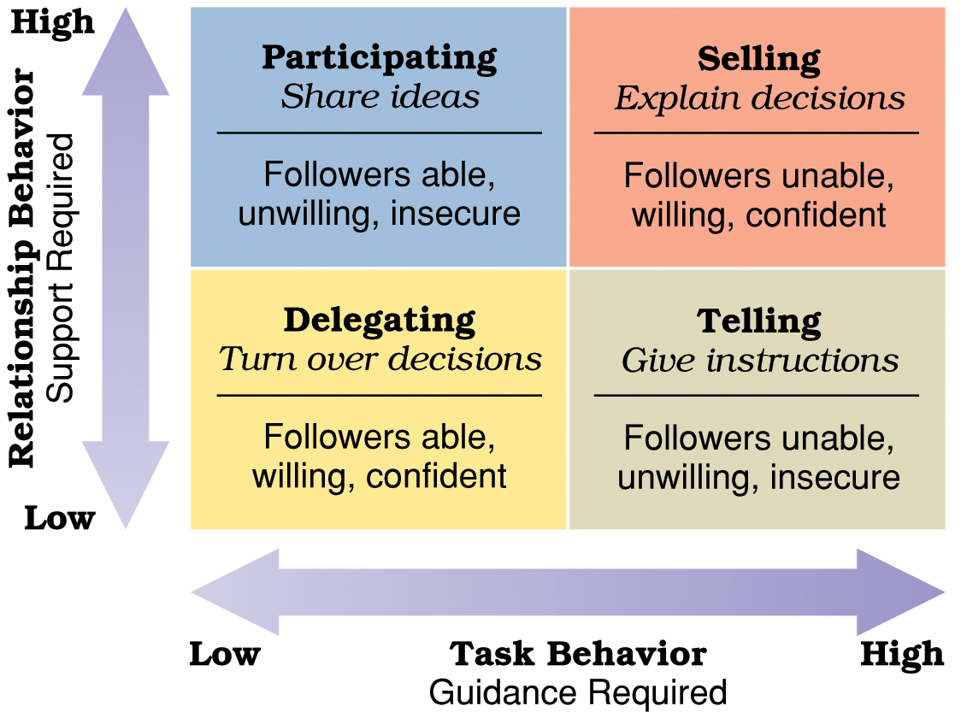
Situational Leadership

