Slide 1
Professional Standards and Communication:
The Art and Science of Influence
Wayne Smith, Ph.D.
Department of Management
CSU Northridge

Slide 2
The Influence “Stack” - Summary
Rhetoric
Logic
Prose
Composition
Philosophy

Slide 3
The Influence “Stack” - Detail
Rhetoric
performative reading
privilege & value
contrast
authority
argument & evidence
Logic
claim (assertion)
reason (evidence→claim)
evidence (facts)
warrant (proposition)
rebuttals & qualifiers
Prose
rhythm
pace
emphasis
feeling
passion
Philosophy
theoretical basis
trans-disciplinary mind
sense- & truth-making
leverage prior work
systematic approach
Composition
language use
word choice
grammar
punctuation
mechanics

Slide 4
The Influence “Stack” - Flow
compelling persuasion
Rhetoric
reasoned rationale
Logic
style/engagement
Prose
approach/strategy
Philosophy
syntax/semantics
Composition

Slide 5
The sine qua non of Professional Influence
Accounting
Expert Convention-as-Rule (e.g., “matching principle”)
Economics
Rationality-as-Rule (e.g., “comparative advantage”)
Law
Philosophy-as-Rule (e.g., “common law”, “torts”)
Statistics
Inference-as-Rule (e.g., “central limit theorem”)
And of course, the same goes for Math (Proof-as-Rule), Writing (Meaning-as-Rule), Computer Literacy (Productivity-as-Rule), et al.

Slide 6
The sine qua non of Professional Influence
Finance
Return-on-Investment-as-Rule (e.g., “risk/reward trade-offs”)
Operations
Efficiency-as-Rule (e.g., “minimal queuing latency”)
Management
Leadership-as-Rule (e.g., “self-efficacy”, “emotional intelligence”)
Marketing
Consumer Behavior-as-Rule (e.g., “exposed preferences”)

Slide 7
Argument and Logic

Slide 8
What is an argument?
Claim (statement/assertion/solution)
What should someone else believe (fact, definition, value) or do (policy)?
Reason (the strength of the Evidence supporting the Claim)
Why should someone else agree with you?
What inference are you making?
Evidence (quantitative data and qualitative data)
What facts do you have? Are the facts accurate, precise, representative, and reliable?

Slide 9
What is an argument?
Warrant (logical proposition)
What principle (theory/model/framework) makes your Reasons relevant to your Claim?
Acknowledgement/Response (rebuttal)
Have the reader’s/listener’s questions or alternatives been proactively identified?
Qualifier (conditions)
Are the known limitations identified and articulated?

Slide 10
An Argument that will Influence Professionals
2
Reason
(your logic)
3
1
Evidence
(premise)
Claim
(conclusion)
4
Warrant
(substantive
theory)
5
6
Acknowledgement
and Response
(feedback)
Qualifications
(conditions)

Slide 11
An Argument that will Influence Professionals
“Interpretive Argument”
(judgment about relevance)
2
Reason
(your logic)
3
2
1
3
1
Evidence
(premise)
Claim
(conclusion)
4
Warrant
(substantive
theory)
5
6
Acknowledgement
and Response
(feedback)
“Vertical Argument”
(judgment about rigor)
Qualifications
(conditions)
4
2

Slide 12
What is an argument?
Will the meaning of all words and sentences be interpreted by all readers/listeners similarly?
Of all the possible causes of an event, 1), have I identified the most important cause, and 2), minimized as many cognitive biases as possible?
Have I overgeneralized (or underspecified)?
Am I clear and unambiguous?
Have I expressed values or evoked feelings?
How can I augment the rational force of an argument to address different points of view?

Slide 13
What isn’t an argument?
Coercion
Makes the cost of rejecting a claim intolerable.
Also, subtle coercion is still coercion.
Propaganda
The reasons don’t have to be good, you don’t care what others think, and you play chiefly on others’ emotions.
Also, a hidden agenda is still an agenda.
Negotiation
You can offer any reason you like, but…
1), you don’t generally disclose everything you know about the reason, and
2), it just needs to be good enough so that both sides can live with the outcome of the negotiation.

Slide 14
What Experienced Speakers Know about Making Arguments
The purpose isn’t to “win” (prevail)…
The purpose is to solve an issue through agreement
Coercion won’t work…
Consider questions and objections of others and respond
Good arguments and sound thinking isn’t enough…
Constant re-thinking and re-evaluation will lead to deeper and more substantive understanding
You can’t invent a new form of argument each time…
You have to “play” to the audience’s expectations
Even if you don’t “win” (prevail)…
A good argument earns the reputation of someone with the qualities of reasonableness and thoughtfulness

Slide 15
In-class Exercise

Slide 16
Sources
Williams, J., and Colomb, G. (2007), The Craft of Argument, 3rd ed., Pearson Education.
Parts of this presentation were inspired by one of my former BUS 302 students—Ms. Shermineh Maleki.

Slide 17
“Back Pocket” Slides

Slide 18
Rule--Lower-division core “top ten” topic
Secondary
Source
Finding,
Conclusion,
Recommendation,
Etc.

Slide 19
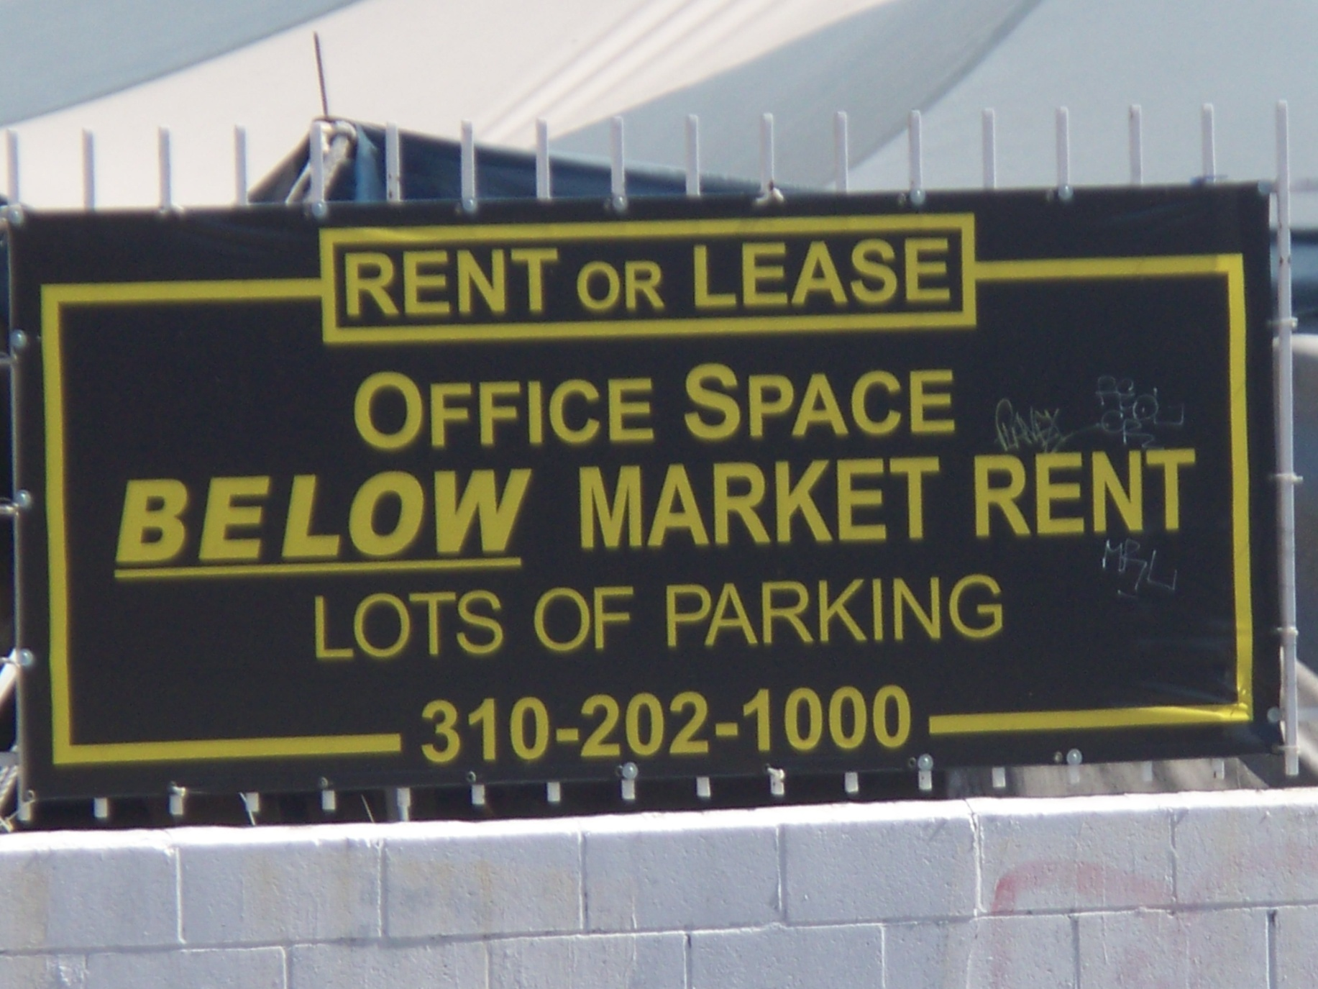
“Below” Market Rent

