Slide 1
Values in Contemporary Business: A Primer on Ethical Decision-making for BUS 302
Wayne Smith, Ph.D.
Department of Management
CSU Northridge
ws@csun.edu

Slide 2
“Legal” and “Ethical” are sometimes similar
If one is acting within the law, presumably one is acting ethically.
The law defines specific duties.
Some conduct is prescribed.
Some conduct is allowed.
Some conduct is proscribed.
If you are in Compliance – no further action
There is formal punishment for illegal conduct.
Statues and Regulations balance competing values.

Slide 3
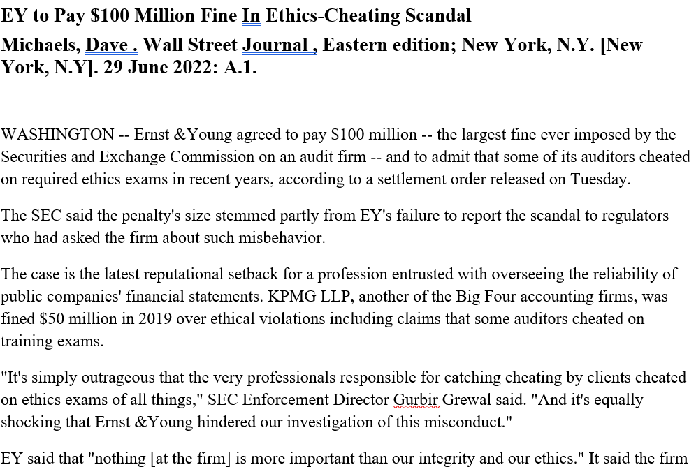

Slide 4
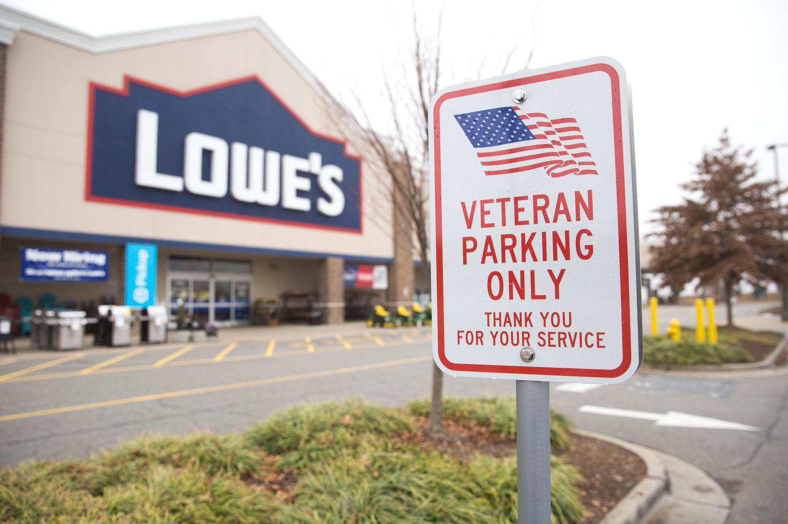

Slide 5
“Legal” and “Ethical” are sometimes different
Ethics offers guidance on how one should act.
Addresses situations where competing values clash.
Action or inaction may be controlled by a formal or an informal process.
Ethics can be seen, therefore, as action beyond mere compliance to legal duty.
So…what, therefore, is ethical decision-making?

Slide 6
How to Analyze Ethical Dilemmas in Business
Identify the key ethical issue(s)
Identify primary (direct) and secondary (indirect) stakeholders
You need to incorporate their positions and perspectives
Use an ethical decision-making approach (this provides structure for the argument)
You need a cohesive, understandable organization (choose one of the two—Tucker or Velasquez (if not specifically provided by the instructor)
Use multiple ethical decision-making theories/models/frameworks to answer each part (this provides strength for the argument)
You must base your argument in rigorous, relevant theory
Compare alternatives and assess consequences
You identify all major alternatives and estimate outcomes

Slide 7
Ethical Decision-making Approach — Tucker
Evaluate each alternative on:
Is the decision profitable (shareholders)?
Is the decision legal (society at large)?
Is it fair?
What is the impact on the rights of stakeholders?
What is the impact on sustainable development (environment)?

Slide 8
Ethical Decision-making Approach — Velasquez
Moral Standards Approach
Is the decision…
Of net benefit to society?
Fair to all stakeholders (fair distribution of benefits and burdens)?
Consistent with each person’s rights?

Slide 9
Ethical Decision-making Theories
Philosophical Branches of Ethics
These are ones that have had the widest impact over time
Utilitarianism (“evaluated by the consequences/value”)
Deontology (“inherent duty”)
Nicomachean (“moral virtues”)
Applied Branches of Ethics
These are combinations and derivatives of the first three
Rights Theory (“freedom, fairness, and equality”)
Justice Theory (“harm to a single individual”)
Corporate Social Responsibility (“organizational values”)

Slide 10
Ethical Decision-making Theory — Utilitarianism
Definition
Utilitarianism is a branch of “Consequentialism”
We evaluate the ethical decision by its results
Jeremy Bentham, John Stuart Mill, Henry Sidgwick
Key Assumption
We can identify and understand values, outcomes, and consequences
Key Decision
Measured Benefits divided by Measured Costs → “Best Ethical Decision”
Key Question(s)
What is the greatest good for the greatest number?
What is the maximum, long-run, aggregate utility for a population?

Slide 11
Ethical Decision-making Theory — Deontology
Definition
We evaluate the ethical decision by its relationship to a person’s inherent duty
Georg Hegel, Immanuel Kant, Thomas Nagel, Tim Scanlon
Key Assumption
An individual’s duty rises in scope and import with one’s knowledge
Key Decision
Endowments subject to Burdens → “Best Ethical Decision”
Key Question(s)
Categorical Imperative
What is right, fair, and just for another individual (without having to evaluate the consequences or use religion)?
Reciprocity
What is the best, empathic relationship for both individuals or organizations?
Enlightened Self-Interest
What improves others’ interests and improves my interests?

Slide 12
Ethical Decision-making Theory — Rights
Definition
We evaluate the ethical decision by its relationship to certain inalienable rights
Isaiah Berlin, Wesley Hohfeld, John Locke, Jean-Jacques Rousseau
Key Assumption
Rights enable an individual’s interests, well-being, will, and choice
Key Decision
Legal Rights plus Natural Rights → “Best Ethical Decision”
Key Question(s)
Does this decision advance…
Rights to claim, privilege, power, and immunity?
Fair and equal treatment?
Privacy and personal security?
Opportunity to keep one’s wealth and property?
Freedom to achieve self-actualization (e.g., life, liberty, and the pursuit of happiness)?
See also…The First 5 amendments to the U.S. Constitution

Slide 13
Ethical Decision-making Theory — Justice
Definition
We evaluate the ethical decision by its applicability to a single individual
Thomas Hobbes, Robert Nozick, Chaïm Perelman, Plato, John Rawls
Key Assumption
A civil society values order, equity, balance, and proportionality
Key Decision
Best for an Individual multiplied by Best for Society → “Best Ethical Decision”
Key Question(s)
Can inequity or harm to a single individual be justified?
Key Types of Justice
Is the process fair and equal? (procedural justice)
Is there a fair distribution of benefits and burdens? (distributive justice)
Is the punishment appropriate? (retributive justice)
Can we repair any harm done? (restorative justice)

Slide 14
Ethical Decision-making Theory — Nicomachean
Definition
Aristotle (“virtues”): Courage, Temperance, Liberality, Generosity, Magnamity, Moderation, Gentleness, Friendliness, Truthfulness, Sense of Shame
Aristotle (“vices”): Is neither prodigal nor stingy, Has neither deficits nor excess, Has disposition but lacks achievement
Confucius (“virtues”): Humaneness, Justice, Proper rites, Knowledge, Integrity, Loyalty, Honesty, Kindness, Bravery, Respect, Modesty
Machiavelli (“vices”): Brute force, Duplicitous guile, Criminal virtue
Key Assumption
Individuals have free will and can choose correct or best paths
Key Decision
Virtues approach ∞ and Vices approach 0 → “Best Ethical Decision”
Key Question(s)
What descriptive attributes will others ascribe to me?
As an educated person, what will others expect of me?
How will I be evaluated in the long run?

Slide 15
Ethical Decision-making Theory — Corporate Social Responsibility
Definition (“organizational values”)
Organizational Values
H. Bowen, A. Carroll, K. Davis, P. Drucker, E. Freeman, D. Wood
Key Assumption
A company’s vision and mission supports society’s wider values
Key Decision
Aligned with Organizational values → “Best Ethical Decision”
Key Question(s)
Is this decision aligned (i.e., “consonant”) with our espoused organizational values, vision, and mission?
Duty of…Care? …Loyalty? …Diligence? …Prudence?
What are the “Systems Effects” and/or “Side Effects”?
What key aspects of labor and capital does Business/Industry control?
(traditional term) “Triple Bottom Line”—Planet, People, Profit
(contemporary term)—Environmental, Social, and Governance (ESG)

Slide 16
Citations and References
You can either use my Powerpoint…or
You can use the Stanford Encyclopedia of Philosophy
https://plato.stanford.edu/

Slide 17
Tests and Questions
Front page test: (Nichomachean, Corp. Social Responsibility)
Would I be embarrassed if my decision became a headline in the local news-paper?
Would I feel comfortable describing my actions or decision to a customer or stockholder?
Golden rule test: (Deontology)
Would I be willing to be treated in the same manner?
Dignity and liberty test: (Rights, Justice)
Are the dignity and liberty of others preserved by this decision?
Is the basic humanity of the affected parties enhanced?
Are their opportunities expanded or curtailed?

Slide 18
Tests and Questions
Equal treatment test: (Justice)
Are the rights, welfare, and betterment of minorities and lower status people given full consideration?
Does this decision benefit those with privilege but without merit?
Personal gain test: (Nichomachean, Utilitarianism)
Is an opportunity for personal gain clouding my judgment?
Would I make the same decision if the outcome did not benefit me in any way?
Congruence test: (Nichomachean, Corp. Social Resp.)
Is this decision or action consistent with my espoused personal principles?
Does it violate the spirit of any organizational policies or laws?

Slide 19
Tests and Questions
Procedural justice test: (Deontology, Justice)
Can the procedures used to make this decision stand up to scrutiny by those affected?
Cost-benefit test: (Utilitarianism)
Does a benefit for some cause unacceptable harm to others?
How critical is the benefit? Can the harmful effects be mitigated?
Good night’s sleep test: (Nichomachean)
Whether or not anyone else knows about my action, will it produce a good night’s sleep?

