Slide 1
BUS 302: End of semester debrief
Wayne Smith, Ph.D.
Department of Management
CSU Northridge
ws@csun.edu

Slide 2
Use any Gateway Ideas (Content or Process)…
…In another class?
…At work?
…Elsewhere?
Explain.

Slide 3
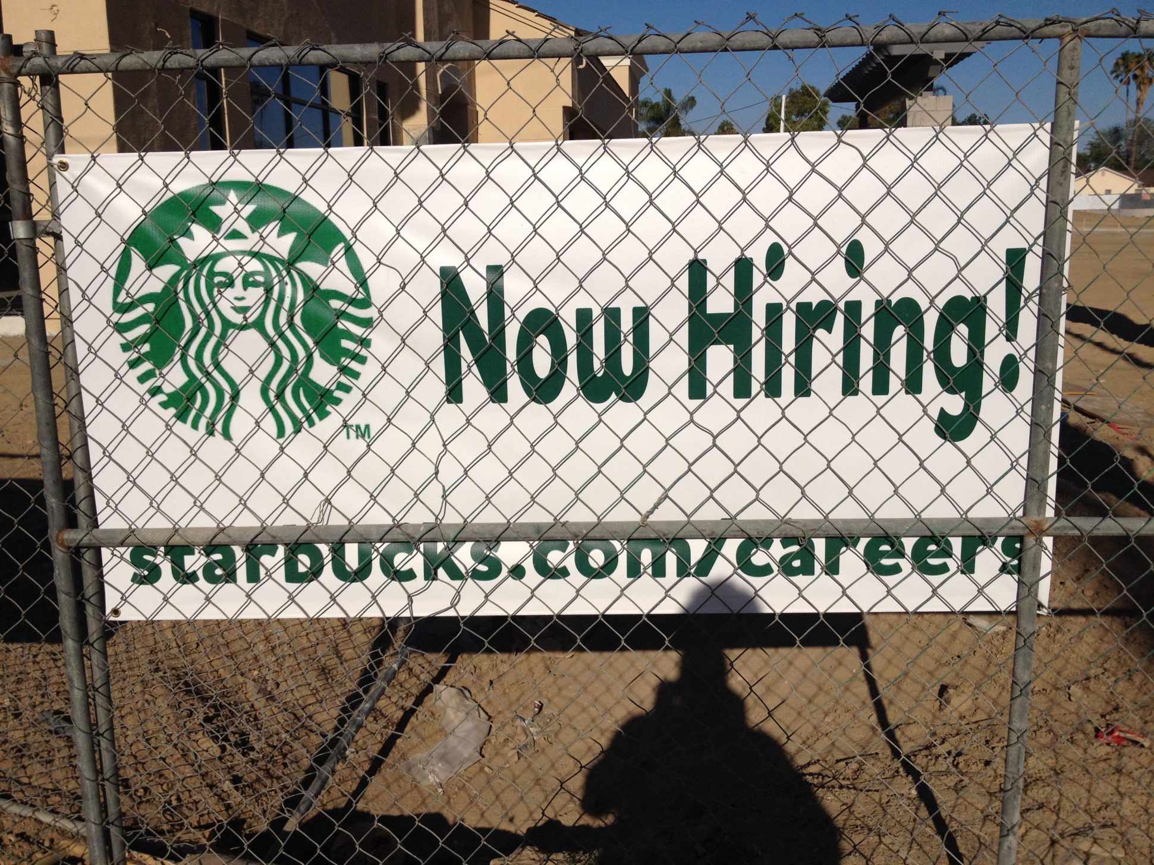
Student Portfolio

Slide 4
What is a Professional?
Privileges preparation and readiness
Is persistently ahead within any given project
Sweats the details
Embraces theory, eschews ideology
Can hold opposing viewpoints and understands differing perspectives
Espouses values, eschews ego-status
Focuses well, take responsibility
Learns rapidly in teams
Takes (and gives) leadership role
Gives (and receives) constructive feedback
Can identify strengths of others, weaknesses in self

Slide 5
Progress and Development
“Matriculation”
“to enroll as a member of a body especially in a college or university”
“Accretion”
“the process of growth or enlargement by gradual buildup”
Source: Merriam-Webster Dictionary

Slide 6
Matriculation and Accretion
More
learning
Integrate Subject Matter
and
Synthesize Processes
Intrinsic Knowledge
And
Extrinsic Value Proposition
Accretion
Breadth of
Foundational
Skills
Depth of
Professional
Skills
Less
learning
Lower
division
Matriculation
Upper
division

Slide 7
Complementing “specialist” skills with “generalist” skills
COBAE graduates aren’t making pins in a pin factory
You’re managing the labor and capital associated with the pin factory
Gauging “strengths” and “weaknesses” rapidly requires
some time
diverse content and tasks
timely, rigorous, relevant feedback
deep preparation
It’s naïve to think that you’ll only (or mostly) work with individuals with same skills, knowledge, or abilities, much less with the same backgrounds and experiences
You really learn a topic when you have to teach it to someone else
The honest truth is that nobody (including you) knows what you’ll be doing in the half-life of your career, much less near the end of it

Slide 8
Student Portfolio

Slide 9
Post-BUS 302 Portfolio (the “hard” stuff)
Portfolio as a Professional
Beyond a Résumé
From learned capability to demonstrated ability
You tell the story of performance
http://www.csun.edu/it/portfolium
Evidence of Explicit Progress and Development
LDC Interdisciplinary Thinking
Introduction to Strategy
Ethical Decision-Making
Teams/Interpersonal skills
Foundational Skills
Oral and Written Communication

Slide 10
Post-BUS 302 Portfolio (the “soft” stuff)
Portfolio as a Student
Beyond a Grade
From learned capability to demonstrated ability
You tell the story of performance
Evidence of Implicit Progress and Development
Developed a sense for the level of peer competition
Learned the difference between effort and performance
Reflected upon your “fits” (strengths) and “gaps” (weaknesses)
Developed Active Listening skills
Learned how to provide Feedback and receive Feedback
Learned the attributes of a business professional

Slide 11
Key Differences between BUS 302 and other COBAE classes
From: Breadth of BUS 302 To: Depth of your Major
You’ll need to do everything in BUS 302 without being asked, including:
Excel at both quantitative tools and qualitative tools
Effective oral presenter and strong written communicator
Integrate topics and subject matter from multiple courses
Strategic thinker
Ethical decision-maker
From: Face-to-Face To: (occasionally) Hybrid or Online
Requires extreme self-discipline and focused attention
From: Small Class (N ~ 40) To: Large-lecture Hall (N ~ 160)
You’ll need to stand out and distinguish yourself
Learn to ask for feedback—early and often
Leverage the Instructor’s Office Hours
And more…

Slide 12
Brief Analysis of MGT 360 grade patterns… (yes, this needs some explanation…)

Slide 13
Prof. Wayne’s Top Ten Tips for Course Success: Understanding pass/fail rates in Large classes
When one studies the issue in depth, what is the pass rate (i.e., “ABCs”) in, say, MGT 360? Or conversely, what is the fail rate (i.e., the “DUFs”, or 100% minus the pass rate)? And in Business, a “C-” is just as bad as a “fail” for some students.
The pass rate for small sections (~40 students) is about 95% or 38 (i.e., 95% of 40 = 38). Or conversely, the fail rate is 5% or 2 (i.e., 5% of 40 = 2).
If the fail rate was the same for the large sections as it was for the small sections, the fail rate would be 5% or 8 (i.e., 5% of 160 = 8).
However, the pass rate for large sections (~160 students) is about 85% or 136 (i.e., 85% of 160 = 136). Or conversely, the fail rate is 15% or 24 (i.e., 15% of 160 = 24).
Note that the fail rate does not stay the same; the fail rate, unfortunately, increases. To be very clear: holding nearly everything else constant, increasing the class size by four increases the fail rate by twelve (i.e., from 8 to 24).
Lesson: It’s easier to fail (i.e., not pass) in a large section than in a small section.
Remedy: Students need to focus and work harder in large lecture hall classes.

Slide 14
Prof. Wayne’s Top Ten Tips for Course Success: Avoiding “DUFs”
“UW/F”
Issue: These students either don’t take the final, or more often, do little or no work after the mid-term, but don’t drop. This grade sticks with you unless and until you repeat the course (something you don’t want to do) and earn a higher grade (something that can be hard to do)
Remedy: Drop early. CSUN has student-initiated (and University-initiated) drops, but not instructor-initiated drops (like many CCCs).
“D+/D/D-”
Issue: These students are missing much work throughout the class. Each missed assignment counts as a zero (i.e., an “F”) in your overall grade.
Remedy: Always turn in all assignments even if you don’t feel it’s your best work. Don’t miss the mid-term or final exam. And of course, always attend every class.
“C-”
Issue: These students earn C’s/D’s on most of their work, but moreover, the work doesn’t improve throughout the semester. That is, the level of performance at the end of class is very nearly identical to the level of performance at the beginning of class.
Remedy: Strive to perform well early, but regardless, strive to continuously improve on each type of class work deliverable as best as you can.

Slide 15
COBAE Upper-Division Core Courses (primary perspectives)
FIN 303
Financial
Management
MKT 304
Marketing
Management
External
Orientation
MGT 360
Mgt. and
Organizational
Behavior
SOM 306
Operations
Management
Internal
Orientation
Economic
Capital
Human
Behavior

Slide 16
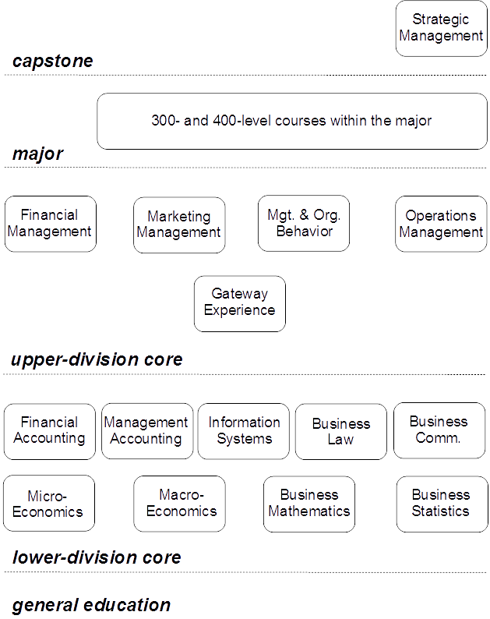

Slide 17
Ethical Considerations
Utilitarianism (“evaluated by the results”)
A Branch of Consequentialism
What is the greatest good for the greatest number?
Measured Benefits divided by Measured Costs → “Best Ethical Decision”
Deontology (“inherent duty”)
Categorical Imperative, Reciprocity
What is right, fair, and just for another individual?
Endowments subject to Burdens → “Best Ethical Decision”
Nicomachean (“moral virtues”)
Courage, Temperance, Liberality, Generosity, Magnamity, Moderation, Gentleness, Friendliness, Wittiness, Truthfulness/Integrity, “Sense of Shame”, …
What descriptive attributes can be ascribed to me?
Virtues approach ∞ and Vices approach 0 → “Best Ethical Decision”

Slide 18
Nicomachean Ethics
Nicomachean (“moral virtues”)
Courage, Temperance, Liberality, Generosity, Magnamity, Moderation, Gentleness, Friendliness, Wittiness, Truthfulness/Integrity, “Sense of Shame”, …
What descriptive attributes can be ascribed to me?
Virtues approach ∞ and Vices approach 0 → “Best Ethical Decision”
In addition to doing the right thing…you need to
Know it’s the right thing to do
Know why it’s the right thing to do
Do it in the way other ethical individuals would do it
Always do that same thing in all future, similar situations
Enjoy doing that thing
And…do it with a compelling and persuasive argument
And…take care to avoid making any logical fallacies
And…link beliefs↔desires and intentionality↔understanding
Whew!...But that’s what the business faculty require of students and what employers expect of professionals

Slide 19
“Upward Influence” (or “Managing your Boss”)
Congruence (work on issues congruent with your position and role)
Credibility (being honest, open, non-self-serving, & straightforward)
Communication (maintain access to a broad communication network)
Compatibility (talk about issues in harmony with the organization)
Solvability (make it clear that the issue can, indeed, be solved)
Payoff (the higher the payoff → the more it will receive attention)
Expertise (identify any required expertise in the organization)
Responsibility (point out the responsibility that top managers have)
Presentation (explain the issue in precise, simple terms & with data)
Bundling (point out the relationship between this issue and others)
Coalitions (gain sponsorship by other people who will help you)
Visibility (bosses act when many individuals are publicly involved)
Dutton, J. E., and Ashford, S. J. (1993). Selling Issues to Top Management, Academy of Management Review, 27:31-40.

Slide 20
Extra-curricular activities matter…deeply
Join the student organization for your major
AA, ALPFA, AMA, BAY, Pre-Law, LBA, MISA, SFA, etc.
http://www.csun.edu/cobaessc/clubs-and-organizations
Take a leadership role if you can

Slide 21
“Today’s College students must…”
Get workplace experience before graduating.
Start building a network early.
Acquire technical, analytical and interpersonal skills not taught in college classes.
Avoid relying heavily on online job boards.
Build a robust LinkedIn profile.
Seek out other experienced adult mentors for advice.
Shellenbarger, S. (May 7, 2019) Job Advice for Grads, Wall Street Journal.

Slide 22
“Suggestions for today’s College students from CEOs”
“No one likes a phony. Don't be a different person at work.”
Mandy Ginsberg (Chief executive, Match Group Inc.)
“Be sensitive. The must-have skill: Empathy.”
Mark Hoplamazian (CEO, Hyatt Hotels Corp.)
“Don't just take the highest-paying offer.”
Clara Shih (CEO, Hearsay Systems Inc.)
“Realize the power in saying ‘no’”
Gary Erickson and Kit Crawford (Co-CEOs, Clif Bar & Co.)
Pick your early bosses wisely. A good test: Do you even like them?
Barbara Corcoran (CEO, Barbara Corcoran Inc.)
Cutter, C., and Fuhrmans, V. (May 11, 2019) Job Advice for Grads, Wall Street Journal.

Slide 23
“Suggestions for today’s College students from CEOs”
Don't overestimate the risk of failure.
Rich Barton (CEO, Zillow Group Inc.)
Embrace being 'purposefully direction-less.' (That doesn't mean stop working.)
Logan Green (CEO, Lyft Inc.)
Dig in. Don't treat your job as a temporary stop.
Laura Alber (CEO, Williams-Sonoma Inc.)
Or maybe job hop. You'll be better for it.
Steve Hafner (CEO, Kayak)
Cutter, C., and Fuhrmans, V. (May 11, 2019) Job Advice for Grads, Wall Street Journal.

Slide 24
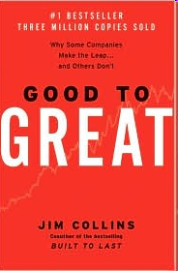
Key Leadership Skills from “Good to Great”
What drives your
economic engine?
What can
you be
the best in the
world at?
What are
you deeply
passionate about?

Slide 25
Korn Ferry’s Four Dimensional Assessment
Traits
The natural tendencies and preferences you lean toward, including personality and intellectual capacity.
Drivers
The values and interests that influence your career path, motivation, and engagement.
Competencies
Your observable skills and behaviors that matter for success.
Experiences
The assignments and roles that shape you for future opportunities.

Slide 26
Fall in love… (yes, this needs some explanation…)

Slide 27
(explain final grades and associated timelines)

Slide 28
(hand back Ethics Essays)

