Slide 1
Technology and Analytics
Understanding technology changes and adoption, and understanding how to gather, transform, analyze, and report strategic data?
Wayne Smith, Ph.D.
Department of Management
CSU Northridge

Slide 2
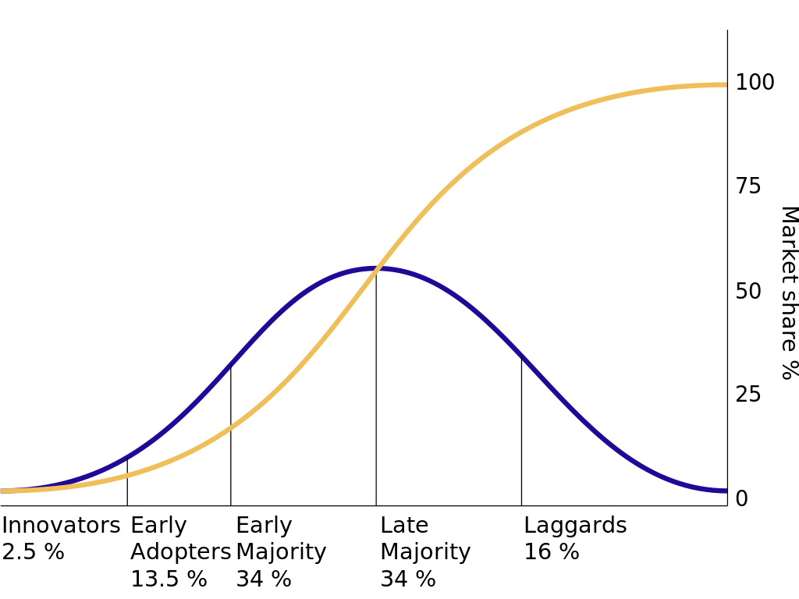
Diffusion of Innovation
Source: https://en.wikipedia.org/wiki/Diffusion_of_innovations

Slide 3
Technology mapped to UDC
Finance
Resource Allocation, ROI/IRR, Industry standards, …
Operations
Quality, Productivity, Logistics, Supply Chain, Maintenance, …
Marketing
Market/Industry Growth, Customer Data, Adoption, Perception …
Management
Strategy alignment, Equity, Complexity, Training, Use, …

Slide 4
Technology mapped to LDC
Financial Accounting
Capital Budgeting, Annual Expense Planning, Depreciation, Audit, …
Managerial Accounting
Break-even, Cost Allocation by Piece/Use/Department, …
Micro-Economics
Life-cycle, Vendor Lock-in, Product Ecosystem, Bandwagon Effects, …
Macro-Economics
Origin Country, Cross-country requirements, Controls, Exchange rates …
Business Statistics
Reliability/Error rates, Data Warehouses, Data Science access, Estimates…
Business Law
Licensing, Intellectual Property, “Right to Fix”, Privacy, “West Coast Law”, …

Slide 5
Technology mapped to Lower-Division Business Skills
Business Math/Calculus
Scale (Century, Decades, Years, Months), Rates of Change, …
Information Systems/ Computer Science
Architecture, Systems, Integration, Security, Upgrades, Replacement, …
Business Communications
Clear and Compelling Rationale, Use Case, Government Requirements, …

Slide 6
Technology mapped to General-Education Skills
English Language Communication and Critical Thinking
Documentation, Understanding, Contingencies, “Open Technologies”, …
Scientific Inquiry and Quantitative Reasoning
Next Generation Technology, Data Literacy, Computational Literacy, …
Arts and Humanities
Aesthetics, Interaction, Experience, Technological Determinism, …
Social Sciences and U.S. History and Government
“Network effects”, Mis/Information, Government subsidies, Export Controls …
Lifelong Learning
Continuous Learning, Career Development, Professional Education, Skills, …
Comparative Cultural Studies/Gender, Race, Class, and Ethnicity Studies, and Foreign Languages
Justice, Diversity, Equity, Inclusion, Translation, Access, “Digital Divides” …

Slide 8
Management Decision-making (from a Quantitative perspective)
Artificial Intelligence (“Machine Learning”, “Algorithms”)
Business Research (“Statistics”, “Hypothesis Testing”)
Big Data (generally, linked data in the “cloud”)
Data Science (“using reproducible tools for visualization/analysis”)
Business Analytics (“simpler approaches, augments decisions”)
Our task (at least from a technology perspective) is to
Capture, transform, analyze, and report data, and…
sometimes, to be quite technical, this means to “copy-paste-adjust”

Slide 9
Information Dynamics
Wisdom
Extraordinary Insight (Explanation) for Foresight (Prediction)
Restaurant: How should our menu change in the future to best optimize nightly sales?
Knowledge
Combination of Explicit Information and Tacit Information
Restaurant: What action led to the change in last night’s sales?
Information
Meaningful Data
Restaurant: How does last night’s sales compare to that night the previous year? How does last night’s sales compare to our goals?
Data
Raw, atomic, basic
Restaurant: What were the total sales for last night?

Slide 10
Analytics for Management Decision-making
Prescriptive Analytics
What should we do?
HR Department: What should we (the HR Department) do to meet or exceed the organization’s hiring and retention goals for next year? What data/information/knowledge/wisdom should we provide to our hiring and technical managers to help? What are we missing?
Predictive Analytics
What is likely to happen?
HR Department: How many new employees will our organization need next year? How will the mix change? What is our competition likely to do?
Diagnostic Analytics
Why did it happen?
HR Department: Did our emphasis on recruiting from campus A (over campus B, etc.) matter? What do the managers of these entry-level employees think?
Descriptive Analytics
What happened?
HR Department: How many entry-level professionals did we hire last year? How many of them are still with us now?

Slide 11
Information Dynamics
You’ve done some of this already
Data, Information, Knowledge, Wisdom
But there is more…
Data
File formats, Database access, “Big Data”, Ethics/Security
Information
Selected Observations, Selected Variables, Exploratory Graphics
Knowledge
Combined quantitative analysis with qualitative analysis, Competitors
Wisdom
Generate Estimates/Predictions, Make specific recommendations

Slide 12
Analytics for Management Decision-making
You’ve done some of this already
Descriptive, Diagnostic, Predictive, Prescriptive
But there is more…
Descriptive
Skewness, Kurtosis, Geometric Mean, Outliers, Missing Data
Diagnostic
Other distributions (passion, Chi-Square, etc.), Other Hypothesis Tests
Predictive
Multiple linear regression, non-linear regression, machine learning, AI
Prescriptive
Simulations (model reality and test), Optimization (make a precise rec.)

Slide 13
A Continuum of Choices
Commercial Off-the-Shelf solutions (software as a service)
Salesforce?, Workday?, SAP?, Intuit?, Google Analytics/AdSense?, Shopify?
Tableau
Telling stories with data?, slicing/dicing?, integrated maps?, fin. analysis?
MS-Excel
Indispensable?, GoogleSheets?, Apple Numbers?, Libredocs?
Office Productivity Tools
Individual/collaborative?, shared drives?, remote access?, security?
SPSS, SAS, Stata, M-Plus, MATLAB
Industry-wide standard?, Enterprise-wide standard? Unit-wide standard?
Custom Programming
Databases?, SQL?, VBA?
R?, Python?, Julia?, Scala?, others?

