Slide 1
Welcome to the...
LATINO BUSINESS ASSOCIATION
Juntos We Rise
Fall 2021 - Spring 2022

Slide 2
Mission Statement
The Latino Business Association (LBA) is a student ran association at California State University, Northridge which focuses on the development and growth of our members academically, professionally, and socially. In addition, LBA provides financial assistance for its members with an annual scholarship drive.

Slide 3
Time to get to know me a little.
Hi! My name is Beatriz (Betty)
Role: President
Year: Senior
Major: Marketing
Fun Fact: I love eating Ramen

Slide 4
Time to get to know me a little.
Hi! My name is Christopher
Role: Vice President
Year: Junior
Major: Mechanical Engineering
Fun Fact: I used to make music

Slide 5
Time to get to know me a little.
Hi! My name is Pamela
Role: Executive Administator
Year: Sophmore
Major: Business Administration
Fun Fact: Favorite Show to rewatch is Home Improvement

Slide 6
Time to get to know me a little.
Hi! My name is Denice
Role: VP of Marketing
Year: Junior
Major: Marketing

Slide 7
Time to get to know me a little.
Hi! My name is Nohe
Role: VP of Membership
Year: Senior
Major:Business Management
Fun Fact: An experienced Starbucks barista

Slide 8
Time to get to know me a little.
Hi! My name is Diana
Role: Corporate Relations Director
Year: Senior
Major: Communications
Fun Fact:I worked and lived with Britney Spears

Slide 9
Time to get to know me a little.
Hi! My name is Ethan
Role: IT Director
Year: Senior
Major: Computer Science

Slide 10
Time to get to know me a little.
Hi! My name is Maher
Role: Fundraiser Director
Year: Senior
Major: Real Estate
Fun Fact: love to travel

Slide 11
Time to get to know me a little.
Hi! My name is Denise
Role: Social Media Director
Year: Senior
Major: Marketing
Fun Fact: I love to travel to ew states

Slide 12
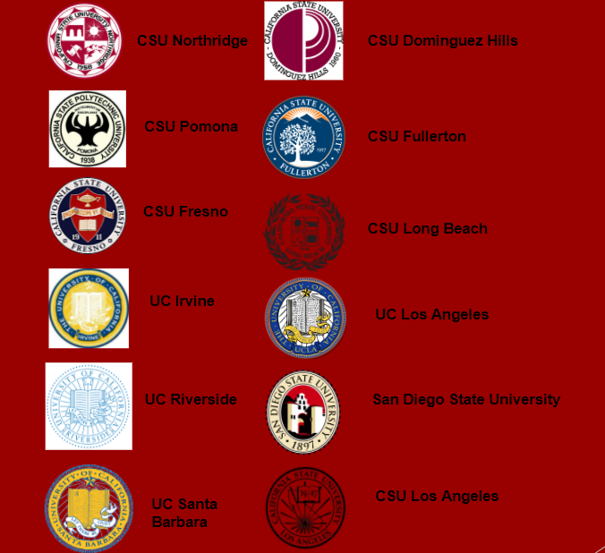
United Latino Student Association

Slide 13
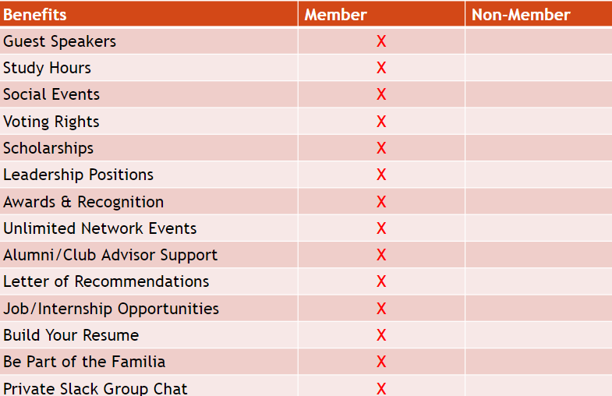
Benefits

Slide 14
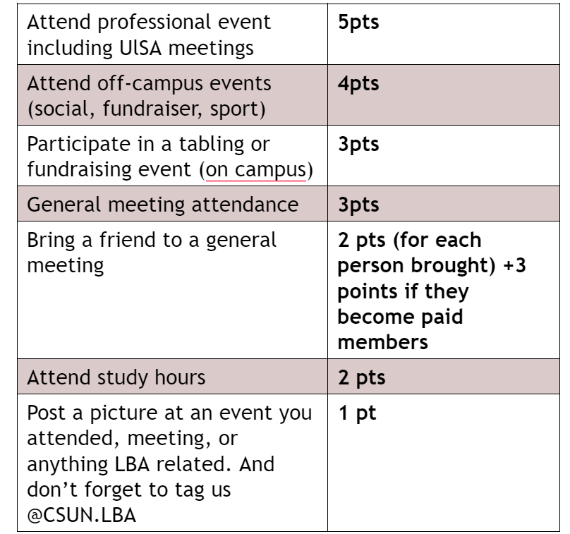
Membership Points

Slide 15
Membership
$20 Membership Fee
Comes with Shirt
Payments:
Venmo: CSUN-LBA : Name, Email Title it "LBA Membership Fees"
Zelle: (323)437-4863
In-person
Payment Plans
$5 or $10
Scan Me

Slide 16
Our GroupChat
Once you have paid your membership Fees you will be added to our Groupchats!
Slack
Discord
Purpose?
Get Updates on Events, Meeting, Resources and Job Opportunities
Watch Movies, Study with the Board, or Play Games

Slide 17
Study Hours
Via Discord!
Mondays
11am - 12pm
Wednesday
12 pm - 1pm
Thursday
3 pm - 4pm

Slide 18
LBA Music Room Recommendations

Slide 19
Scholarships
LBA Involvement Scholarship
LBA Execellence Scholarship
LBA Relief Scholarship

Slide 20
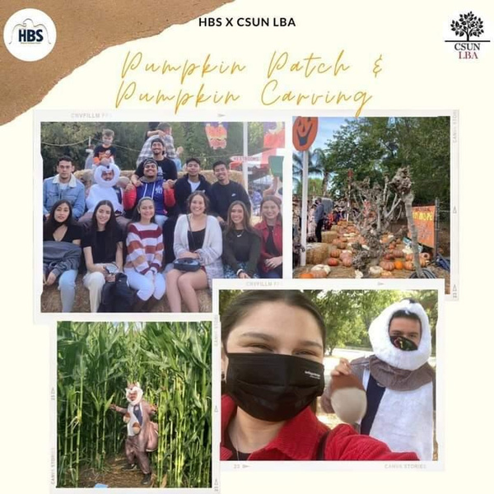
Social Events

Slide 21
Collab with Other Chapters

Slide 22
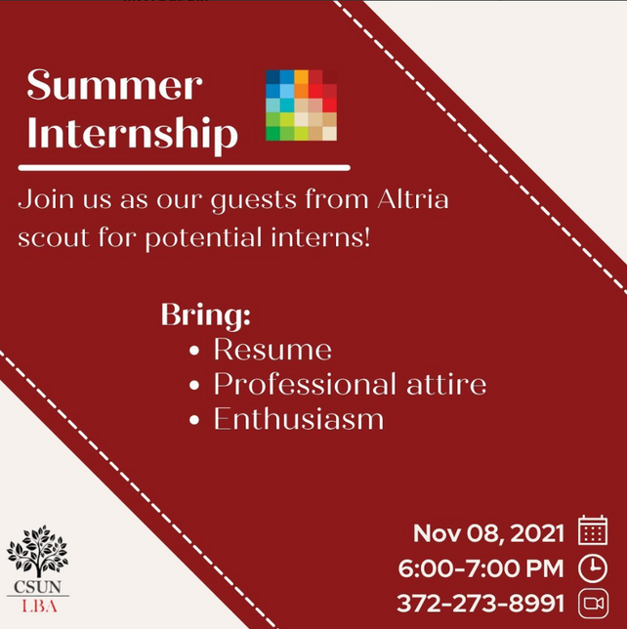
Professional Events

Slide 23
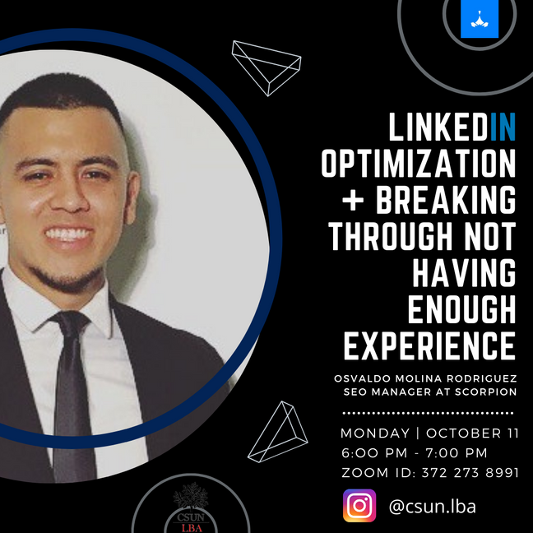
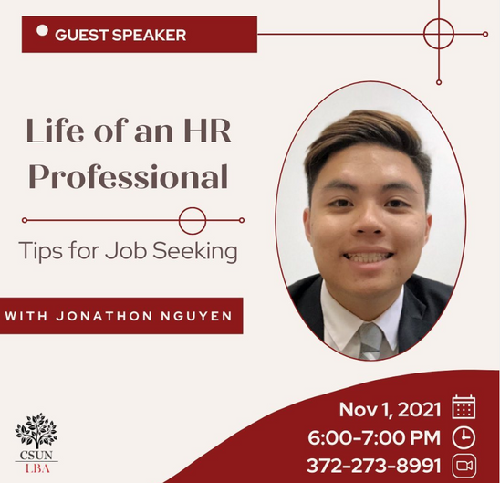
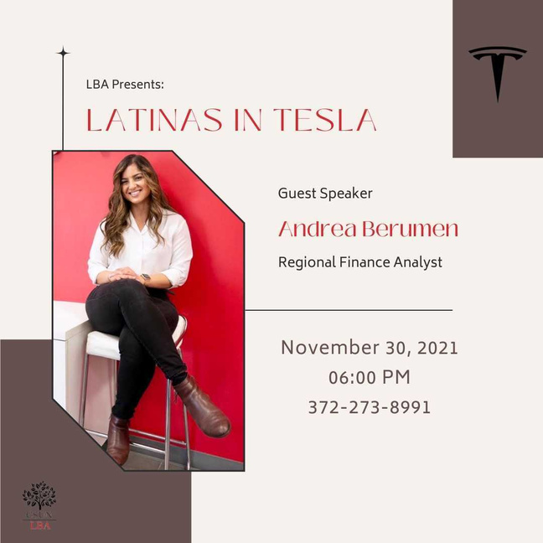
LBA Guest Speakers

Slide 24
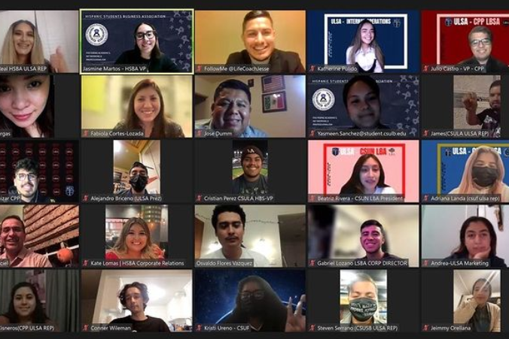
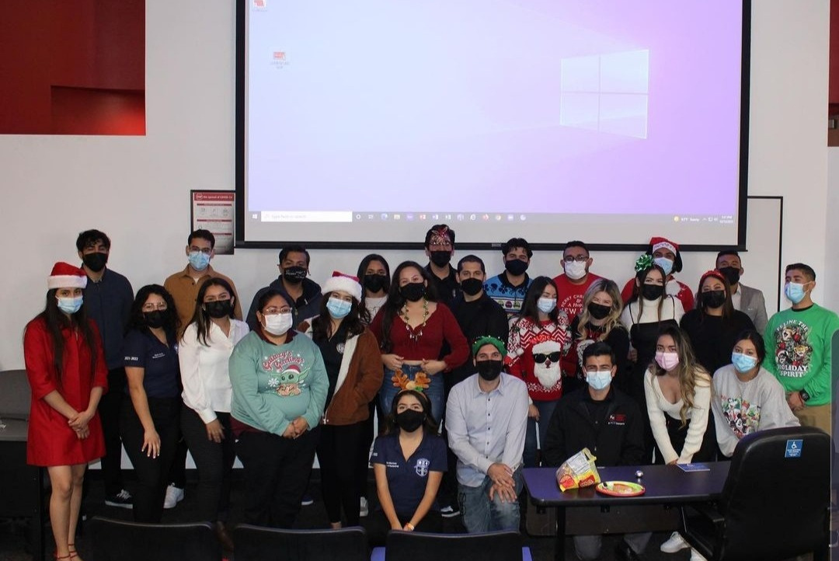
Ever Lasting Memories
#Familia

Slide 25
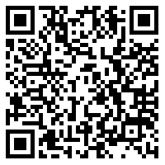
Board Positions Available
VP of Finance
VP of Social Development
Vp of Professional Development
Vp of External Affairs
Recruitment Director
Corporate Relations Director
Community Service Director
Social Media LinkedIn Director
Professional Media Director

Slide 26
FOLLOW US
@CSUN.LBA

