Slide 1
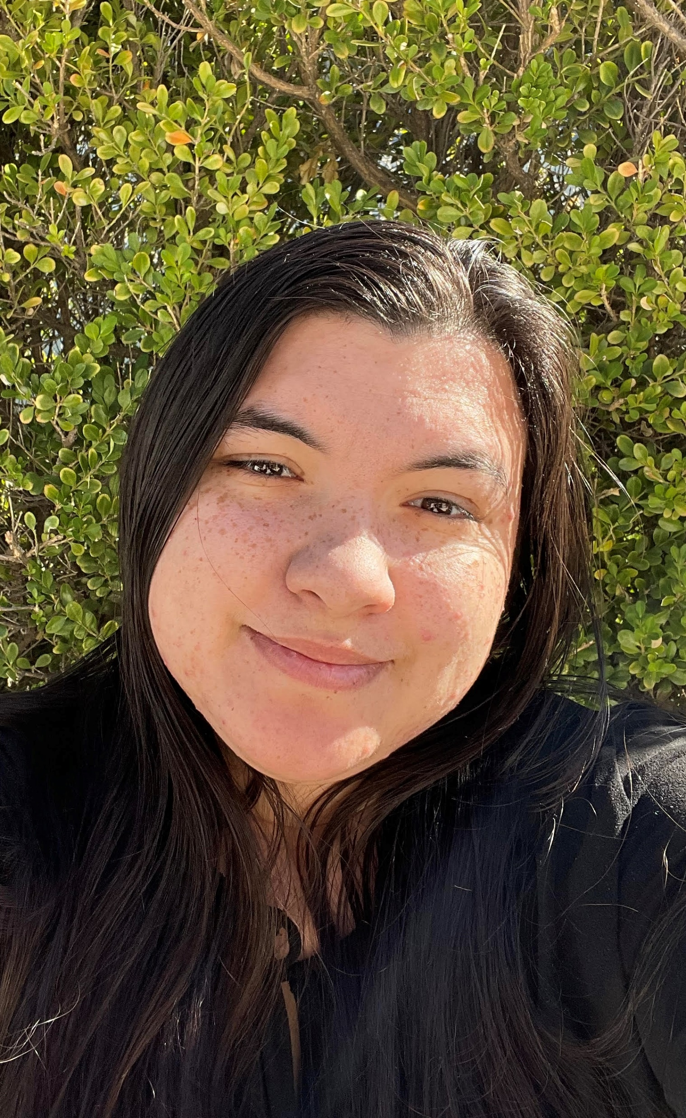
CSUN AMA
Presented by
Angela Clark
Director of Memberships

Slide 2
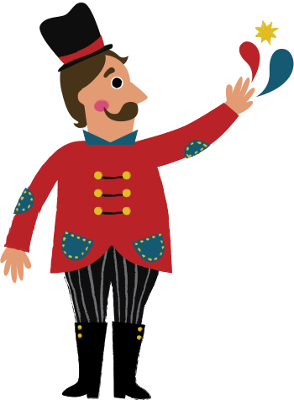
Benefits
Easier access to internships
Networking Events: Marketing Mash-Up
Meeting with professionals
Professional Growth
Leadership Opportunities

Slide 3
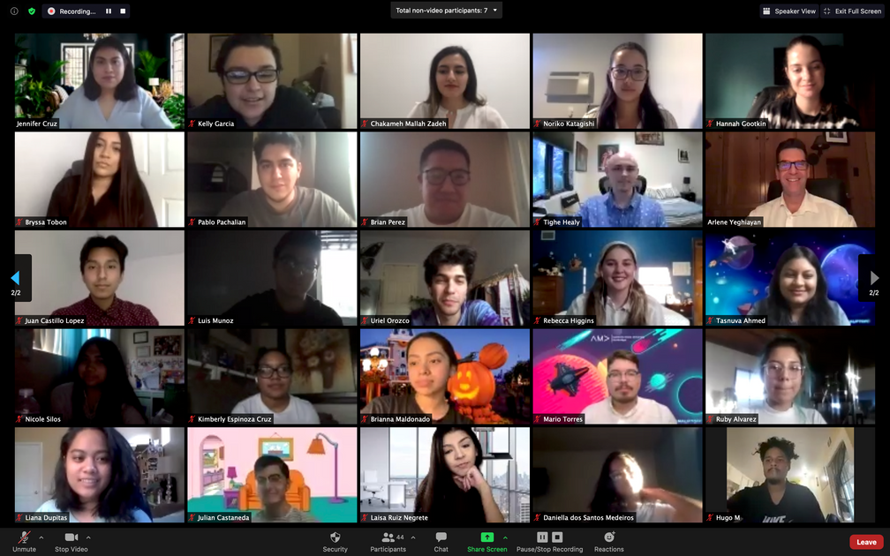
ALL Majors Welcome!
Meeting Times:
Every other Thursday
4 pm - 6 pm
No experience required

Slide 4
AMA Portal
Exclusive Access to:
Guest Speaker Recordings
Internship Opportunities
Career Resources
& More

Slide 5
Join Our
E-Board
Enhance professional skills
Develop leadership skills
Work with a diverse team of motivated individuals
Meet every other Thursday
4 pm - 6 pm

Slide 6
Open Positions:
VP of Multimedia, VP of Sponsorships, Chief of Staff, VP of External Affairs,
VP of Internal Affairs
Vice President Positions:
Director Positions:
All positions open*
*except Memberships department

Slide 7
Digital Mash-Up
Two-day networking mixer hosted by AMA
Connect with professionals and gain insight into various career opportunities
CSUN
AMA

Slide 8
First TWO meetings
are free:
Feb 03 4 pm - 6 pm
Feb 17 4 pm - 6 pm

Slide 9
Stay Connected with CSUNAMA
Group Me
Groupchat
&
Newsletter
Instagram:
CSUNAMA
LinkedIn:
CSUNAMA
Email:
ama@my.csun.edu

Slide 10
Become a
member today!
Questions?
Notes:
Possible Question: Will CSUNAMA be online or in-person? For the first three weeks, we will be meeting through zoom. After Feb 17, we will resume in-person meeting if allowed by CSUN. Our club will be adhering to all CSUN guidelines as we repopulate campus

