Slide 1
Management 370 Management Skills Development
Presenter: Alexandra Ochoa
LinkedIn

Slide 2
Today Agenda 10/14/2020 The Year we don’t talk about
Intro to Alex (who is this person and why should I listen to her)
How to change anyone’s mind! By Berger, Jonah
Imposter Syndrome
C-Suite Strategies -- The Hidden Status Battles That Can Roil the Office by King, Marissa
Chapter 7
Questions
Please come ready to discuss

Slide 3
HOW TO CHANGE ANYONE’S MIND!
Berger, Jonah 5 Recurring Barriers to change (discuss #1)
Reduce Reactance
How do you get avoided being shut down?
What are other key takeaways in this article?

Slide 4
Facing The Imposter Syndrome
(also known as impostor phenomenon, impostorism, fraud syndrome or the impostor experience) is a psychological pattern in which an individual doubts their skills, talents or accomplishments and has a persistent internalized fear of being exposed as a "fraud".
We understood how to change someone's mind but first we must learn how to change our own.

Slide 5
C-Suite Strategies The Hidden Status Battles That Can Roil the Office by King, Marissa
The approaches
Interpersonal Conflicts
Getting teams to rely on peer-to peer recognition
Allows members to acknowledge colleagues for their contribution
KEY takeaways from this article

Slide 6
Chapter 7 Managing Conflict
Please review Professor Smith PowerPoint
We will discuss 3-4 takeaways

Slide 7
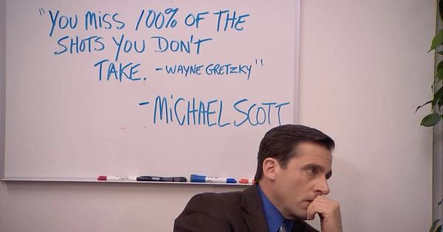
Any Questions/Comments/Concerns

