Slide 1
MGT 370: Management Skills Development
Course Introduction
Wayne Smith, Ph.D.
Department of Management
CSU Northridge

Slide 2
Introduction
Course Logistics
Course materials (frontload)

Slide 3
Your Managerial Career Trajectory
(i.e., the perspective from MGT 360)
Organizational Behavior
Leadership
Power
Motivation
Conflict Resolution
Communication
Teams
Strategy
Measurement/Control
Organizational Impact
Technical Analysis
Vision/Mission/Goals
Management
Decision-making
Org. Culture/Change
Human Resources
Ethics/CSR
Managerial Roles
A 40-year work life

Slide 4
Academic Focus
Key Assumptions
  Can be Learned and Can be Continuously Improved
  Self-efficacy
Skills, Knowledge, and Abilities
  What are Skills?
Locus
  Internal

Slide 5
Academic Focus (cont.)
Personal Objectivity
  Reflective
Bests
  Best in communication
    In every time; in every place; in every context;
  Best in observation
    Anthropologists
Qualitative Research
  In-depth Interview, Oral History, Focus Group, Ethnography, Content Analysis, Case Study

Slide 6
Personal Competencies for Managerial Success
All competencies are important, but a few competencies characterize the key differences between professionals and managers. These are relatively indifferent to country, economy, industry, firm, salary, rank, seniority, etc.
Ethics and Values; Integrity and Trust; Compassion; Managing Diversity;
  Successful managers know that trust is the true organizational currency.
Action Oriented; Command Skills; Managerial Courage; Standing Alone;
  Successful managers shrewdly demonstrate a bias towards action.
Interpersonal Savvy; Organizational Agility; Political Savvy; Creativity;
  Successful managers have behavioral flexibility to adapt to reach any goal.
Developing Relationships with Bosses, Direct Reports, and Peers;
  Successful managers are constantly cultivating and nurturing relationships.
Managing Through Systems; Personal Learning;
  Successful managers are the best at self-initiated learning, and the best at visualizing invisible structures in entire organizational ecosystems.
Tolerance for Ambiguity; Dealing With Paradox; Conflict Management;
  Successful managers thrive in environments of uncertainty.
  e.g, Non-routine decision-making; unclear goals, tasks, and outcomes; role conflict

Slide 7
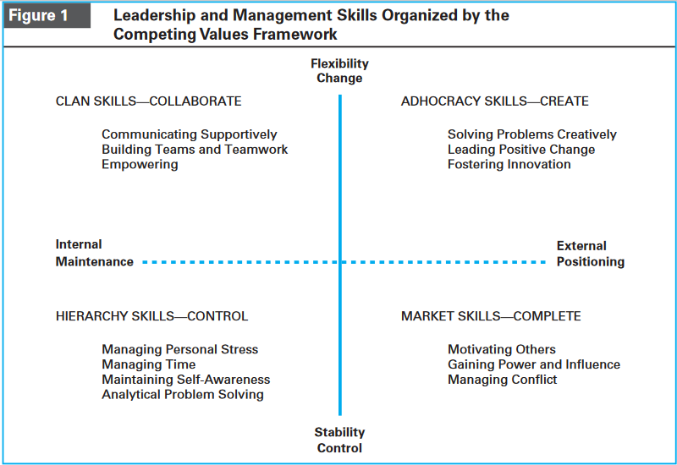
Tolerance for Ambiguity
(Why is it important?)

Slide 8
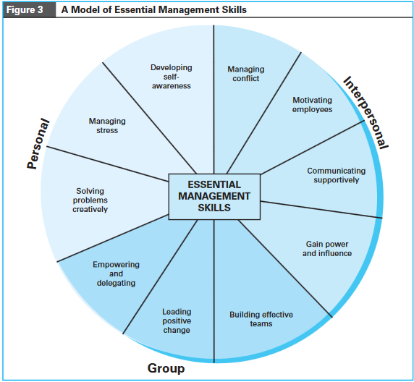
Tolerance for Ambiguity
(How do we deal with it?)

Slide 9
A Story
I have a friend…

Slide 10
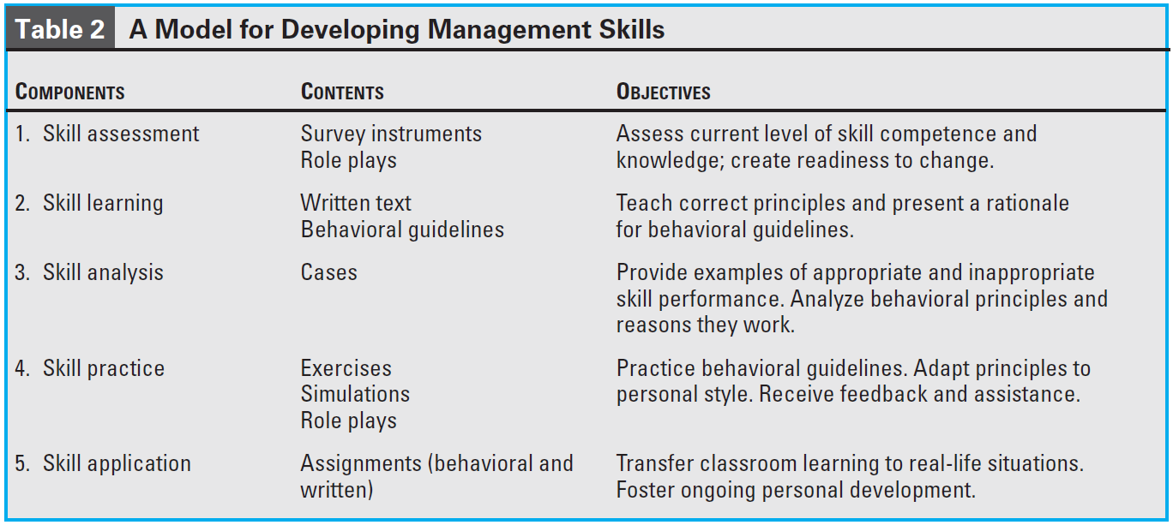
How, specifically, do we develop management skills?

Slide 11
Some Recent Examples
Wall Street Journal
“Investigators Repeatedly Warned Navy Ahead of Deadly Collisions”
“Uber CEO Says He Needs ‘Leadership Help’ After Video Shows Him Berating Driver”

