Slide 1
Latino Business Association
“Juntos, we rise”

Slide 2
What Is LBA ?
The Latino Business Association (LBA) is a student ran association at California State University, Northridge which focuses on the development and growth of our members academically, professionally, and socially.

Slide 3
LBA’s Statement
In joining LBA,
●We can assure academic advisement through mentorship from executive board members.
●Scholarship Opportunities
●Group study sessions
●Networking Events
○Leadership Conferences
○Guest Speakers
○Alumni Mixer
○Interview Sumits
○Corporate Nights
●We can assure social growth in the community by participating in events such as community service events, fundraisers, and more.

Slide 4
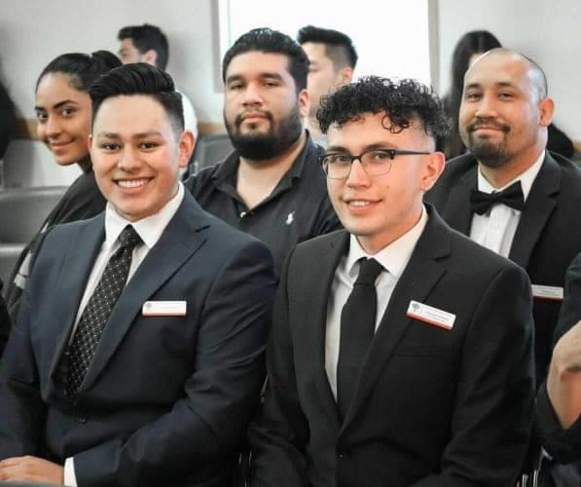
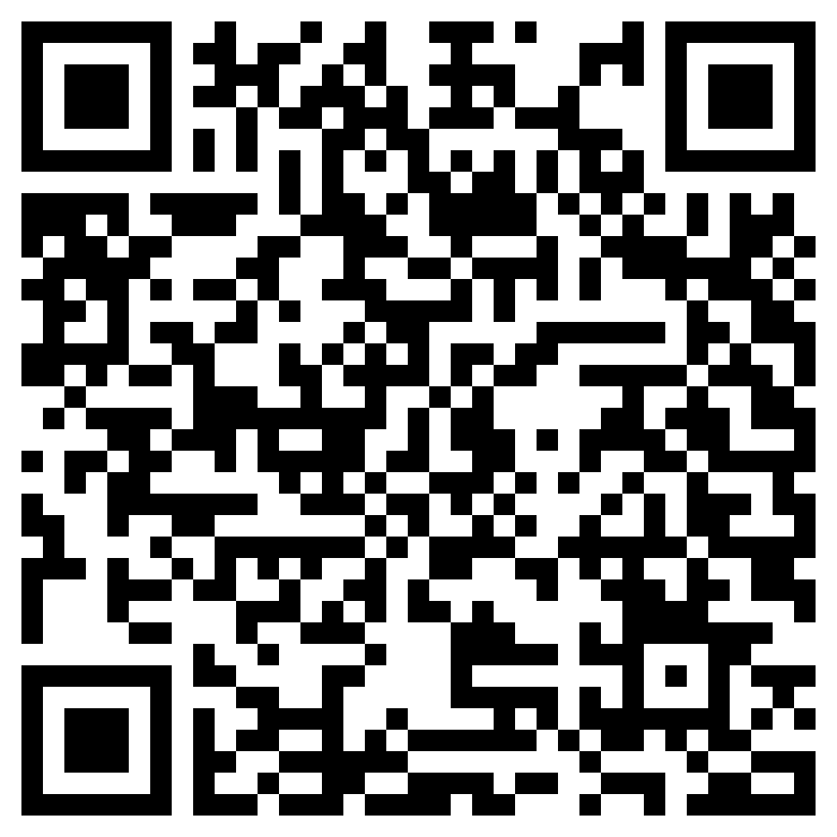
Leadership Opportunities!

Slide 5
Scholarships
●LBA Involvement Scholarship
●LBA Academic Excellence Scholarship
●Small Business Scholarship

Slide 6
Past Guest Speakers

Slide 7
Professional and Social Events

Slide 8
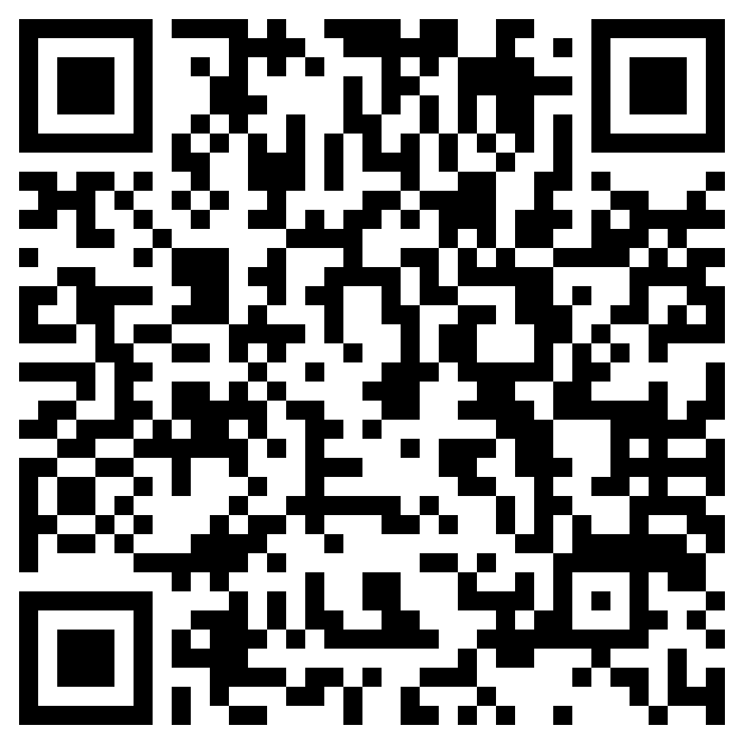
How to Join:
Fill out our Membership google form for Application !
Membership Dues:
a.Venmo: CSUN-LBA
b.$20 membership fee, Zelle: (661) 313 - 0264
c.Provide Name, Email, and “LBA Membership Fees” in transaction
Welcome !
a.You now have access to
i.Social Events
ii.Professional Events
iii.Slack Group Chat
iv.Study Hours
v.Scholarships
vi.Guest Speakers
vii.& Much More !!!

Slide 9
Follow Us
@csun.lba
Any Questions ?
Email: president.csunlba@gmail.com

