Slide 1
Fall, 2019 BUS 497a “Strategy Detail” Student Presentations

Slide 2
FINANCE 359
Quantitative Finance
Arpine Zamanyan
Major: Financial Analysis

Slide 3
FIN 359 Quantitative Finance:
Forecasting
Quantitative finance is the use of forecasting models to analyse financial statements and predict future revenues and expenses for a given firm.
There are four forecasting methods, the simplest and widely used method is known as Straight line forecasting.

Slide 4
FINANCE 303: Financial Management
FIN 303 briefly covers the topic of “Financial Forecasting”
In FIN 303 we learned how to analyse financial statements, which helps you determine the past and current financial state of the company.
Financial statements provide management with information on how efficiently the company is run.
FIN 359, provides management with information on how well the company is projected to do in the next few years.

Slide 5
Straight-Line Method
With the help of historical figures and trends, analyst can predict the future growth of the company.
Straight line method uses constant growth for projections.
Formula for Revenue projection:
Previous Revenue x (1+%Growth)

Slide 6
Forecasting In Strategy Execution
Strategic planning involves determining the direction of the organization. To do so, it is necessary to understand the current position of the company and use historical data to predict the future growth.
The future projections enables the company to plan ahead by creating budgets to support the predictions.
In some cases, forecasting allows companies to borrow necessary funds for expansions and innovations.

Slide 7
Jordan Balboa
Management Major

Slide 8
Management 462
Business and Society

Slide 9
Business and Society
Class was about reading about current Business News and discussing the effect
Relates to Managers making decisions
Business decisions shape and create our society
Society also shapes the Business

Slide 10
Different uses for Autonomous Vehicles
People Moving
Trucks
Product Delivery
Groceries

Slide 11
Thank You

Slide 12
Modeling Consumers: Market Basket Analysis
BUS 497 # 13422 12/10/19
Brent Balingit

Slide 13
Introduction
I am a Marketing Major with an Econ Minor
I will be talking about Market Basket Analysis
Learned it from MKT 356 Marketing Metrics
It is simple and gives a lot of information
Builds off Consumer Behavior
(Substitutes vs Compliments)

Slide 14
Market Basket Analysis Overview
Analyzes what customers buy, how much, and when
Useful for:
Characterizing customers
Understanding why they make certain purchases
Gaining insights about merchandise

Slide 15
Market Basket Analysis Factors
Goal: Measure the Strength of Association Rules
An association rule is a statement of the form (item set A) => (item set B)
Ex. If they buy chips, then they will buy soda
Measures
Support = (containing item combination)/ (total number of record)
Confidence = (the support of the combination{A&B})/ (the support of the condition {A})
In the simplest situation, data consists of two variables: a transaction and an item
﻿TID CID Date Item Qty
111 201 5/1/99 Pen 2
111 201 5/1/99 Ink 1
111 201 5/1/99 Milk 3
111 201 5/1/99 Juice 6
112 105 6/3/99 Pen 1
112 105 6/3/99 Ink 1
112 105 6/3/99 Milk 1
113 106 6/5/99 Pen 1
113 106 6/5/99 Milk 1
114 201 7/1/99 Pen 2
114 201 7/1/99 Ink 2
114 201 7/1/99 Juice 4
{Ink} => {Milk}
Support: 50%
Confidence: 66.7%

Slide 16
Main Uses
Affinity Positioning
Coffee & coffee makers in proximity
Cross-Selling
Cold medicines, tissues, orange juice
Promotion
Specials and Coupons

Slide 17
How to motivate a work force
Jack Burleigh

Slide 18
Leadership and Power Techniques
Internal Pressure
External Prssure

Slide 19
Internal Pressure
Inspire your workers.
Make them want to be better.
Lead them don’t manage them.
Threaten
Scare your workers into submission.
Demand results you want to see.

Slide 20
External Pressure
This is for the situation when workers don’t want to be around you. They simply like being at the company to reap the rewards of working.
So figure out why your staff like to work for you.
Motivators
Pay
Hours
Job benefits
Vacation
Safety

Slide 21
Leadership is situational

Slide 22
Marketing: Consumer Behavior
By: Stephanie Calabrese

Slide 23
Attention and Perception are two ways consumers process marketing stimuli.
These two process concepts are important for marketers in order to ensure that consumers are processing the marketing stimuli to its fullest.
Attention
Consumer Must
“Look at”
the message
To maximize attention paid to visual
advertisements, it matters how that
information enters our visual field.
Perception
Consumer Must
“Take in”
the message
We receive external stimuli through our
five senses. All five senses can be
used to market to the consumer.

Slide 24
Hemispheric lateralization
Attention:
Hemispheric lateralization is how consumers use peripheral vision to become aware of stimuli.
The ability to process depends on where a stimulus is placed in relation to a subject (consumer)
Stimuli that enter the peripheral vision from left are processed by the right hemisphere and vise versa.
Location of advertisements are important to how consumers attention is grabbed.

Slide 25
Perception: Visual
Consumers perceive 80% of their information through vision.
Warm colors : Encourage activity and excitement also Increases appetite
Cold/cool colors : sooth and relax also suppress appetite
The science behind how consumers previse colors is important for company branding.

Slide 26
Perception: Visual
Understanding color theory is one way to influence and shape consumer perception.
Colors play an important role in attracting profitable consumers.
Colors influence the consumers emotions and perception about the company.
Though there are more senses that marketers use to alter consumer perception, Visual perception is the most effective out of the five senses.

Slide 27
Attention and Perception
“How might this idea be helpful in the
strategy formulation or execution process?”
If the company had a strategy to gain consumer likeness
and more brand awareness, they would use this concept because….
Attention and Perception are two very important concepts for a marketing team to focus on because it will help the team solidify a well-known brand.
Grasping the attention of the consumer and manipulating their perception of the company or brand can effect sales.
Using the correct Attention and Perception techniques will ensure the likeness of the company with the consumer.

Slide 28
Kurt Lewin’s
3 Leadership Styles
MGT 380: Employment Practices Concept
By: Celina Carpina

Slide 29
Leadership Styles...
Refers to a leader's characteristic behaviors when directing, motivating, and managing groups of people
Used to motivate others to perform, create, and innovate
Great leaders can inspire political movements and social change
Notes:
https://www.verywellmind.com/leadership-styles-2795312

Slide 30
Kurt Lewin’s 3 Leadership Styles
Authoritarian Leadership (Autocratic):
What, when, and how something should be done (Tell not ask)
Leaders make decisions without input from members
This style looks at decision-making as a less creative thing to do
Participative Leadership (Democratic):
Most effective style of leadership → Applies to any organization
Group members feel engaged in the process and are more motivated and creative
Leader has final say on decisions but involves
decision-making process to its members
Delegative Leadership (Laissez-Faire):
Least productive style
Leaders allow the members to set deadlines and goals
Leader is uninvolved
Notes:
KURT LEWIN IS A PSYCHOLOGIST
In 1939 - he conducted research where schoolchildren were assigned to one of three groups with an authoritarian, democratic, or laissez-faire leader.
The children were then led in an arts and crafts project while researchers observed the behavior of children in response to the different styles of leadership.
The researchers found that democratic leadership tended to be the most effective at inspiring followers to perform well.
WORK CITED:
https://www.verywellmind.com/leadership-styles-2795312

Slide 31
Why did I choose the topic of Leadership Styles?
Notes:
The REASON I felt inclined to talk about this topic is due to:
I feel that it is absolutely NECESSARY to help assist with any organization’s strategy - to eventually lead a team effectively and efficiently in coming up with a solution to any issue and to also achieve goals.
I feel that this is something that I as a female in the business field want as a skill that I hope to perfect one day.

Slide 32
Thank you!
:)

Slide 33
Naira Davtyan
Systems and Operations Management
Theory: Deming’s Approach
Core: SOM 467
Prior Upper Division Course : MGT 360

Slide 34
Deming’s system of profound knowledge consists of four parts
Appreciation for a system
Knowledge about variation
Theory of knowledge
Psychology
Naira Davtyan

Slide 35
“The 14 points all have one aim: to make it possible for people to work with joy.”
Create constancy of purpose for the improvement of product and service
Become competitive, stay in business, and provide jobs.
Adopt the new philosophy of cooperation
Win-win
Stop depending on inspections
Build quality into the process from start to finish
Use a single supplier for any one item
Quality relies on consistency
Naira Davtyan

Slide 36
5. Improve constantly and forever
6. Use training on the job
7. Implement leadership
Don’t simply supervise
8. Eliminate fear
Allow people to express ideas
9. Break down barriers between departments
Build a shared vision Naira Davtyan

Slide 37
Theory will be helpful on the strategy formulation or execution process
Encourages ideas
Supports ideas
Break down barriers between departments
Eliminates fear
Naira Davtyan
10. Get rid of slogans
11. Eliminate management by objectives
Measure the process rather than the people behind the process
12. Remove barriers to pride of workmanship
Allow everyone to take pride in their work
13. Implement education and self-improvement
14. Make transformation everyone’s job
Each person take a step towards quality

Slide 38
Summary of the Concept
Importance of planning your finance
Setting clear goals and objectives
Individuals factors

Slide 39
Elective Course
FIN-442
Theory and Practice of Financial Planning
Data Gathering, Cash Flow, Debt Consideration, Goal Settings and Objectives, Integration, Plan Formulation, Tax Consideration and Implementation.

Slide 40
Why this concept and what is my visceral appeal?
This concept is important for both personal and professional life.
This concept can be easily applied to other subjects.
This concept appeals to me because it helped myself to positively manage my finance, and I believe that can help all of you to do the same.

Slide 41
Relation to Prior Upper Division Course
The concept is related to FIN 303 – Financial Management, specifically with the concept of “Capital Budgeting”.
While FIN 442 focuses on the management of capital at an individual level, FIN 303 analyzes the capital’s management at a firm level.
The concept “Capital Budgeting” for a firm is directly related with the concept of “setting clear goal and objectives” for an individual.

Slide 42
Key Elements of the Concept
Setting goals and objectives is necessary to be successful in planning your finance.
Goals and objectives are always based on individual factors. Those factors could be debts consideration, retirement , investments or many others.
The goals and objectives that you set should consider the priorities in your life.

Slide 43
Types of business organizations
Delaney Des Baillets
Tu 3:30
Strategy “Detail”

Slide 44
SOLE PROPREITORSHIP
No distinction between the owner and the business
Entitled to all the profits but responsible for all expenses
TAX ADVANTAGES
Losses incurred can be used immediately to reduce taxes paid
Simplicity of Tax Return
TAX DISADVANTAGES
Self-Employment Taxes

Slide 45
LIMITED LIABILITY COMPANY
Combines tax features of a partnership but limited liability of a corporation
Tax Advantages
Initial losses are beneficial
Pass Through Taxation
Taxed on at owner level not at LLC level
Tax Disadvantages
Must pay taxes on share on income no matter if funds are physically distributed
Self-Employment Taxes

Slide 46
C CORPORATION
Corporation is a separate legal entity
TAX ADVANTAGES
Flat Tax Rate of 21%
Resulting in significant tax savings
TAX DISADVANTAGES
Double Taxation
Taxed at corporate level
Taxed at individual level as dividends
Inability to use losses until income is generated

Slide 47
THANK YOU FOR YOU ATTENTION ANY QUESTIONS?

Slide 48
Surrendering-Sharing Information Prof. Walker – MKT350
Emily Ekman
BUS497a – Wayne Smith
Notes:
The purpose of this presentation is to make you aware if you are surrendering or sharing your information. I will use course tools from MKT 350 such at the surrender and sharing matrix

Slide 49
What leads to Surrendering to Technology
Lack of Time/Attention and Information Overload
Risk of Loss of Security or Data Breaches
Unclear Terms and Conditions
Notes:
So what leads to surrendering your information
1. Fast decision making due to lack of time, your in a hurry to make whatever account you are signing up for a so you aren’t really reading the information in the terms
2. Continuous partial attention – you are able to multitask. So you are able to be watching tv or doing homework while you are setting up your account which takes away your attention to the terms
3. Vulnerability is the loss of security and Risk is the probability that security will be lost
4. Uncertainty of the risk. The terms and conditions are long and confusing, they use law terms you may not understand which is the fault of the company who wrote them

Slide 50
2x2 Matrix – Walker

Slide 51
2x2 Matrix – Walker
Conditional Share- ACTIVE / TRUST
When consumers trust an exchange on the Internet and engage in active protection, they share information yet place conditions on the information they provide.
Conditional Surrender- ACTIVE/ FAITH
When parties in an exchange exhibit faith in an exchange of information on the Internet and are active in their privacy protection (placing conditions on the exchange), they are actively allowing others some access.
Unconditional Share – PASSIVE/ TRUST
When parties in an exchange exhibit faith in an exchange of information on the Internet and are active in their privacy protection (placing conditions on the exchange), they are actively allowing others some access.
Unconditional Surrender – PASSIVE/ FAITH
Parties have faith in an exchange of information on the Internet and are passive in their privacy protection.

Slide 52
Hello, my name is Herber Flores
The Major I study is,
S.O.M.
(System and Operation Management)

Slide 53
Name of Course and Concept
SOM 467 Quality Management and Control.
The concept is, Kaizen.

Slide 54
Concept of Kaizen
Kaizen means to continually improve.
The concept can be applied to MGT 360.
Applying Kaizen to the business world will allow increase in work efficiency.
Good example would be ensuring tools in a machine shop are easy accessible and identified in their tool box.

Slide 55
Visceral Appeal
Kaizen, is constantly being done by every one, most people do not realize they are doing it.
Improving work efficiency creates a happy and easy work environment.
A great suggestion to the company can turn in to a raise in productivity and pay to the individual or work section.

Slide 56
In Conclusion
Kaizen can be applied at work, at home, or in everyday situations.
Improves work efficiency
Teaching Kaizen concept in school can help individuals think of how to better prepare themselves to study and then apply it to work.
Thank You! Any Questions?

Slide 57
Name: Iris Garcia Major: Accountancy
Topic: Internal Control Over Cash Transactions

Slide 58
Internal Control Over Cash Transactions:
”Are procedures for the receipt of cash. The controls used are intended to limit access to cash to specified employees and verify that all receipts, refunds or transfers are documented correctly and in a timely manner.”
2

Slide 59
The Which, Why, and How
Core Class: Acct 460 Auditing Principles and Analytics
Selection of Concept: Entrepreneur
Topic linked to: MGT 360 & SOM 306
3

Slide 60
Key Elements
Do not permit any one employee to handle a transaction from beginning to end.
Separate cash handling (custody) from record keeping
Record cash receipts on a timely basis
Have monthly bank reconciliations
Monitor cash receipts and disbursements and compare them with budgeted amounts.
4

Slide 61
Advantages of Internal Controls Over Cash Transactions
The internal control over cash transactions help businesses to prevent loss due to fraud and accounting errors.
The internal control over cash transactions help strategic teams to develop plans under accurately disposition of funds and to borrow only the funds needed to complete a project.
5

Slide 62
Teaching and Learning a “Strategy Detail”
By
Brian Khachatourian

Slide 63
The Idea and Concept
Marketing is Data-Driven!
Initial assumptions of marketing subjective by design
Every decision is made off of objective information
Gathering information and turning into data
Information
Data
Decision

Slide 64
The Upper Division Courses
MKT 346 Market Research
Use of Scientific Methods in formulation of solutions for MArketing Management problems
Emphasis on the use of marketing research
MKT 356 Marketing Metrics
Covers analytics using practical applications
Developing actionable insights
306
SOM
303
FIN
360
MGT

Slide 65
The Key Elements
The use of markets research methods and attributes
Focus Groups
Primary and Secondary Data
Quantitative vs Qualitative Data
Instruments of Research and Analysis
Tableau
SPSS
Excel

Slide 66
Strategy Formulation and Execution
Utilizing Proper Market Research will allow for optimal forms of decision making
Gathering and interpreting data in effort to plan strategic marketing plans
Make more accurate assessments into certain markets segments an organization may look to enter

Slide 67
Kevin Lee
_ Marketing Major
_ Hybrid Advertising (Traditional + Digital)
_ Lowering information cost is the key to effective communication

Slide 68
Elaboration
Likelihood
Model
Central Route
Elaboration
PERSUASION
Peripheral Route
Cues

Slide 69
Central Route
Cost
Insurance Cost
Safety Rating
Reliability
Quality of Reviews
Fuel Efficiency
Peripheral Route
Visual Appeal
Speed
More Expensive Than Your Neighbor’s
RROC

Slide 70
Fishbone diagram
By Kimberly Leverenz

Slide 71
Fishbone diagram
Visualization tool for categorizing the potential reasons of a problem in order to identify its root causes
Learned in SOM 467: Quality Management and Control
Visual Learner + Breaks down complex problems + focus on it from various perspectives
This idea builds upon MGT 360 and the concept of process management

Slide 72
People
Methods
Materials
How you knead your hands
Type of soap
Staff
Not washing hands correctly
Soap dispenser
Dispenser location
Equipement
Environment

Slide 73
The fishbone diagram and Strategy
Top management -> Looking to improve
A common challenge -> Identifying the root causes for an issue
The fishbone diagram gives you a better understanding to what is causing the issue -> addressed correctly

Slide 74
Q & a

Slide 75
Teaching and Learning: A Strategy detail
Walter Martinez
Finance: Financial Planning
Finance 442: Personal Finance (topic)

Slide 76
What is investing in real estate?

Slide 77
REIT
Equity: Buy, own and manage income-producing real estate. Revenues come primarily through rents and not from the reselling of the portfolio properties.
Mortgage: Their earnings come primarily from the net interest margin—the spread between the interest they earn on mortgage loans and the cost of funding these loans.
Hybrid: hold both physical rental property and mortgage loans in their portfolios.

Slide 78
Thank You

Slide 79
Materials Management: Planned Production
Melissa Mendoza
Global Supply Chain Management

Slide 80
What I Hope to Teach
Importance of Production Planning
Why forecasting your demand is critical to planned production
How Level Planning Production works

Slide 81
Google wants to develop a level production plan for their Google Pixel 4. Opening Inventory is 450, and a decrease to 200 units is expected at the end of a plan. Demand per period of given and all periods have same amount of working days. How much should Google produce each period? What is the ending inventory per period? Do you see any problems with this plan?

Slide 82
Period | 1 | 2 | 3 | 4 | 5 | 6 | Total
Forecast Demand | 1300 | 1200 | 800 | 600 | 800 | 900
Planned Production
Planned Inventory (450) |  |  |  |  |  | ~200
5,600

Slide 83
Calculate Planned Production Rate for a Level Production Plan
Forecast Demand – Beginning Inventory + Ending Inventory = Production
5600 – 450 + 200 = 5,350
5,350 / 6 = 892 Pixel 4’s per period

Slide 84
Period | 1 | 2 | 3 | 4 | 5 | 6 | Total
Forecast Demand | 1300 | 1200 | 800 | 600 | 800 | 900 | 5,600
Planned Production | 892 | 892 | 892 | 892 | 892 | 892 | 5,350
Planned Inventory (450) | 42 | -266 | -174 | 118 | 210 | 202
Problems: Period 2 and 3 contain negative inventory.
Potential Solution: Begin production plan with more Pixel 4’s in inventory.

Slide 85
Budgeting using Excel
By
Laura E Monge
Financial Analyst Major

Slide 86
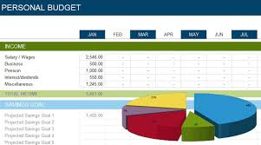
Budgeting using Excel
Personal Finance (FIN 302)
Budget
Quantitate Finance (FIN 359)
Microsoft Excel Program

Slide 87
Fin 302 Personal Finance
Budgeting
Budgeting Process
Forecasting
Implementing
Monitoring
Reevaluating regularly
Important Factors that affect budgets:
Family size, age, money attitudes, and sources of income
https://www.lynda.com/Excel-tutorials/Creating-simple-Excel-budget/165644/186636-4.html

Slide 88
Fin 359 Quantitate finance
Microsoft Excel Programs
Lyda.com
https://www.csun.edu/it/linkedin-learning

Slide 89
THANK YOU FOR THIS OPPORTUNITY!
GO MATADORS!!
Q & A
???????

Slide 90
Teaching and Learning: A Strategy detail
Walter Martinez
Finance: Financial Planning
Finance 442: Personal Finance (topic)

Slide 91
What is investing in real estate?

Slide 92
REIT
Equity: Buy, own and manage income-producing real estate. Revenues come primarily through rents and not from the reselling of the portfolio properties.
Mortgage: Their earnings come primarily from the net interest margin—the spread between the interest they earn on mortgage loans and the cost of funding these loans.
Hybrid: hold both physical rental property and mortgage loans in their portfolios.

Slide 93
Thank You

Slide 94
Concept Review from Marketing 346
Audrey Whelan
Bus497a-13422

Slide 95
Distinguishing between Primary and Secondary Data
Primary Data:
Primary data collection dictates an organization conducting its own research for a specific purpose.
Examples:
Surveys, Interviews, Focus Groups
Secondary Data:
Gathered from a pre-existing database or research firm and is not tailored to the needs of the organization, but rather contains general information.
Examples:
IBISWorld, EBSCO, Google Scholar

Slide 96
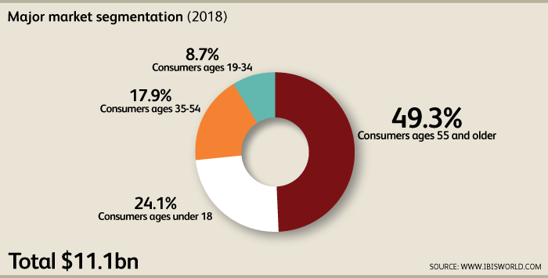
Health Care Industry Secondary Research

Slide 97
Primary Data Collection For Marilyn Magaram Center
Summary of the Statistical Analysis
Major focus of questionnaire survey:
Bod Pod, Nutrition counseling, Dietary Analysis
27 multiple choice questions:
Descriptive Analysis + Hypothesis testing
2 open-ended questions:
Content Analysis

Slide 98
Builds on Concepts from Management 304
Primary and secondary research is a great tool for management
May aid in developing, producing, and marketing a product
Secondary research should be used initially to understand new markets and/or competitors before primary research is conducted
Must consider time, cost, and relevancy before conducting primary research
Ensure research is accurate, valid, reliable, and relevant in good faith
Be aware of potential “confirmation bias”

Slide 99
CHARITABLE CONTRIBUTION DEDUCTION (Acct 441 Tax)
BY MADELYN SAJCHE

Slide 100
BASIC IDEA
There are many limitations about the Charitable contribution deductions in C Corporation.
However, IF THE ORGANIZATION that is receiving the donation DOES NOT USE THE contribution to its RELATED BUSINESS OPERATION, the amount that we can deduct is affected

Slide 101
EXAMPLE
FOX CORPORATION DONATES ARTWORK TO A MUSEUM . THE ARWORK, PURCHASED EARLIER FOR $15K , IS WORTH $38K ON THE DATE FOX DONATES IT.
AT THE TIME OF THE DONATION THE MUSEUM’S DIRECTOR INTEND TO SELL THE WORK TO RAISE FUNDS TO CONDUCT MUSEUM ACTIVITIES. = FOX’S DEDUCTION FOR THE GIFT IS LIMITED TO $15K
IF THE MUSEUM PLANS TO DISPLAY THE ARTWORK TO THE PUBLIC, THE ENTIRE $38K DEDUCTION IS PERMITED .
FOX CAN AVOID LOSING A PORTION OF ITS CHARITABLE CONTRIBUTION DEDUCTION BY, AS A CONDITION OF THE DONATION, PLACING RESTRICTIONS ON THE SALE OR USE OF THE PROPERTY.

Slide 102
WHY MIGHT BE HELPFUL IN THE STRATEGY FORMULATION?
A C CORPORATION CAN TAKE ADVANTAGE BY PLACING RESTRICTIONS ON THE SALE OR USE OF THE PROPERTY DONATED.

Slide 103
QUESTIONS?
?

Slide 104
Filter Bubbles
By: Ruben Rosales

Slide 105
What are Filter Bubbles?
A bubble created by the information collected from consumer’s online interactions that results in personalization of the web.

Slide 107
Consumers vs. Marketers Impacts
Consumer Impacts:
Comfortable
Are not challenged by opposing views
Limits information
Marketer Impacts:
Able to easily target audiences that are already interested in their products

Slide 108
The End

Slide 109
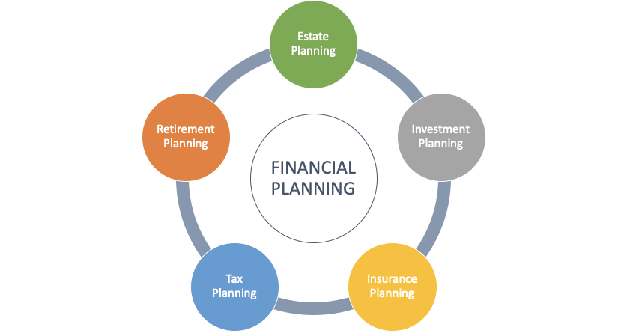
Retirement Planning
.
Mizan J. Rahman (MJ)
ERPA, QPA, TGPC
Founder & CEO
Nesa Plan Consultants
Dec. 10, 2019
You Need 70%-80% Wage Replacement Ratio
10%-13% Annual Savings at Age 25 to Achieve Retirement Plan Goals
57% (>100 Million) of Working Age Individuals Don’t Own Any Retirement Assets
Source: National Institute of Retirement Security (NIRS)
Disclosure: I’m neither a financial advisor nor do I provide financial advice.

Slide 110
Planning for Golden Years
01
Savings + Brokerage Accounts
Savings Rate Today: 7.8%*
After-Tax Savings
Savings
02
Future is Unknown
People Are Aging & Living Longer
More Money Coming Out Than Going In
Social Security
03
401k - You Can Contribute up to $19,500
IRA - You Can Contribute Up to $6,000
Pre-Tax Savings
Employer Match
401k/ 403b/ IRA
Source: FRED

Slide 111
Retirement Plan Advantages
Tax Savings Example
Salary | $50,000
401k Contributions | $5,000
Your Tax Bracket | 25%
Your Tax Savings | $1,250
Your True Contribution | $3,750
Employer 401(k) Match Example
Employer matches 50 cents on a dollar up to 6% of salary
401k Contributions | $5,000
Employer Match | $1,500
Total Contributions | $7,500

Slide 112
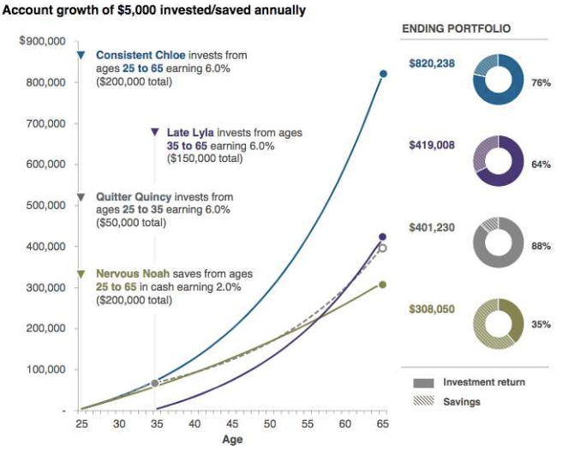
Power of Compounding, Consistency & Starting Early
Consistent Chloe Sticks Through It All
Late Lyla Starts Saving at 35
Quitter Quincy Stops Saving at 35
Nervous Noah is Scared of the Market

Slide 113
Takeaways
Start Saving Early
Capture Employer Match !
Read and Understand the Summary Plan Description (SPD)
Company Decision Maker? Ensure 401(k) is Competitive
Getting or changing job? Consider ALL benefits !
Salary + Health Benefits + Dental & Vision Benefits + Fringe Benefits + Retirement Plan
Thank You!
Mizan J. Rahman (MJ)
Cell 818-602-1738
mjrahman1030@gmail.com
www.nesa401k.com

Slide 114
Retirement Planning
.
Mizan J. Rahman (MJ)
ERPA, QPA, TGPC
Founder & CEO
Nesa Plan Consultants
Dec. 10, 2019
You Need 70%-80% Wage Replacement Ratio
10%-13% Annual Savings at Age 25 to Achieve Retirement Plan Goals
57% (>100 Million) of Working Age Individuals Don’t Own Any Retirement Assets
Source: National Institute of Retirement Security (NIRS)
Disclosure: I’m neither a financial advisor nor do I provide financial advice.

Slide 115
Planning for Golden Years
01
Savings + Brokerage Accounts
Savings Rate Today: 7.8%*
After-Tax Savings
Savings
02
Future is Unknown
People Are Aging & Living Longer
More Money Coming Out Than Going In
Social Security
03
401k - You Can Contribute up to $19,500
IRA - You Can Contribute Up to $6,000
Pre-Tax Savings
Employer Match
401k/ 403b/ IRA
Source: FRED

Slide 116
Retirement Plan Advantages
Tax Savings Example
Salary | $50,000
401k Contributions | $5,000
Your Tax Bracket | 25%
Your Tax Savings | $1,250
Your True Contribution | $3,750
Employer 401(k) Match Example
Employer matches 50 cents on a dollar up to 6% of salary
401k Contributions | $5,000
Employer Match | $1,500
Total Contributions | $7,500

Slide 117
Power of Compounding, Consistency & Starting Early
Consistent Chloe Sticks Through It All
Late Lyla Starts Saving at 35
Quitter Quincy Stops Saving at 35
Nervous Noah is Scared of the Market

Slide 118
Takeaways
Start Saving Early
Capture Employer Match !
Read and Understand the Summary Plan Description (SPD)
Company Decision Maker? Ensure 401(k) is Competitive
Getting or changing job? Consider ALL benefits !
Salary + Health Benefits + Dental & Vision Benefits + Fringe Benefits + Retirement Plan
Thank You!
Mizan J. Rahman (MJ)
Cell 818-602-1738
mjrahman1030@gmail.com
www.nesa401k.com

Slide 119
Sofia Nilsson - Marketing
MKT 448 - Digital Marketing
Free Google Online Training and Certifications

Slide 120
Google Skillshop
Google Ads
Google Marketing Platform
Google Analytics
Google My Business
Google Ad Manager
Manage Campaigns
YouTube
And more..
https://skillshop.withgoogle.com/

Slide 121
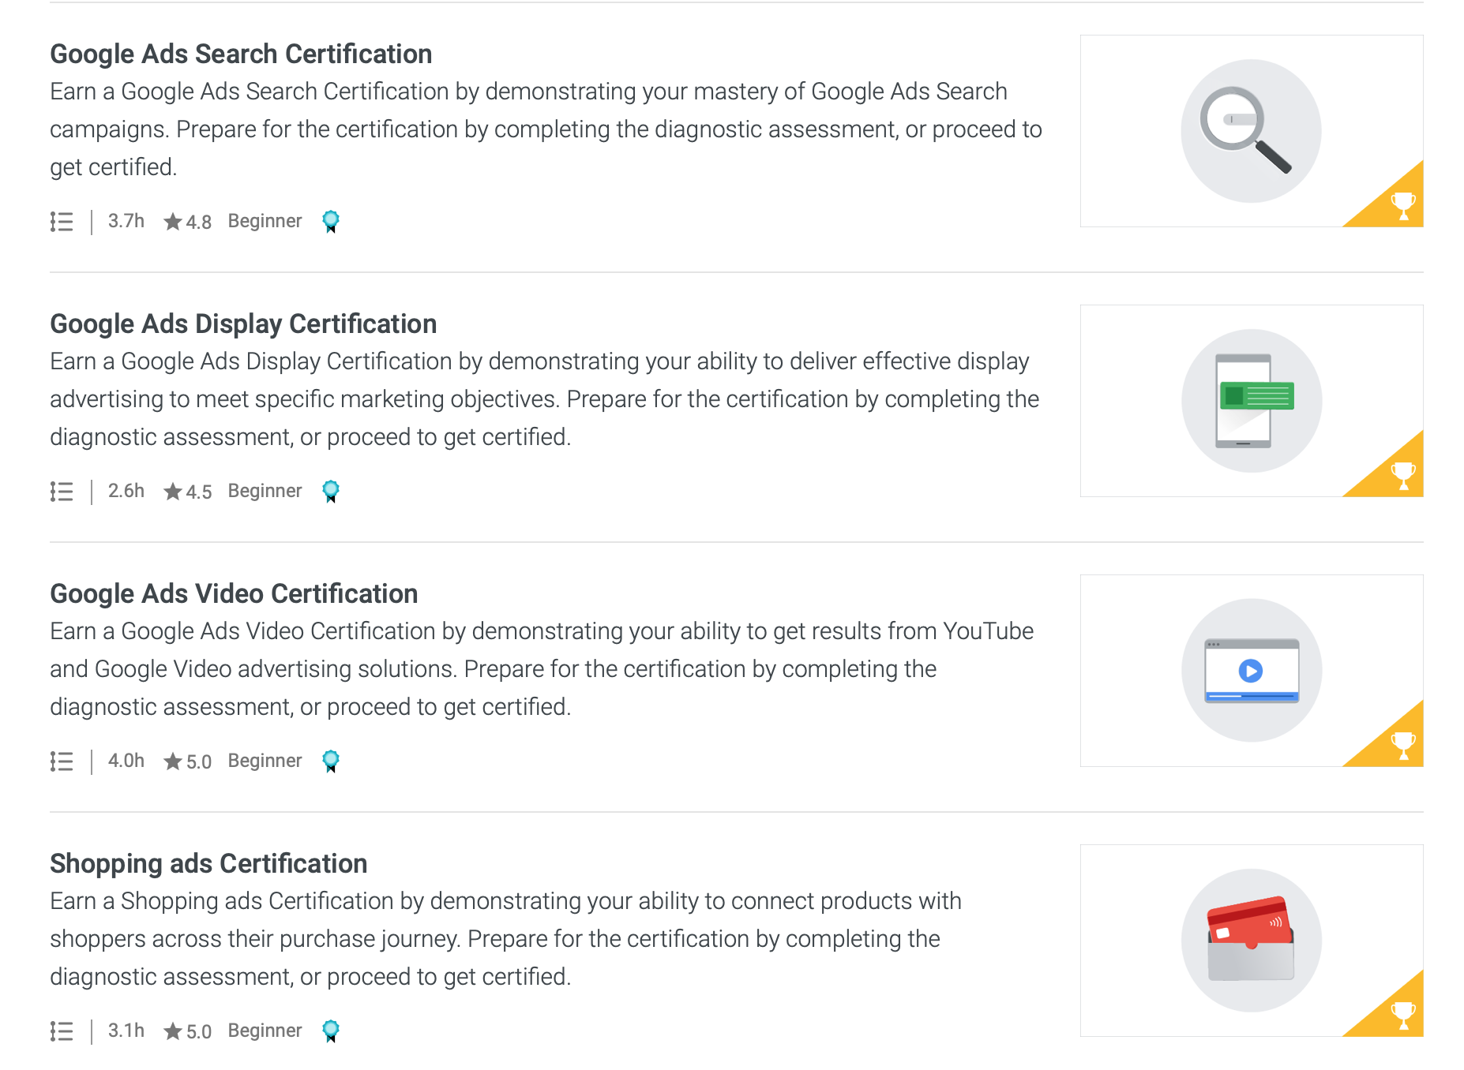

Slide 122
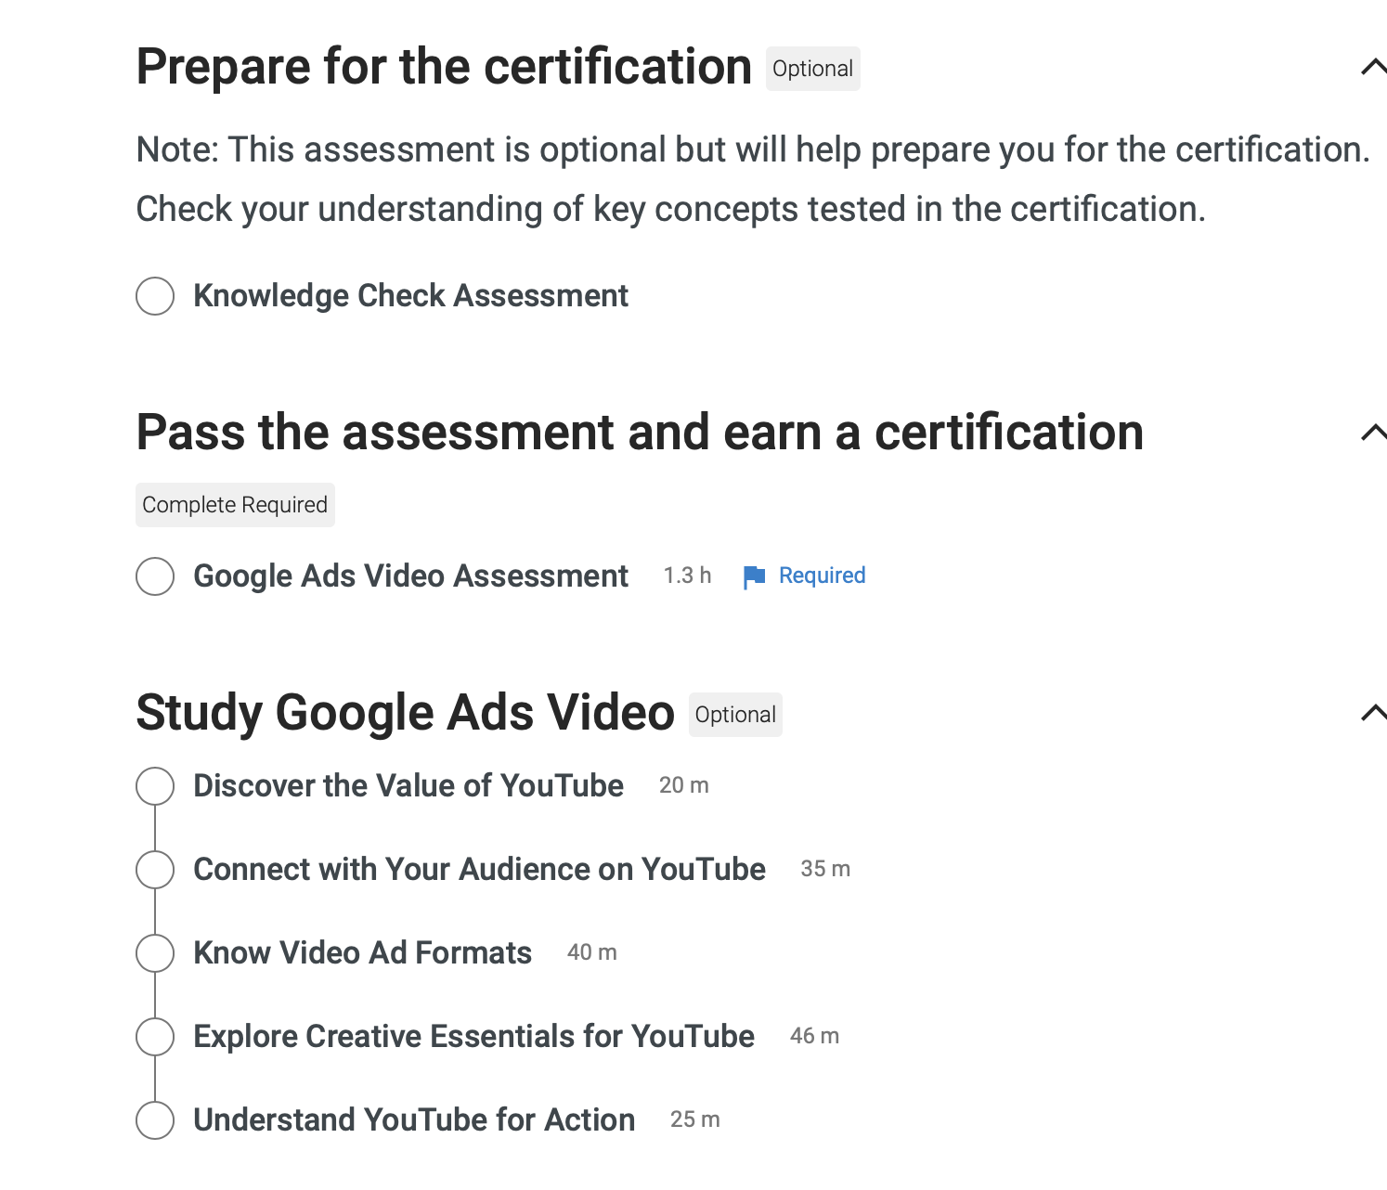
Passing score of 80%
If you fail you have to wait 24 hours to retake
You can take the tests as many times as you want
Certifications are valid for 1 year
Individual Certification

Slide 123
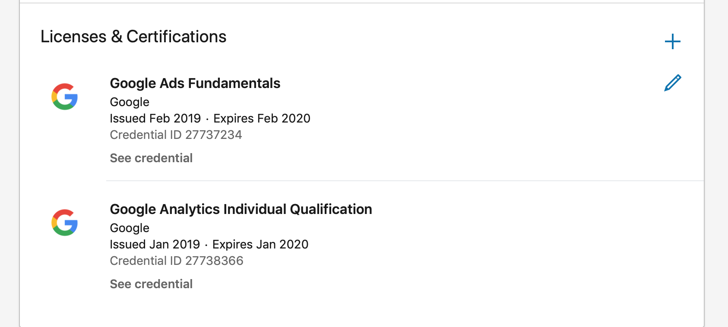
Add to your resume
“The Google Ads certification is a professional accreditation that Google offers to individuals who demonstrate proficiency in basic and advanced aspects of Google Ads. A Google Ads certification allows individuals to demonstrate that Google recognizes them as an expert in online advertising.”

Slide 124
Agile Project Management
Purpose: the Agile Project Management (APM) was developed to deal with two issues in Information Technology
When scope cannot be determined with high confidence in advance
When constant scope and timeline change are expected
APS is primarily used in the software industry today, though its use is expanding rapidly to multiple in industries and functions
Major firms such as Sky, Philips, and JP Morgan Chase all use APM to enhance their business processes
Agile differences from Traditional include
Small team is located at a single site and collaborates closely everyday
Teams deal with one requirement at a time
Traditional is a more of a sequential set of batch processes, whereas APM is more of a continues flow process

Slide 125
12 Agile Principles
Highest priority is to SATISFY THE CUSTOMER through early delivery of valuable software
Welcome CHANING REQUIREMENT
Deliver working software FREQUENTLY, from a couple of weeks to months
Work TOGETHER DAILY through the project
Build project around MOTIVIATED INDIVIDUALS, give them the environment and support they need, and trust to get the job done
Face to Face conversation
WORKING SOFTWARE is the primary measure of progress
Process promote sustainable development. The sponsors, developers and users should be able to maintain a constant pace indefinitely

Slide 126
12 Agile Principles
Continues attention to TECHNICAL EXCELLENCE and GOOD DESIGN ENHANCE agility
SIMPLICITY- the art of maximizing the amount of work not done is essential
The best architectures, requirements, and designs emerge from self-organizing teams
The team reflects on how to become more effective then tunes and adjusts its behavior accordingly

Slide 127
Agile vs Traditional
Agile | Traditional
Continues Design | Design up front
Flexible | Fixed scope
Features/Requirements | Deliverables
Freeze design as late as possible | Freeze design as early as possible
High Uncertainty | Low Uncertainty
Embrace Change | Avoid Change
High Customer Interaction | Low Customer Interaction
Self-organized project teams | Conventional project teams

