Slide 1
A Multi-disciplinary Perspective on Decision-making and Creativity:
Using the Diversity of Truth-seeking and Sense-making to Advantage in Organizational Contexts
Wayne Smith, Ph.D.
Department of Management
CSU Northridge

Slide 2
10 – Technological and Engineering

Slide 3
Technological
History of Technology Development
Has always been enmeshed with “education” (i.e., not just now)
Cardinal technologies (e.g., water/power)
Sense-making (e.g., Weick)
Lodestone use by the Chinese
Productive use of “diving rods” by remote Alaskan tribes

Slide 4
Technological
Knowledge Management (Nonaka, et al.)
Knowledge Acquisition
Tacit vs. Explicit Knowledge
Knowledge Transfer
Authoritarian
Socialization
Information Hierarchy
Data, information, knowledge, wisdom

Slide 5
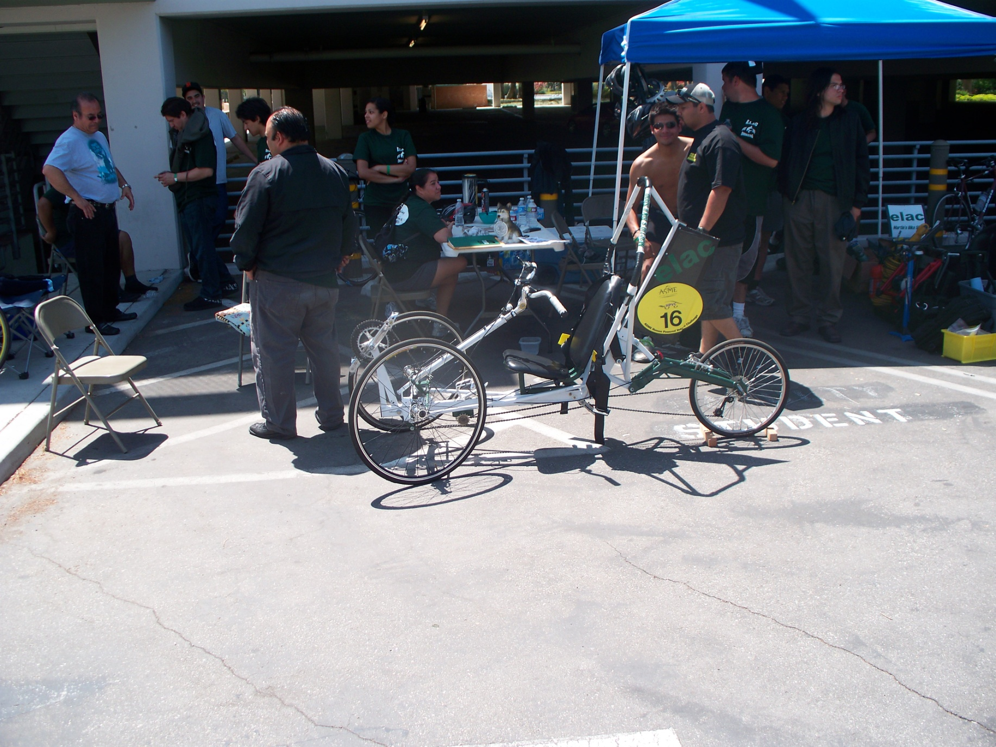
ASME bike race 2010 – 1

Slide 6
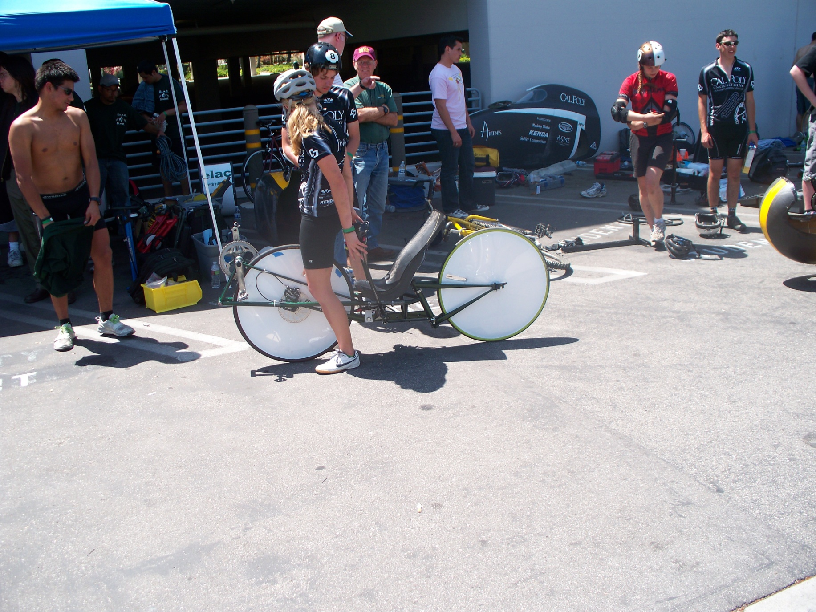
ASME bike race 2010 – 2

Slide 7
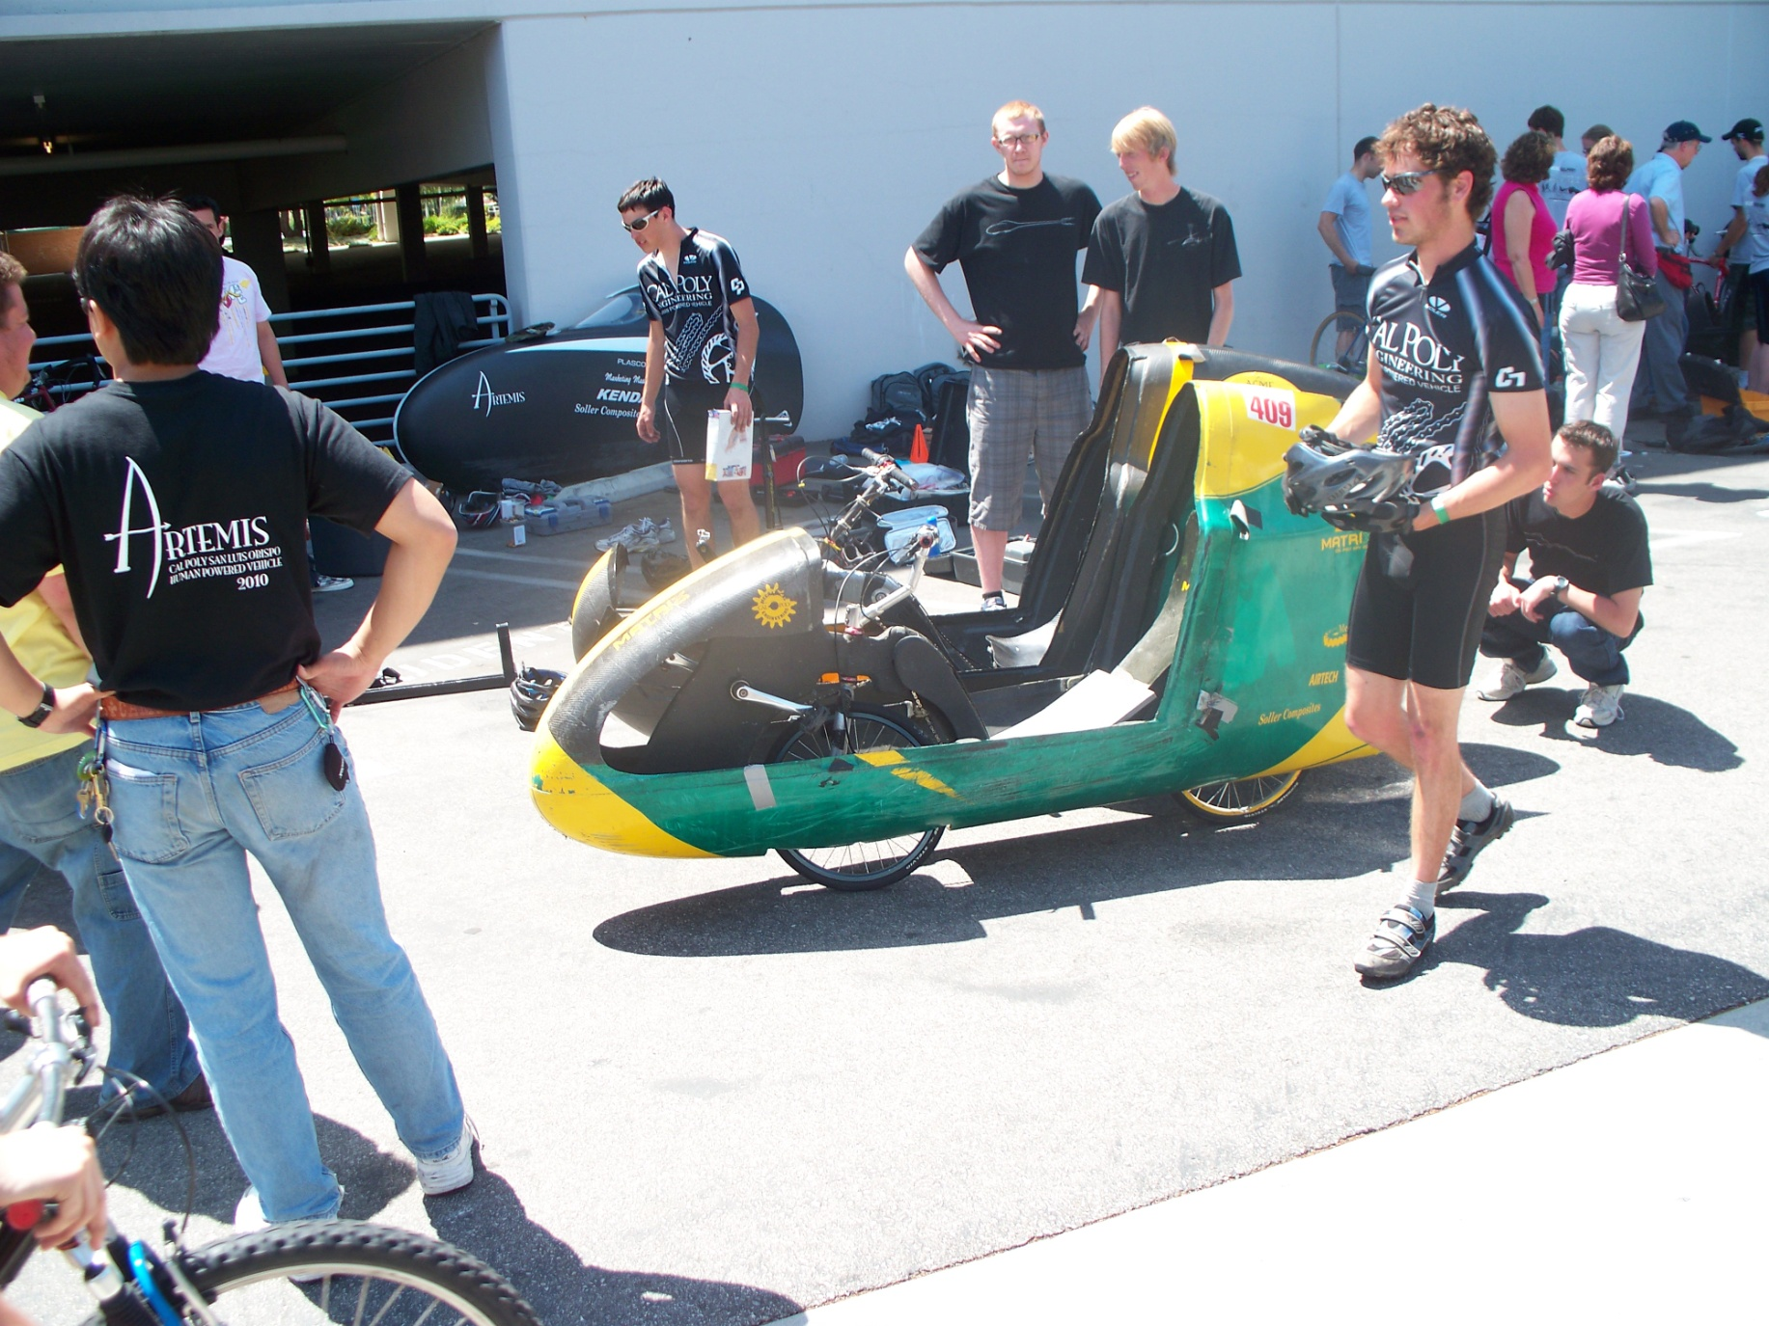
ASME bike race 2010 – 3

Slide 8
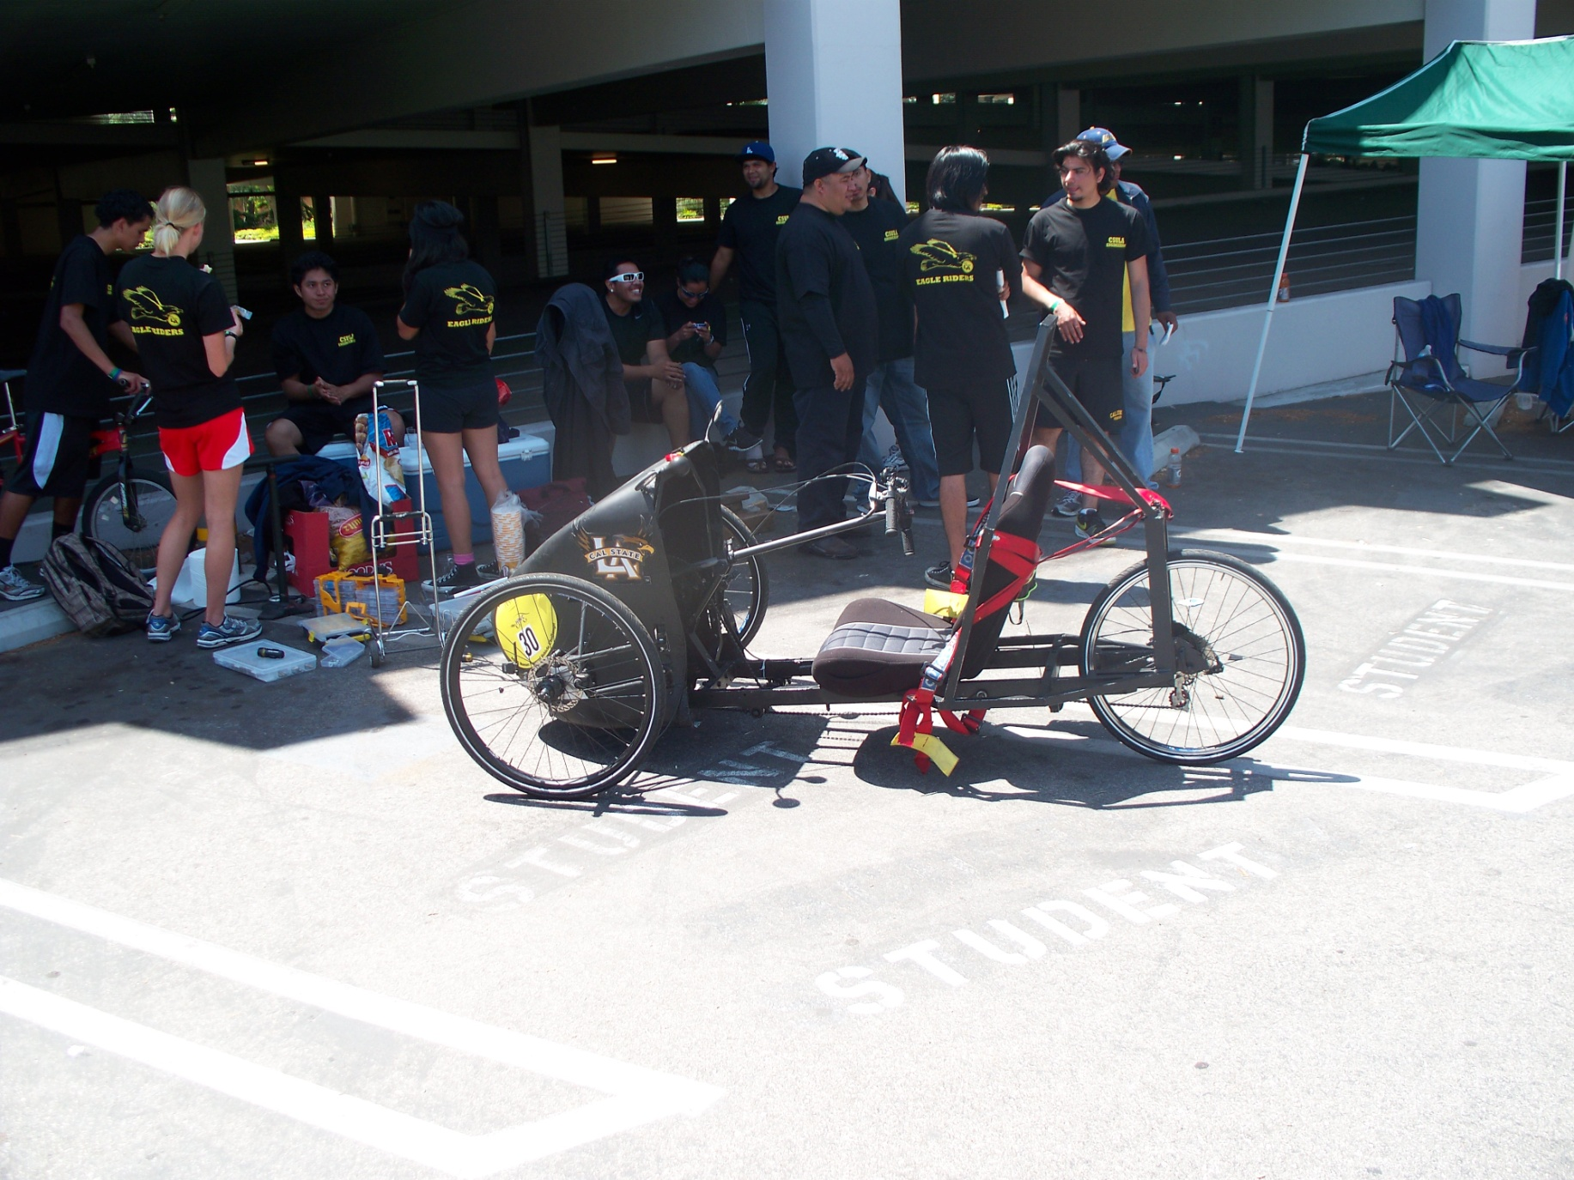
ASME bike race 2010 – 4

Slide 9
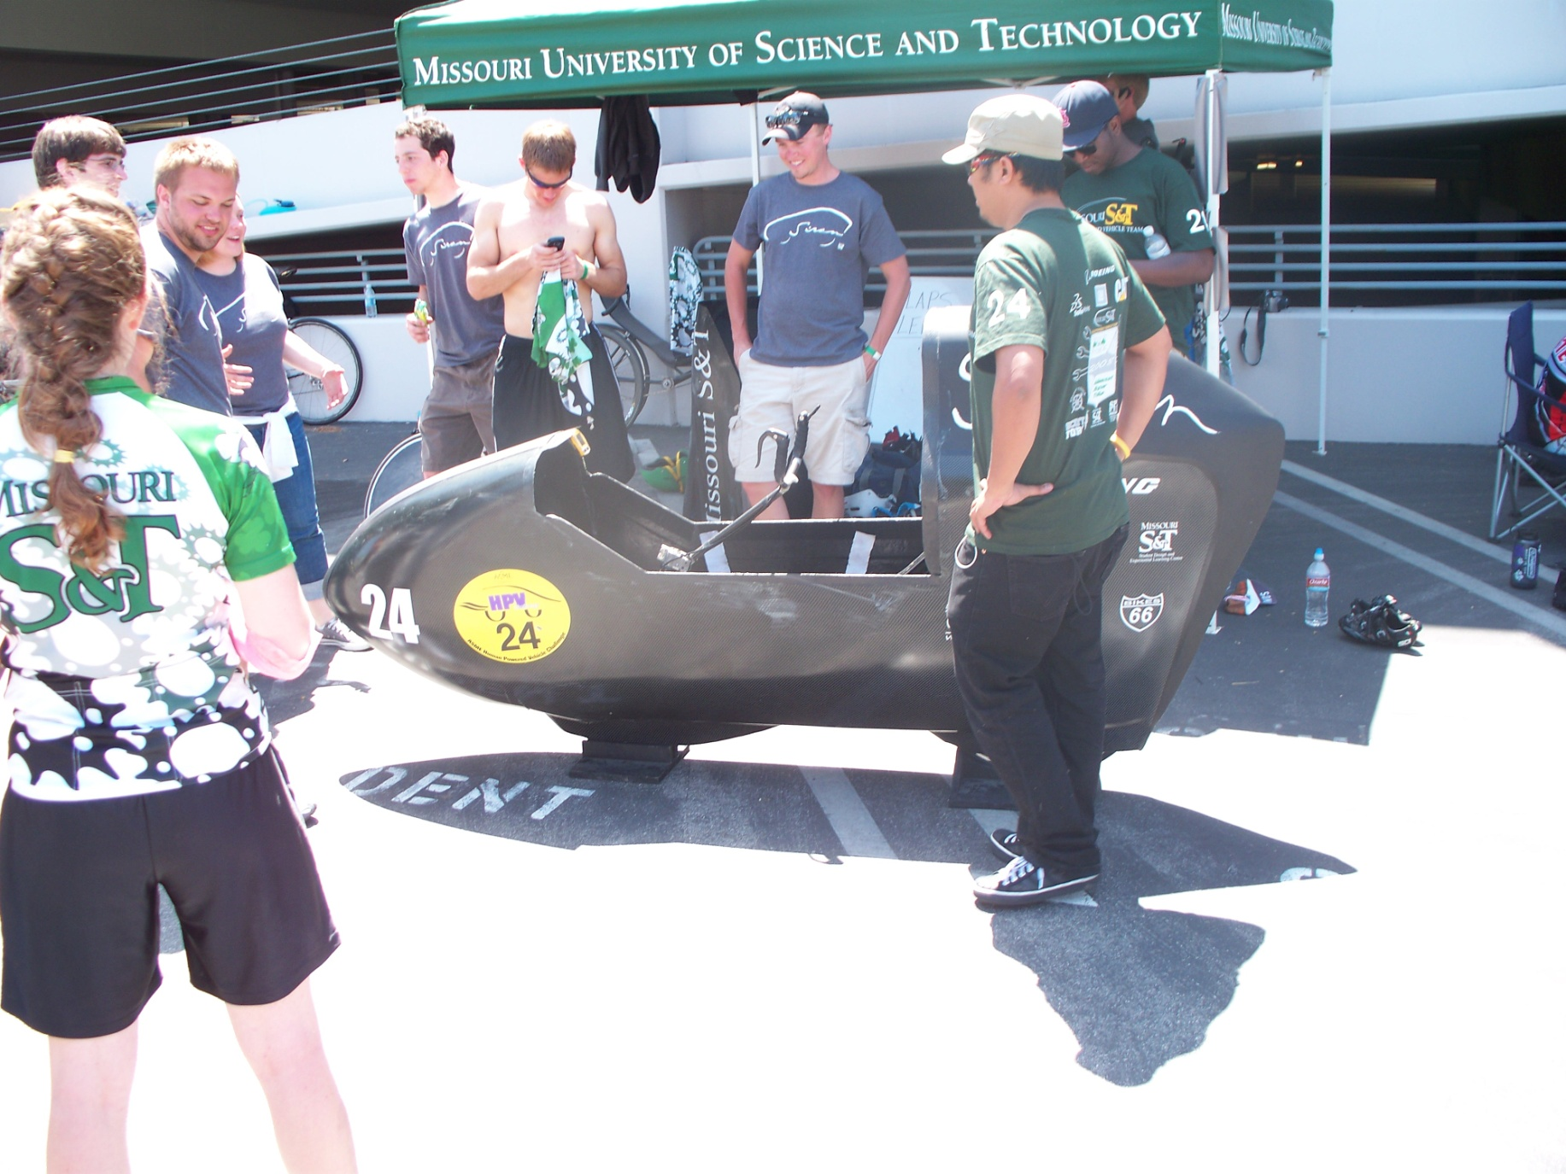
ASME bike race 2010winner1

Slide 10
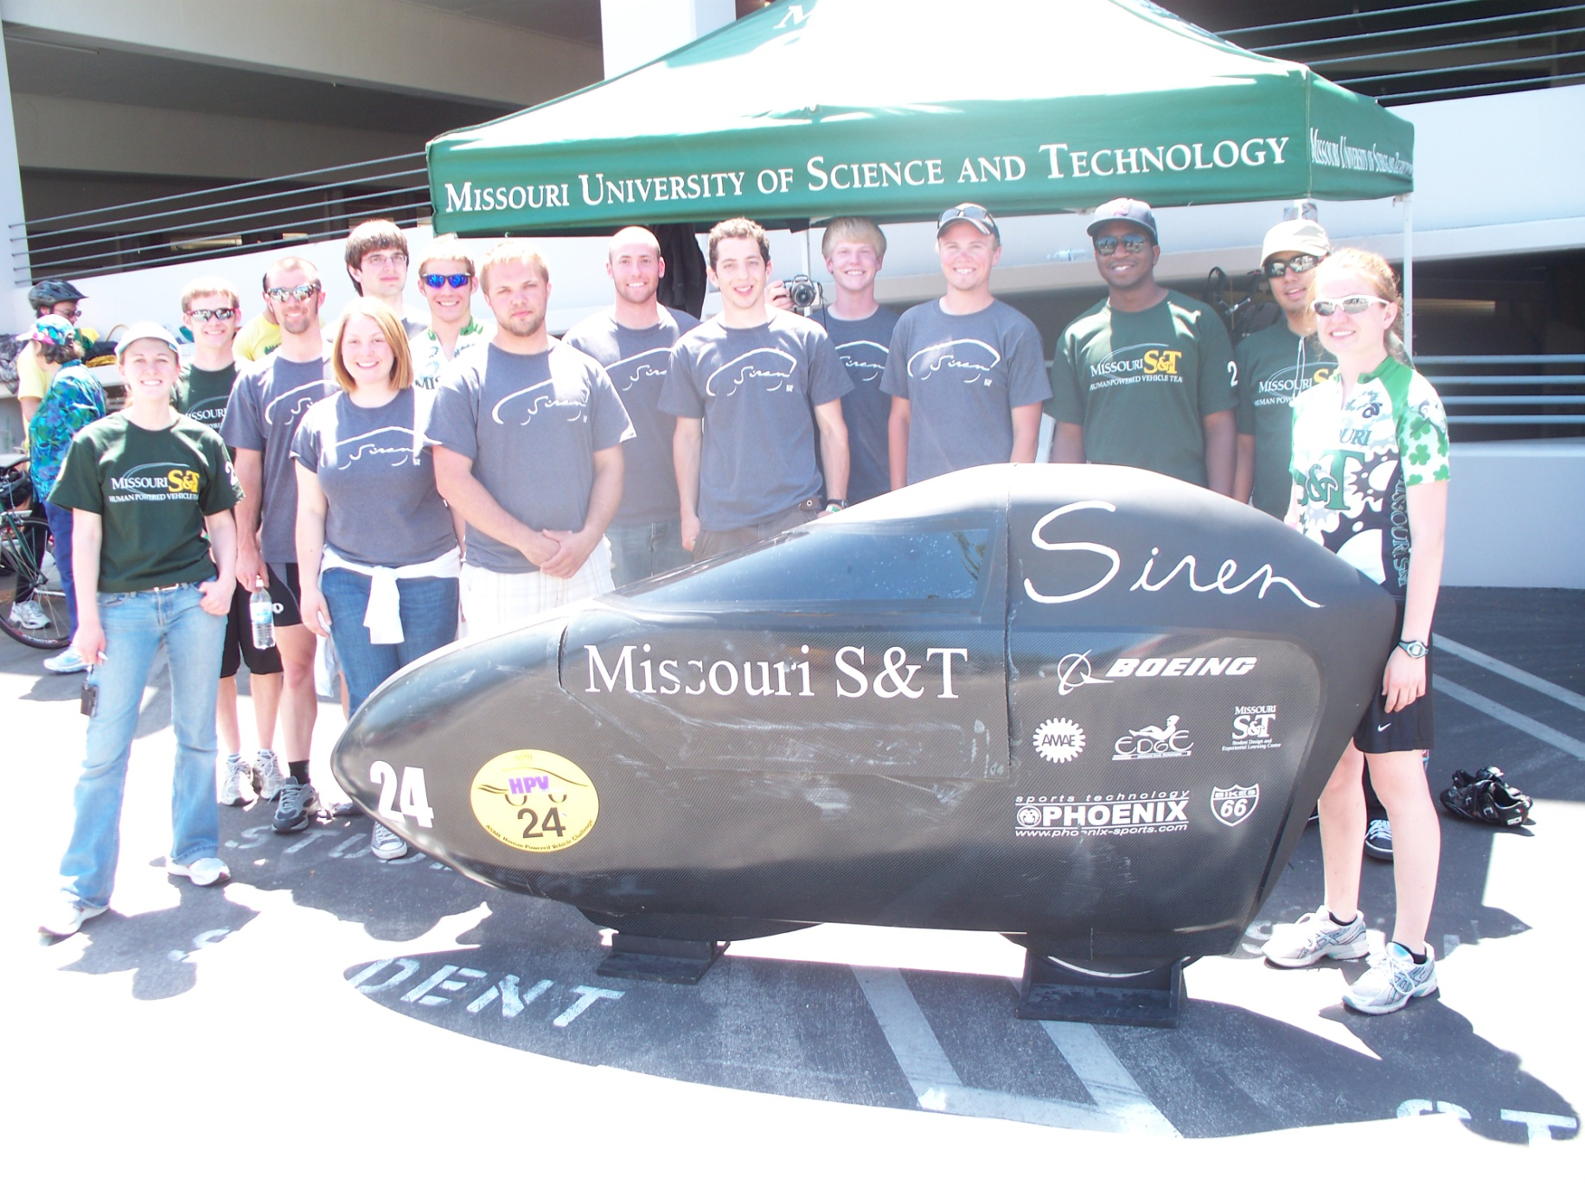
ASME bike race 2010winner2

Slide 11
Engineering
Quality
“Root Cause”
E.g., Toyota braking and acceleration systems
Increase speed, decrease cost, improve quality
How come it’s so difficult to get all three?
Entropy

Slide 12
Engineering
S-curve
Tipping point
Inflection
Long-tail
The science of the non-normal distributions
The art of the diaspora
Diffusion of Innovation

Slide 13
Creativity in Engineering
Lean Manufacturing
Reduce non-value-added work (“muda”)
Transport, Inventory, Motion, Waiting
Over-production, Over-processing, Defects
Doesn’t meet customer-defined quality
Waste of unused human talent
Reduce overburden (“muri”)
Reduce unevenness (“mura”)
E.g., http://en.wikipedia.org/wiki/Lean_manufacturing
SCAMPER
Substitute, Combine, Adapt, Magnify, Put to other uses, Eliminate, Rearrange
E.g., http://litemind.com/scamper/

