Slide 1
A Multi-disciplinary Perspective on Decision-making and Creativity:
Using the Diversity of Truth-seeking and Sense-making to Advantage in Organizational Contexts
Wayne Smith, Ph.D.
Department of Management
CSU Northridge

Slide 2
8 - Sociological

Slide 3
Anthropological
Culture
Rite, Ritual
Myth, Legend
Story, Folk-tale
Symbol, Language, Gesture
Physical Setting
Artifacts

Slide 4
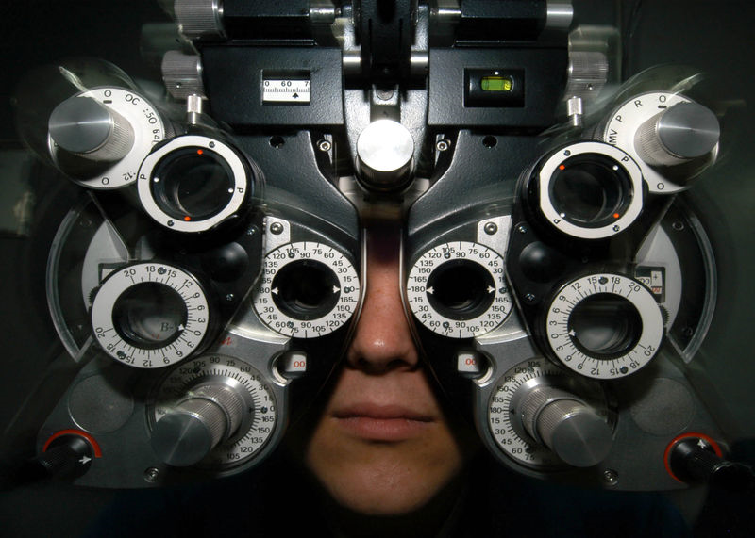
SFVSC T-shirt

Slide 5
Student Success: Culture—Surface Attributes
Physical Setting
Those things that physically surround people and provide them with immediate sensory stimuli as they carry out culturally expressive activities
Artifacts
Material objects manufactured by people to facilitate culturally expressive activities
Language
A particular manner in which members of a group use vocal sounds and written signs to convey meanings to each other
Gesture
Movements of parts of the body used to express meanings
Symbol
Any object, act, event, quality, or relation that serves as a vehicle for conveying meaning, usually representing another thing
Story
A narrative based on true events—often a combination of truth and fiction

Slide 6
Student Success: Culture—Sub-Surface Attributes
Legend
A handed-down narrative of some wonderful event that has a historical basis but has been embellished with fictional details
Folk-tale
A completely fictional narrative
Myth
A dramatic narrative of imagined events, usually used to explain origins or transformations of something. Also, an unquestioned belief about the practical benefits of certain techniques and behaviors that is not supported by demonstrated facts
Ritual
A standardized, detailed set of techniques and behaviors that manages anxieties but seldom produces intended, practical consequences of any importance
Rite
A relatively elaborate, dramatic, planned set of activities that combines various forms of cultural expression and that often has both practical and expressive consequences

Slide 7
Political
Decision rights
Societal-level (“law”)
Intellectual Property
Ownership
Economic Control
Social Control
Organizational-level (“policy”)
Empowerment
Sclerosis (“what you know is outdated”)
Lack of change (in decision-making) over time
Cronyism (“who you know is most important”)
Lack of meritocracy (in decision-making) over time

Slide 8
Sociological (network)
Crowdsourcing
“Wisdom” of Crowds
TED Conference video?

Slide 9
Legal
Logical Fallacies
Logic2.ppt

