Slide 1
A Multi-disciplinary Perspective on Decision-making and Creativity:
Using the Diversity of Truth-seeking and Sense-making to Advantage in Organizational Contexts
Wayne Smith, Ph.D.
Department of Management
CSU Northridge

Slide 2
2 – Definitions and Examples

Slide 3
What is Decision-making?
Thinking and Deciding
Decision-making is a skill

Slide 4
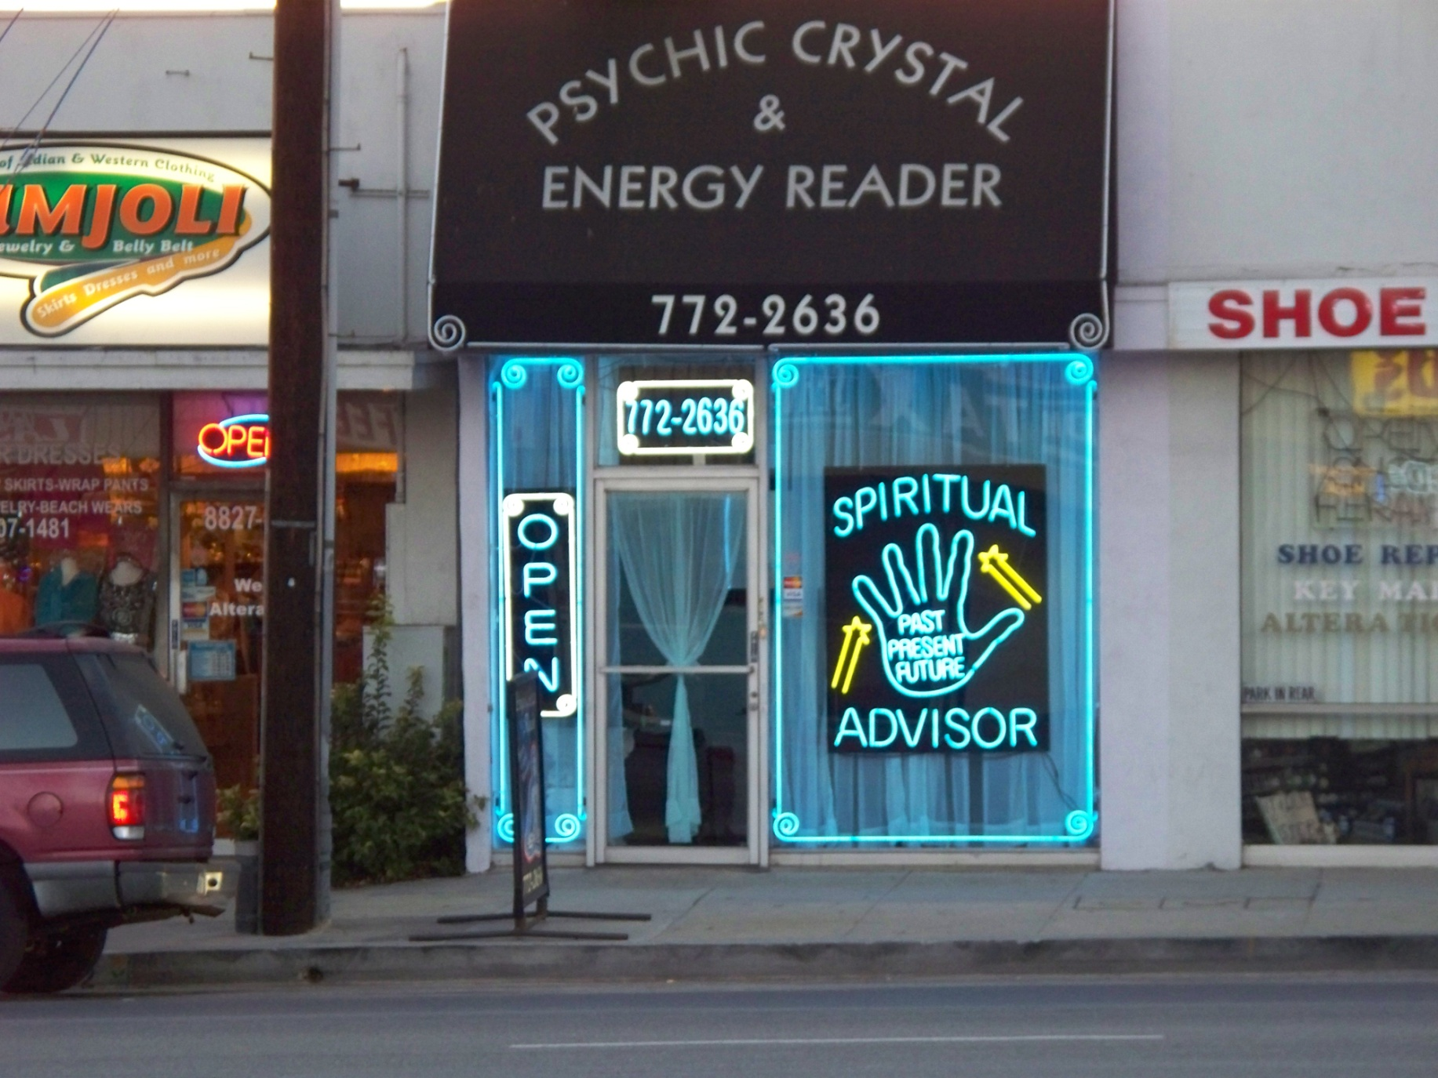
Spiritual Advisor - wide

Slide 5
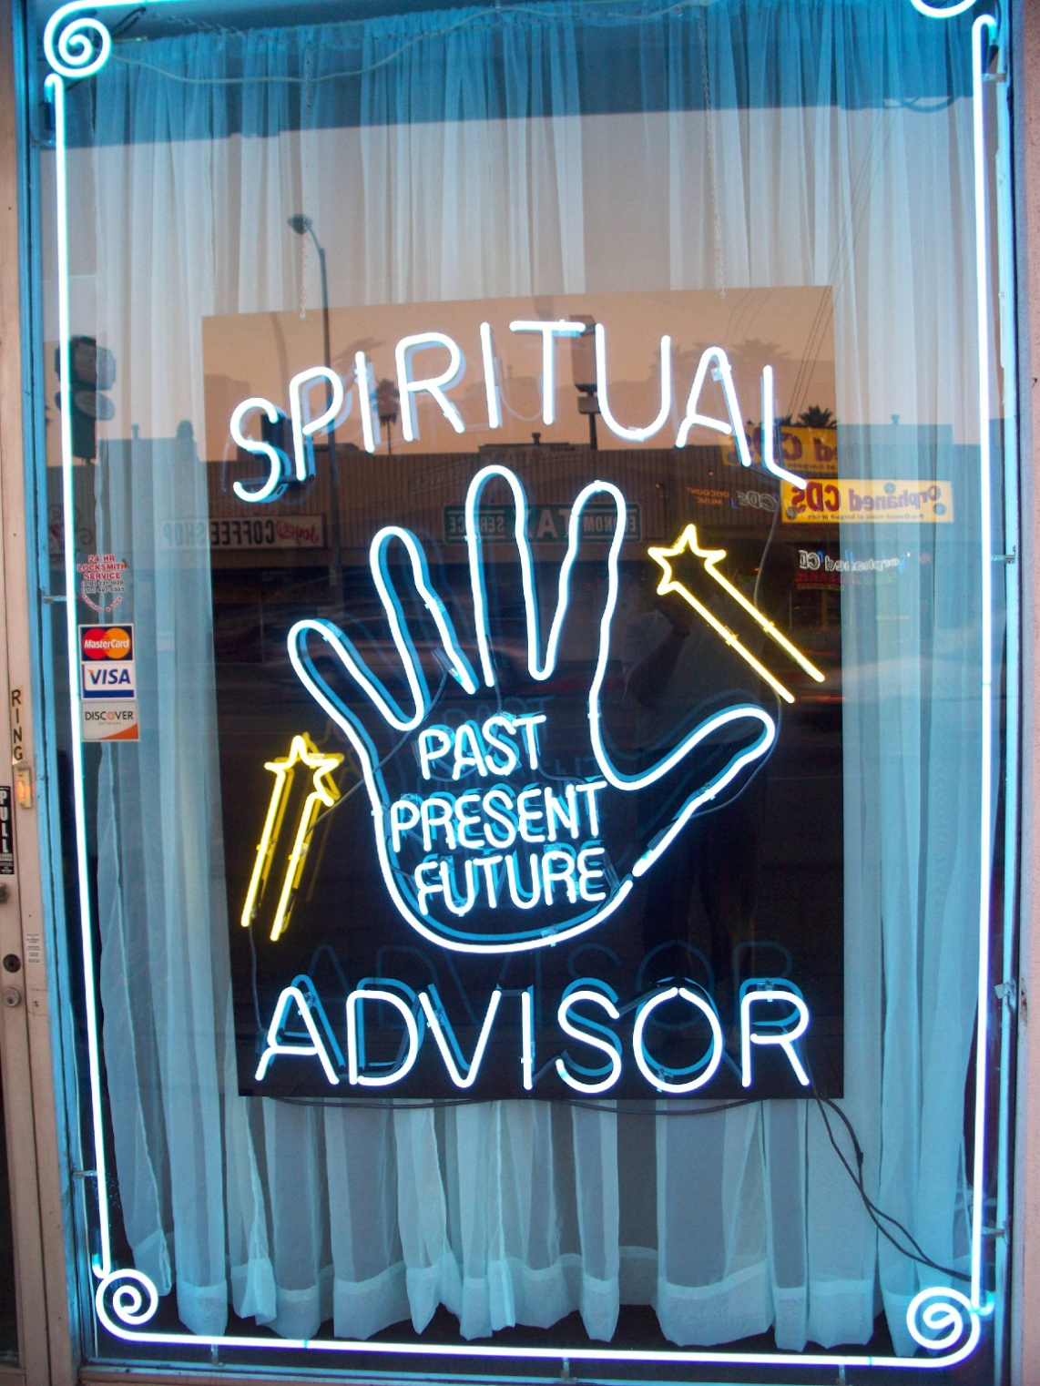
Spiritual Advisor – up close

Slide 6
What is Decision-making?
What is Decision-making?
Formal Definition
“The process of identifying problems and opportunities for the Organization”
Requires 1), design a choice, 2), form expectations, and 3), evaluate the consequences
Informal Definition of a Decision
Deliberate, Conscious (e.g., material choice)
Automated, Saccadic (e.g., eye movement)
Short sequences (e.g., driving a car)
Long sequences (e.g., life-time investment)

Slide 7
What is Decision-making?
“Rational” Decision-making
Uncertainty
Chance
Explanation
correlation and causation
Expected Utility Theory
Fundamental preferences

Slide 8
What is Decision-making?
Assumptions of “Rational” Decision-making
Clear and unambiguous problem
Complete and perfect Information
Single, well-defined goal
No conflicts or hidden dependencies
Maximal pay-offs
Abundant time and resources
Willingly implemented and supported by all constituents and stakeholders

Slide 9
What is Decision-making?
Problems with preferences
Known preferences vs. Unknown preferences
Known preferences, but preferences are not acknowledged (or rather, they are denied)
Explicit preferences vs. Implicit preferences
Explicit preferences, but preferences are not transmitted clearly (or rather, received unambiguiously)
Preferences can change in time and space
Linking other preferences to choice

Slide 10
What is Decision-making?
“Other than Rational” Decision-making
“Bounded Rationality” (Herb Simon)
“satisficing”
Prospect Theory (Kahneman/Taversky)
We weigh gains and losses differently
Sometimes we are “risk-adverse”; sometimes we are “risk-seeking”
“Behavioral Economics”/“Behavioral Finance”
Theories, models, and frameworks that explain/predict how humans make less-than maximal/optimal decisions
Expert Judgments
Strategy, Heuristics, Anchoring/Adjustment

Slide 11
What is Decision-making?
“Other than Rational” Decision-making
Cognitive Neuroscience
The brain is a neural network and operates most decidedly in a non-linear manner
Intuition
We actually decide first, then analyze/justify second
Reasoning from Analogy
Emphasize similaries, but emphasize differences
Sensemaking
No unilateral decision-making; it’s “shared cognition”
Stories and Scenarios
Sometimes, this is all we have

Slide 12
Decision Making and Creativity (in a Management Context)
You’ve all had a bunch of classes now
Here’s our focus for this course
DM&C and Leadership
DM&C and Ethics
DM&C and Strategy
DM&C and Communication
DM&C and Teams
DM&C and Risks

Slide 13
What is Creativity?
Formal Definition
“The generation of novel ideas that may meet perceived needs or respond to opportunities for the Organization”
Requires 1), unique techniques, 2), observe needs/opportunities, and 3), evaluate the desired impact
Obviously, creativity needs to be…
Legal, Ethical, Value-focused

Slide 14
RedBox Video Vending

Slide 15
RedBox Video Vending

Slide 16
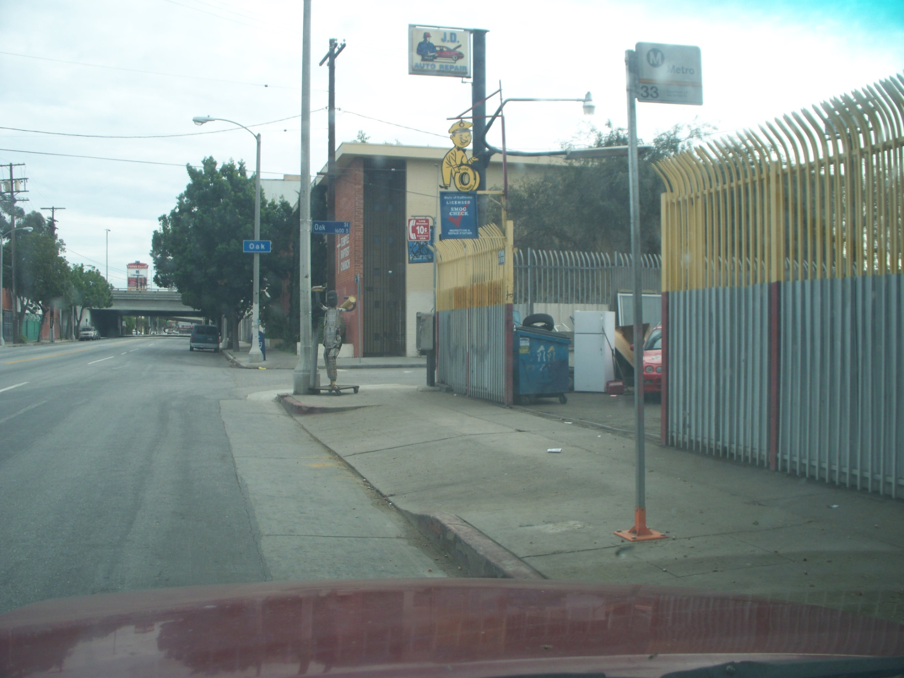
Body Shop - wide

Slide 17
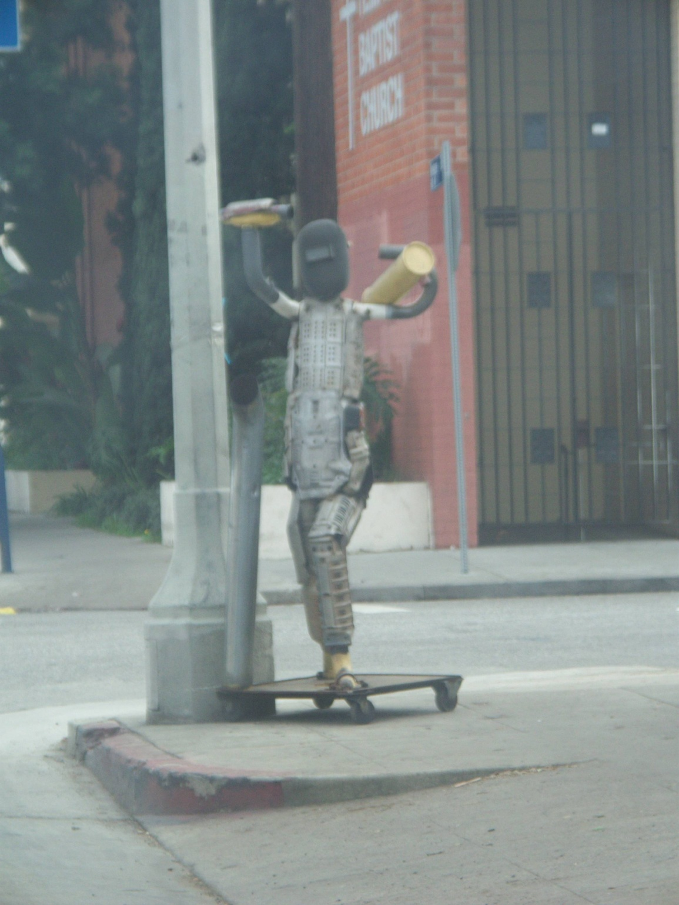
Body Shop – up close 1

Slide 18
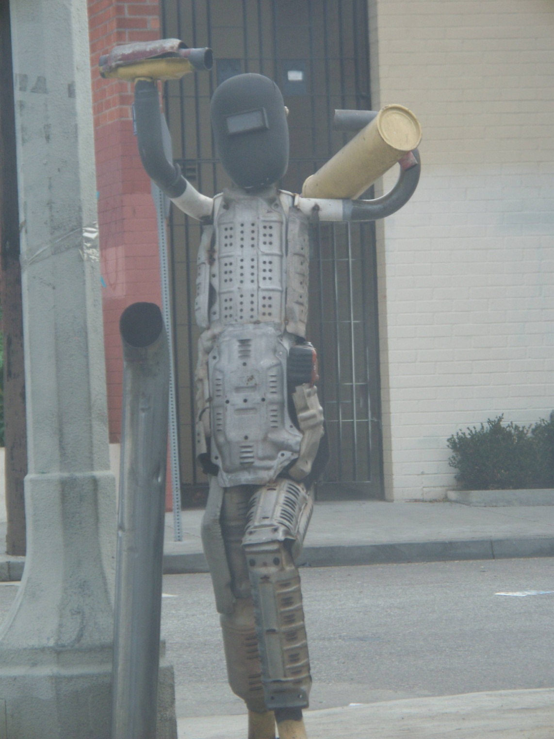
Body Shop – up close 2

Slide 19
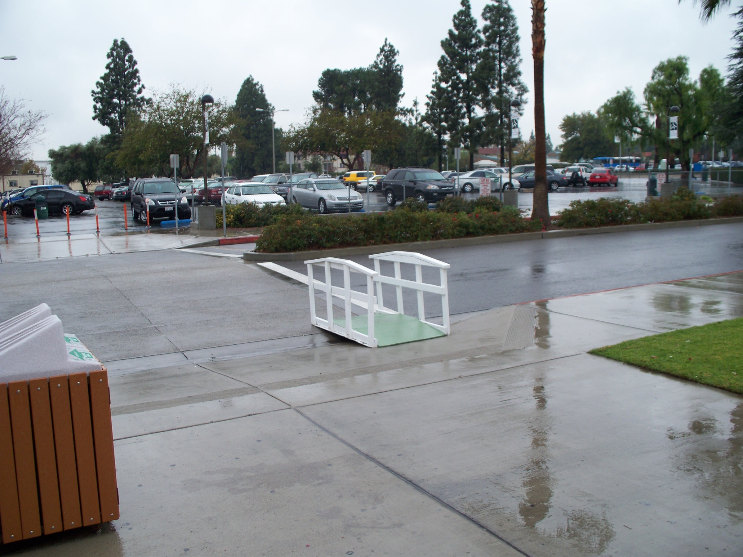
CSUN Walking Bridges

Slide 20
CSUN Walking Bridges 2

Slide 21
Gas pump hose joint

Slide 22
Gas pump hose joint

Slide 23
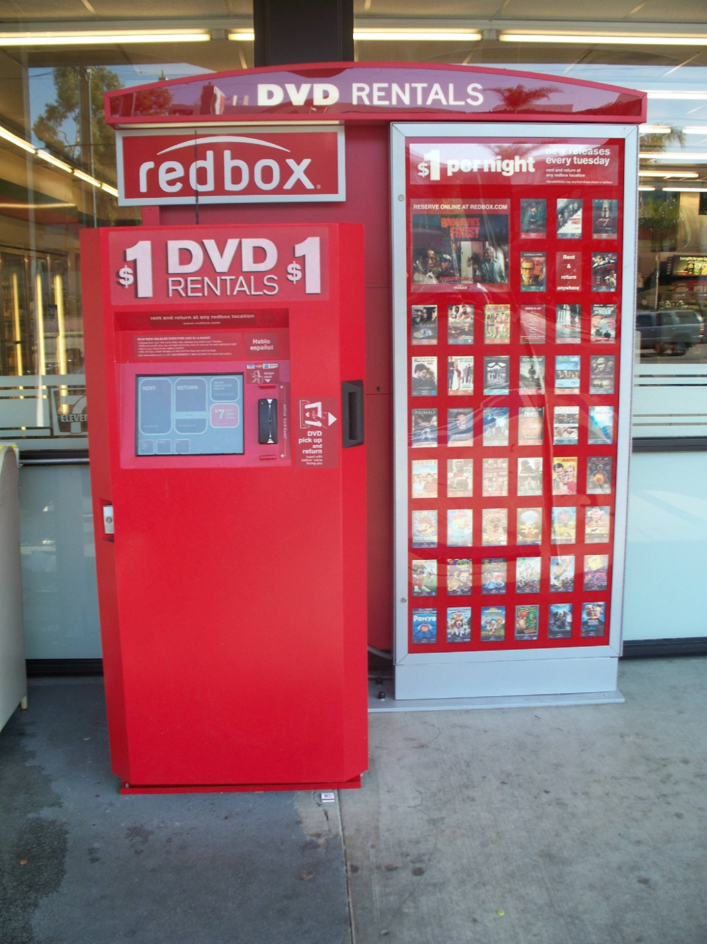
RedBox Video Vending

Slide 24
Management Decision-making
Desire
Prediction
Desire
Explanation
Modeling
Judgment
Model-based
(H_{a} confirmation)
Motivational
Biases
Quant-
ified
Risk
(with
some
data)
Qualified
Risk
(without
much
data)
Probability
KE/SL/RO
BJ
CR
PO
objective
subjective
Model-free
(machine learning)
Task
Complexities
Maximize
Rationality,
Minimize
Uncertainty
Change
Leverage
Serendipity,
Control
Complexity

Slide 25
Management Decision-making (key dimensions)
Model-based
Model a H₀ Hypothesis and then test sample data against one or more distributions (e.g., Binomial, Normal, Student-t, Poisson, Chi-square, etc.)
Model-free
Sensor Dynamics, Association Rules, Bayesian Analysis, Clustering, Classification, Decision-Trees, Network Analysis
Motivational Biases
Anchoring, Framing, Education-level, Experience and Expertise, Cognition, Instinct, Satisficing, Peers & Crowds
Task Complexities
Sell a banana, Reconcile monthly A/R, Contact a new customer, Hire/Retain/Promote employees, Re-design process and product, Merge & acquire organizations, …Facilitate and Negotiate Middle-East Peace

Slide 26
Sources
Daft, R., and Marcic, D. (2011) Understanding Management (7th ed.), South-Western College Publications.
Hastie, R., and Dawes, R. (2010), Rational Choice in Uncertain World: The Psychology of Judgment and Decision Making, Sage Publications.
O’Hagan, A. et al. (2006), Uncertain Judgments: Eliciting Experts’ Probabilities, John Wiley and Sons.

