Slide 1
A Multi-disciplinary Perspective on Decision-making and Creativity:
Using the Diversity of Truth-seeking and Sense-making to Advantage in Organizational Contexts
Wayne Smith, Ph.D.
Department of Management
CSU Northridge

Slide 2
9 – Systems Dynamics

Slide 3
Systems Dynamics
Peter Senge’s “The Fifth Discipline”
Personal Mastery
Mental Models
Building Shared Vision
Team Learning
Systems Thinking
Integrating all of the previous 4
Complexity
Detail Complexity
Relationship Complexity

Slide 4
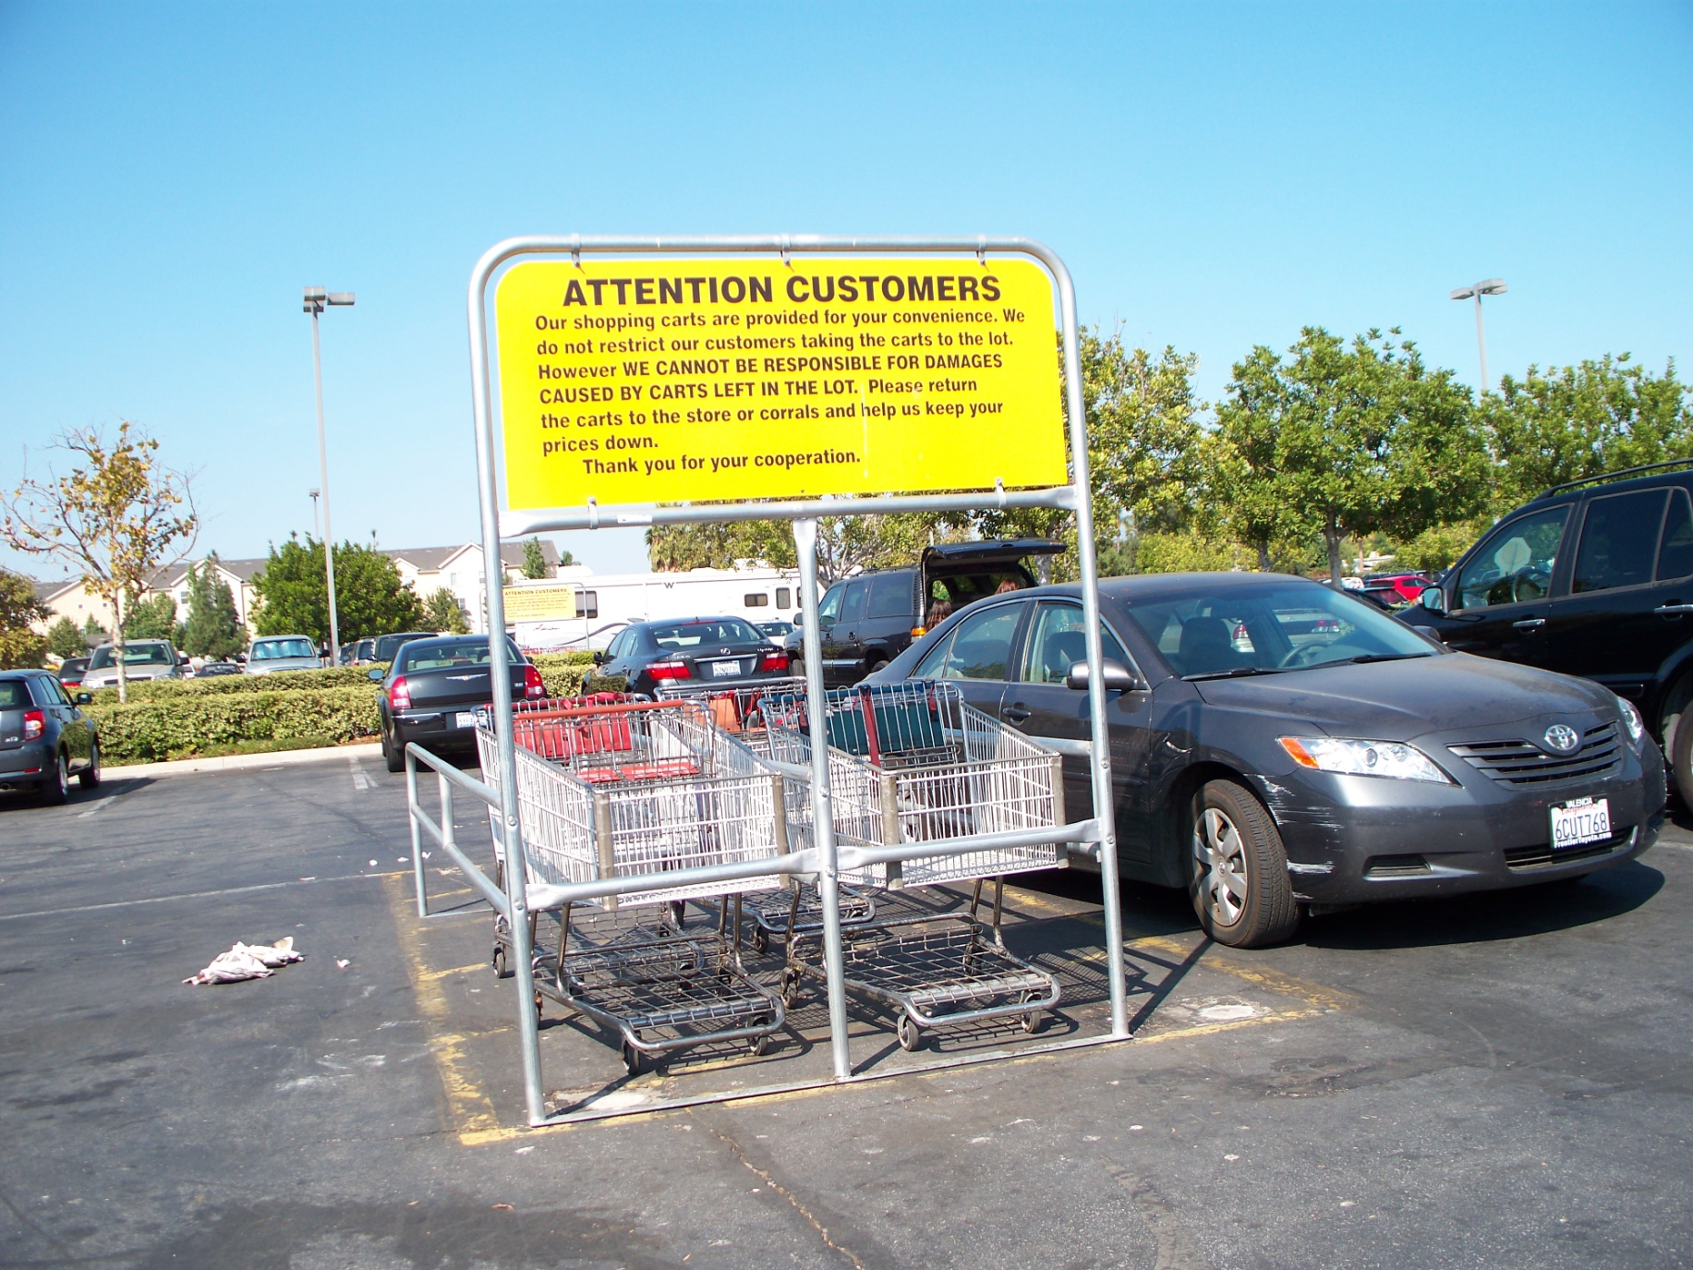
Parking lot (wide)

Slide 5
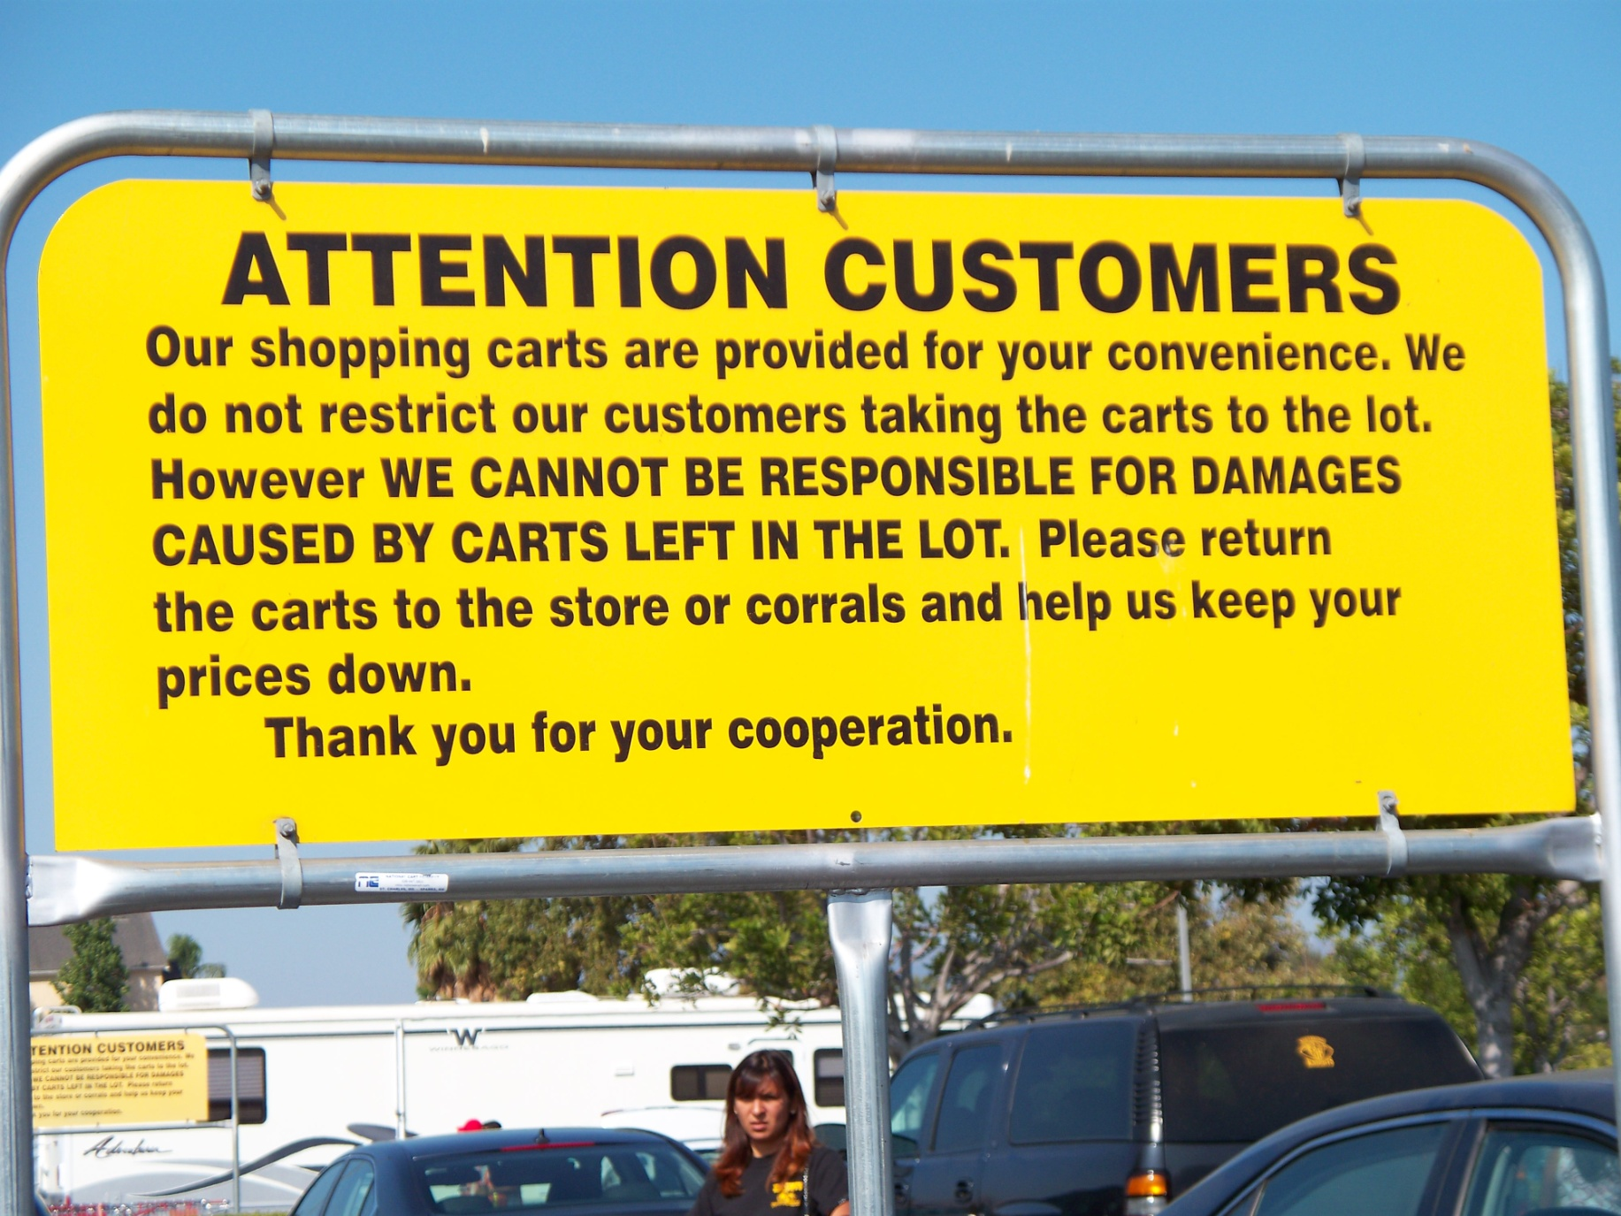
Parking lot (up close)

Slide 6
System Dynamics
Return Cart
+
+
Lower Prices

Slide 7
System Dynamics
Return Cart
-
+
More Customers
Lower Expenses
+
+
Lower Prices

Slide 8
The Language of Systems Dynamics
Reinforcing Loops
A process (virtuous or vicious) that shows an intensifying trend either cycle up or down
Persistent, accelerating, easily underestimated
No “O”s or an even number of “O”s
Balancing Loops
A process that shows the limiting or adjusting elements of the cycle
Self-correcting, self-regulating, stable
An odd number of “O”s

Slide 9
The Language of Systems Dynamics
“S” means “same direction”
“O” means “opposite direction”
Thinking of them as “correlations” helps
Examples
O
S
Demands
on Service
Quality
of Service
Revenues
Revenues

Slide 10
Problems
(Piling up more)
S
B
R
S
Team Agenda (Full)
S
Treatment of Problems (Superficial)
Performance or Condition
Team Level of Focus
O
Level of Shared Understanding
(Low)
O
Optional Variable

Slide 11
Demand for Facility
B
O
O
Waiting Time
(Rising)
Clinical Reputation (Dropping)
S
Patient Satisfaction
(Going Down)
O

Slide 12
Layoffs
S
O
Employee Satisfaction
Production Cost
O
S
Performance

Slide 13
Staff Communication
S
O
Meeting Attendance
Staff Meetings
O
S
Scheduling Conflicts

Slide 14
Sources
Qayoumi, M. Personal conversation (used by permission).

